Slide 1
Creating a Balanced Lifestyle
Understanding the Impact of Participation for Health and Wellbeing in the Context of Social Isolation

Slide 2
Consider the Following
Think about these questions; note down your thoughts and reflections
What do the words participation and occupation mean to you?
What occupations did you participate in prior to the Covid-19 outbreak?
3) What occupations do you participate in now?
4) Have you noticed a change in your occupations?

Slide 3
5) What skills and strengths do you identify in yourself?
6) What strengths and barriers do you identify in your environment?
7) What occupations have you previously wanted to participate in, and what has been a barrier to you participating in them in the past?
8) What does a Balanced Lifestyle look like to you?

Slide 4
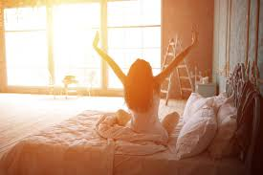
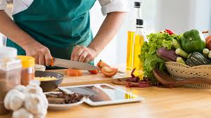
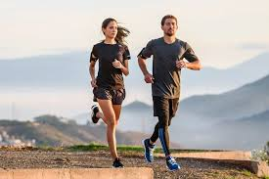
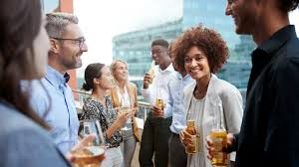
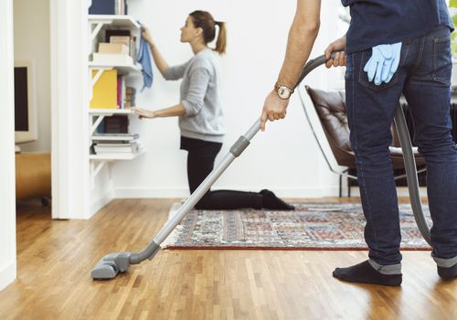
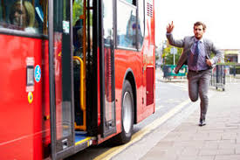
Defining Occupation
Occupations refer to the everyday activities that people do as individuals, in families and with communities to occupy time and bring meaning and purpose to life.
Occupations include activities people need to, want to and are expected to do (World Federation of Occupational Therapists, 2020)

Slide 5
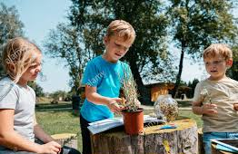
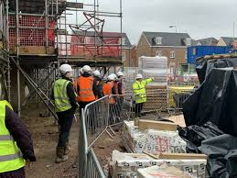
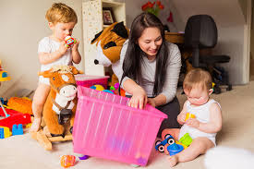
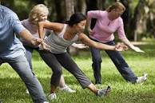
Defining Participation
Participation literally means involvement or sharing in an activity
hence, taking part.
Participation in the everyday occupations of life is a vital part of human development.
Through participation, we learn skills and abilities, connection with others and communities, and find purpose and meaning in life.

Slide 6
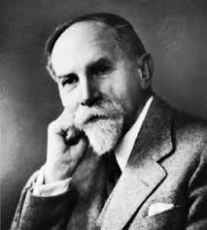
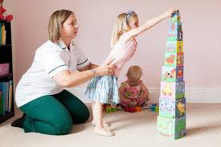
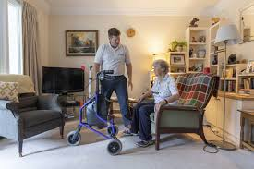
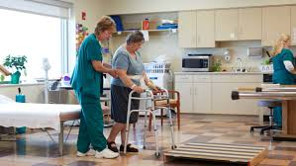
Participation in Occupational Therapy
Participation has always been a central focus of the Occupational Therapy profession.
Participation is what occupational therapy is all about. It is our professions unique contribution to society.
One of the founders of the occupational therapy profession explained it this way:
A human is an organism that maintains and balances itself in the world of reality and actuality by being in active life and active use....It is the use that we make of ourselves that gives the ultimate stamp to our every organ.
(Meyer, 1922, p. 1)

Slide 7
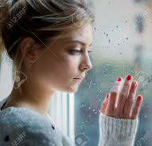
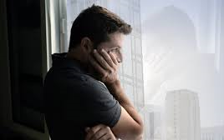
How have things Changed?
The COVID-19 pandemic is having a profound impact on the lives, health and wellbeing of individuals, families and communities worldwide.
Impact on how people carry out their occupations for example: Accessing resources, undertaking activities of daily living, communicating, and travelling.
Social isolation, feeling displaced, mental health issues and a decrease in wellbeing are the result.

Slide 8
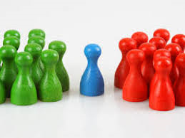
The term occupational therapist use for this phenomenon is
Occupational Injustice

Slide 9
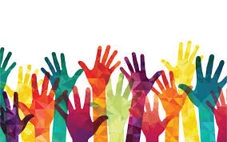
Occupational Justice
Occupational justice: the right all people have to do the occupations they have to do and want to do which contribute positively to their health and well-being (Wilcock, 2006; Wilcock & Townsend, 2009).
An occupationally just world is once where all individuals can flourish by doing what they decide is most meaningful and useful to themselves and to their families, communities, and nations (Wilcock & Townsend, 2009, p. 330).

Slide 10
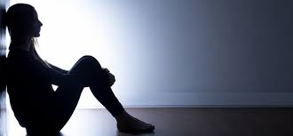
Occupational Injustice
When people are not able to do the things that matter to them, this is a matter of injustice (Townsend & Wilcock, 2004).
Occupational Deprivation results when this is not possible.
Occupational Imbalance results when too much time is spent occupied in one area of life at the expense of other areas (Stadnyk et al., 2010).
Occupational Imbalance can occur when the timing of occupations is out of alignment with personal or physiological needs or routines (Wilcock, 2006).

Slide 11
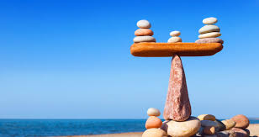
Kathleen Matuska and Charles Christiansen are two occupational therapists who have researched
the theory behind creating a balanced lifestyle.
Their description of a balanced lifestyle is one which is:
A satisfying pattern of daily activity that is healthful, meaningful and sustainable, within the context of their current life circumstances.

Slide 12
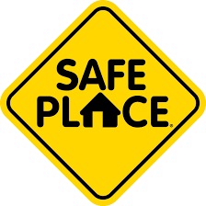
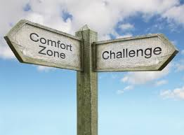
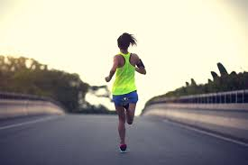
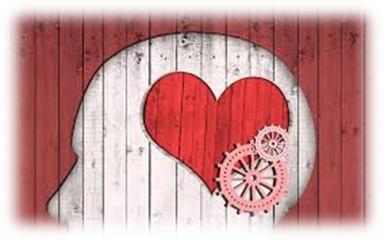
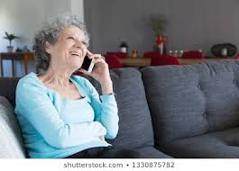
Meeting basic health and
safety needs
Feeling engaged,
challenged and competent
Having rewarding and self-affirming relationships with others
Creating meaning
and a positive identity
Elements of a Balanced
Lifestyle

Slide 13
The Kawa Model as a way to Create a Balanced Lifestyle
If your life were a river, how would you want it to flow?
Along the way there can be obstacles that impede the flow of our river.
You can increase the flow of your river by maximising the spaces in between the obstacles

Slide 14
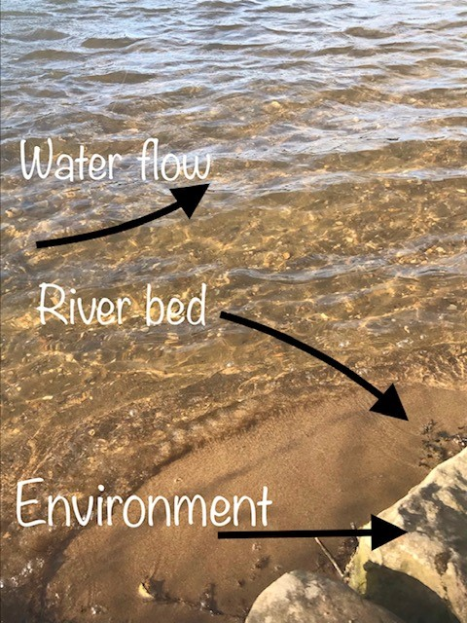
Improving the Flow of your River: Creating a more Balanced Lifestyle

Slide 15
My River (Based on the Kawa Model, Iwama, 2006)
Consider the Following:
Rocks (Current life difficulties)
Drift Wood (Values, personality, personal resources)
River Bed (Environment)
Spaces Between (Occupations that bring life satisfaction)
Using this model is a helpful way to organize your thoughts and feelings at this time, as a tool for reflection.

Slide 16
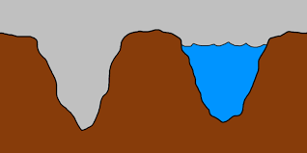
Defining your River Bed
The river walls and base is your environment, which gives the river its shape.
These can be things like: who you live with, the important people in your life, where you live and work, your family, healthcare professionals, schools, culture.
To improve the flow of your river: widen the river bed walls, change or modify your environment.

Slide 17
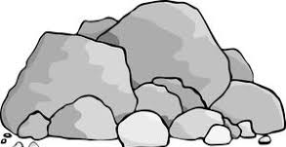
Identifying the Rocks in your Life
Rocks are your current life difficulties, fears or concerns which block and slow down the flow in your river.
To increase the flow in your river, you have to break the rocks: remove the obstacles or make them smaller.

Slide 18
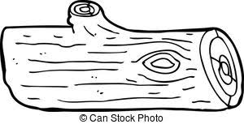
Identifying the Driftwood in your Life
The driftwood is your values, personality and personal resources.
Sometimes these can help you and sometimes they can hinder you.
The driftwood can further block the water or bump the rocks away, enhancing the flow.
Use the driftwood: your personal qualities or things that you already have to improve your situation.

Slide 19
Now is the perfect time to take stock and reflect on our River.
These resources may help you to do this:
Seven Tips for Staying Happy and Healthy During a Lockdown
https://www.bbc.co.uk/programmes/articles/1fZkc8Tj7LpBYMKF1H0pc3t/seven-tips-for-staying-happy-and-healthy-during-a-lockdown
Looking After your Health During Coronavirus Outbreak
https://www.mentalhealth.org.uk/publications/looking-after-your-mental-health-during-coronavirus-outbreak
Occupational Balance, A Reflection During the Covid 19 Crisis
https://www.theothub.com/post/occupational-balance-a-reflection-during-during-the-covid-19-crisis
Mental wellbeing while staying at home
https://www.nhs.uk/oneyou/every-mind-matters/coronavirus-covid-19-staying-at-home-tips/

Slide 20
Now is the perfect time to take stock and reflect on our River.
These resources may help you to do this:
Kashdan, TB. (2010) Psychological Flexibility as a Fundamental Aspect of Health, Clinical Psychology Review. 30(7). pp. 865–878.
https://www.ncbi.nlm.nih.gov/pmc/articles/PMC2998793/
Being Well with Rick Hanson
https://www.rickhanson.net/being-well-podcast/
Rick Hanson’s Suggested Resources
https://www.rickhanson.net/favorites/
Kristin Neff: Self-Compassion Resources
https://self-compassion.org/

Slide 21
Matuska, K and Christiansen, CH.(2008). A proposed Model of Lifestyle Balance. Journal of Occupational Science. 15(1):9-19.
References
Meyer, A. (1922). The philosophy of occupation therapy. Archives of Occupational Therapy. 1(1), pp. 1–10.
Stadnyk, R., Townsend, E., & Wilcock, A. (2010). Occupational justice. In C. H. Christiansen & E A. Townsend (Eds.). Introduction to occupation: The art and science of living. (2nd ed., pp. 329 358). Upper Saddle River, NJ: Pearson Education.
Townsend, E., & Wilcock, A. (2004). Occupational justice and client-centered practice: A dialogue in progress. Canadian Journal of Occupational Therapy. 71(2), 7587.
Turpin, MJ, and Iwama, MK. (2011) Using Occupational Therapy Models in Practice. London: Elsevier Health Sciences.

Slide 22
Wilcock, A., & Townsend, E. (2009). Occupational justice. In E. B. Crepeau, E. S. Cohn, & B. A. B. Schell (Eds.), Willard and Spackman’s occupational therapy (11th ed., pp. 192199). Philadelphia, PA: Lippincott Williams & Wilkins
World Federation of Occupational Therapists (2020) About Occupational Therapy. Available from:
https://www.wfot.org/about/about-occupational-therapy. [Accessed on 08/04/2020].
World Federation of Occupational Therapists (2020) Occupational Therapy and Human Rights (Revised). Available from: https://www.wfot.org/resources/occupational-therapy-and-human-rights. [Accessed on 08/04/2020].
World Federation of Occupational Therapists (2020) Public Statement - Occupational Therapy Response to the COVID-19 Pandemic. Available from: wfot.org/about/public-statement-occupational-therapy-response-to-the-covid-19-pandemic. [Accessed on 08/04/2020].

