Slide 1
Welcome to Session 3!
Today we are exploring woods and hedgerows

Slide 2
So far….
I hope you have been enjoying the course so far and have been able to take your time and notice nature in new ways.
Over the course of these sessions, each day we are growing in our confidence in exploring the world around us and expressing ourselves in our journal notes. And taking lots of lovely photos too!
Just checking in with you all and looking back on what we had planned to achieve during the course; we have been aiming to:
Spend time in the fresh air
Connect to nature and the world around us
Create a journal of reflections, thoughts, feelings, observations from spending time outdoors

Slide 3
Thinking back over the course and looking forward…
We are also aiming, wherever we are, to:
Try out new ways of looking at the natural world to spark enthusiasm and interest to find out more / to continue this practice
Building a sense of hope and confidence in and with the natural world
Develop a sense of awe and joy from observing nature and have a reservoir of good memories to inspire
Perhaps take a few moments now to think back across the last couple of sessions and wonder how you are doing with this?
If there is something you feel you have been doing well, then why not share this on the course forum? Perhaps there is an area where you feel you would like to explore more and focus more fully on? Share your aims on the forum, if you wish…

Slide 4
Making progress…
In preparing this course, I have felt my confidence when I am out and about has grown and also my confidence in expressing myself in my journal nature notes has increased… take a moment to think, how are you doing with this?
This course is designed to help us all to:
Feel encouraged to share the joy we have felt in nature with others in the safe place of the forum or on the SWALC Facebook page
Develop different ways of being creative inspired by experiencing the natural world
So let’s move on to our third session and think about woodlands and hedgerows…

Slide 5
Woods and Hedgerows
Woods and hedgerows are vital to our landscapes and for our planet to function well.

Slide 6
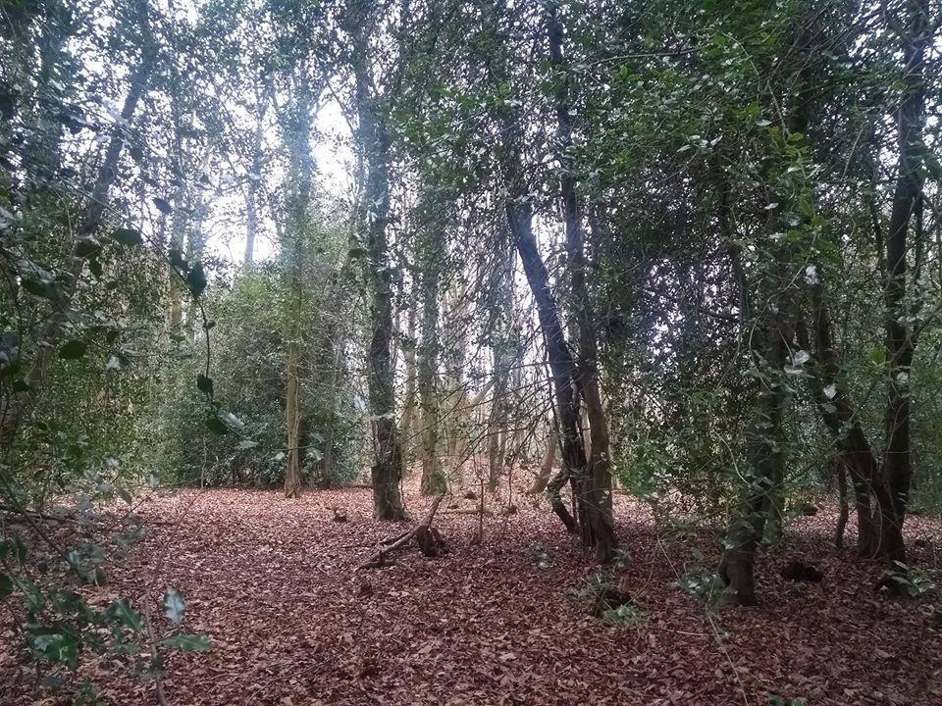
Woods
Here’s a photo of a woodland I have visited recently

Slide 7
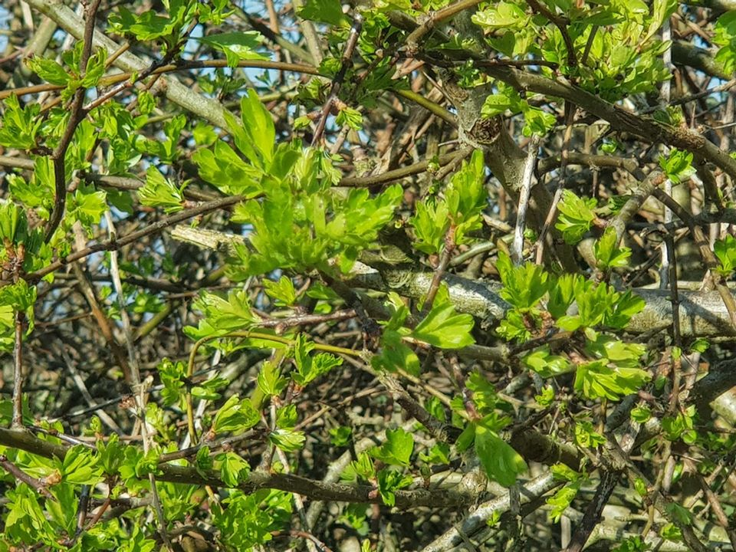
Hedgerows
Here’s a photo of a hedge made of hawthorn, from a walk I went on in the spring

Slide 8
Wonderful woods and rich hedgerows
Woods might be huge forests, covering acres of land. They might be a few trees at the edge of a housing estate or by a road verge. Wherever the woods are, and however much of an area they cover, they are places of great natural diversity and often have a special feeling when you enter them. During this session, and in our explorations in woods, we will discover more.
Hedgerows… what come to mind when you think of hedges? We usually think of these as merely being shrubs or trees marking or enclosing the edge of a field. But hedgerows are amazing places, hosting all sorts of animal life and often made up of all sorts of different trees and shrubs.
Whether we are exploring hedges or woods on this session, or a mix of both, we will discover they are places of wonder and wildness.

Slide 9
Woods
Do you know of an area of trees near you?
It might be a fair sized woodland or just a little gathering of tall trees?
When you are out and about, see if you can begin to notice woodland areas.
You can work through this session being in any kind of wooded area or you could seek out a larger woodland.
Try to have a look at the Woodland Trust website and click on Visiting Woods, Find a Wood and then search from your location: https://www.woodlandtrust.org.uk/visiting-woods/find-woods/
See what come up near you or for now, stick to an area closer to home? It’s up to you!

Slide 10
Wild woods

Slide 11
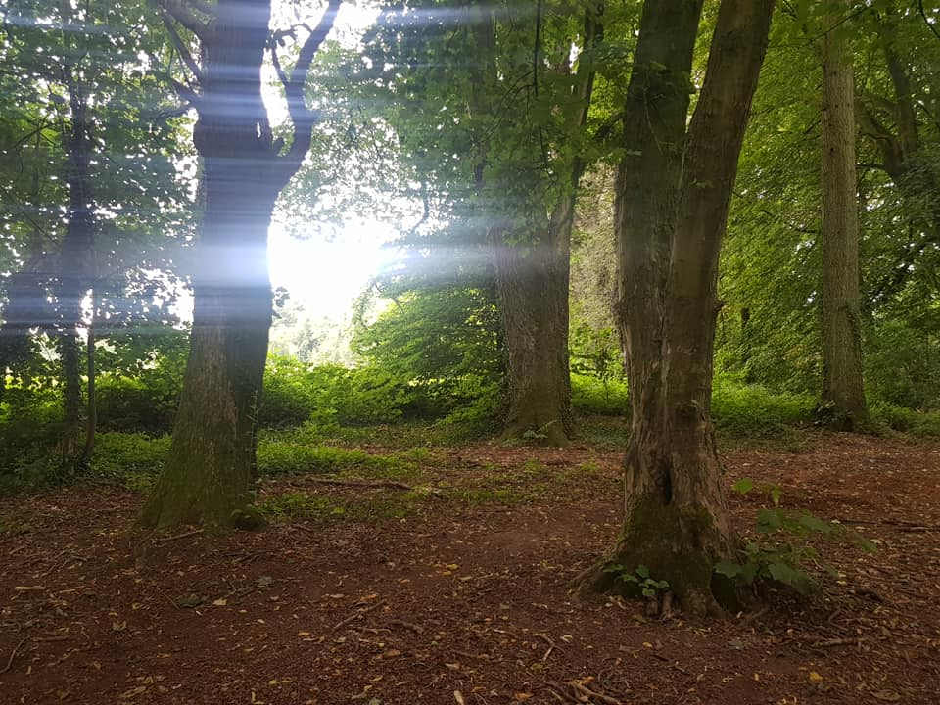
In amongst it!
OK, so now we are on the edge or just entering a wooded area.. What’s the weather like? Take some time just to be still and settle… breathe deeply..
Looking around... What can you see? What can you hear? What can you smell?
How are you feeling? What are you noticing?

Slide 12
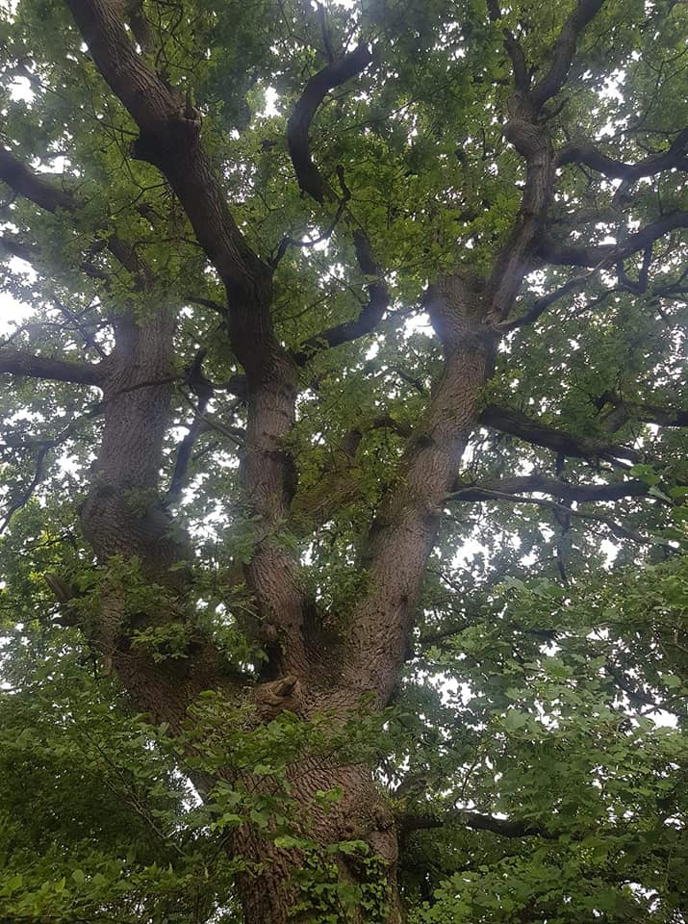
Looking around…
What is the view?
What is the light like? What is the colour of the light?
Is it darker here than in the open? Is the air filtered with green from the leaves?

Slide 13
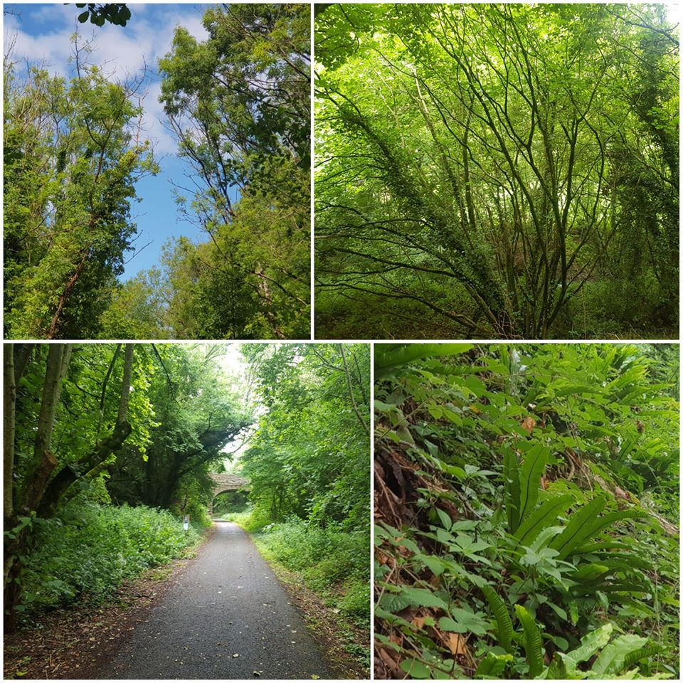
Going deeper…
What colours can you see? Can you see the sky? How is the sky looking?
What is the woodland floor looking like? Are there leaves, nutshells, pathways, brackens, all types of undergrowth or perhaps flowers and trees saplings…
Take some time to be still, breathe gently and deeply

Slide 14
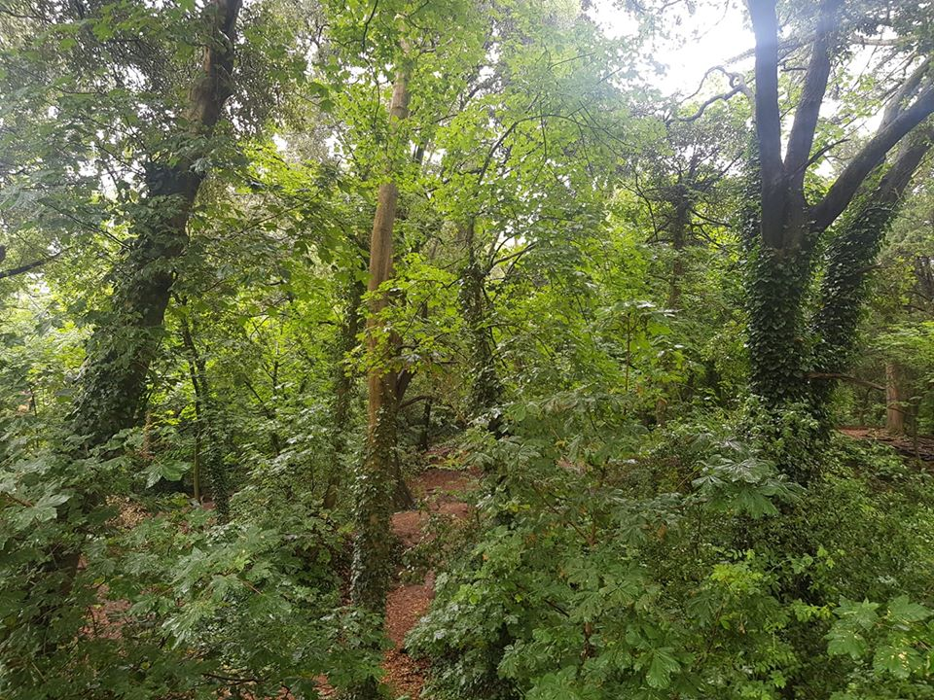
Breathe…
If there is a bench or a handy tree to lean against, and you feel safe to do so, gently close your eyes… take some calming breaths, are you noticing different sounds or fragrances now?
Woodland air is really rejuvenating and has all sorts of positive minerals floating about that can do us so much good!

Slide 15
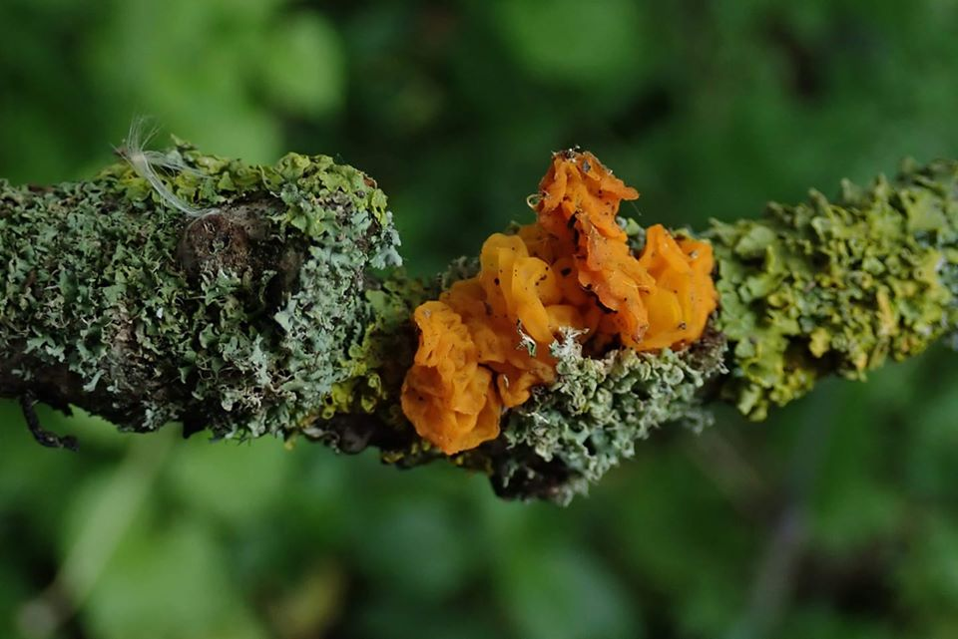
Gathering in…
Perhaps as you gaze at the woodland floor, you notice a leaf or a nut or a twig with colourful lichen on it…
Pick it up and have a good look at it closely…
Notice textures and colours…

Slide 16
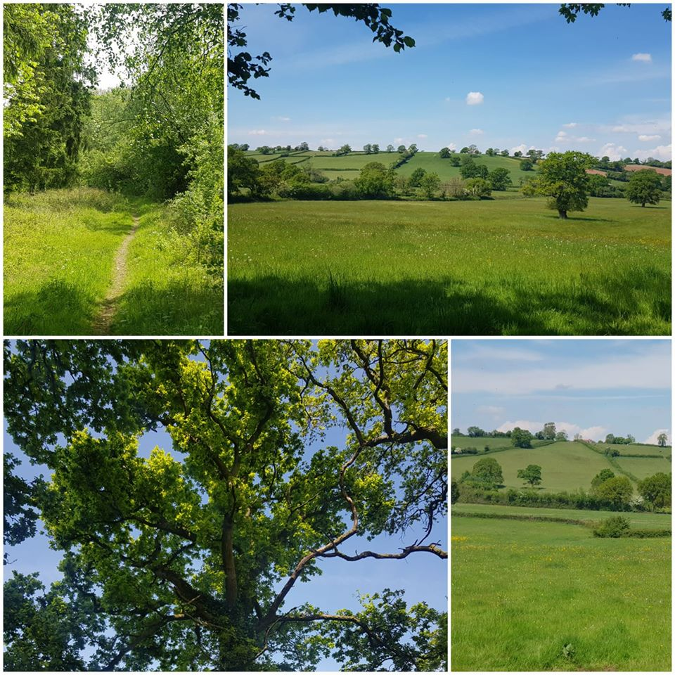
Scenery…
“I felt my lungs inflate with the onrush of scenery—air, mountains, trees, people. I thought, "This is what it is to be happy.” Sylvia Plath

Slide 17
My reflections from a visit to the woods
I am making these reflections in the form of scattered thoughts and words as it was a windy day in the woods….

Slide 18
A windy day in the woods – some blustery thoughts
Movement Noise of wind in the treetops
Shadow Moving patterns of light and dark on the woodland floor
Light Mix of colours of greens and browns
Dapple Ever shifting
Texture Rough and smooth feel of different barks
Tiny things like acorns and massive things life mighty oak trunks
Rustling leaves Birds moving between trees, wings lifted on the breeze
Swaying tree canopy A place of light and shade, decay and growth
Woodland wonder Wandering in the trees
A great connection felt between me and the trees Finding my senses

Slide 20
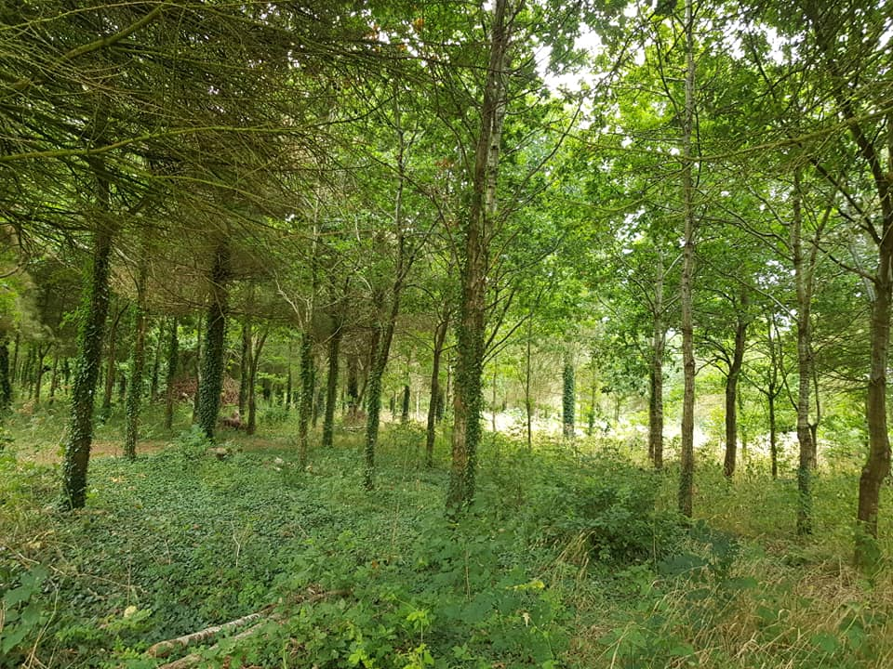
I wonder...
Have I seen something new today?
Did I see something that made me feel calm happy, relaxed?
Did something in you shift or change as you entered or left the woodland?
What sights and smells did you encounter?
How does being in a wood feel different for you compared to being in a more open landscape?

Slide 22
Finding out more
Do I know the name of any of the flowers, trees, animals?
Do I want to find out more about what I have seen?
There are all sorts of websites, if you want to know more, about what you have seen?
For example, there is an easy to use tree guide at https://www.woodlandtrust.org.uk/trees-woods-and-wildlife/british-trees/how-to-identify-trees/

Slide 23
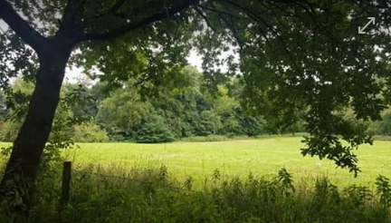
Edges and hedges
Perhaps you also have the time to explore a hedgerow near you? Or at the edge of field nearby?
What do you notice about the plants in the hedge? Are there a variety of leaves and colours?
Do they look cut or manged in some way? Are they lay so they can grow but act as a more secure boundary?
Can you see little birds flitting in and out of the hedge?

Slide 24
Gratitude and growth
Is there something I am particularly grateful for after being in nature?
Do I want to thank that thing in my heart?
What did I enjoy about today, while I was in nature?
Did I find anything difficult, inspiring, challenging, comforting?
What could I try next?
What would I like to do more of? What would I like to try again?
How have my senses and my enjoyment of nature developed?

Slide 25
Noticing and connecting
One of the things we have been doing throughout these sessions has been taking time to notice things… often noticing things that we might otherwise not see or rush by…
The concept of looking at a hedge may seem rather strange! But when we raise our awareness of the ordinary world around us, we can start to notice extraordinary things!
I walked along a field edge a few weeks ago and noticed some amazing things… here is what I would have sent back on a postcard from there..

Slide 26
Postcard from the hedge
“Hello! How are you? What have you been up to? I have had a busy day and needed to get out and about to have a change of scene! It’s me writing to you from a field near my house. I know! It’s a funny place to bother to write from, but I have seen some amazing things. At the field edge, there were some thistles where some little goldfinches picked off the seeds and ate them, then fluttered off to the next one. As it was an evening walk, I could see how the sun was setting behind the hedge and making the edges of the leaves all golden, even though they were still green. On the other side of the hedge, I could hear something before I saw it! I could hear sheep bleating away, and when I stood especially still and listened I could hear the grass they were eating being pulled up by them. I must have walked by this field loads of times and thought it was just a hedge… but this evening I have noticed new things and it has brought me back to myself somehow and gathered me in! Anyway, bye for now; waving from the hedge! Sara.”

Slide 27
“If you will stay close to nature, to its simplicity, to the small things hardly noticeable, those things can unexpectedly become great and immeasurable.”
Rainer Maria Rilke

Slide 28
Writing home
Perhaps from the hedgerow or field edge you have visited, you might like to write down your reflections in the form of a postcard from the hedge…!?
Or maybe as a journal with jottings about what you saw and heard?
Taking the time to notice nature and reflect on what we have seen can be a source of great contentment and enjoyment.
It can be a comfort and an inspiration when we are out and about in the fresh air, taking time to be still and notice the world around us
It can be source of strength and encouragement when we look back at our nature notes and photos and remember where we have been
It can be a motivation for us to continue to try to get out and about in all sorts of weather and seasons and see what we can see!

Slide 29
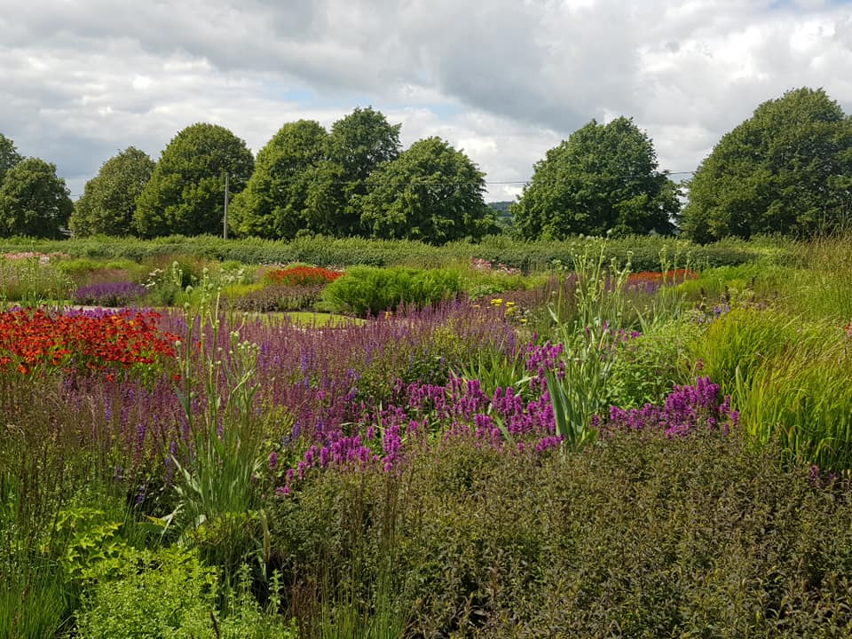
I wonder…
What has been my favourite thing I have seen today? Or seen at any stage of this course?
How can I make a memory of this? Take a photo, gather an item like a leaf or a pebble, make notes in a journal, make a drawing of the scene, write a postcard, work on a poem…

Slide 30
Being out and about in nature…
“Live in each season as it passes; breathe the air, drink the drink, taste the fruit,
and resign yourself
to the influence of the earth.”
Henry David Thoreau

Slide 31
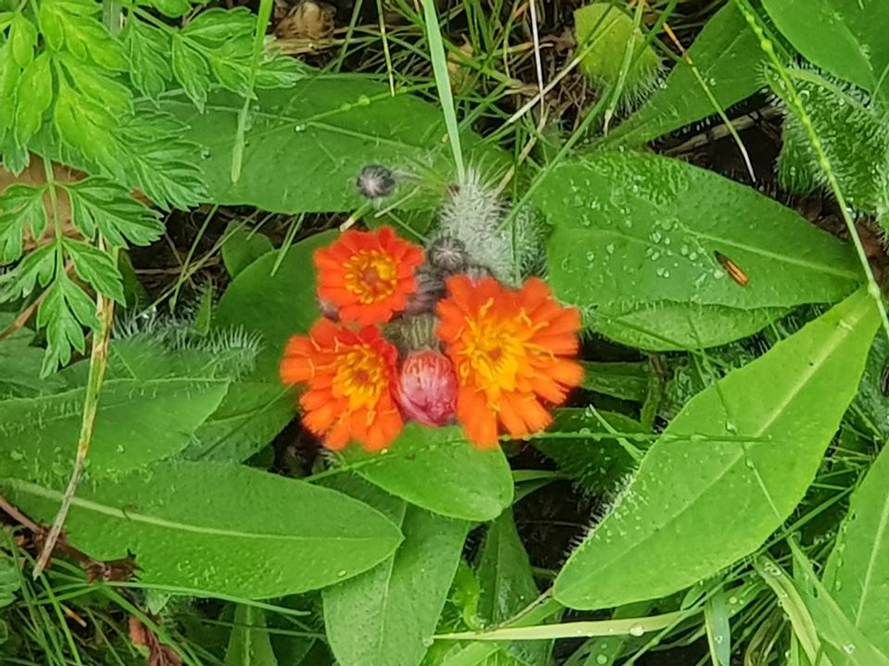
Conclusions
We’re coming to the end of this online course.
I do hope you have enjoyed it and taken time to notice nature. I have gained much from being able to share some of my nature noticing moments!

Slide 32
Connecting with nature
The natural word is such a source of strength and renewal; by tuning into it, we can acknowledge so many aspects of ourselves and let nature guide us through the seasons of change and potential.
We have been journeying together through this course, shared some of our reflections and journal notes, some of our photos and feelings… through wild woods, along bustling hedgerows, in sunny or cloudy parks and gardens, along ordinary streets where we live and discovered the extraordinary world around us, as we have begun to connect with nature! We have so much more to discover, each and every day we take steps to connect with nature... onwards!

Slide 33
Connecting with nature

Slide 34
Enjoy each day, as you step out in to the natural world!

