Slide 1
Emotional control and daily emotional hygiene
With
Bernard Genge

Slide 2
Aims and desired outcomes
Aims – To know how to control your emotions, replace negative ones with positive ones and practice daily ‘emotional hygiene’
Outcomes – To be more confident because you feel more in control of your emotional wellbeing and to experience a high level of peace of mind and lower stress
As we go through this masterclass decide what you will START, STOP & CONTINUE doing
54321 DD
Notes:
On these masterclasses as we all learn in different ways there will be spoken words from me, written words on the ppt, pictures, quotes and for those that are very visual youtube clips to watch afterward. The key to learning however is doing and teaching – 54321 DD

Slide 3
Set scene
A useful definition of emotional wellbeing is offered by the Mental Health Foundation: ‘A positive sense of wellbeing which enables an individual to be able to function in society and meet the demands of everyday life; people in good mental health have the ability to recover effectively from illness, change or misfortune.’
Emotional health is an important part of overall health. People who are emotionally healthy are in control of their thoughts, feelings, and behaviours and able to cope with life's challenges. They can keep problems in perspective and bounce back from setbacks.
Depression, anxiety, stress, poor body image, grief, loss, a major change in your life such as becoming a new parent can all affect your mental and emotional health and day to day living. Sometimes it is hard to know if what you are experiencing is depression, sadness, worry or anxiety.
Notes:
A question worth pondering over is does depression for example cause poor emotional wellbeing or does poor emotional wellbeing (trapped emotions) cause depression?
Emotions are ‘energy in motion’

Slide 4
How emotions impact what we do?
Inward Emotions (introvert) = lose/win thinking = passive
Fear
Disgust
Contempt
Hate
Outward emotions (extrovert) = win/lose thinking = aggressive
Anger
Shame
Pride
Depression
Are there positive inward emotions?
Admiration
Respect
Hope
Contentment
Are there positive outward emotions?
Liking
Joy
Love
Forgiveness
But how do we use this information?
Notes:
Reflect on the negative emotions you experience and STOP and ask are they inward or outward? Then ask how this impacts my thoughts and behaviour - for example if you experience fear does that encourage you to think in a low confidence lose/win way? When doing STOP when observing consider how this emotion of fear makes you feel then the oppositive positive emotion (curiosity/trust/courage/calmness) and how that feels. You can also consider the intensity of both. Then move on to the P of STOP as you’ve thought about it observed how it (the positive and negative) makes you feel so you now need to PLAN what to do you now focus on the positive so our example of fear the opposites of curiosity/trust/courage/calmness refocus on one or more of these then turn them into a self-talk statement and visualize yourself doing it, for example “I trust myself to courageously face my fear of …………. In a calm way”

Slide 5
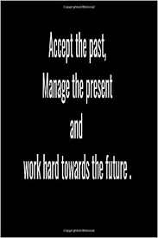
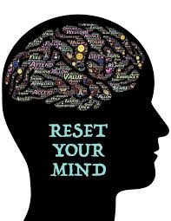
Emotions are information but what do we do with that information?
About past experiences so we don’t get blocked which prevents a natural flow of emotional energy just like a river. We don’t want to be ‘non-emotional’ just control harmful emotions.
Is the key to accept and then manage them?
When we react to our emotions is when they get ‘blocked’ = depression

Slide 6
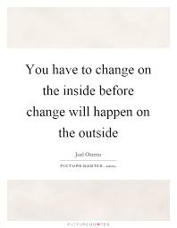
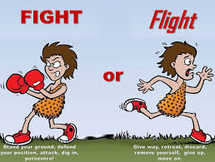
Often in surprising ways – we call them coincidences. We can then be no longer a victim of our circumstances and can ...
But when we are in constant ..
We are less immune, whereas when we take control and focus on positive emotions =
Greater immunity – within 4 days
Notes:
90% of thoughts/emotions today same as yesterday and 50% of them not true. Within 4 days we can increase immunity by 50% (research Dr Joe Dispenza) with positive emotions and within 60 days can lengthen life.
5 short term fight or flight is Ok and increases immunity, but when its constant it pushes our immune system out of balance
Fight or flight – short term Ok (increases immunity) long term bad decreases immunity and this is especially relevant for me as recent research shows us men are more susceptible to viruses, cancer and other diseases because females have different genetics and estrogen which increases immunity

Slide 7
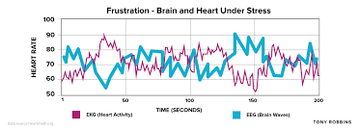
Debilitating emotions such as anger raises brain waves by over 200 times the norm, its no wonder we can’t think/act rationally when angry.
Notes:
Its interesting that here we have heart and brain waves, although we think they are separate recent neuroscience research tells us they are closely related – in this image here is one trying to compensate for the other? What is also interesting is both cardiac and neuro surgeons reccommend similar lifestyles to prevent heart attack and stroke

Slide 8
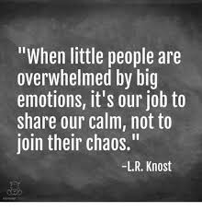
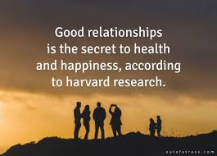
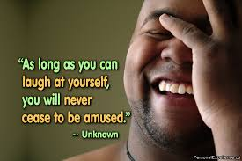
Characteristics of good emotional wellbeing
They are comfortable with their challenging emotions so in turn can then be comfortable with others
Notes:
2 - an ability to stay calm in a crisis
4 – they know how to process negative emotions and help others process theirs – they know how to STOP
In addition they have a sense of purpose, will not shy away from things, they have a good emotional and mental environment, they are decisive, comfortable saying no, they go beyond ‘FINE (frazzled, insecure, needy, emotional) when someone asks say “I am absolutely fantastic, living the dream, making memories every day – if I was any better I’d need to be twins to share all my joy”, then ask how are you!!

Slide 9
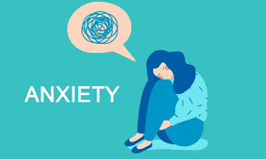
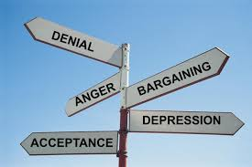
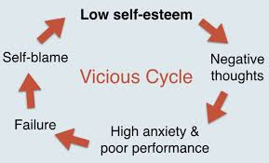
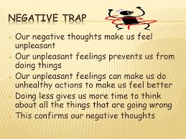
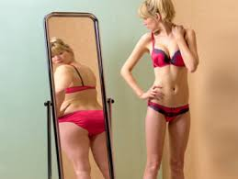
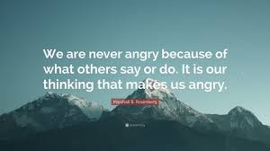
What affects emotional wellbeing
Notes:
3 – living in denial we need to change as we all do. Allowing anger to take hold, bargaining rather than facing reality, allowing low moods, negative thoughts to lead to depression and acceptance is an interesting one, we don’t need to accept negative thoughts, other people’s or the media’s negativity but we need to accept negative emotions before we can process them, so its about firstly deciding to take control then accepting negative emotions before dealing with them
7 – what hurts us most is how we react to others and the world
8 – we see twice here un healthy cycles so use your self-awareness right now to recognise any for yourself. Unhealthy thoughts make us unhealthy, so healthy ones make us healthy

Slide 10
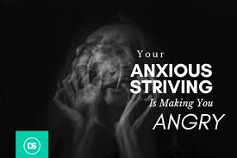
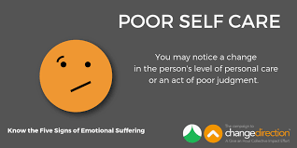
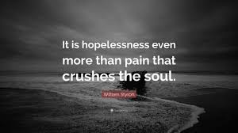
Signs of poor emotional hygiene/wellbeing
Notes:
10
10
4 – high levels of anxiety can lead to angry outbursts and that’s not to mention what physical impact it has on us – heart, ulcers, immune system etc.
7 – a feeling of hopelessness – this can lead to learned helplessness and depression. There are numerous survival stories where the ones who never have up hope survived and those who gave up hop perished

Slide 11
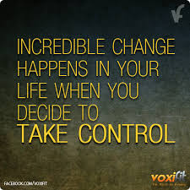

Slide 12
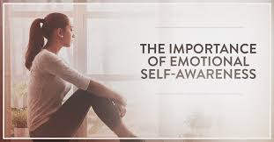
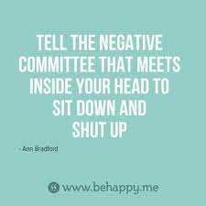
Good emotional hygiene
Notes:
12
12
Next slide positive emotion of the day
2 –reflect on the emotions you’ve experienced recently, think about it and give them a name, observe how they felt
3 – us a cue such as an elastic band
5 – Sound therapy has been used for transmuting emotions, thoughts and beliefs by changing your biology, mind and emotions. You can create a daily sound therapy meditation – find a good sound therapist who knows about transmuting emotions – Niki Gratix. Edgar Cayce said sound energy is the medicine of the future. It is the rhythmic stimulation of music (rather than the melody) that has the greatest anti-pain effect in the brain (neurochemistry research). Use for anxiety, PTSD etc. It is believed that the sound therapy heals dissonance in our energy fields. Nikigratix.com gives you a method for doing this at home yourself on yourself – get the free stuff

Slide 13
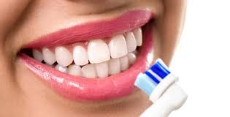
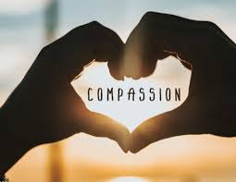
Positive emotions of the day
Forgiveness***
Gratitude/appreciation
Affection
Courage
Determination
Enthusiasm
Happiness
Inspiration
Kindness
Passion
Pride
Respect
Sensitive
Thankful
Thoughtful
Understanding
Warm-hearted
Creativity
Notes:
13
13

Slide 14
Management of negative emotions – if you can recognise it you can deal with it
The key to the management of negative emotions is ‘self-awareness’ which is being aware when you experience such an emotion and recognising what it is such as: anger, anxiousness, embarrassment, guilt, feeling miserable, stress, withdrawn, sad, volatile etc.
Then ask some key questions to get to the root of it and then turn it around:
What are its exact features
What actions is it encouraging in me
How does it feel in me? Where do I feel it? How intense is it?
What insights can I now gain
What is the opposite ‘positive emotion’?
Can I now focus on that positive emotion?
What can I now do to maintain longevity with that positive emotion?
Notes:
This is the detail of STOP
Shoe locker

Slide 15
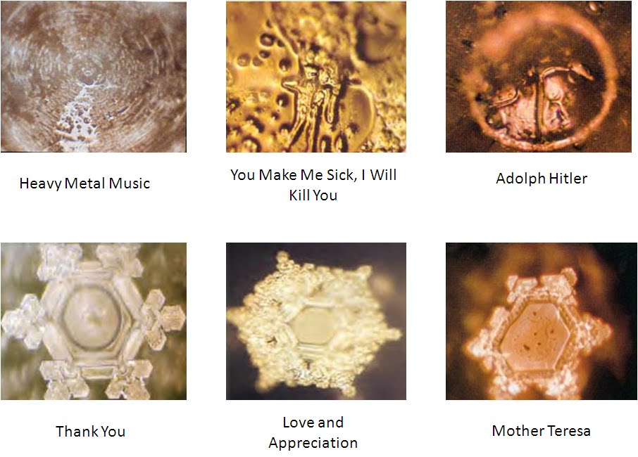
Notes:
These are images of water crystalising and this shows the difference between the emotional triggers we expose ourselves to, why? We are 70% water. Choose carefully what you read, watch and listen to.

Slide 16
Notes:
Praise/positive affirmation is good for the other person as well as us. Over the next 48 hours catch someone doing something right and recognize it = motivation

Slide 17
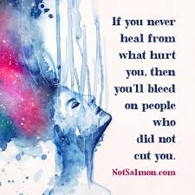
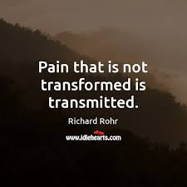
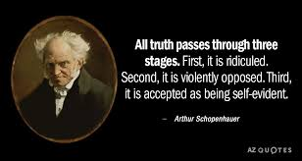
EFT

Slide 18
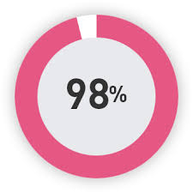
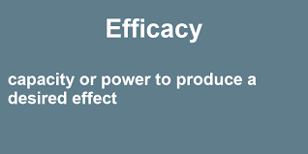
EFT – how does it work
It works by the retrieval of fear memories, incorporation of new emotional experiences and learnings into the memory, and finally reinforcement of the new learning. The greater the negative intensity the better, you need to ‘feel it to heal it’.
EFT relies on the premise that acceptance of, rather than resistance to, a particular condition can reduce suffering. Its like watching a movie rather than continually re-living it.
We can think of EFT as helping reboot our personal energy system in relation to the issue at hand, similar to the way we reboot a computer, which has got stuck or has crashed.
We can’t change our past but we can release it!
Is energy imbalance and unresolved emotional trauma the underlying cause of many physical chronic conditions? What if they were? To avoid or cure disease we need to stop causing it!
Notes:
More than 60 research articles
Scans of the brain, including fMRIs (functional MRIs), have shown that the stimulation of acupoints sends signals directly into the "survival" parts of the brain where the fight-or-flight part of us lives. Words alone cannot reach these areas of the brain, which do not have direct neural connections with rational language centres. EFT reaches the survival-instinct mechanism of the brain and helps to reprogram our reactions at that level. When we are under stress, the pre-frontal cortex of the brain goes “offline,” and our body begins flooding with adrenaline and cortisol. The EFT intervention can help calm the amygdala, facilitate the release of calming chemicals, and bring us back to a more resourceful state.
Mention Christopher Reeves wife who died of lung cancer 2 years after he died – non smoker and we know grief resides in the lungs.

Slide 19
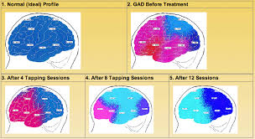

Slide 20
EFT
To see a demo of EFT and emotional hygiene:
https://www.youtube.com/watch?v=02Aip5q_x8M
To obtain an EFT users guide e-mail:
bernard.genge@gmail.com
Notes:
Mention EMDR (changes emotional energy field frequence by moving the eyes whilst focusing on the traumatic event) and The Emotion code – with all these it involves no talking – yapping does not work. 10 hours of EFT, EMDR, emotion code or sound therapy will heal PTSD

Slide 21
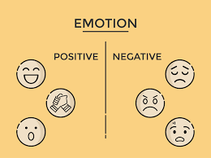
30-day challenge
Positive emotion of the day for the next 30 days
Watch the youtube clip on the previous slide about EFT and emotional hygiene

Slide 22
Action plan
As a result of todays masterclass what will you:
START DOING
STOP DOING
CONTINUE DOING
Notes:
54321 Decide/do

Slide 23
Further opportunities
Personal Resilience facebook group.
Ignite: Find Your Passion, Live Your Purpose & Re-Write Your Future
https://www.facebook.com/groups/216645969611627/?ref=share
Personal resilience online programme;
https://ignitepd.thinkific.com/courses/rock-solid-resilience?fbclid=IwAR1dt6Mw_cw8EqDPPJA3bpynSEVhFxwfMWBZpPKO1IZq04ZvxHHc0ty8KRc
bernard.genge@gmail.com

Slide 24
Further information/watching
https://www.youtube.com/watch?v=Z7dFDHzV36g
Barbara Fredrickson discusses how positive emotions broaden our awareness of the world, allowing us to become more in tune with the needs of others.
https://www.youtube.com/watch?v=F2hc2FLOdhI
We'll go to the doctor when we feel flu-ish or a nagging pain. So why don’t we see a health professional when we feel emotional pain: guilt, loss, loneliness? Too many of us deal with common psychological-health issues on our own, says Guy Winch. But we don’t have to. He makes a compelling case to practice emotional hygiene — taking care of our emotions, our minds, with the same diligence we take care of our bodies.

