Slide 1
How to set goals that propel you towards your vision
With
Bernard Genge

Slide 2
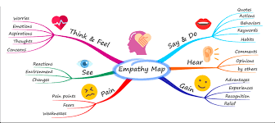
Aims & desired outcomes
Aims – How to set meaningful goals that you can make a 100% commitment to.
Outcomes – To have goals in place that link to your vision and mission and gives you a yardstick for weekly action that makes incremental and significant progress in life.
As we go through this masterclass decide what you will START, STOP & CONTINUE doing
Notes:
On these masterclasses as we all learn in different ways there will be spoken words from me, written words on the ppt, pictures, quotes and for those that are very visual youtube clips to watch afterward. The key to learning however is doing and teaching – 54321 DD

Slide 3
Set scene
Goals help you to think about and then go after the things you really want in life, rather than feel as if your're adrift in the world. So many people work hard, but they don't seem to get anywhere worthwhile, goals help you set out on this journey called ‘life’ with a clear idea of the destination, after all we wouldn’t go on a major car journey without knowing the destination.
Setting goals should link to your long-term vision and give you short-term motivation. It focuses your acquisition of knowledge and helps you to organise your time and your resources so that you can make the most of your life.
Have you thought about what you want to be doing in five years' time? Are you clear about what your main objective at work is at the moment? Do you know what you want to have achieved by the end of today?
If you want to succeed, you need to set goals. Without goals you lack focus and direction. Goal setting not only allows you to take control of your life's direction; it also provides you a benchmark for determining whether you are actually succeeding. But what is success? This is personal to you and should be revealed clearly in your personal vision and mission.
With goal setting comes pain, the pain of self-sacrifice of easy and pleasant things.
﻿

Slide 4
Rudders and oars
Notes:
Your goals are like the rudder on the boat. They set the direction and determine where you go. If you commit to one goal, then the rudder stays put and you continue moving forward. If you flip-flop between goals, then the rudder moves all around and it is easy to find yourself rowing in circles.
However, there is another part of the boat that is even more important than the rudder: The oars. If the rudder is your goal, then the oars are your process for achieving it. While the rudder determines your direction, it is the oars that determine your progress.
If you’re a runner, your goal is to run a marathon. Your system is your training schedule for the month.
Goals determine your direction. Systems determine your progress. You'll never get anywhere just by holding the rudder. You have to row.

Slide 5
Linking goals to your vision and mission
Evaluate
VISION
MISSION
Take Action with commitment
Roles
Plan Weekly
Goals
SMARTER
Notes:
VISION - cathedral = compelling vision. GOALS – SMARTER = marathon, Roger Bannister, goals v new years resolutions (a wish that people talk about), something red

Slide 6
Roles
As you go through life, you have a range of roles: employee, provider, caregiver, spouse or partner, parent, grandparent. Each of these roles comes with different expectations.
Typically, we experience changes in roles during significant events in life, such as a child moving away from home or retirement from a long career. While these can be changes for the good, they can also bring with them all sorts of new pressures and challenges. Sometimes we find that what’s important to us changes and we set new goals.
Over the course of a day, you might help a neighbour, lead a meeting at the office, help a friend in need over lunch, drive your son to rugby practice, and do and say a number of other things that illustrate the many roles you play in life. After all, most of us hold several titles—boss/employee, parent, child and so on—each of which requires us to give of ourselves in different ways. While you may enjoy many of the moments that result, juggling it all “perfectly” can be demanding—and, truth be told, unrealistic.
These roles also change, I’m a Dad today and a grandad tomorrow!
So, the question is what are your roles right now?
Notes:
We spoke about vision and mission in the previous module now lets talk about our roles

Slide 7
Notes:
1 - Extended family role as well as mum/dad, brother/sister, son/daughter etc.
3 – your role in your community and as a global citizen
4 – what is your role at work and what responsibilities that come with that role? What responsibilities come with the other roles you have
5 – sports teams have clear roles, what is your role within your team at work?

Slide 9
Tips for setting your goals – 1 eliminate goal competition
One of the greatest barriers to achieving your goals is the other goals you have. In other words, your goals are competing with one another for your time and attention. Whenever you chase a new goal, you have to pull focus and energy from your other pursuits. This is basically The Four Burners Theory in action. When you turn one burner up, you have to turn others down.
One of the fastest ways to make progress on your goals is to simply press pause on less important things so you can focus on the most important goal right now. Sometimes you just need to reorganise your priorities a little bit and suddenly progress comes much more quickly because you are now fully committed to a goal that was only getting moderate attention previously.
This is an important insight. Typically, when we fail to reach our goals, we think something was wrong with our goal or our approach. What often looks like a problem of goal setting is actually a problem of goal selection. What we really need is not bigger goals, but better focus. You need to choose one thing and ruthlessly eliminate everything else. You don't need more time, you just need to decide.
Our lives are like rose bushes. As a rose bush grows, it creates more buds than it can sustain. If you talk to an experienced gardener, they will tell you that rose bushes need to be pruned to bring out the best in both their appearance and their performance. In other words, if you want a rose bush to thrive, then you need to cut away some of the good buds so the great ones can fully blossom. Full growth and optimal living require pruning.

Slide 10
Tips for setting your goals – 2 stack your goals
Research has shown that you are 3x more likely to stick to your goals if you make a specific plan for when, where, and how you will take action. For example, in one study scientists asked people to fill out this sentence: “During the next week, I will partake in at least 20 minutes of vigorous exercise on [DAY] at [TIME OF DAY] at/in [PLACE].”
Researchers found that people who filled out this sentence were 2x to 3x more likely to actually exercise compared to a control group who did not make such plans.
A great way to utilise this finding is with a strategy called habit stacking by just filling out this sentence. After/Before [CURRENT HABIT], I will [NEW HABIT].
Here are some examples:
Meditation: After I brew my morning coffee, I will meditate for one minute.
Press-ups: Before I take my morning shower, I will do 10 press-ups.
Positive emotion of the day: After I clean my teeth, I will repeat my positive emotion of the day three times.
Gratitude: Before I eat dinner, I will say one thing I am grateful for that day.
Networking: After I return from my lunch break, I will send one email to someone I want to meet.
Habit stacking works well because you not only create a specific plan for when and where you will implement your goals, but also link your new goals to something you are already doing each day.

Slide 11
Tips for setting your goals – 3 Set an upper limit
Whenever we set goals, we almost always focus on the lower limit. That is, we think about the minimum threshold we want to hit. The implicit assumption is, “If I can do more than the minimum, I’ll go for it.”
An individual might say, “I want to lose at least 5 pounds this month.”
An entrepreneur might say, “I want to make at least 10 sales calls today.”
An artist might say, “I want to write at least 500 words today.”
A runner might say, “I want to run at least 3 miles today.”
But what would it look like if we added an upper limit to our goals and behaviors?
“I want to lose at least 5 pounds this month, but not more than 10.”
“I want to make at least 10 sales calls today, but not more than 20.”
“I want to write at least 500 words today, but not more than 1,500.”
“I want to run at least 3 miles today, but not more than 6 miles.”
Notes:
Test this theory and see whether you vere towards the upper or lower limit

Slide 12
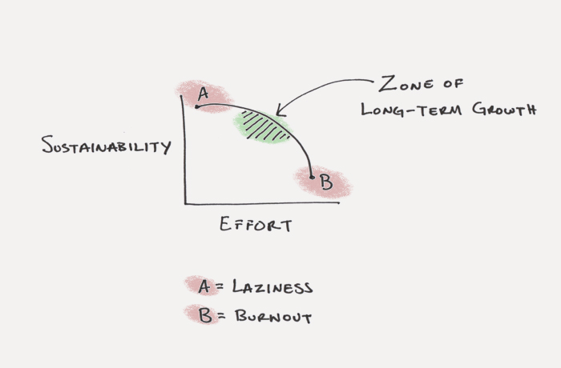
The zone of long-term growth
Notes:
In many areas of life, there is a magical zone of long-term growth. You want to push hard enough to make progress, but not so much that it is unsustainable. This is where setting an upper limit can be useful. Upper limits make it easier for you to sustain your progress and continue showing up.
This is especially critical in the beginning. Whenever you set a new goal and begin working toward it, the single most important thing is showing up. In the beginning, showing up is even more important than succeeding because if you don't build the habit of showing up, then you'll never have anything to improve in the future.
This aligns to the principle of personal continuous improvement, something highly resilient people embrace

Slide 13
Tips for setting your goals - 4 Achieving consistency with your goals
Too often, we set the right goals inside the wrong system. If you're fighting your system each day to make progress, then it's going to be really hard to make consistent progress. There are all kinds of hidden forces that make our goals easier or harder to achieve. You need to align your environment with your ambitions if you wish to make progress for the long-run.
Aligning Your Environment With Your Goals
Although most of us have the freedom to make a wide range of choices at any given moment, we often make decisions based on the environment we find ourselves in.
If you sleep with your phone next to your bed, then checking social media and email as soon as you wake up is likely to be the default decision.
If you keep alcohol in your kitchen, then drinking consistently is more likely to be the default decision.
Of course, defaults can be positive as well.
If you keep a dumbbell next to your desk at work, then pumping out some quick curls is more likely to be the default decision.
If you keep a water bottle with you throughout the day, then drinking water rather than a fizzy drink is more likely to be the default decision. It's very hard to stick with positive habits in a negative environment.
Use visual cues that help to nudge you in the right direction. Use the Seinfield strategy.
Opt-out (its what organ donation do effectively) - opt your future self into better habits ahead of time. Schedule your yoga session for next week while you are feeling motivated today. Then you have to opt-out and justify it!!
Notes:
Seinfeld Strategy:
He told me to get a big wall calendar that has a whole year on one page and hang it on a prominent wall. The next step was to get a big red magic marker.
He said for each day that I do my task of writing, I get to put a big red X over that day. “After a few days you’ll have a chain. Just keep at it and the chain will grow longer every day. You’ll like seeing that chain, especially when you get a few weeks under your belt. Your only job next is to not break the chain.”
“Don’t break the chain,” he said again for emphasis.

Slide 14
Tips for setting your goals – 5 Measuring your goals
Another key to making long-term progress on your goals is measurement. One of the most motivating things we can experience is evidence of our progress. This is why measurement is so critical for effective goal setting. By measuring your results, you get insight on whether or not you are making progress.
The things we measure are the things we improve. It is only through numbers and clear tracking that we have any idea if we are getting better or worse:
When you measure how many press-ups you do you get stronger.
When you track reading 20 pages a day, you will read more books.
When you record your values and commit to reading them twice every day for the next month, you perhaps start living with more integrity.
The trick is to realise that counting, measuring, and tracking is not about the result. Measure to discover, to find out, to understand. Measure to see if you are committed. Measure to see if you're actually spending time on the things that are important to you

Slide 15
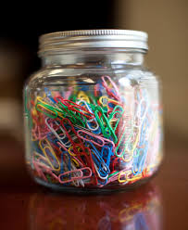
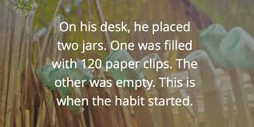
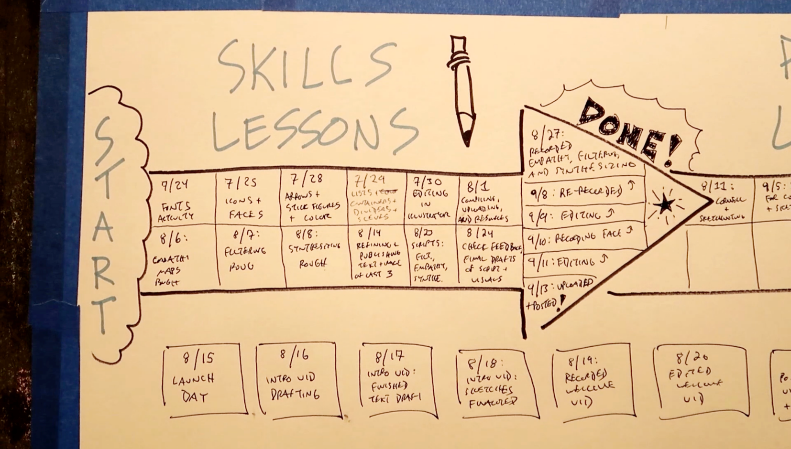
Notes:
2 The Paper Clip Strategy
Dyrsmid began each morning with two jars on his desk. One was filled with 120 paper clips. The other was empty. As soon as he settled in each day, he would make a sales call. Immediately after, he would move one paper clip from the full jar to the empty jar and the process would begin again. “Every morning I would start with 120 paper clips in one jar and I would keep dialing the phone until I had moved them all to the second jar,” he told me.
Within eighteen months, Dyrsmid was bringing in $5 million to the firm. By age twenty-four, he was making $75,000 per year—the equivalent of $125,000 today. Not long after, he landed a six-figure job with another company.
4 – seinfield strategy put a cross on each day you complete your action

Slide 16
30-day challenge
Have your vision and mission as your north star, before identifying your key roles, before in turn identifying your SMARTER goals
Set yourself 1 (or more) SMARTER goals to achieve in the next 30 days.
Remember the 5 tips:
Eliminate goal competition
Stack your goals
Set an upper (as well as a lower limit) to your goals
Achieve consistency
Find a way of measuring them
And also make your goal setting system visual

Slide 17
Action plan
As a result of todays masterclass what will you:
START DOING
STOP DOING
CONTINUE DOING
Notes:
54321 decide/do

Slide 18
Further opportunities
Personal Resilience facebook group.
Ignite: Find Your Passion, Live Your Purpose & Re-Write Your Future
https://www.facebook.com/groups/216645969611627/?ref=share
bernard.genge@gmail.com

Slide 19
Further information/watching
https://www.youtube.com/watch?v=yS4rYDUVJ_Y
The 5/25 Rule - How Warren Buffett Sets His Goals (animated)
https://www.youtube.com/watch?v=lkqOZgVLC88
SETTING GOALS THAT MATTER | Samantha Kris | TEDxLaval
As a success coach with a background in marketing, I understand the necessity of emotion to move people towards a desired outcome. Capitalizing on research into the effect that emotions have on accountability, I will share my proprietary way of goal setting that challenges us to put our feelings at the core of our goals.
https://www.youtube.com/watch?v=cdiApKj3QPg
How to Set Goals: 80/20 Rule for Goal Setting | Brian Tracy
The 80/20 Rule, also known as Pareto's Principle, a wonderful tool in time and life management. In this video, I explain the 80/20 Rule and share how you can apply that rule to setting and achieving any goal you set for yourself.

