Slide 1
Managing Anxiety and Stress During as we Come out of Lockdown

Slide 2
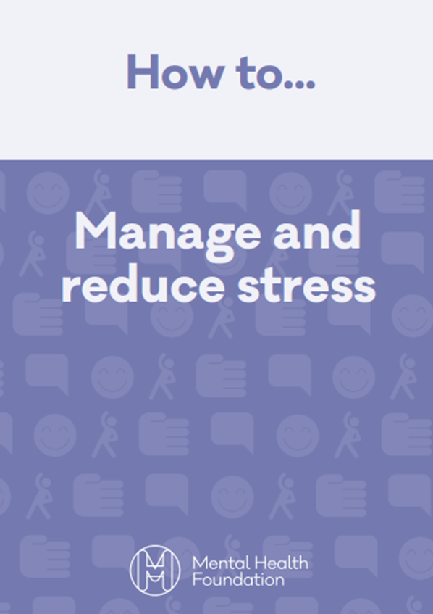
Identifying Signs of Stress
Everyone experiences stress. However, when it is affecting your life, health and wellbeing, it is important to tackle it as soon as possible, and while stress affects everyone differently, there are common signs and symptoms you can look out for:
feelings of constant worry or anxiety
feelings of being overwhelmed
difficulty concentrating
mood swings or changes in your mood
irritability or having a short temper
difficulty relaxing
depression
low self-esteem
eating more or less than usual
changes in your sleeping habits
using alcohol, tobacco or illegal drugs to relax
aches and pains, particularly muscle tension
diarrhoea and constipation
feelings of nausea or dizziness
loss of sex drive.
www.mentalhealth.org.uk/sites/default/files/how-to-manage-and-reduce-stress.pdf
Mental Health Foundation
(2020)
www.mentalhealth.org.uk/publications/how-manage-and-reduce-stress

Slide 3
What are our Anxieties and Causes of Stress During this Time?
Worries around your health
Protecting your loved ones
Unsure how to follow social distancing
Following hygiene guidelines correctly
Returning to work or school
Taking public transport
Being in social situations again

Slide 4
How to look after your mental health using exercise
From the Mental Health Foundation (2020)
www.mentalhealth.org.uk/publications/how-to-using-exercise
Down load the PDF Here:
www.mentalhealth.org.uk/sites/default/files/How%20to...exercise.pdf
Diet and mental health
https://www.mentalhealth.org.uk/a-to-z/d/diet-and-mental-health
Food For Thought: Mental Health And Nutrition Briefing
https://www.mentalhealth.org.uk/publications/food-thought-mental-health-and-nutrition-briefing

Slide 5
As with any period of intense and unrelieved stress, when the stress is lifted, there is sometimes an impact on physical or mental health. It’s possible that as lockdown eases, you may realise how hard it has been and you may get unwell, or low.
- MHF 2020

Slide 6
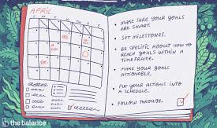
Plan ahead*
Consider which situations you’re feeling particularly anxious about and decide what you could do in this situation to help ease your concerns.
If you’re anxious about taking public transport, can you find another way to travel? If not, could you travel at a quieter time of day when there may be less people around?
If you’re worried about returning to work, could you speak to your manager and ask to compress the hours you spend in the office?
Plan ahead where possible, and take a positive, problem-solving approach.
Bupa (2020 )*www.bupa.co.uk/newsroom/ourviews/manage-post-lockdown-anxiety

Slide 7
Arm Yourself With Trustworthy Information*
The guidance on what to do and how to stay safe during coronavirus is constantly evolving. So it’s understandable if you’re feeling unsure what hygiene precautions you should take, or what social distancing measures to follow.
Knowledge is power here! Arming yourself with the correct facts will help you feel confident that you know what to do, and can help ease your worries. But if watching or reading the news about coronavirus makes you feel anxious, limit this to once a day.
It’s important to make sure the information and advice you’re reading comes from sources that are up-to-date, trustworthy and evidence-based. Keep up to-date with the latest guidance on coronavirus at gov.uk.
Bupa (2020)
*www.bupa.co.uk/newsroom/ourviews/manage-post-lockdown-anxiety

Slide 8
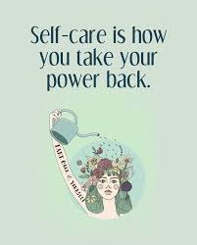
Look after your wellbeing*
Taking care of your physical health can help you to cope with feelings of anxiety and stressful situations when they arise. Try to eat a healthy diet, limit alcohol, exercise regularly and get good-quality sleep.
Remember to take some time out to look after yourself. Try a few different things until you find what works for you.
You could try reading a book, practise mindfulness, get creative, bake or go outdoors for some exercise. Spending time outside in green, open spaces can have positive effects on your wellbeing.
Bupa (2020)
*www.bupa.co.uk/newsroom/ourviews/manage-post-lockdown-anxiety

Slide 9
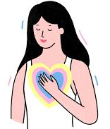
Practise self-awareness and compassion*
It’s completely understandable to feel a mixture of emotions right now – particularly as the situation continues to change daily.
On one hand, you might be craving some structure to your day, or looking forward to a socially-distanced catch up outside with a friend. But on the other hand, you might feel concerned or anxious about returning to situations you haven’t been in for some time.
The key is to recognise this and be kind to yourself. If you find you’re being self-critical – ask yourself – how would I speak to a friend right now? You deserve to show yourself the same care and compassion that you would to someone else.
Bupa (2020)
*www.bupa.co.uk/newsroom/ourviews/manage-post-lockdown-anxiety

Slide 10
Speak to someone you trust*
Share your fears and concerns with someone you feel comfortable talking to.
The chances are they’re experiencing similar feelings. Sharing how you’re both feeling can help you both to feel supported and understood.
If you have specific concerns about returning to work, speak to your line manager and colleagues.
Bupa (2020)
www.bupa.co.uk/newsroom/ourviews/manage-post-lockdown-anxiety

Slide 11
Responding to the Unfamiliar*
You may witness people around you panicking. On the other hand, you may experience those don't seem concerned at all when a pandemic is on the rise, assured that it won't affect them. You may find yourself feeling all kinds of emotions—or maybe, you are confused and don't know how to feel.
People tend to overreact to unknown threats as easily as they underreact to familiar threats. What we know less about is more likely to make us nervous.
Being bombarded with news that constantly talks about death tolls, and reports that emphasize how many are sick, can cause people to overestimate the risks they face in contracting the illness.
However, reliable sources of media can also have positive effects during a pandemic.
*Very Well Mind (2020) www.verywellmind.com/managing-coronavirus-anxiety-4798909

Slide 12
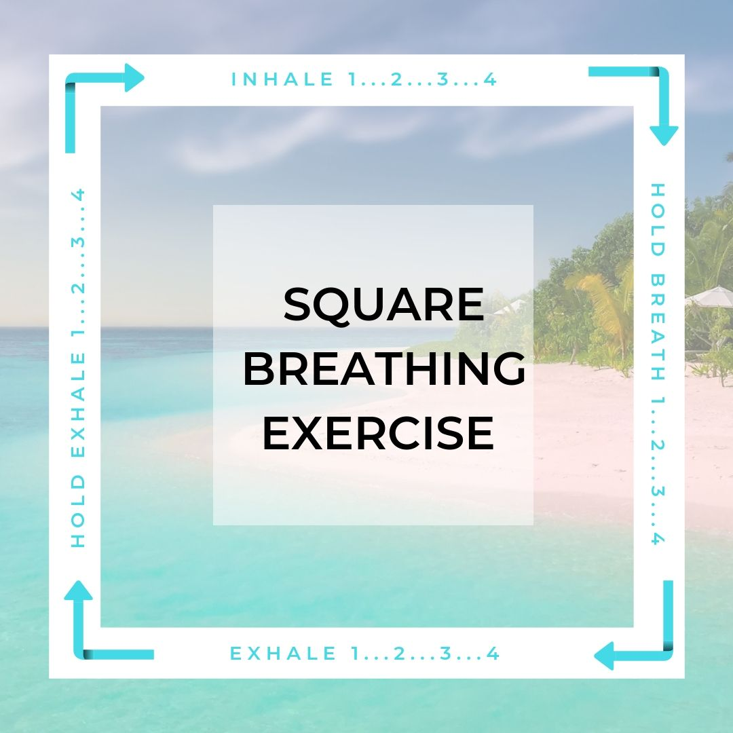

Slide 13
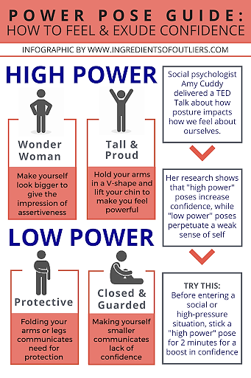

Slide 14
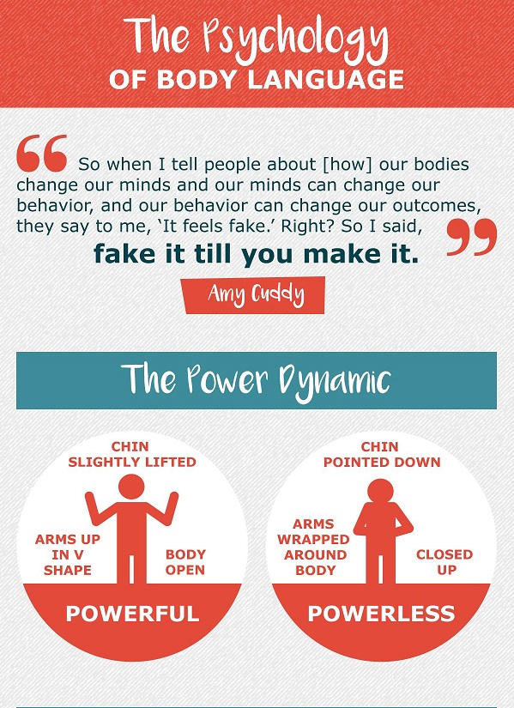

Slide 15
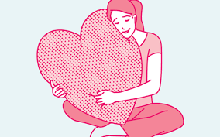
How to Practice Loving Kindness Meditation*
The following is a simple and effective loving kindness meditation technique to try.
Imagine yourself experiencing complete physical and emotional wellness and inner peace. Imagine feeling perfect love for yourself, thanking yourself for all that you are, knowing that you are just right—just as you are.
Focus on this feeling of inner peace, and imagine that you are breathing out tension and breathing in feelings of love.
Repeat three or four positive, reassuring phrases to yourself.
*www.verywellmind.com/how-to-practice-loving-kindness-meditation-3144786

Slide 16
Loving Kindness Scripts to Try
May I be happy
May I be safe
May I be healthy, peaceful, and strong
May I give and receive appreciation today
Bask in feelings of warmth and self-compassion for a few moments. If your attention drifts, gently redirect it back to these feelings of loving kindness. Let these feelings envelop you.
You can choose to either stay with this focus for the duration of your meditation or begin to shift your focus to loved ones in your life.
Begin with someone who you are very close to, such as a spouse, a child, a parent, or a best friend. Feel your gratitude and love for them. Stay with that feeling. You may want to repeat the following phrases or similar ones that bring about feelings of loving kindness within you:

Slide 17
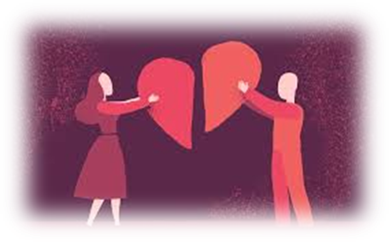
Loving Kindness Meditation Script for Other People
May you be happy
May you be safe
May you be healthy, peaceful, and strong
May you give and receive appreciation today
Once you've held these feelings toward that person, bring other important people from your life into your awareness, one by one, and envision them with perfect wellness and inner peace.
Then branch out to other friends, family members, neighbours, and acquaintances. You may even want to include groups of people around the world. Extend feelings of loving kindness to people around the globe and focus on a feeling of connection and compassion. You may even want to include those with whom you are in conflict to help reach a place of forgiveness or greater peace.
When you feel that your meditation is complete, open your eyes.

Slide 18
References
Bupa (2020) Six ways to manage post-lockdown anxiety. Available from:https://www.bupa.co.uk/newsroom/ourviews/manage-post-lockdown-anxiety. [Accessed July 14 2020].
Mental Health Foundation (2020) How to manage and reduce stress. Available from: www.mentalhealth.org.uk/publications/how-manage-and-reduce-stress. [Accessed on July 14 2020].
Mental Health Foundation (2020) How to Look After your Mental Health During the Coronavirus Outbreak.
Available from: https://www.mentalhealth.org.uk/coronavirus. [Accessed July 14 2020].
Very Well Mind (2020) How to Practice Loving Kindness Mediation. Available from: https://www.verywellmind.com/how-to-practice-loving-kindness-meditation-3144786. [Accessed on July 14 2020].
Very Well Mind (2020) Managing Coronavirus Anxiety. Available from: www.verywellmind.com/managing-coronavirus-anxiety-4798909. [Accessed on July 14 2020].

