Slide 1
Making significant positive change
With
Bernard Genge

Slide 2
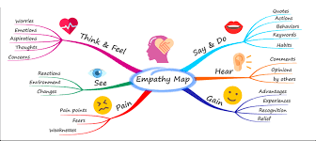
Aims and desired outcomes
Aims – To know how to make significant positive change in life – personally and professionally
Outcomes – To be a person who continually embraces change in life
As we go through this masterclass decide what you will START, STOP & CONTINUE doing
Notes:
On these masterclasses as we all learn in different ways there will be spoken words from me, written words on the ppt, pictures, quotes and for those that are very visual youtube clips to watch today and afterward. Share stories at the end. The key to learning however is doing and teaching – 54321 DD
Do ask questions – the one who does might feel silly for a few seconds the one who doesn’t appears silly for a lifetime.
Key message on every slide
Exeter Uni – the videos Did you know 2019; who moved my cheese – any lightbulb moments?

Slide 3
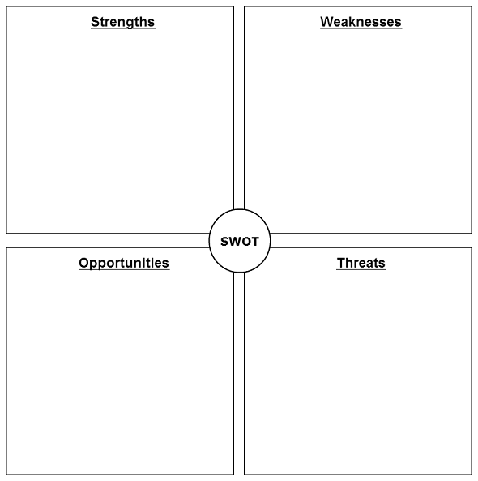
Notes:
Key message - think of a change you could make in your life by doing a quick SWOT – what strengths/opportunities can they build on or weaknesses/threats to overcome – 1 in each area

Slide 4
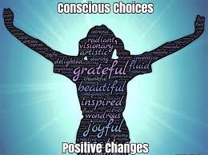
Set scene
What makes change difficult is that we are often trying to do it from the outside in – that is, to change our external behaviour without making any change to our thoughts/beliefs. When there is no internal basis for change we need threats, reminders, or someone to nag us to make sure we keep up with the change. When we truly connect with the change from the inside it becomes so much easier.
Understand ‘why’ and what you want to change at a really deep level.
Think about the beliefs and biases you have that shape your mindset and drive the behaviour. For example, if you want to stop working so hard because of the resulting stress but you have a deep-rooted belief that to be successful you have to work long hours you will need to address this belief before change will work.
Notes:
Then we can make a Conscious Choice about the actual change we are going to make. Then we can embrace Conscious change many people make the big mistake of thinking that having made the decision to change they can make a few steps in the right direction and all will miraculously fall into place.
When you make conscious choices/decisions you create the right environment to make conscious/positive changes
Change is inevitable (everything changes – economy, weather/climate, our body etc.), growth/learning/personal development or improvement are optional – post traumatic growth. When we learn from our experiences we gain experience.
Commitment comes from rowing your boat in life and not someone else’s, or a boat someone tells you to row, make your own decisions so you are not rowing it downstream and fighting against the current, so row with peace, kindness, gratitude and gentle determination
Key message – use your self-awareness to understand what needs to change in your life then change your thinking to the end result of the change you want to make, visualize it with positive self-talk as you develop the change skills/habits here to develop an empowering belief regarding the change you will make – it will become conscious.

Slide 5
Characteristics of a changing/growing person
High degree of self-awareness – they understand we live in an ever-changing world and to grow/survive in this world they must embrace change
Patience to think things through, be decisive and make the necessary sacrifices
Being prepared to be uncomfortable and stretch that comfort zone
Prepared to challenge and question self
Incrementally growing in confidence
Their life is changing for the better – even if its small changes
Notes:
Key message – reflect on what your life will be like when these things are happening to you.
1 – Mongolian nomads move their home 3 times a year in tune with the seasons, they have truly embraced impermanence and interestingly they don’t get depressed. Expand your periphal vision to see beyond what is in front of you.
3 - Transformation only happens when your desire to change is bigger than your strongest excuse.
4 – ask soul searching questions to find your true purpose (beyond self), have a vision for your future and work towards it with pride but without attachment.
6 – the importance of setting 30-day challenges so you can review progress
In addition they will focus on changing their habits. Psychologists have found that people who exhibit positive personality traits (such as kindness and honesty) have developed habitual responses that have stuck. But to change habits we need to challenge and change our beliefs and values

Slide 6
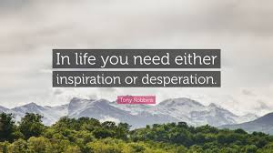
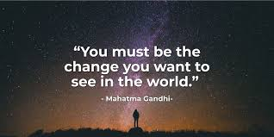
Why do we change?
Notes:
The best fire you’ll ever light is the fire from within, not someone else’s.
2 change because of your values
60 years – one example more info in a week than a lifetime, one constant,
Key message – change either happens to us or we happen to make it happen

Slide 7
CHANGE READINESS – a good gauge of your current levels of resilience/change readiness
THE RESISTERS
Critical, narrow minded, unconvinced, can be mischievous with their resistance
THE FLOURISHING
Enthusiastic & optimistic, embracing change & their own development. Open to lead
Low Levels of personal resilience High
THE DROWNING
Overwhelmed, loudly critical, withdrawn, resentful & dysfunctional
THE QUITTERS
Eager at the outset but get disillusioned when going gets tough. Feel betrayed by management
Low Change Readiness High
Notes:
This is the relationship between our ability to embrace change and our levels of personal resilience. Talk about self-awareness and honestly reflect on this – if you are a quitter building your personal resilience is a priority, if drowning both resilience and learning how to be confident with change, if a resister focus on learning to embrace change
Resilience related to change = physically, emotionally, psychologically, cellular resilience and even as we will see on the next slide getting past denial and all of this comes down to honest self-awareness of how resilient we are right now.
Key message – to be flourishing future leader focus on developing high change readiness and personal resilience and embrace change enthusiastically.

Slide 8
THE LOSS CURVE
The Loss Curve
Shock
Denial
Relapse or make it stick
Anger such as blame, resentment, frustration
Guilt
Taking action, problem Solving
Anxiety
Relief and feeling positive
Performance
Stress
Acceptance
Despondency
Depression
Time
Notes:
Explain my gran and Steph visiting stories ask them to think about times when they’ve faced change and the emotions they experienced?
Key message – change is a rollercoaster so be comfortable with the emotions you experience and learn how to control negative emotions

Slide 9
THE STAGES OF CHANGE
NEUTRAL ZONE
Your change plan
Begin with
ENDINGS – create a
burning platform
NEW BEGINNINGS
The compelling vision
Denial
Make it stick
Taking action & problem Solving
Blame
Shock
Performance
Self-Blame
Acceptance
Time
Notes:
Refer back to slide 5 we need desperation or inspiration
Key message – too many people make the mistake of going straight to the neutral zone and make change without a push/pull/change of mindset/belief

Slide 10
DIFFUSION OF INNOVATION
Organisational willingness to engage with change?
EARLY
MAJORITY
LATE
MAJORITY
EARLY
ADOPTER
SHEEP
ALOOF CAT
LAGGARD
Will follow the crowd that shouts the loudest, whether positive or negative. They need to receive effective communication and given more attention.
Your change is probably an inconvenience. They’ll adopt and change when they’re good and ready. They’ll want the change delivered on their terms. And they will need considerable care and attention.
STUBBORN MULE
INNOVATOR
GOOD DOGS
01
EAGER BEAVER
Enthusiastic and happy to be involved. Will respond positively. Supporters of the change. Their tails are wagging for the change.
The stubborn old mules. Prefers to stay put. You’ll need to push them uphill. Will only change when they are forced to.
Like an eager beaver the innovator excitedly embraces anything new. Wants to get involved. Recognises the positives. Is your advocate. These are the real change champions.
Notes:
Two questions for everyone to consider here:
1 – of course we react differently to different types of change but use your honest self-awareness to identify where you sit with personal change and organizational?
2 – what would it take for you to be an innovator in your own life and at least an early adopter (preferable innovator) with organizational change.
Innovatiors 2.5%; e adopters 13.5%; early and late majority 34%; laggards 16%
Self awareness
This theory seeks to explain why, how and at what rate new ideas/technology spread.
Everett Rogers, a professor of communication studies argues that diffusion is the process by which an innovation is communicated over time among the participants in a social system – use the example of climate change
It can also be useful as a self-reflection tool to ask ourselves, how do I accept new ideas and change, so imagine you are at work and someone suggests a good new idea how do you respond? How good are you with new ideas and suggesting change or improvements? Are you an:
Innovator. They are a small group of people exploring new ideas and technologies. It includes "gadget fetishists!" In an online marketing context there are a lot of specialist blogs and media sites to engage them, Engadget and Gizmodo for examples.
Early Adopter. Considered to be Opinion Leaders who may share positive testimonials about new products and services, seeking improvements and efficiency. Engagement requires little persuasion as they're receptive to change. Provide guides on how to use the product/service.
Early Majority. These are Followers who will read reviews by earlier adopters about new products before purchasing. They can be engaged with reviews and via YouTube, where they will look for your products/service.
Late Majority. To generalise, these are sceptics who are not keen on change and will only adopt a new product or service if there is a strong feeling of being left behind or missing out. They can be engaged with providing marketing material, evidence, reviews from Opinion Leaders and case studies to show how it works.
Laggard. The descriptor says it all! Typically they prefer traditional communications and will adopt new products when there are no alternatives. Laggards will come on board when 'others' have written about your products/services, they have research evidence, statistics or felt pressure from others.
Key message – know what would it take for you to be an innovator in your own life and at least an early adopter (preferable innovator) with organizational change.

Slide 11
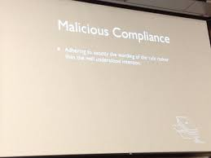
How we resist change
Deflection and avoidance
Notes:
As we look at these reflect on ones you’ve used when faced with change in the past
1 – confusion
2 – Denial is a big one
5 – Easy agreement
Key message – know how you resist change (we all do to a degree) so you can overcome it

Slide 12
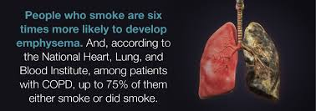
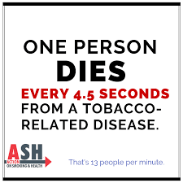
I want to give up smoking and need a ‘push’
Notes:
Key message – After being aware of what you want to change and changing the mindset/belief then create your own burning platform to push you away from something you no longer want – no pain, no pleasure. Don’t wait until the crisis is actually with you, the time to repair the roof is when the sun is shining.

Slide 13
I want to give up smoking and need a ‘pull’
Notes:
Key message – make your vision board so compelling that everytime you look at it you feel excited and burning with desire and hope.
Exeter Uni – reflect on the change you want to make and gather some first thoughts on your burning platform and compelling vision
Break when back from the break go into groups and discuss:
1 – characteristics of a changing person
2 – change readiness (resisters, drowning, quitters & flourishing
3 change curve and emotions we experience when facing change – shock, denial, anger, guilt, acceptance and how the push and pull can help us
4 the perils of denial
5 can guilt be minimised by not reacting negatively and embracing change?

Slide 14
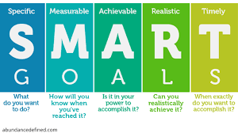
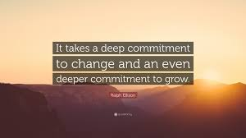
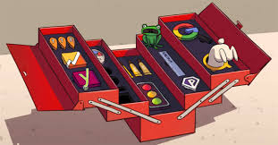
You have a push and pull now you need a plan
Notes:
Don’t let problems hold you back. If you have a problem and there is no solution make the decision to create one!
Key message – Decide to be decisive and to embrace change, set STARTER goals then use some tools in the following slides to deepen that commitment.

Slide 15
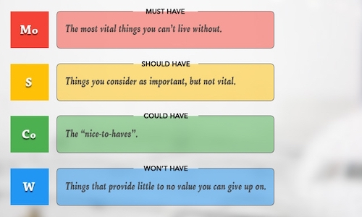
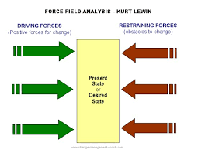
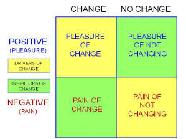
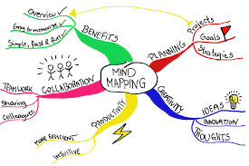
Tools for making change
Notes:
Key message - Need to use some of these ‘tools’ to deepen our commitment to make the change stick so select at least 3 you will use.

Slide 16
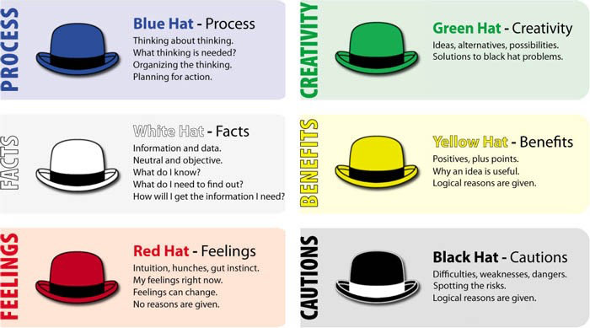
Tools for making change

Slide 17
30-day challenge
Use a number of ‘tools’ to deepen your commitment and see through with it
Notes:
Its worth reflecting on what is success to each of us, what is our story, is it currently fact, fiction, perception, conditioning or something else? How incomplete and perhaps disempowering is our story? Even worst what if its someone else’s story or written by someone else? If we change our story do we change our lives? Can you be the editor of your own life? Can you be free of any shackles, feelings of being trapped and be a change agent in your own life – too many of us want to change others (conflict over the last 20 years). New stories are uncomfortable, but start today writing it (vision) and let go of the past (burning platform) because if you wait for someone else to write it, its you obituary!
So what is success?
We all talk about success and the assumption is that most of us want to be successful. But how do we define success and what exactly does it look and feel like to you?
We often look to those who have achieved financial success as role models, or commercially successful businesses as examples of success.
Should we really be looking outward when it comes to defining success? Could an inward facing approach be more rewarding – defining success on our own terms?
The late Maya Angelou, successful author and poet (and much more), once wrote: “Success is liking yourself, liking what you do, and liking how you do it.” Compare this to how Winston Churchill viewed success: “Success is not final, failure is not fatal: it is the courage to continue that counts.” Both Angelou and Churchill were successful in their own right, and while their definitions of success were different, what unites them is that they each chose to define their own success. And the best part? They were both successful based on their definitions.
Surely that is the key to success – to start with our unique definitions of success which apply at an individual level, and then work towards achieving it. We each need to take the time to look inward and ask ourselves what success looks like for us – not for anyone else. When we come to a definition of personal success, we then need the passion, perseverance and resilience to achieve it.
It is clear that the image of success is changing (it was financial, now fulfilment, happiness etc.) and the metrics we use to measure it are varied; this calls for each one of us to develop our own definition. At the most basic level, defining success is similar to setting yourself a goal and maybe that should be one of your goals from today, to define success for yourself. With so many choices, decisions to be made and career paths, it is easy to get distracted and let others’ definitions of success drown ours. Therefore, being clear in your mind about what a positive outcome would look like will provide a strong sense of direction. As Henry Ford said, “[the] whole secret of a successful life is to find out what is one’s destiny to do, and then do it.” The challenge of course is in the first step – defining success.
Do challenge yourself to stretch that comfort zone, because comfort stops us growing, working (even if we turn up), being creative and been the best version of ourself we can be. When you are green you grow, when you ripen you don’t, never allow yourself to be fully ripe, constantly grow. Get busy been born or re-born because if you don’t you could be is busy or slowly dying. Success is buried on the other side of comfort, frustration at times and even rejection so become comfortable with these by experiencing them more and finally give to receive – if you went to the soil to bear fruit on your tree of life it would not matter how persuasive you are, you’ll get nothing back because you haven’t planted the seed, watered it and nurtured it to bearing fruit.

Slide 18
This is where we watched the video:
Why Change is Good | Motivational Video | Goalcast
https://www.youtube.com/watch?v=sOA6_xh4neM&t=70s

Slide 19
Action plan
As a result of todays masterclass what will you:
START DOING
STOP DOING
CONTINUE DOING
54321 DD
Notes:
Do remember that habits are hard to change so do commit to a 30-day challenge then do it for another 30 days then another 6 (need 66 days) and identify what you have to gain by staying where you are right now (its called a secondary gain) for example kids who get bullied at school will make and keep themselves sick to gain avoid going to school and be exposed to the bullying. Tie this to creating your own burning platform and compelling vision – you need to create new neuropathways to change habits by really understanding what keeps you where you are, creating a push and pull and practice positive daily habits that you turn into a daily ritual – 4 p’s = performance, psychological safety, purpose and pride.

Slide 20
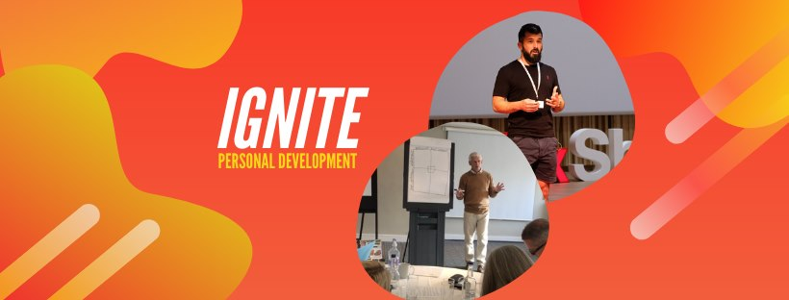
https://www.facebook.com/groups/216645969611627/?ref=share
bernard.genge@gmail.com

Slide 21
Further information/watching
Did you know 2019 – 6 minutes
https://www.youtube.com/watch?v=bTM06NZOyDQ
Who moved my cheese – 15 minutes
https://www.youtube.com/watch?v=jOUeHPS8A8g
Overcoming resistance to change – isn’t it obvious 6 minutes
https://www.youtube.com/watch?v=hcz1aZ60k7w
Jason Clarke – Embracing change 18 minutes
https://www.youtube.com/watch?v=vPhM8lxibSU

