Slide 1
How to say yes to the important things in life and no to those things that are unimportant
With
Bernard Genge

Slide 2
Aims & desired outcomes
Aims – To know what is important to say ‘yes’ to and ‘no’ to the things that are unimportant (even if they are nice and easy)
Outcomes – To be decisive continually in saying yes and no to what is important and not important.
As we go through this masterclass decide what you will START, STOP & CONTINUE doing
Notes:
On these masterclasses as we all learn in different ways there will be spoken words from me, written words on the ppt, pictures, quotes and for those that are very visual youtube clips to watch afterward. The key to learning however is doing and teaching – 54321 DD

Slide 3
Set scene
You cannot manage time; you manage the events in your life in relation to time. You may often wish for more ‘time’ but you aint going to get it, you’ll only get 24 hours, 1,440 minutes or 86,400 seconds each day. How you use that time depends on skills learned through self-awareness, planning, evaluation, and the amount of discipline and self-control you develop.
Time is like money as it is both valuable and limited: it must be protected, used wisely, and budgeted. People who practice good time management techniques often find that they:
Are more productive,
Have more energy for things they need to accomplish,
Feel less stressed,
Are able to do the things they want,
Get more things done,
Relate more positively to others, and
Feel better about themselves
﻿

Slide 4
Self-awareness
The starting point is knowing how you spend your time now. Keeping a time log is a helpful way to determine how you are using your time. Start by recording what you are doing for 15-minute intervals for a week or two. Evaluate the results. Ask if you did everything that was needed; determine which tasks require the most time; determine the time of day when you are most productive; and analyse where most of your time is devoted — job, family, personal, recreation, etc.
Identifying your most time-consuming tasks and determining whether you are investing your time in the most important activities can help you to determine a course of action. In addition, having a good sense of the amount of time required for routine tasks can help you be more realistic in planning and estimating how much time is available for other activities.
﻿

Slide 5
Some questions
Do I use a planning tool?
How good am I at prioritising?
How organised am I?
Do I schedule my time well?
If I am able to, do I delegate to others or seek help where needed?
Do I put off anything I should have really done?
Do I manage time wasters, say no to unnecessary conversations, meetings, visitors or activities?
Do I do too much multi-tasking?
Do I include my health, fitness mental/emotional wellbeing in my priorities?
Do I use and stick to a ‘to-do’ list?
﻿

Slide 6
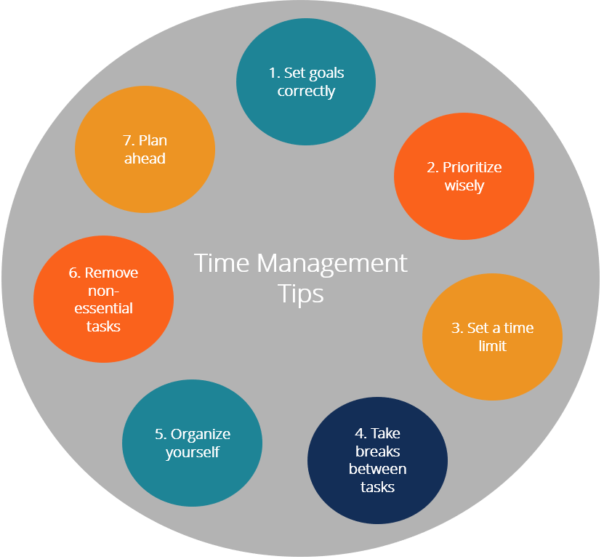

Slide 7
Linking goals to your vision and mission
Evaluate
VISION
MISSION
Take Action with commitment
Roles
Plan Weekly
Goals
SMARTER

Slide 8
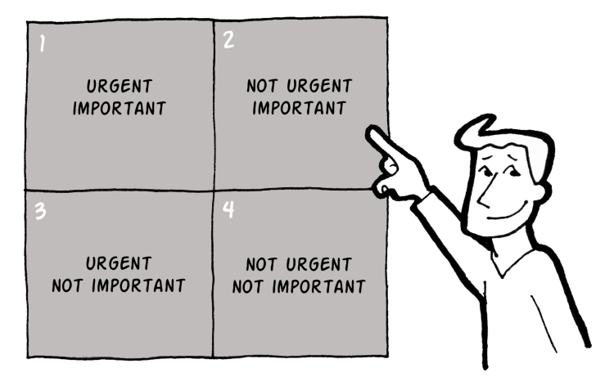
Taking control – being effective rather than just efficient
URGENT NOT URGENT
This is good prioritising
Resilience, physical & mental wellbeing
NOT IMPORTANT IMPORTANT
Discuss your priorities with others to say ‘NO’
Notes:
8
8
Effectiveness v efficient, not about time management its self management

Slide 9
Effectiveness v efficiency
H
RTDB
Right Things
Done Badly
RTDW
Right Things
Done Well
IMPACT
WTDB
Wrong Things Done Badly
WTDW
Wrong Things Done Well
L
H
PERFORMANCE
Notes:
What are the right things for you to do to move towards your compelling vision of your future?

Slide 10
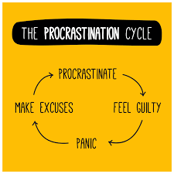

Slide 11
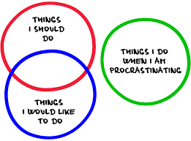
Procrastination
Procrastination is the act of delaying or postponing a task or set of tasks. It causes us stress, has a detrimental impact on self-confidence and has also been associated with psychological disorders such as anxiety and even depression – it needs to be dealt with and avoided.
Do you put things off? If you do why?
Notes:
Become comfortable being uncomfortable by expanding your comfort zone to not procrastinate

Slide 12
Do you do any of these?
Anxious procrastination – the anxiety associated with starting or completing any task or making a decision. You are bad at managing your time and often end up scheduling in more work than you can actually do, leaving no time for fun activities or resting. This causes stress and anxiety which some people deal with by procrastinating.
How to beat it - “unschedule” is a way to combat this anxiety driven procrastination. The unschedule method involves filling your schedule with fun activities and rest before scheduling in any work. This scheduled fun or downtime will give you the chance to relax and prevent you from over scheduling.
Fun procrastination - would rather be doing anything except that one dreaded task. After all, there’s so many fun and exciting things you could be doing instead, how can you bear to start that boring (but important) thing?
How to beat it - try indulging in some structured procrastination. You’re going to procrastinate anyway so why not make it useful? Give in to your desire to procrastinate, but instead of watching youtube, start another item on your to do list. By starting another item first, you’ve made the dreaded task a lower priority which (in theory) will make you dread it a lot less, and in the meantime, you’re still being productive. It’s a win-win.

Slide 13
Do you do any of these?
“Plenty of time” procrastination – difficulty starting a project when you know the deadline is a long way off. This type of procrastination is clearly visible if you were an ‘exam crammer’. You may also have tasks that don’t have deadlines. Take a look at your to-do list. Chances are you have at least one item that you’ve been putting off for weeks if not months. It’s something you want to do, you know it will make things better in the long run, but you keep putting it off.
How to beat it - set yourself deadlines and tell someone else who will hold you to account. Try setting deadlines and telling your friends, family and colleagues about them. This public commitment should keep you on track and motivate you to meet those deadlines.
Perfectionist procrastination - always striving for the best and, as such, you are constantly criticising your own work. For some perfectionists, the fear of failing, or producing work to a low standard, can be so overwhelming they never actually get around to starting anything.
How to beat it - even the worst perfectionist procrastinators can improve by creating a very small goal to begin. One decision to make, one email to write, one piece of clothing to put away, one drawer to declutter. Chances are that, once you start, you'll keep on going.
Notes:
it can actually be a good thing for perfectionists - as long as you have a lot of time to do a task, you fantasise about doing a perfect job. Leaving it till the last minute is a way of giving oneself permission to do a merely adequate job. 99 percent of the time a merely adequate job is all that is needed.” Try looking back at the last 5 jobs you completed. Were they all perfect? Probably not. Were they sufficient? Chances are you’re already working to a high standard so stop giving yourself a hard time. Identifying times when you didn’t do the perfect job, but the consequences were the same as if you did, will help you to overcome your perfectionist routine and stop procrastinating.
So in answer to the question, do you procrastinate? If the answer is yes (and research suggests 95% of us do and 20% are chronic procrastinators, so it’s a big problem) then tackle it. And a footnote – severe perfectionism can lead to depression.

Slide 14
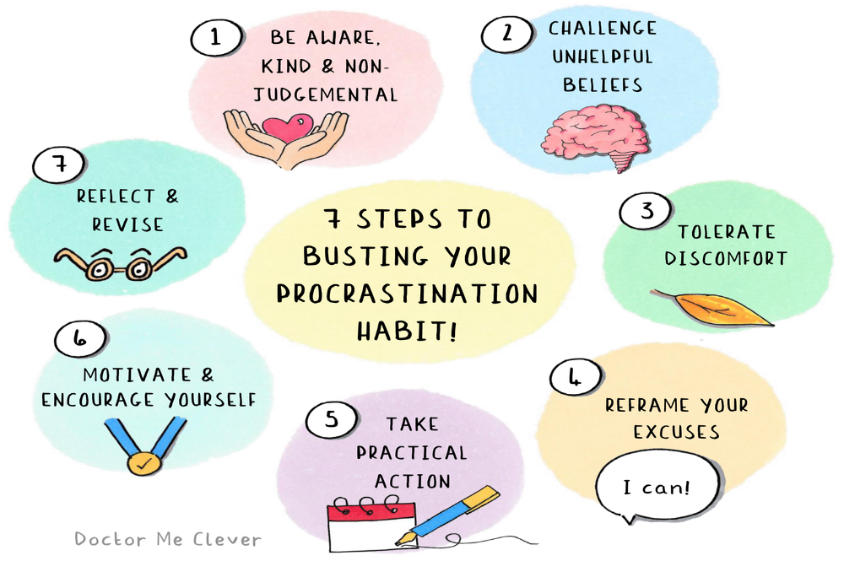
CELEBRATE
Notes:
7 – don’t forget to celebrate

Slide 15
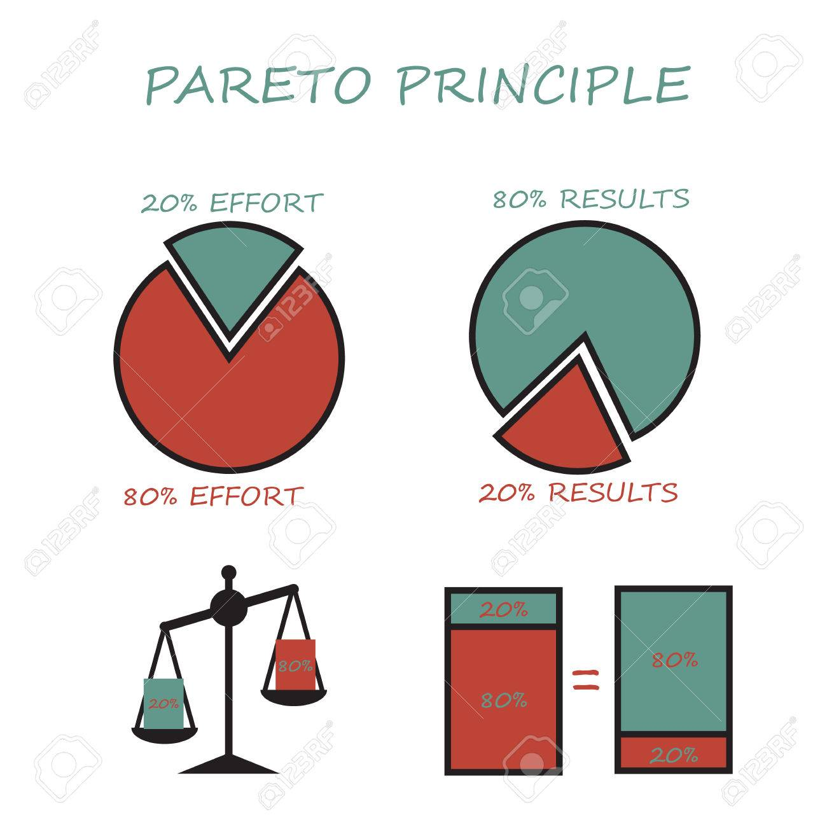
Notes:
Explain pareto
What is the 80/20 diet? In “The 80/20 Diet,” Australian nutritionist, chef, and personal trainer Teresa Cutter writes that you can lose weight if you eat nutritiously 80 percent of the time and allow yourself to indulge in less healthy food for the remaining 20 percent of your meals.
It’s a misconception that the numbers should always be around 80 and 20. They do not necessarily need to, these numbers are just a baseline.
The main point is to find the small things that give you the biggest results. The 80/20 rule is a guide that will help us understand typical distributions not matter what the numbers are
The Pareto principle is not about working less, or producing less, it’s more about working smarter and prioritizing the right things in order to deliver better results and value.

Slide 17
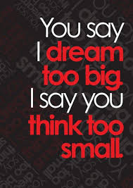
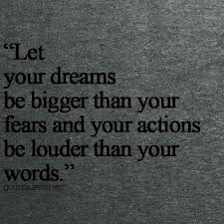

Slide 18
Notes:
3min 15 Personal Effectiveness & the 4 Principles of Success

Slide 19
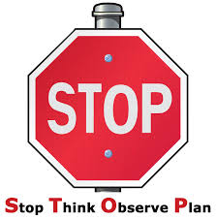
30-day challenge
Give daily awareness of how you spend your time now and whether you procrastinate
Every day for 30-days ask yourself “Am I focusing on what is truly important and saying no to what is not”?
In 30-days time evaluate your success and ask yourself some of the questions on slide 5 – don’t forget to celebrate your success
Every day for 30-days practice ‘effectiveness’ by doing the right things and use the 80/20 principle

Slide 20
Action plan
As a result of todays masterclass what will you:
START DOING
STOP DOING
CONTINUE DOING
Notes:
54321 decide/do

Slide 21
Further opportunities
Personal Resilience facebook group.
Ignite: Find Your Passion, Live Your Purpose & Re-Write Your Future
https://www.facebook.com/groups/216645969611627/?ref=share
Personal resilience online programme;
https://ignitepd.thinkific.com/courses/rock-solid-resilience?fbclid=IwAR1dt6Mw_cw8EqDPPJA3bpynSEVhFxwfMWBZpPKO1IZq04ZvxHHc0ty8KRc
bernard.genge@gmail.com

Slide 22
Further information/watching
https://www.youtube.com/watch?v=arj7oStGLkU
Inside the mind of a master procrastinator | Tim Urban 14 minutes
Tim Urban knows that procrastination doesn't make sense, but he's never been able to shake his habit of waiting until the last minute to get things done. In this hilarious and insightful talk, Urban takes us on a journey through YouTube binges, Wikipedia rabbit holes and bouts of staring out the window -- and encourages us to think harder about what we're really procrastinating on, before we run out of time.

