Slide 1
How to develop trust and build rapport with other people as a foundation to develop great relationships.
With
Bernard Genge

Slide 2
Aims & desired outcomes
Aims – To know how to build a solid foundation for effective relationships with others
Outcomes – To be a confident building trust and rapport with other people that lasts.
As we go through this masterclass decide what you will START, STOP & CONTINUE doing
Notes:
On these masterclasses as we all learn in different ways there will be spoken words from me, written words on the ppt, pictures, quotes and for those that are very visual youtube clips to watch afterward. The key to learning however is doing and teaching – 54321 DD

Slide 3
Set scene
We build rapport when we develop mutual trust, friendship and affinity with someone. Building rapport can be incredibly beneficial to us both professionally and personally – it helps us establish good interpersonal relationships, and this can open many doors.
Have you ever known people who have a knack for connecting with others? No matter who they meet, they manage to create a sense of trust and understanding within minutes.
It doesn't matter what industry you're in or what position you hold – knowing how to build rapport can bring you countless opportunities. After all, when you have rapport with someone, he or she will usually want to help you succeed.
By being yourself, genuinely friendly, taking the attention away from yourself, showing real interest, finding common ground and giving genuine compliments are all tried and tested formulas for building trust and rapport.
In this module we will discuss connecting with and building relationship with others. It can be considered as a state of harmonious understanding with another individual or group. Building rapport is the process of developing that connection.
﻿

Slide 4
Why is it important?
It opens up employment/promotion opportunities – ‘people buy people’
It’s a foundation for open, honest communication
It makes conflict resolution easier
It creates an environment for mutual understanding
It helps create a foundation for creative problem solving
When we have rapport and trust with another we can value differences rather than reject them
It encourages people to work with you to make change happen
It reduces stress and anxiety
It can foster a positive environment
It earns respect
It boosts confidence in yourself and others
﻿

Slide 5
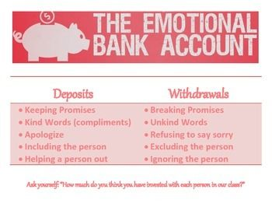
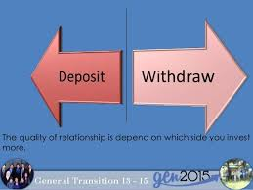
Notes:
Tell the story of flowers
Ask everyone to think of one person in the personal and professional life and think about what is important to them, then write down one thing for each under ‘start doing’ in the next 3 days that will be a significant deposit.

Slide 6
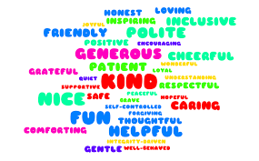
What to do
﻿
Notes:
If you haven’t got your values written down consider that as another ‘start doing’ to create a written values statement

Slide 7
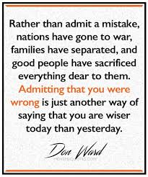
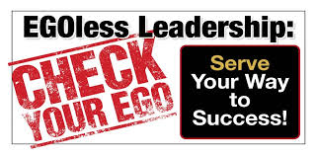
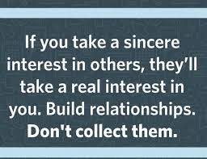
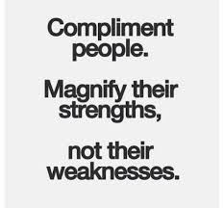
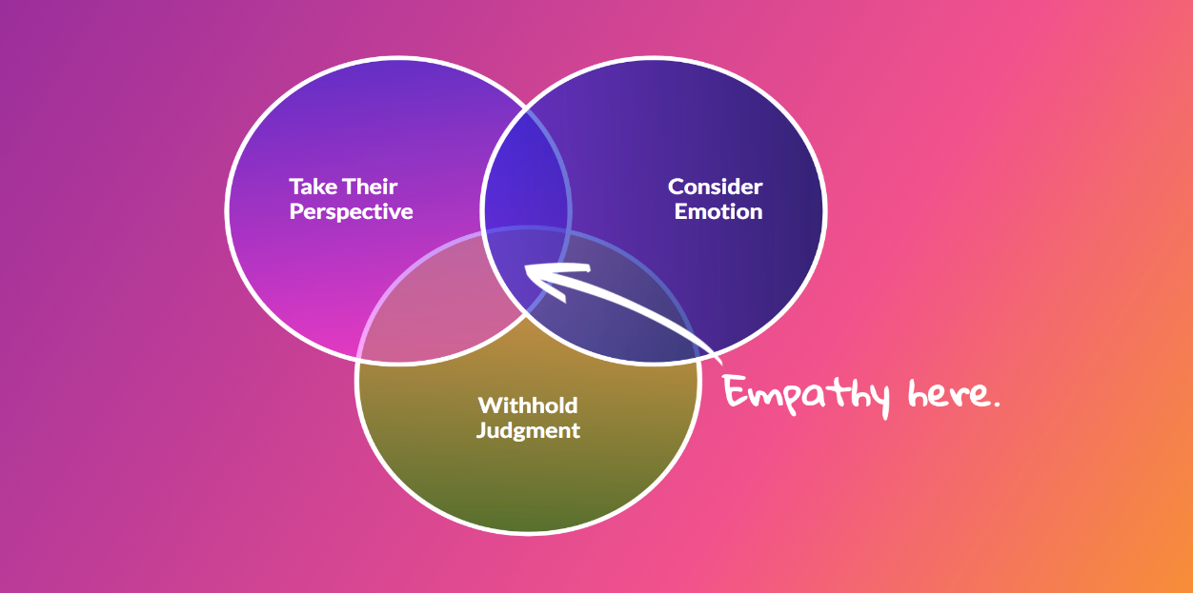
What to do
Notes:
2 - To manage your ego, do these things today:
Spend some time reflecting today and to try and listen to your inner voice – ignoring your ego.
Being ‘right’ is OK if we communicate it with dignity; but do remember that our ‘right’ is our perception of a situation. Arguing to make a point is something to STOP doing right now.
Be comfortable in who you are, commit to living by your values and gaining comfort in who you are and what you do.
Be thick skinned and soft-hearted, by not taking things personally and accept that not everyone will like us, and that is OK.
As we’ve spoken about before, develop the attitude of gratitude, see the good in others and if you find it hard to be kind to someone, be quiet.
Before speaking STOP – Stop, Think, Observe and Plan what you will say rather than just saying it.

Slide 8
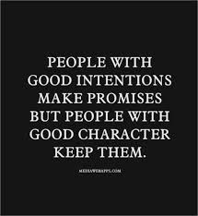
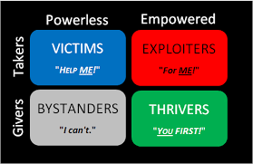
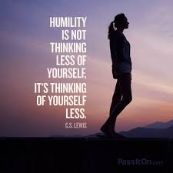
What to do
Notes:
2 - dignity rather than disgrace.
3 - On the next slide we will look at givers, takers and matchers

Slide 9
Givers, takers and matchers
Takers are trying to get as much as possible from another person and contribute as little as they can in return, thinking that is the shortest and most direct path to achieving their own goals.
Givers are looking to help others by making an introduction, giving advice, providing mentoring or sharing knowledge, without any strings attached. These givers actually prefer to be on the contributing end of an interaction. Very few of us are purely takers or purely givers. Most of us hover somewhere in between. That brings us to the third group of people, who are matchers. A matcher is somebody who tries to maintain an even balance of give and take. If I help you, I expect you to help me in return. In some respects’ they keep score of exchanges, so that everything is fair and really just.
Research suggests that givers are overrepresented at the top as well as the bottom of most success metrics. The success of givers and the fall of takers is also driven by matchers. A matcher is somebody who really believes in a just world. Of course, a taker violates that belief in a just world. Matchers cannot stand to see takers get ahead by taking advantage of other people. The data on this suggests that matchers will often go around trying to punish them, often by gossiping and spreading negative reputational information.
Notes:
Just as matchers hate seeing takers get away with exploitation, they also hate to see people act really generously and not get rewarded for it. Matchers will often go out of their way to promote and help and support givers, to make sure they actually do get rewarded for their generosity. That is one of the most powerful dynamics behind the rise of givers.
Often givers put themselves at risk in the short run. But in the long run, they end up building the kind of social capital that is really important for success in the very connected world in which we live.
Takers tend to actually have incredibly broad networks. In part, because when they burn one bridge, they have to go and find new people to exploit, in order to keep the network going. Matchers tend to have much narrower networks. They will typically only exchange with people who have helped them in the past or who they expect to be able to help them in the future. They end up restricting their universe of opportunities. Givers tend to build much broader networks than matchers, but in a very different way than takers. What giver’s will typically do when they meet somebody new is try to figure out, “How can I add value to this person’s life, and what could I possibly contribute that might benefit this person?” What that typically means is they end up creating a lot of good will in the relationship.

Slide 10
Build rapport by breaking the ice effectively
Creating rapport at the beginning of a conversation with somebody new will often make the outcome of the conversation more positive. However stressful and/or nervous you may feel, the first thing you need to do is to try to relax and remain calm.
By decreasing the tension in the situation communication becomes easier and rapport grows.
When you meet somebody for the first time, there are some easy things that you can do to reduce the tension:
Use non-threatening and ‘safe topics’ for initial small-talk.
Avoid talking too much about yourself.
Avoid asking direct questions about the other person & listen.
Look for shared experiences or circumstances.
Try to inject an element of humour or joke about yourself or the situation but avoid making jokes about other people.
Be conscious of your body language/non-verbal signals
Maintain eye contact for approximately 60% of the time.
Relax and lean slightly towards them to indicate listening and interest
Show empathy.

Slide 11
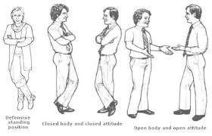
Verbal and non-verbal rapport building
A lot of rapport-building happens without words and through non-verbal communication channels. Things to do:
Observe friends talking and look for how they mimic each other
Smile and be welcoming
Relaxed and open posture
Match their words reflect back and clarifying
When we are nervous or tense, we tend to talk more quickly. This in turn can make you sound more stressed. We tend to vary our voices, pitch, volume and pace to make what we are saying more interesting, but it also has an effect on how we come across. Try lowering your tone and talk more slowly and softly. This will actually help you develop rapport more easily.

Slide 12
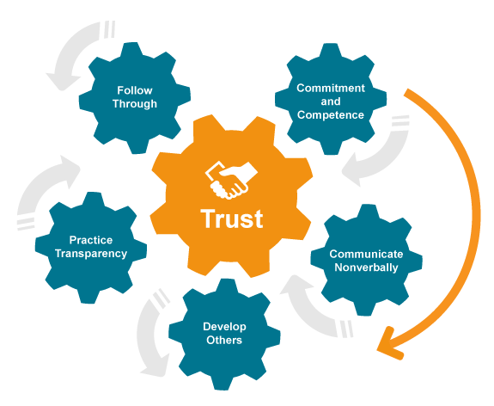

Slide 13
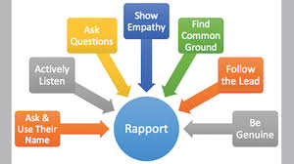
Notes:
Listen and empathy – remember we all have 2 eyes but we all see things differently – if I asked everyone to describe me it would be different with all of you. Empathy v sympathy

Slide 14
Notes:
Stop it at 7 mins 10 secs Why you should be a giver: GIVE & TAKE by Adam Grant

Slide 15
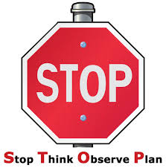
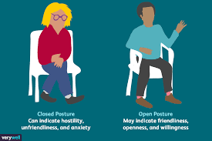
30-day challenge
Identify 5-10 of the most important relationships in your life and then list a number of things you can do to make deposits of trust into the trust bank account you have with them.
Notes:
3 – over the next 30-days look for opportunities to pay sincere compliments, be humble/egoless, show empathy, make and keep a promise, admit a mistake or a random act of kindness
4 –when you meet someone new make a good first impression by being relaxed, smiling, making eye contact and having open body language

Slide 16
Action plan
As a result of todays masterclass what will you:
START DOING
STOP DOING
CONTINUE DOING
Notes:
54321 decide/do

Slide 17
Further opportunities
Personal Resilience facebook group.
Ignite: Find Your Passion, Live Your Purpose & Re-Write Your Future
https://www.facebook.com/groups/216645969611627/?ref=share
Personal resilience online programme;
https://ignitepd.thinkific.com/courses/rock-solid-resilience?fbclid=IwAR1dt6Mw_cw8EqDPPJA3bpynSEVhFxwfMWBZpPKO1IZq04ZvxHHc0ty8KRc
bernard.genge@gmail.com

Slide 18
Further information/watching
https://www.youtube.com/watch?v=mTsvSAItPqA&feature=youtu.be
How You Treat People Is Who You Are! (Kindness Motivational Video) 4 minutes
"No matter how educated, talented, rich or cool you believe you are, how you treat people ultimately tells all. Integrity is everything."
https://www.youtube.com/watch?v=B9xpKY7eWfU
The 3 ways to silence your ego: EGO IS THE ENEMY by Ryan Holiday 8 minutes
https://www.youtube.com/watch?v=sepARXV8MRI
The Simple Truths of Service: Johnny the Bagger
An inspiring video about a grocery store bagger with Down syndrome who changed the company culture and created customer loyalty by providing service from the heart.

