Slide 1
Hello and welcome!

Slide 2
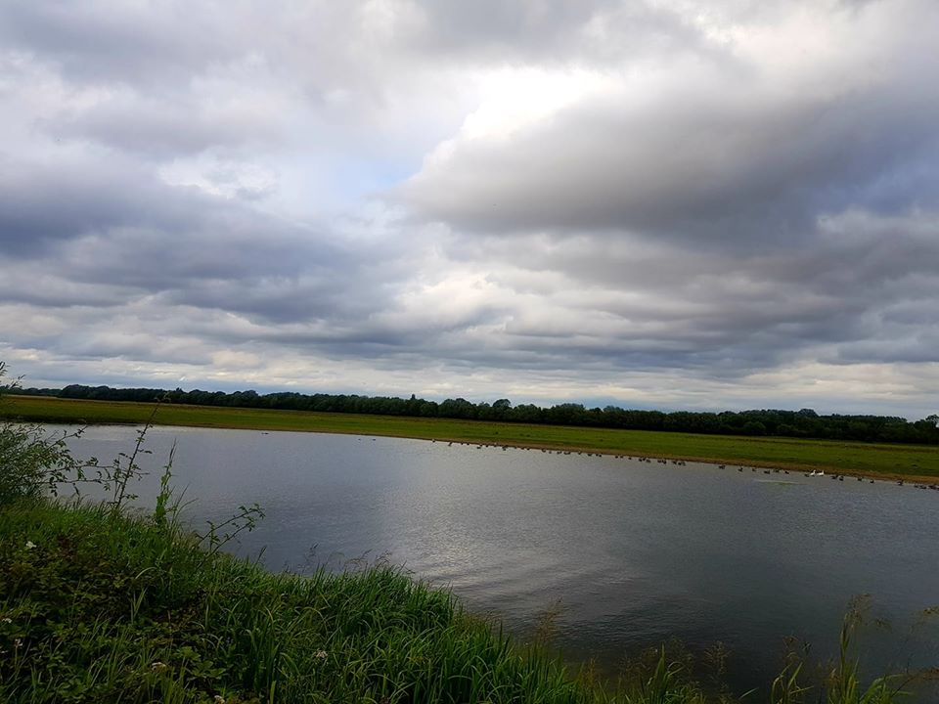
Introduction…
The world can sometimes go by too fast or we’re too absorbed in our own world to notice what’s going on around us.
Taking time each day to stop, breathe, notice, relax, become aware, can be a great gift to feed our senses and our souls….

Slide 3
Noticing nature…
Over the course of the last few months, things have changed greatly for us and one source of strength and inspiration I have gained, during these strange days, has been noticing nature more and the tiny changes in animal and plant life which I may have been too tired or too busy to notice otherwise.
I am noticing… more bird song….
I am noticing… when a new daisy appears on the path by my house
It might be that you’ve heard more bird song because there’s been less traffic, or perhaps you’ve seen flowers in the verges on your way to the corner shop?
What are you noticing?
This course will help us to tune into things around us, notice nature and give it space in our hearts to restore us…

Slide 4
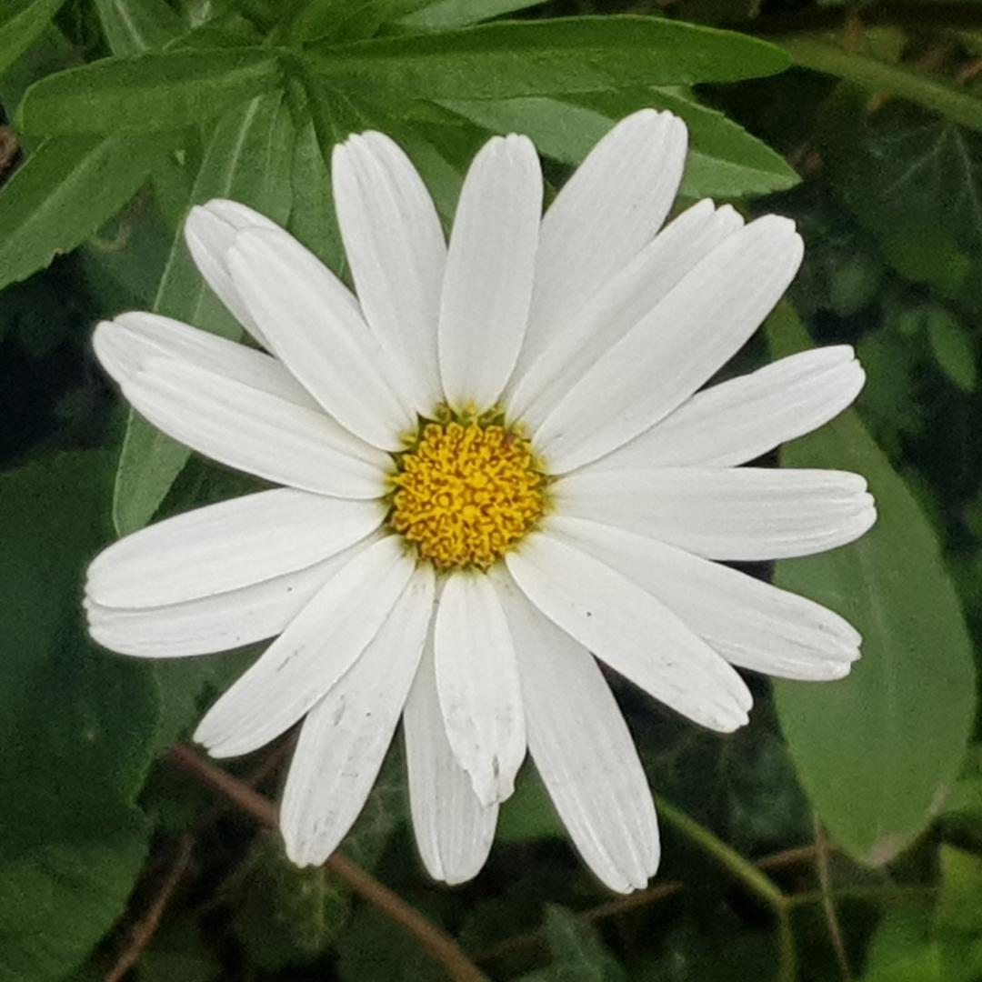
Raising our awareness of the natural world
So what have you noticed lately? Take a moment to make a note in your mind or on a notepad about what you have noticed…
Over the course of the next four sessions together, we will learn how to notice things more keenly, how to gather in the thoughts and sights we see and give them space in our hearts and minds to restore and refresh us..

Slide 5
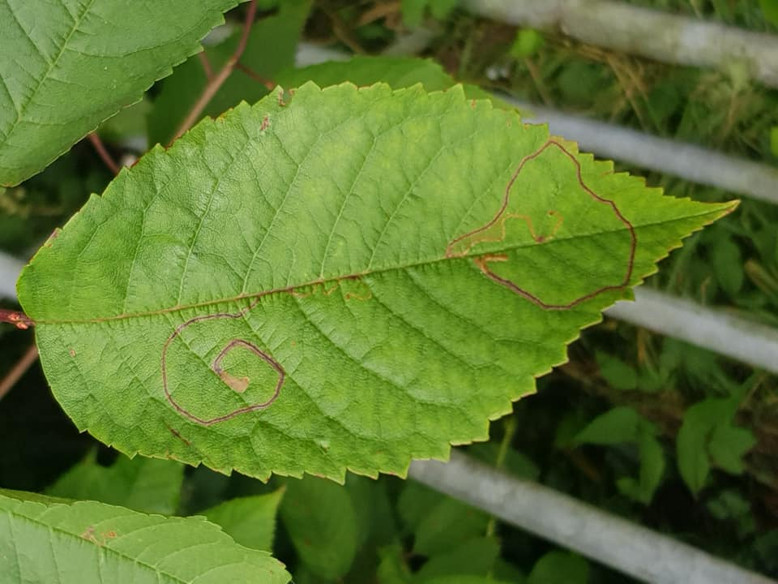
Our course together
This course is to help us to notice nature, to bring to our attention the sights, smells and sounds of the world around us.
Over the next four sessions, we’ll have the opportunity to heighten our senses, to connect with nature and enrich our lives, inspired by our environment.
We’ll be doing this in all sorts of ways – perhaps taking photos, jotting some thoughts down in a journal, tuning in to the scents around us to make a memory, sharing our nature encounters on the course group or gathering something from our walk to treasure, like a pebble or a leaf.

Slide 6
Capturing and sharing
What you write, photograph or recall is yours and yours alone, but if you do wish to share on SWALC Facebook group site, on the Forum of this course or with me as your tutor, please feel free.
Often the things we discover, or things that inspires us, can inspire others too. The course is designed to be done over a period of 3-4 weeks, with time outdoors a couple of times a week, then time reflecting.
If you like you can repeat a session again and see what else comes up for you, or you can move on to the next session’s sheet.

Slide 7
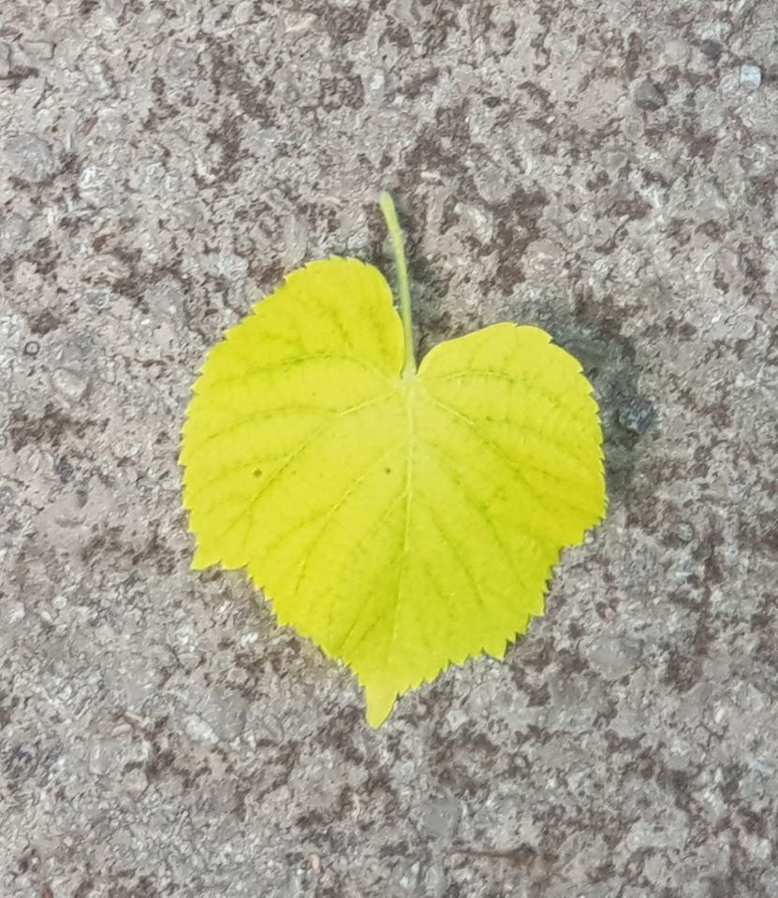
As and when….
You can walk when you like and respond to the time in the day that’s best for your energy levels, your other commitment and the weather patterns….

Slide 8
A little bit about me…
I’m Sara. Hello!
Someone who enjoys the outdoors, although I don’t always have the confidence to go out and about. In recent times, tried to get outdoors in the fresh air more regularly and it has done me so much good. I have found such joy, solace, wonder, comfort and inspiration in noticing the natural world around me and I would like to help others to gain this sense of connection.
I am a learning and skills tutor and have experience of community development work. I like photography, creative writing, wildlife and noticing colour, shape and texture in the world around me. Let’s get out and about together, through the support of this online course, and connect with nature!
Perhaps, if you wish, you can share a bit about yourself on the Forum for this course…

Slide 9
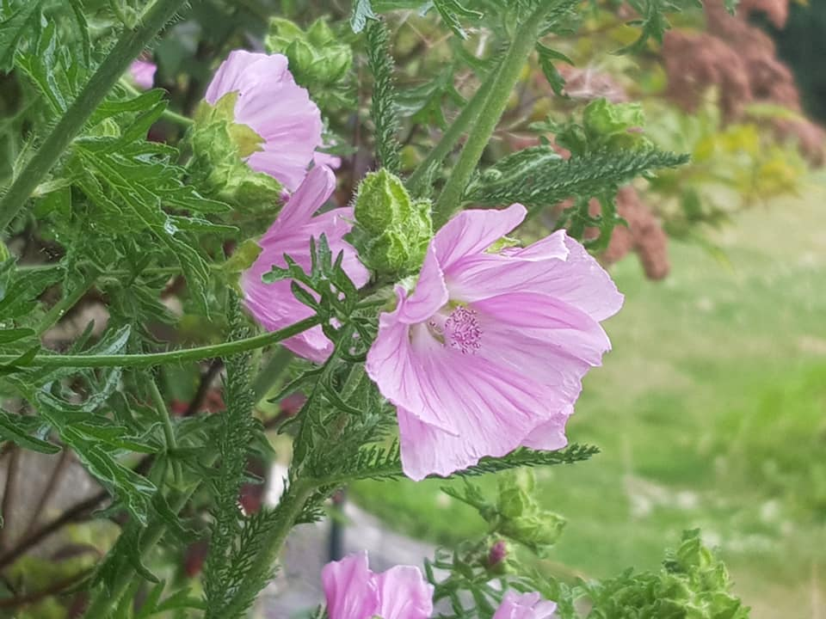
So let’s begin!
This course is all about noticing the natural world around us. It is the form of a guided journal with ideas about what to look out for and thoughts on how we might reflect on what we have seen while out and about and getting a bit creative, inspired by our nature walk.
It’s not about knowing the names of the plants or the types of trees we have spotted, although if you are interested in that, you can always find out more.

Slide 10
Time and place…
The main thing is for us to enjoy being out and about and noticing things we might not usually notice and enjoying the fresh air and the treasures of the season!
You don’t have to be out and about walking for miles or gazing from your window for hours, but it is a good idea to have at least half an hour or more free to take your time, let the scenes around you and the natural world have chance to be noticed and for you to steady yourself and start to observe things with greater intention.
Taking our time can be one of the greatest gifts we give ourselves, just taking time to notice nature. It is in the slowness and calm, that more things let themselves be shown to us…

Slide 11
Let’s begin with Session One
A window on the world / my home patch

