Slide 1
Developing a resilient mindset
With
Bernard Genge
Notes:
For most of this masterclass we will explore the mindset aspect of this title but lets start by clarifying what resilience is.
Often resilience is seen as being really tough and bouncing back easily from traumatic or difficult situations. But what is the true meaning of a resilient mindset? Resilience is the ability to navigate life, adapting to change, learning through adversity and understanding your feelings and emotional responses to situations.
Resilience is an evolving way of being and takes personal understanding and awareness.
Resilient people don’t wallow or dwell on failures – they acknowledge the situation, learn from their mistakes and move on. Resilience doesn’t mean being tough – you can be resilient and still show emotion. The characteristics of resilience refer to your capacity to deal with discomfort and adversity and are traits that enrich your life.
The most important question we can ask ourselves others regarding our resilience is ‘what am I responsible for’. Mental toughness is a lifestyle thoice regarding our thinking and taking control/responsibility for it, we need discomfort to grow.
Dr Bruce Lipton (epigenetics) suggests through his studies your mind and emotions can prevent, cure or cause cancer as only 5 – 10% is down to genetics – a profound statement indeed. Whether that is true or not see your mind/body as an ally and not an enemy.
On this masterclass there is some science at the beginning but practical strategies later on, so you can see the benefits of developing our brains, minds and mindset and then how.

Slide 2
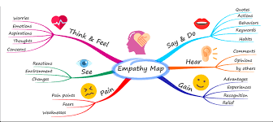
Aims and desired outcomes
Aims – To know how to control your thoughts and mindset so you can develop resilient, confident and empowering beliefs
Outcomes – With practice to automatically ‘think’ like a confident, resilient person to handle the challenges life throws at you.
As we go through this masterclass decide what you will START, STOP & CONTINUE doing
Notes:
On these masterclasses as we all learn in different ways there will be spoken words from me, written words on the ppt, pictures, quotes and for those that are very visual youtube clips to watch afterward. The key to learning however is doing and teaching (we teach what we need to learn) – 54321 DD
Do ask questions – the one who does might feel silly for a few seconds the one who doesn’t appears silly for a lifetime.
Based on latest neuroscience research in particular Dr Jo Dispenza & Brad Nelson and modelling – next slide.
Simplicity is the ultimate in sophistication a really good start is to make the decision to be a wellness warrior and be the healthiest most resilient version of yourself that you can be, because if we treat our body/mind right and it will treat us right – this is part of an overall healthy lifestyle and we will explore this in a moment with a healthy mind platter.

Slide 3
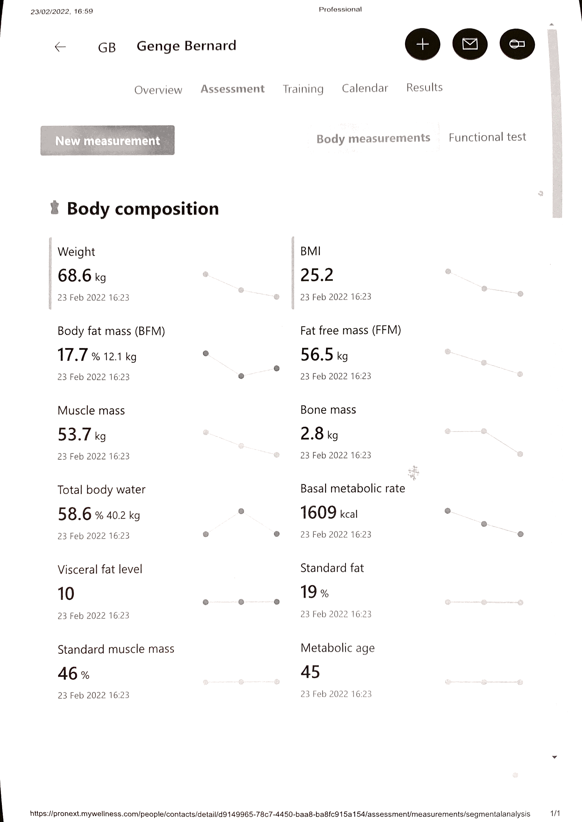
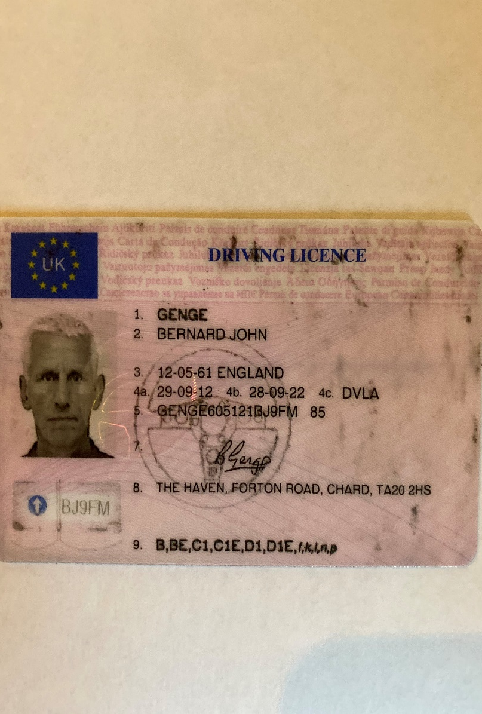
Notes:
It is safe to say that in the West with the chronic illness laden lifestyles that have become vastly cultural that we have peaked as a species, on this workshop we will explore one area where we can take back control.
Teach this to your kids as they are still making up their minds, we have to change ours.
Before we set the scene reflect on this, does your environment control your thinking or does your mind control your environment? To make significant change in life we need to think greater than our environment with a vision and then live as if that vision is reality and neuroscience says this is possible . Later we will listen to a video that talks about the power of our imagination and throughout this we will reflect on vision and visualisation – don’t under-estimate its power.
Its also worth reflecting upon neuroscience tells us the style of our thoughts determine the quality of our minds and in turn our minds and brains are structured by what we do and don’t do and as we will see later what we do is massively impacted by what we think and feel.
When it comes to sustaining health and well-being, the importance of a positive mental attitude - embodying traits such as empathy, compassion, gratitude and understanding - can’t be overestimated. The act of offering forgiveness - as difficult as it may be - is particularly significant. According to Loren Toussaint, PhD, a professor of psychology at Luther College in Decorah, IA, recent research published in Biological Psychiatry has shown that forgiveness is linked to improvements in mental health outcomes, such as reduced anxiety and depression. Interestingly, forgiveness is also associated with fewer physical health problems and lower mortality rates. “Everyone can benefit from being more forgiving,” says Toussaint. Everett Worthington, Ph.D., a professor of psychology at Virginia Commonwealth University, agrees, adding that “forgiveness is not a sign of weakness.” Worthington also points out that offering empathy and understanding to those who may have hurt you doesn’t necessarily mean “letting someone off the hook.” Rather, it offers a place for healing that can ultimately benefit the victim.

Slide 4
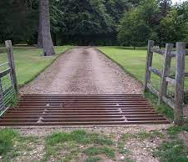
Notes:
Start this without the pictures.
Our minds can be conditioned by our environment, others, the media, what we hear, watch and see and this conditioning can be powerful. One study I read by WHO (World Health Organisation) suggested more people die of suicide (one every 40 seconds in the world) now that are killed in wars, criminal activity and terrorism combined, but what makes the headlines?? Our minds are part of the army inside our bodies, that just like any army the better trained it is the more effective it is.
Lets explore an example. In some national parks around the world they need to keep cattle in or out so in the past they had gates, this meant drivers had to stop, open the gate drive through stop the car and close the gate, but drivers got lazy and didn’t bother closing the gate so they would put in cattle grids that cattle would not go through because they would break their legs but the problem with these (put up image 1) is that they are expensive. But because the cattle have been conditioned that these grids should be avoided the authorities have used painted lines like this (image 2) which is cheaper but just as effective as the cattle stay away. The good news is unlike cattle we have self-awareness, so we can ask ourselves how our mind has been conditioned and then we can re-condition (like we can re-condition a car) in a way we want to move away from self-limiting beliefs. You can experience anxiety, sadness etc. but do not label yourself as anxious, sad or depressed.
We need to practice self-awareness and observation – ask delegates just for a moment to relax and look at the wall and observe the wall and recognise you are the observer and then do it with a few objects in the room, then yourself and do this regularly as it refines your ability to observe, so you can observe your behaviour without giving yourself a label. Even positive labels can hold you back, telling yourself ‘I am smart’ might hold you back from doing something because ‘smart’ people would not do that – we need to see ourself as action orientated beings – as a smart person I ask questions and take action rather than ‘I am smart’. However, by using our self-awareness we can identify areas in our life that are opportunities to improve and can use positive self talk to aid that and we will explore that in a while. With the pictures here, what about if the landscape changes and we need to move the cattle grids, the one on the top is fixed so this is going to be difficult, whereas the one on the bottom is much more easily moveable. With our mindset we need to evolve from a fixed to a moveable or even growth mindset – next slide.

Slide 5
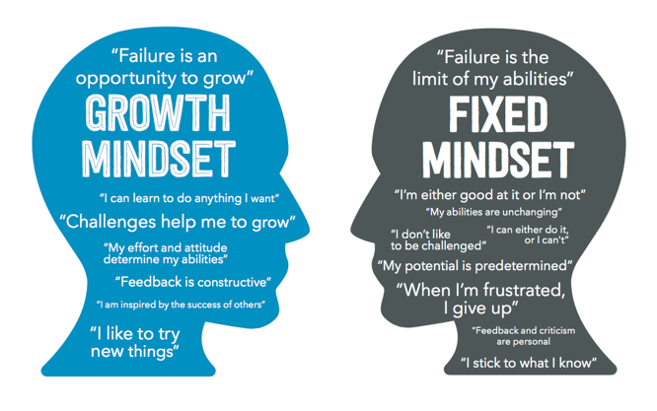
Set scene
Notes:
80% of the 60,000 thoughts you have every day are negative, and 95% of those negative thoughts are recurring, according to the National Science Foundation.
Although most people actually have a positive outlook in their CONSCIOUS brain, 70% of the information in their UNCONSCIOUS mind is negative, and it directs the lion's share of actions, habits, and behaviours! Negative thoughts are like survival genes as they turn on when something bad happens and they recur to protect us, but do they or does the law of attraction make more of that happen?
Insecure thoughts lead to a feeling of insecurity which leads to more other insecure thoughts/feeling and we tell ourselves ‘I am insecure’ – that label we just spoke about. Our thoughts are the language of the brain - past focused – we can change that by starting to change our thoughts which will change our biochemistry, feelings, mood/attitude, what you do and inevitably our results – this is exciting!
New thoughts = new choices/decisions = new behaviours = new experiences = new feelings = new state of being = new outcome! Make the decision now to not be addicted to negative feelings/thoughts – this addiction is borne out in research.
With a resilient/success/growth mindset you will always seem to figure out how to make things happen, despite seemingly impossible odds, you will no longer be a survivor but a thriver.
So many thoughts we have are not ours, they are others and from conditioning from our environment/culture – develop awareness and take control of yours, don’t hold on to others that are unnecessary.
We hear health professionals (and others) talk about the relationship between mind and body but the body really does respond to what is happening in the mind and there is more and more evidence coming though regarding this, its one of the keys to preventing and even treating (think placebo) chronic illness. Your body and mind together are a wellness making machine which is so much better than choosing by default an illness making machine.
Our minds control everything but it doesn’t come with an owners manual – this is the start of the creation of your owners manual.
Every thought/emotion changes our brain – we choose how to change our brain by choosing our thoughts emotions, key word in choice.
The genes in our brain are dependent upon what we feed them including the thoughts we feed them of course. We really are the architects of our own brains. After saying that research on baboons found those that were at the bottom of the hierarchy suffered more stress/depression than those in the middle and this plays out in vastly uneven societies like ours and the USA, as inequality grow so does depression. Norway is more equal = less depression, so its about power imbalances not chemical ones. Take control of what you let into your mind from society, the media etc.
We are dictated to by our own thoughts, but we are free to control them and change them. We now need to evolve and upgrade from being smart monkeys to conscious wise beings. Its not possible external events that are the biggest threat to your own happiness and wellbeing its your own thoughts and those thoughts will determine to a large part the destiny of your life and collective thoughts of us as a species will determine our ultimate outcome as a species –profound thoughts.
On the next slide we will explore what we can do to create a healthy mind, but what are the benefits?
The main benefit is responding rather than reacting to stressful events and preventing chronic stress but also:
Reduction in anxiety.
Improved moods.
Clearer thinking.
A greater sense of calm or inner peace.
Increased self-esteem.
Reduced risk of depression.
Improvements in relationships.
Ask everyone if they would like to have a great day tomorrow? A growth mindset believes that is a decision/choice. Don’t put it down to circumstance, don’t out-source your happiness or even unhappiness as they are a state of mind so we need to source our happiness from within.
We would not watch a crap film over and over again so it doesn’t make any sense to tolerate crap thoughts.

Slide 6
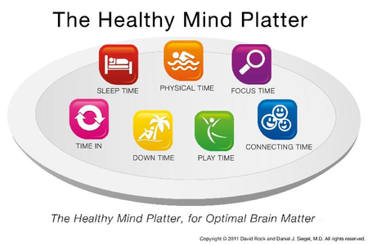
Notes:
If anyone would like the research behand what I share here please e-mail me. In the further resources slide at the end is one example, a study - Do Ultra-Processed Foods Cause Cognitive Decline? - Emeran Mayer, MD. “The researchers found decreased performance in a cognitive exam testing for language and executive function in individuals with higher ultra-processed food consumption.” I also have an article I can e-mail ‘How a processed food diet impacts our brain and cognitive ability’.
It might be surprising on a mindset workshop to talk about healthy lifestyle habits but a healthy mind is part of a healthy lifestyle. But why would we give such attention to a healthy mind/brain? Well the brain is the only organ in the body that is capable of continuing to develop – if nurtured. You are not stuck with the brain and mind you’ve got. According to the WHO brain/mind disorders are 25% of the burden of disease and 75% of us will suffer from a brain/mind disorder in our lives.
The field of cognitive neuroscience is relatively new—only around 100 years old—so it’s no surprise we are still honing our understanding of how the brain works. For the better part of a century, it was said that the brain could not regenerate itself once damaged which created a false belief that the brain is essentially in a perpetual state of decline.
The reality of brain cell regeneration has been firmly established by thousands of scientific studies over the past 25 years. The idea that the adult brain is capable of growing new neurons and cells is now widely accepted. Today, we view the brain as resilient and pliable—in other words, plastic. The term neuroplasticity refers to the ability of the brain to “rewire” itself in response to learning a new skill, changes in the environment, or after an injury and it really does style who we become. Neurogenesis is the process by which new neurons are formed in the brain. Adult neurogenesis is now accepted to be a normal process that occurs in the healthy brain, but a healthy brain doesn’t happen by accident. We’ve gone through three revolutions with brain health 1 – around 140 years ago psychological (previous to that we constrained and punished people) then 2 chemical about 70 years ago with the introduction of anti-depressants which are now widely used but at the same time depression has increased massively and now classed as the most disabling illness in the world 3 the neuroscience, neuro-modulation and now neuroplasticity.
With the proper mindset and intention, along with the proper nourishment, sleep and stimulation, the brain can heal, grow, and adapt at any stage of life, but start now.
Looking at the platter here.
Sleep/Physical time - When you hear the phrase “train your brain,” you probably don’t think of lifting weights. However, it turns out that physical exercise is one of the best things you can do for both your body and brain. The brain benefits of exercise are two-fold. First, your brain is a huge consumer of glucose and oxygen with no ability to store excess energy for later use. A continual supply of these are needed in order to maintain optimal functioning. Physical exercise increases cerebral blood flow and boosts the delivery of fresh oxygen and glucose to hungry brain cells. A 2014 study revealed that just 30 minutes of moderate cardio is enough to boost cognitive function at any age. Aerobic activities such as running, cycling, swimming, and even strength and conditioning, are effective ways of boosting neurogenesis. The aim is getting the heart pumping for more than 20 minutes at a time, and on a regular basis. In this state levels of several growth hormones are elevated in the brain.
Why the Brain is Built for Movement | Anders Hansen | TEDxUmeå – in further resources at the end. He shares compelling evidence regarding how aerobic exercise influences our brain in a massive way including better fitness = higher IQ – the brain is built for movement.
In March 2021 a study found that for every 1 hour of sleep you have the odds of becoming infected by covid decreases by 12%. Sleep deprivation starts after just one night of bad sleep and affects every organ in your body as well as lowering your immune system, impacts decision making, creativity, ageing, mood, weight and libido and a risk factor for Alzheimers, cancer, heart attack, stroke, diabetes, depression, anxiety and obesity. Many of us pay more attention to our phone clocks than our body clocks. Sleep is when the brain flushes toxic metabolites (caused by information overload, all the decisions you’ve had to make during the day etc.). When in deep sleep the body produces white blood cells that fight disease. It is also a natural lowering of blood pressure.
Matt Walker (one link in further resources) found in Spring when we have an hour less sleep there is an over 20% increase in heart attacks and in Autumn when we have an hour more and 20% decrease). Shorter your sleep the shorter your life. Practice good sleep hygiene it really is important:
Get into a regular sleep routine, wind down and try meditation
Get devises out of the bedroom and your life 1 hour before sleep and if you use a phone as an alarm make sure its 6ft away
Complete darkness in the bedroom and get the temperature right – 20 degrees and keep noise down
Optimise your sleep time, don’t stay up later than you should – we should sleep soon after sunset and rise at sunrise, but of course this is not always possible. An interesting study with some volunteers who lived in a tent for a week within a couple of days they started falling asleep at sunset and getting up at sunrise.
Don’t eat late at night and no caffeine in the evening
Fight after food drowsiness and reduce day time napping or be smart with it (15 – 20 mins)
Comfy bed and make your bed and bedroom your sleeping sanctuary and with relaxing colours
Exercise during the day – morning cardio as it gets cortisol moving
The last thing you think about at night is the first thing you think about next morning so reflect on the best thing that happened today, in your life or reflect upon a good deed you’ve done or will do or positive emotion – you’ll wake up with more energy, transformed mood and change how you see the world.
Whatever you do find a way of getting in tune with your circadian rhythm.
We know from studies Physical activities reduces dementia risk by 17 percent.
Focus time - A growing body of literature shows that retaining a sharp, lucid brain means never retiring our critical thinking skills. The largest study to date examining the benefits of cognitive training in older adults was completed in 2014. The study involved nearly 3,000 volunteers and spanned more than a decade.13 Participants demonstrated improved brain processing speed and reasoning skills for up to ten years after the completion of the cognitive training program. Tangible brain benefits spilled over into their daily lives, improving their performance on normal daily tasks such as personal finances, meal preparation, and personal care routines. Studies tell us that mental activities – like reading, writing, watching stimulating TV, playing games, and making crafts reduces dementia risk by 23 percent. It is important however to focus on what you want in life not what you don’t want (compelling vision) – racing car drivers are taught this if they are careering towards a wall the temptation is to focus on the wall, and inevitably they will crash, if however they focus on what they want (to get out of the skid and get around the corner) that is what often happens.
The takeaway is, never stop learning and challenging your mind. Retirement is a risk factor, especially retirement from learning, the older you get, become more avid with learning and challenging your mind.
Connecting time – We are not talking about connecting online – did you know there is now a term called ‘Facebook addiction disorder’ The more we use social media, the more socially isolated we feel which leads us to use social media more.
Age UK report - Research suggests that having close ties to friends and family, and participating in meaningful social activities, may help people maintain their thinking skills better in later life and slow down cognitive decline. People who are socially engaged have at least a 7% reduced risk of dementia.
Play time, down time and time in (reflection) – Our minds in our modern lifestyles are over-stimulated. Include stress management as stress is one of the key players in age-related cognitive decline.
Good lifestyle choices only have side benefits and no side effects. In countries (Finland) where they take a holistic approach to mental health issues rather than just a prescription have a considerably higher success rates. Change the mindset of a pill for every ill and focus on skills not pills.
Leaky gut = leaky brain = degenerative disease so eat a healthy diet with foods from the rainbow and the widest range of fruit & veg (anti-oxidant food) you can get –deep breaths before eating = rest & digest. One study suggested that this diet = 50% less chance of dementia.
Eat poorly you have a 70 – 90% increased chance of depression, eat a good healthy diet and this reduces by 40%. Stay very well hydrated as water transports the good nutrition from your diet to your brain. Sugary foods accelerate memory loss.
Thinks SLEDS to prevent dementia – SLEEP, LEARN, EXERCISE, DIET, STRESS.
Whilst talking about dementia/Alzheimer’s a lot of research suggests vitamin K could have profound effects in preventing the disease, consider supplementation but also spinach, kale, broccoli, asparagus, onions and sauerkraut. Another research study revealed in the UK population, we observed that up to 17 percent of dementia cases might have been avoided by boosting vitamin D levels to be within a normal range.“
The study is timely since dementia cases are projected to reach 153 million by 2050.
Vitamin D works to fight brain disorders because it fights inflammation, boosts specific genes, and helps parts of the brain communicate with each other – all key factors in the fight against dementia. Get sunshine and in the winter months consider a supplement.
Whilst having time in rather than accepting the negativity of ‘mainstream media’ seek out intellectually challenging material and humour as it impacts our physical and mental health and scientists have shown that positive humor can offer protection against symptoms of anxiety and depression. It can even be a balm against the psychological toll of death and dying.
Design your own dementia prevention programme and live it, don’t blame it on genetics, its habits and habits can change gene expression. Know the truth about health and wellbeing and the truth will set you free – unfortunately its not on mainstream. All success starts in your mind as your mind makes the decisions about everything else – treasure it and don’t let its history be your destiny.
Talk about retraining the brain through PDCA, and Kolb (this is really good for your action plan at the end of this session) – 1 completing a concrete experience by doing an activity (spot the dots or changing to a nutritarian diet for example), (2) reflecting and observing the experience, (3) forming abstract concepts by thinking about the experience, and (4) using the experience for planning future tasks.
Whilst talking about a healthy mind on yourtube (link in further resources)a 1hr 2 mins video titled ‘How to recover from depression’ by Dr Michael Yapko is well worth seeing https://www.youtube.com/watch?v=TVgQ_tgWMyU
If anyone experiences regular nightmares then at the end we could come back to this slide and look at a study regarding the relationship between nightmares and dementia based on research.
We all have bad dreams from time to time. But, in a first of its kind study, researchers from the University of Birmingham discovered that experiencing frequent nightmares in middle age can be a sign that cognitive decline and dementia are on the horizon.
The recent study included over 600 participants between the ages of 35 and 64 and another 2,600 adults 79 or older. All participants were dementia-free at the beginning of the study.
Scientists collected data on the younger group for an average of nine years and the older group for five years. During this time, participants responded to questionnaires that tracked the frequency of their bad dreams.
Ultimately, the researchers analyzed all the study data using statistical software, looking for a connection between frequent nightmares and the later development of cognitive decline and dementia.
And boy, did they find one!
Nightmares DOUBLED Dementia Risk
The results show that middle-aged folks (between the ages of 35 to 64) who experience weekly nightmares are FOUR times more likely to experience cognitive decline over the following decade.
For seniors, weekly nightmares DOUBLED their chance of receiving a dementia diagnosis.¹
“We’ve demonstrated for the first time that distressing dreams, or nightmares, can be linked to dementia risk and cognitive decline among healthy adults in the general population,” says Dr. Abidemi Otaiku, of the University of Birmingham’s Centre for Human Brain Health.
“This is important because there are very few risk indicators for dementia that can be identified as early as middle age. While more work needs to be done to confirm these links, we believe bad dreams could be a useful way to identify individuals at high risk of developing dementia and put in place strategies to slow down the onset of disease.”²
Men Are At Higher Risk
Interestingly, the results showed that this connection between nightmares and cognitive decline is more prevalent in men.
For instance, senior men having nightmares every week were at five times greater risk of dementia than older men reporting no bad dreams. Although, at this time, it is unclear why bad dreams put men in greater danger of memory loss.
Because of their strong results, the research team would like to explore the long-term impacts of nightmares on different age groups – including younger people. Additionally, they want to index the impact of vividness and recollection when it comes to dementia outcomes.
Clearly, there’s a lot more research to be done in this area.
Its also worth exploring recent science about microglia in the brain and the impact of the nutrient luteolin for long-term brain health – luteolin is sold as a formula but is also in foods like parsley, artichoke, celery, basil, cabbage, cauliflower, broccoli, onions, rosemary, grapes, green beans and Mexican oregano – Dr Shallenberger has done work in this area.

Slide 7
https://www.youtube.com/watch?v=1EQ3kAPzVVI
Neuroplasticity explained 2 mins 20

Slide 8
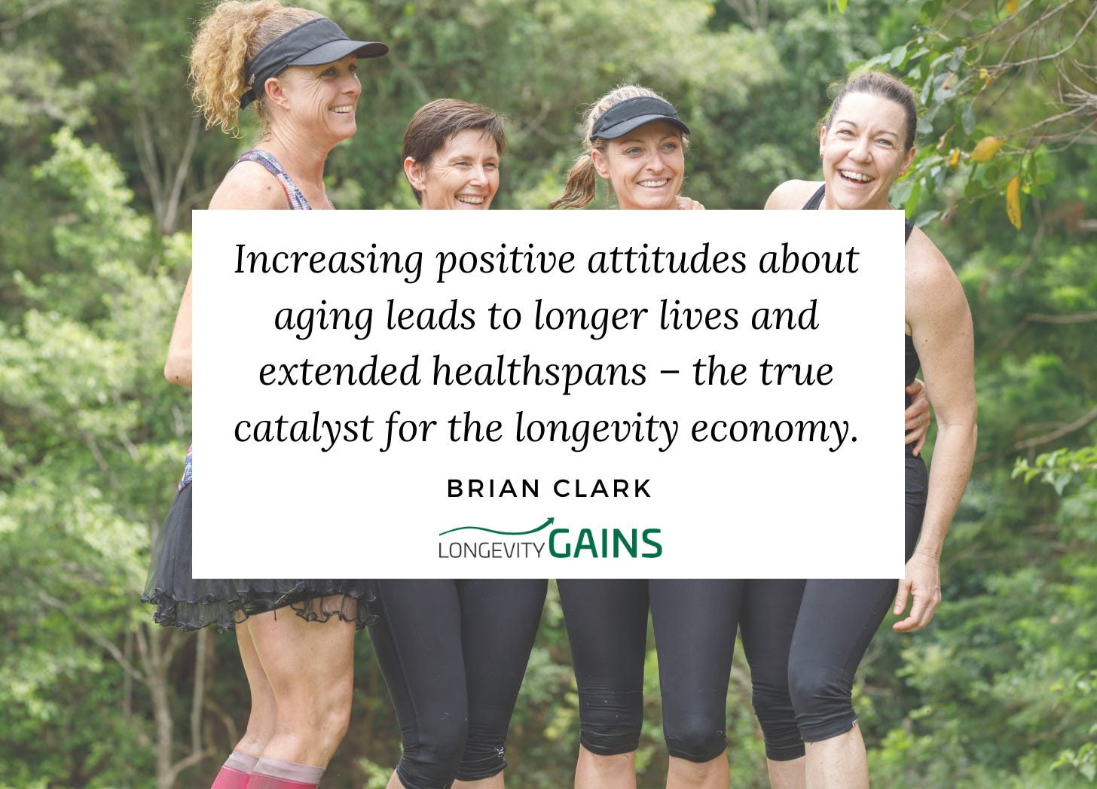
Notes:
For some people the thought of getting older fills them with a sense of dread. They’re worried about experiencing illness or loneliness. While others welcome the end of their working life and celebrate the newfound freedom to engage in hobbies, travel, and new adventures.
The attitude you have about aging and the approach you choose is important.
The latest research shows your attitude toward aging has a profound influence on the health of your brain and the clarity of your memory. In fact, if you already have memory problems, seeing aging in a positive light will increase your chance of making a full recovery.
In a scientific first, a new study provides evidence that positive beliefs surrounding aging contribute to recovery from mild cognitive impairment (MCI).
Attitude Trumps Blood Pressure, Smoking
The study was led by Professor Becca Levy of Yale University, whose longstanding work in this field has been featured in the publication Aging Defeated. In that article she was quoted as saying: “Positive age beliefs are better for you than low blood pressure or even giving up smoking.
“In study after study I conducted, I found that older people with more positive perceptions of aging perform better physically and cognitively than those with more negative perceptions of aging. They are more likely to recover from severe disability, they remember better, they walk faster, and they live longer.”
Her latest study reinforces these earlier findings.
The study included 1,716 men and women aged 65 or older who were either cognitively healthy or had Mild Cognitive Impairment.
Dr. Levy’s team asked them questions regarding their aging beliefs, such as whether they disagree with the phrase, “The older I get, the more useless I feel.”
Other questions included whether things get worse as you get older and whether you’re as happy now as you were when you were younger. The researchers categorized them based on their answers as having either positive or negative age beliefs.
Next, researchers tracked them every two years from 2008 to 2020 during which time they performed cognitive tests.
After taking multiple factors into account that affect the health of the brain, the results showed that participants with MCI at the start of the study were significantly more likely to experience cognitive recovery if they had positive age beliefs at that time.
The positive age-belief group had a 30.2 percent greater likelihood of making a full recovery back to normal cognition than the negative age-belief group. What’s more, this recovery advantage persisted regardless of the degree of MCI severity. Participants with positive age beliefs also had a faster transition from MCI to normal cognition.
In addition, among participants with normal cognition when the study began, those with positive age beliefs were significantly less likely to develop MCI over the following 12 years compared to those with negative age beliefs.
Pessimists Can Change
Commenting on the findings, Dr. Levy said: “Most people assume there is no recovery from MCI, but in fact half of those who have it do recover. Little is known about why some recover while others don’t. That’s why we looked at positive age beliefs, to see if they would help provide an answer.
“I think the hopeful message of this study is that those who had taken in more positive age beliefs from their society were significantly more likely to show cognitive recovery. This suggests that efforts to reduce ageism on a societal level and to promote positive age beliefs on a societal and individual level could have cognitive benefits.”
Although the mechanism behind the effect wasn’t addressed in the study, previous research suggests positive age beliefs reduce stress caused by cognitive challenges, increase self-confidence about cognition, and improve cognitive performance.
Dr. Levy’s earlier work shows that age beliefs can be modified. So, if you find yourself in the negative category, all is not lost. For help, she authored a book called Breaking The Age Code: How Your Beliefs About Aging Determine How Long And Well You Live, which was published in 2022.

Slide 9
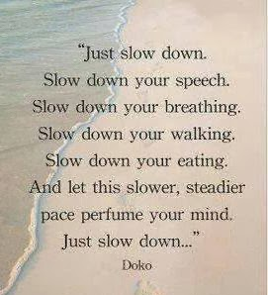
Notes:
We know that the rev counter on our car counts revolutions per minute, but what about if we had a mental tachometer/counter that instead of measuring RPM measure TPM (thoughts per minute), perhaps the scale would look like this: 0 – 50 TPM – Our deepest wisdom, relaxing thoughts, spontaneous insights
50 – 100 TPM – good functioning, doing day-to-day stuff
100 – 200 TPM – muddled thinking, beginning to overload, mild stress
200 – 300 TPM – beginning to meltdown, chronic stress, emotional outbursts
Over 300 TPM – burnout, illness, disease breakdown.
Our thoughts make a great servant but a terrible master. Meditating with a quiet mind is regarded by some as our natural state and a very beautiful and peaceful place to be and there really is nothing we can do to quieten the mind faster than doing nothing to quieten the mind and perhaps the less we have on our minds the better our lives will get.
It is worth slowing down and been more aware of our thoughts, just for a moment imagine if what Buddhists believe is true – that our thought vibrations communicate to the wider world so others pick up on our negative thoughts and can be a source of karma (our thoughts are our karma) as it can impact their behaviour towards us.
On a video in further resources called, ‘this is how your thoughts affect your karma’ it talks about how negative thoughts to others come back to us as retribution

Slide 10
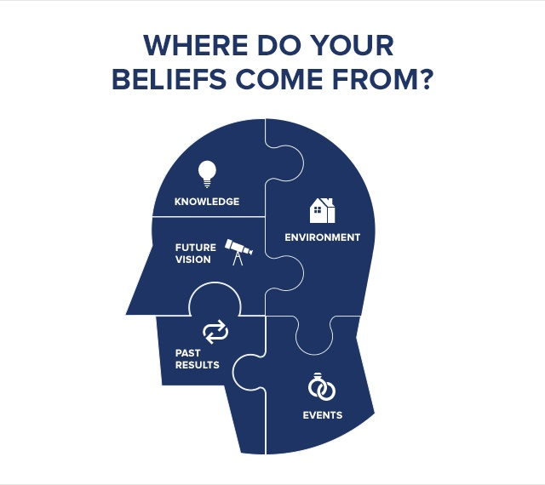
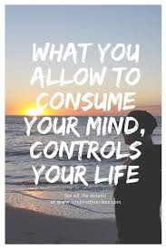
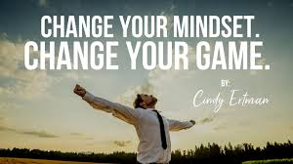
Notes:
1 – visualize the beliefs you want (future vision) your imagination is such a powerful tool in your resilience toolkit. A big influence of our mindset/beliefs is from what we bring into our minds so take control of what you hear/watch – from others, TV, radio. If anyone has seen ‘The Secret’ some great minds of the present age argue that the Law of Attraction is almost as powerful as the law of gravity – when linked to SMARTER goals I believe that to be true.
2 - One study of 3 year old kids found more of them recognized the McDonald M than knew their own name – advertising and junk ’external’ rather than internal values. Also never underestimate the impact of the media on our mindset and indeed anxiety and fatigue, by using the media too much we go from a feeling we are uninformed to BEING misinformed.
Most of our core beliefs come from childhood so ask yourself now ‘were my childhood beliefs nurturing or disabling? We can absolutely change any conditioning from our past.
When we change our thoughts (from negative to positive) we change the neuropathways in our brain in a good way (and increase them for example when we learn something new our neuro-connections go from 130,00 to around 260,000) and when we sustain those new positive thoughts those new pathways remain = healthier brain = less chance of a neuro-degenerative disease. Think Kolb that we mentioned earlier.
4 - Meditation – which is a great way to create these positive neuro-pathways and way of accessing our deepest and highest consciousness, it is the science of intuition. With practice meditation can help you observe the mind and divert destructive thoughts into constructive thoughts because you’ll be able to identify thought patterns, see where they will lead and then choose another direction for those thoughts if you need to, this will lead to be able to identify which thoughts will lead to different emotional states which in turn will help you proactively choose the emotional state you want. The key is that through meditation you create a safe, stable, space and silence – you are what you consume in your mind – just like junk food leads to obesity junk data leads to junk minds. How well do you understand your mind – the reality is for most of us, not very well?
Belief is everything, if you believe our food can kill or heal and food is our natural medicine you’ll eat a healthy diet.

Slide 11
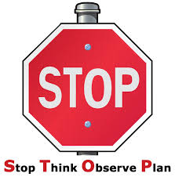
Empowering and disempowering thoughts/beliefs
DISEMPOWERING THOUGHTS | EMPOWERING THOUGHTS
Notes:
Do this before the first image
Negative thoughts lead to negative theories which lead to negative actions & outcomes – I think ‘if I stick to this healthy lifestyle my life will be boring’ = give up on that healthy lifestyle = illness/disease. Its vitally important to create positive thoughts and theories. It is however always good to keep an open and curious mind so you develop a realistically optimistic approach to life. We can train our minds. If your dog was chewing your computer cable you would train the dog to chew on what you wanted it to chew on and this is what we need to do with ourselves.
1 - Disempowering - frustrated, disappointed, angry, guilty, regretful, overwhelmed etc.
2 - Now STOP– So instead of frustrated you could choose satisfaction, instead of disappointment could be delighted/excited, instead of anger happiness instead of regret choose contentment.
When doing STOP remember when we experience negative thoughts, over-worry, are stressed or anxious we need to focus on changing the thoughts, changing how we feel but also think about your body language – when stressed, anxious, worrying we slump and contract which creates incoherence, so stand proud, upright, and practice open confident assertive body language.
STOP helps our body and mind work in tandem as just trying to think positively is not enough because this thinking is 5% which is the conscious mind trying to beat 95% which is feeling which is the subconscious mind, but when you can think and feel positivity you are on the rollercoaster of success.

Slide 12
THINKING LIKE A RESILIENT PERSON
Success
Skill. How to
Do it
Attitude. Want to
do it
Knowledge.
What to do
Belief
Our success is determined by ……..
Visualisation
Positive self-talk
What we do, which in turn is determined by …..
Our thoughts/mindset, but how do we shape them?
Our attitude, but what moulds our attitude?
Notes:
To make profound change, do the visualisation and positive self-talk but change your behaviour/do at he same time because changing what you do delivers different results which facilitates a change of mindset.
Doctor story. Listen to how you talk to yourself you are listening – if you say you can’t/won’t you are absolutely right – if you say you can, you stretch that comfort zone and who knows the result – this is exciting! Kids in a tree.
Stinking thinking really isn’t good for you.
90% of todays thoughts are the same as yesterday and neuroscience tells is 50% of thoughts from the past are not true – we stay attached to them because its comfortable whereas change, any change is uncomfortable. Within 4 days releases 50% more healing chemicals into your body and within 60 days it starts lengthening your life. Change your thoughts – change your personality – change your personal reality.
The mistake too many people make is they try to change their behaviour without changing their thoughts – change thoughts and behaviours visualise it and even write it down as a +ve affirmation in the present tense so your mind accepts it as reality
A lady was diagnosed with cancer and given 6 months to live and died 6 months later, then the doctors realised they had muddled up the records and there was nothing wrong with this lady but she ‘believed’ – there are numerous stories of the opposite

Slide 13
Positive self-talk affirmations – choose at least 5
I choose to be in a good mood
I choose to have a positive attitude
I forgive myself for not being perfect
I make the best of every situation
I have control over my thoughts and feelings
I treat others with respect
I practice patience and understanding with others and myself
I choose to smile and enjoy life to the fullest
I eat well, exercise, and get plenty of rest to help balance my life
I have huge inner strength
I am resourceful and resilient
My life is full of unlimited possibilities
I learn from every situation in life and grow stronger as a result
I choose a vital and authentic life
I immediately bounce back from any set-backs in life
Notes:
13
13
Choose 5 and use them for the next 7 days then review how you feel

Slide 14
Positive self-talk affirmations – choose at least 5
I am extremely proud of all that I have achieved, and I am determined to fulfil my dreams, hopes and desires.
I choose to live my life positively, and reject all negative thoughts, self-judgement and criticism.
I deserve the best that life can provide and I will fulfil my dreams
I reject all that is negative and damaging in my life, and embrace all that is positive, kind and strength building
I choose to be strong, positive and resilient today, and reject all that is destructive and self-harming.
I will fulfil my dreams, hopes and desires, and eradicate all self-doubt, fear and criticism.
No matter how difficult or challenging today may become, I will always remain calm, positive and in control at all times.
I am strong against negative life circumstances
I can face anything that confronts me
I face life head-on
I have willpower
Notes:
14
14

Slide 15
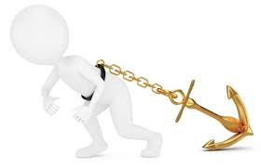
Positive self-talk affirmations – choose at least 5
I am in control of my life
I use my inner strength in necessary situations
I have insurmountable amounts of inner strength
I practice building my personal resilience continually
I am naturally strong
I stand up to anything
I am bold and brave
I have full confidence in myself
I am resilient and strong
I believe in myself
At the end of each day record three positive/good things that have happened during the day. At the end of each week/month review the list to get a sense of all the good things.
Try issuing a ‘STOP’ command when you experience a negative thought or use a ‘cue’ such as an elastic band
Notes:
15
15
With the 5 statements delegates have chosen choose one of them and for the next minute focus on it, visualize it, feel it – get rid of any distractions for the next minute then anchor those thoughts using all your senses, see, hear, feel, smell & taste. Anchoring guide in my fb page
As we’ve already discussed meditation is another very effective way to control thoughts and bring more positive ones into our lives Also consider when you do your positive emotions do some EFT/tapping to lodge it – EFT demo in the fb page
What about if we have believed in the past and it didn’t work – the first question we should ask is how do we know it didn’t work? Maybe we should have given it more time? This old story from India helps us relate to this.
The farmer only has one horse to plough the field and it runs away and the neighbours say that’s terrible, and he says maybe. The next day he comes back with two horses and the neighbours say that is great and the farmer says maybe, then one of the horses breaks his son’s leg and they say oh that’s horrible and he says maybe, the next day the army turn up to take all the young men to war but they can’t take his injured son and the neighbours say, you are so lucky and the story goes on as does our life
Break reflect on then come back and discuss in breakout groups:
1 – how easy/difficult it is to take control of our thoughts when we have so much information/marketing etc thrown at us.
2 – Anchoring positive thoughts through affirmation, visualization and using your senses
3- Using meditation to generate more empowering thoughts. Get a piece of string for the end and a piece of paper with a cross on it.
Just before you go to bed at night reflect on and write down the three best things that happened today and what you did to make them happen (studies show that people who do this for 4 days feel more positive and after 14 days experience less stress, burnout and depression, less conflict and better relationships – a great investment of two minutes a day.
The next slide we will see why this is so important

Slide 16
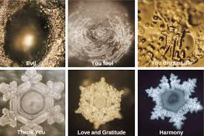
Notes:
(On the bottom of this is the Japanese guy who found this)
These are images of how water cystalises differently depending on what it is exposed to, we human beings are 70% water so what impact does positive words and images have on us?? Talk about the power of words
As we’ve already discussed take control of what you read, watch & listen to especially in the mornings – people who watch 3 mins of negative news in the morning are 27% more likely to rate their day as negative. Also research has shown that being stressed in the morning about the day ahead has a very negative impact on cognition, memory and of course things like decision making.
During the pandemic rather than building our resilience/wellbeing our society and especially the media gave us fear which depletes our immune system – how many lives we lost needlessly? What would the impact have been if we were constantly fed information about how to build our immune systems, resilience, sense of control to name but a few?
On the next slide is a 5 minute demonstration of another method for rewiring the brain towards something we really want. This comes with a health warning as when I do the eye movement it makes me look a bit weird but I promise you I’m not a weirdo!!
Masaru Emoto (江本 勝, Emoto Masaru, July 22, 1943 – October 17, 2014)[ was a Japanese businessman, author and pseudoscientist who claimed that human consciousness could affect the molecular structure of water. His 2004 book The Hidden Messages in Water was a New York Times best seller. His conjecture evolved over the years, and his early work revolved around pseudoscientific hypotheses that water could react to positive thoughts and words and that polluted water could be cleaned through prayer and positive visualization.
From 1999, Emoto published several volumes of a work entitled Messages from Water, containing photographs of ice crystals and accompanying experiments such as that of the ‘rice in water’ 30 day experiment.

Slide 17
VIDEO
https://youtu.be/ra5IjoXWSlU
In this 5-minute video you'll see a simple but effective mind rewiring demonstration that you can use to create new habits or realities in your life.
Notes:
Written instructions for the content of the video
1 close eyes and place one hand on the forehead (the frontal cortex of the brain which is responsible for collection of cognitive skills including the capacity to plan, organise, initiate, self-monitor and control one's responses in order to achieve a goal) and the other on the back of the head (the part of the brain - occipital lobe responsible for visual processing) this triggers subtle energy that connects the front and back of the brain (intuitive/vision and rational logical thinking)
2 focus on something positive or you’d like to manifest – use your senses
3 state the name of what it is you want to manifest in as much detail as possible if its an object describe it
4 recognize and name the emotion (happy, calm, peaceful etc. and notice how you feel and smile
5 take a few moments to say “ this is my new truth and reality” or something like that
6 open your eyes with hand still on head and appreciate the new experience whilst moving your eyes to the right and left 10 -15 times, this stimulates the right and left hemispheres of your brain and in effect locks in what you’ve just done. You need to do this daily for 66 days. You will then naturally create more thoughts/beliefs that support this new manifestation and then as you are living these new beliefs you create a new vibrational frequency that magnetises what you want towards you – the law of attraction.

Slide 18
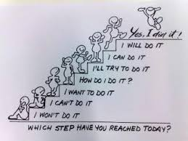
Notes:
Words are powerful. They can build up or they can tear down. They can bring joy or they can bring pain. We can unintentionally speak words of condemnation and death over our dreams, goals, and even our lives – never do it. A simple word can be a daily reminder to help you affirm your goals. Think of the difference between fear and fearless and what impact it will have on you.

Slide 19
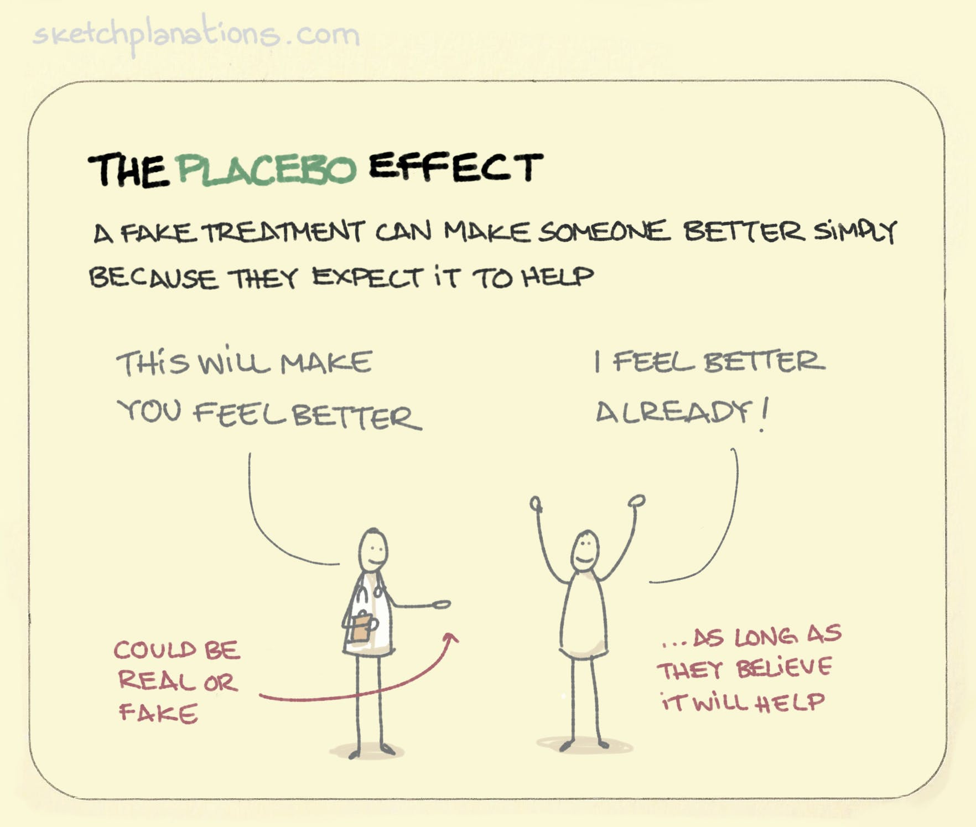
What we believe is what we experience”
Is there scientific proof we can heal ourselves? | Lissa Rankin, MD | TEDxAmericanRiviera– YouTube https://www.youtube.com/watch?v=LWQfe__fNbs
Notes:
Did you ever feel your own shoulders relax when you saw a friend receive a shoulder massage? For those of you who said “yes,” congratulations, your brain is using its power to create a “placebo effect.” For those who said “no,” you’re not alone, but thankfully, the brain is trainable.
The placebo effect is defined as a phenomenon in which some people experience a benefit after the administration of an inactive "look-alike" substance or treatment. This substance, or placebo, has no known medical effect. Sometimes the placebo is in the form of a sugar pill, but it can also be an injection (saline solution) or consumable liquid. In some cases, placebos can exert an influence powerful enough to mimic the effects of real medical treatments. In some respects its an inconvenient truth to conventional medicine.
In most cases, the person does not know that the treatment they are receiving is actually a placebo. Instead, they believe that they are the recipient of the real treatment. The placebo is designed to seem exactly like the real treatment, yet the substance has no actual effect on the condition it purports to treat.
As we’ve discussed the mind can have a powerful influence on the body, and in some cases, can even help the body heal. The mind can even sometimes trick you into believing that a fake treatment has real therapeutic results.
But the placebo effect is much more than just positive thinking. Placebos are often utilized in medical research to help doctors and scientists discover and better understand the physiological and psychological effects of new medications.
One of the most studied and strongest placebo effects is in the reduction of pain. According to some estimates, approximately 30% to 60% of people will feel that their pain has diminished after taking a placebo pill.
Why do people experience real changes as a result of fake treatments? While researchers know that the placebo effect is a real effect, they do not yet fully understand how and why this effect occurs. Research is ongoing as to why some people experience changes even when they are only receiving a placebo. A number of different factors may contribute to this phenomenon - One possible explanation is that taking the placebo triggered a release of endorphins. Endorphins have a structure similar to morphine and other opiate painkillers and act as the brain's own natural painkillers. Other possible explanations include a learned response. In some cases, a placebo can be paired with an actual treatment until it evokes the desired effect.
For example, if you're regularly given the same arthritis pill to relieve stiff, sore joints, you may begin to associate that pill with pain relief. If you're given a placebo that looks similar to your arthritis pill, you may still believe it provides pain relief because you've been conditioned to do so.
Expectations, or what we believe we will experience, have been found to play a significant role in the placebo effect. People who are highly motivated and expect the treatment to work may be more likely to experience a placebo effect.
A prescribing physician's enthusiasm for treatment can even impact how a patient responds. If a doctor seems very positive that a treatment will have a desirable effect, a patient may be more likely to see benefits from taking the drug. This demonstrates that the placebo effect can even take place when a patient is taking real medications to treat an illness.
Verbal (health care professional talking positively), behavioural (taking the pill to relieve symptoms), and social cues (reassuring body language, eye contact, and speech from a doctor or nurse) can contribute to a person's expectations of whether the medication will have an effect.
A 2013 study from the U.K. found that 97% of physicians acknowledged in a survey having used some form of placebo during their career. This might be as simple as expressing a strong belief in the likelihood that a patient will feel better from whatever treatment the doctor prescribes, even if the treatment itself is not chemically powerful.
One study found that people with a gene variant that codes for higher levels of the brain chemical dopamine are more prone to the placebo effect than those with the low-dopamine version.
In Psychology Experiments participants in placebo groups have displayed changes in heart rate, blood pressure, anxiety levels, pain perception, fatigue, and even brain activity. These effects point to the brain's role in health and well-being.
The placebo effect can have a powerful influence on how people feel, but it is important to remember that they are not a cure for an underlying condition.
Healthcare providers aren't allowed to use placebos in actual practice without informing patients (this would be considered unethical care), which reduces or eliminates the desired placebo effect.
Part of the beauty of placebos is that it is thought they activate existing systems of healing within the mind and body. Elements of the body once thought to be outside of an individual’s control are now known to be modifiable. A legendary example of this is Tibetan monks who meditate to generate enough body heat to dry wet sheets in 40-degree Fahrenheit temperatures.
A field called Mind Body Medicine developed from the work of cardiologist Herbert Benson, who observed those monks and other experts mastering control over automatic processes of the body. It’s well understood in the medical field that many diseases are made worse by the automatic changes that occur in the body under stress. If a placebo interaction reduces stress, it can reduce certain symptoms in a scientifically explainable way.
There are numerous researches that show that the individual who thinks that he/she has a good health condition, live around 10 years more than the one who thinks that he/she has a bad health condition, even though the real health conditions of both the people is same. An experiment was conducted on the cleaning workers of a hotel. Half of the workers were told that they are burning a lot of calories and they are improving their health by doing the exercises in the form of the cleaning work that they do daily, while nothing was told to the other half of the workers. After some months, it was observed that the workers who were told about their work benefits on their health had shown improvement in their cholesterol level and some had even lost their weight, while there was no such improvement in the health conditions of the other half of the workers.
Key message:
Be proactive in generating positive thoughts/beliefs, speak positively, behave positively by focusing on what you can influence and walk/talk positively and also think about the language you use with other people. .
The link on the slide- New age gurus suggest that we can heal ourselves by simply changing our minds, but is this concept grounded in cold, hard science? Lissa Rankin, MD explores the scientific literature, reviewing case studies of spontaneous remission, as well as placebo and nocebo effect data, to prove that our thoughts powerfully affect our physiology when we believe we can get well.

Slide 20
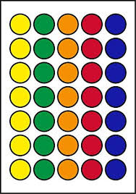
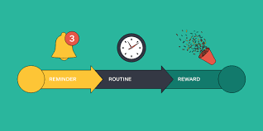
Spot your dots
This is what you do:
Stick a load of these dots around your house and workplace (if you are allowed)
Make three lists: 1 – Three happy memories; 2 – Three people you love or who love you; 3 – Three things that could make you happy in the future
Implant everything on your list in your mind so you can recall each memory (use your senses), imagine been with each of those special people and imagine those future events happening.
When you see a dot think of an item on your list. The more you do this the bigger the impact it will have.
Make this into a habit so strong positive thoughts are part of every day.
Notes:
Do anything you can everyday to remind you to be positive and think about how you start and finish your day, The last thing you think about at night is the first thing you think about next morning so reflect on the best thing that happened today, in your life or reflect upon a good deed you’ve done or will do or positive emotion – you’ll wake up with more energy, transformed mood and change how you see the world. Make the fist step out of bed an optimism step and choose a positive emotion of the day and remember the word PACE – positive attitude changes everything.

Slide 21
Notes:
In addition to everything we’ve talked about there are other things we do to develop a more resilient mindset.
Everyone select 5 from this list but also consider:
Regularly question your thoughts, beliefs, values, practice self-awareness and seek out opposite information to your current beliefs.
As part of healthy relationships on here set boundaries – decide now what is acceptable/unacceptable..
Identify mistakes you’ve made in your life and write down what you can learn from them
Limit social media, TV, computer games etc and replace with enriching material
Never compare to others unless they are the best and someone you want to emulate
Stretch your psychological comfort zone every week – e.g. do a public talk – mental hormesis, consider designing your own world-view, your own ‘Why’ in life, accumulate diverse and challenging knowledge to create that world-view along with identifying your fears and conquering them – think gradual exposure
And most importantly as we’ve discussed here today take control of your life, thoughts and emotions.

Slide 22
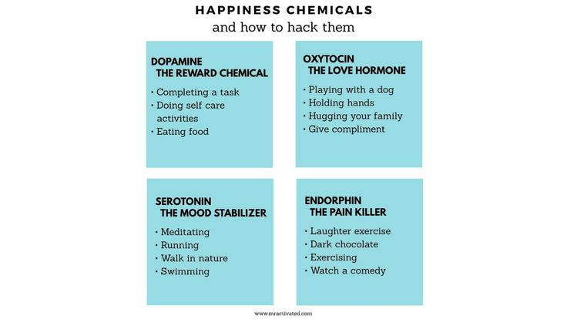
Notes:
Exercise/being active cuts across all of these.
Lets explore one of these – serotonin.
Serotonin plays several roles in your body, including influencing learning, memory, happiness as well as regulating body temperature, sleep, sexual behaviour and hunger. Lack of enough serotonin is thought to play a role in depression, anxiety, mania and other health conditions.
Most of the serotonin found in your body is in your gut (intestines). About 90% of serotonin is found in the cells lining your gastrointestinal tract. It’s released into your blood circulation and absorbed by platelets. Only about 10% is produced in your brain.
Serotonin is made from the essential amino acid tryptophan. An essential amino acid means it can’t be made by your body. It has to be obtained from the foods you eat.
Low levels of serotonin may be associated with many health conditions including:
Depression and other mood problems.
Anxiety.
Sleep problems
Digestive problems.
Suicidal behaviour.
Obsessive-compulsive disorder
Post-traumatic stress disorder
Panic disorders
Schizophrenia
Phobias.
Scientists still have a lot to learn about the role of serotonin in the body and in disease.
What can cause low serotonin levels?
A low serotonin level usually has more than one cause. Technically, serotonin levels are low because:
Your body isn’t producing enough serotonin.
Your body isn’t effectively using serotonin. This can happen if you don’t have enough serotonin receptors or the receptors aren’t working as they should.
What can I do to increase serotonin levels?
Ways to increase serotonin levels include:
Eating more tryptophan-containing foods – the science behind this is complex and inconclusive but a good healthy diet is a darn good start – foods of the rainbow = healthy microbiome – fermented foods – sauerkraut, kefir etc. Stop snacking and eat two healthy meals a day. Herbal teas.
Getting more sunlight – stimulates the part of the retina that stimulates the creation of serotonin & also get into nature as plants give off chemicals that also helps.
Taking certain supplements tryptophan – take at night as it helps sleep and take on an empty stomach.
Getting more exercise (speeds up brains ability to convert tryptophan into serotonin and it also boosts dopamine – reward) and lowering your stress level – cortisol lowers serotonin.
Get good sleep and practice good sleep hygiene.
Practice remembering happy events, positive emotions as it releases endorphins.
What’s the difference between dopamine and serotonin?
Dopamine and serotonin are both neurotransmitters. This means they are chemical message carriers between nerve cells in the brain as well as to and from other areas of your body. Both are also considered the “happy hormones,” as they both play a role in positive mood and emotion. Serotonin is associated with happiness, focus and calmness. Dopamine is associated with rewards and motivation. Dopamine and serotonin also share involvement in some mental health conditions, including depression and mood disorders.
Dopamine and serotonin also have some distinct functions. Dopamine controls body movements and coordination. Serotonin helps regulate digestive functions including bowel function and appetite. Dopamine causes a feeling of hunger while serotonin suppresses that feeling. Dopamine is mostly stored in your brain while serotonin is found mostly in your gut.
Sometimes these neurotransmitters work together to stay in a careful chemical balance in your body. Sometimes an imbalance leads to an overproduction of the other neurotransmitter. Having too much or too little of either can cause physical and psychological symptoms.

Slide 23
This is your brain on art: How music, dance and poetry can help your brain : Shots - Health News : NPR https://www.npr.org/sections/health-shots/2023/04/03/1167494088/your-brain-on-art-music-dance-poetry?inf_contact_key=eb5275f3854320a3a33af39bdcbe8e205ed554ec5cb65b266886a8a7a9bbed85
Notes:
If you’re concerned there may be memory trouble in your future, something you can do to save your memory is to take a page out of Fred Astaire’s book… and that is turn up the music and dance.
While just about any kind of dancing can get your blood pumping and give your cognition a lift, the type of moves Fred Astaire specialized in can really give your brain and your memory a boost.
According to the latest research, ballroom dancing should be your first choice because it may edge out other types of dancing when it comes to sharpening your memory.
Back in 2003, a major study conducted by scientists at the Albert Einstein College of Medicine, New York, found different types of dancing reduced the risk of dementia by a whopping 76 percent. In fact, dancing was more effective than walking, climbing stairs, cycling, or swimming.
Since then, other studies have confirmed the value of dancing to stop dementia in its tracks. Between them they show ballroom dancing can benefit different aspects of memory and overall cognition.
A recent review evaluated eleven studies. The researchers concluded by writing: “Dance is a promising therapeutic intervention for older adults looking to improve their cognitive health.” While the earlier study compared dancing to traditional exercise, few others have done so. This inspired a new team at Albert Einstein College to conduct a fresh study.
Sixteen men and women over the age of 65 had a screening interview which indicated they were at greater risk of Alzheimer’s and other forms of dementia. None engaged in dancing or any other form of exercise.
Researchers split them into two groups. One group took twice-weekly ballroom dancing classes for six months, while the other attended twice-weekly treadmill walking classes. They all took tests that measured different aspects of cognitive function and underwent brain scans.
At the end of the trial, both groups saw an improvement in executive function, which is involved with planning, reasoning, and processing tasks that require attention. However, compared to walkers, dancers saw markedly greater improvements in processing speed – the time it takes to respond to and process information.
They also had reduced brain atrophy in the hippocampus – a key memory area that’s particularly affected by Alzheimer’s disease. It’s known from previous research that this part of our brain can undergo neurogenesis – or grow new neurons – in response to aerobic exercise.
Although the study involved few participants and much larger trials are needed to confirm the findings, lead researcher Helena Blumen believes social dancing is likely to be more beneficial than walking because it’s physically, socially, and cognitively demanding.
Meanwhile, the ballroom dancer enjoys a physical workout that increases the heart rate and uses brain regions that are important for physical movement. Intellectual skills are also challenged from learning the steps and remembering what’s already been learnt. Having to work with a partner means interacting and adapting to their movements.
The overall effect of dancing enables a wide network of brain regions to be strengthened. And best of all, this is possible even in later life.
Since ballroom dancing has all these benefits and targets both isolation and inactivity, Dr. Blumen says it’s a great therapy for anyone over the age of 50. Dr. Blumen explains by writing, “Lifestyle interventions like social ballroom dancing are a promising, non-invasive and cost-effective path toward staving off dementia”

Slide 24
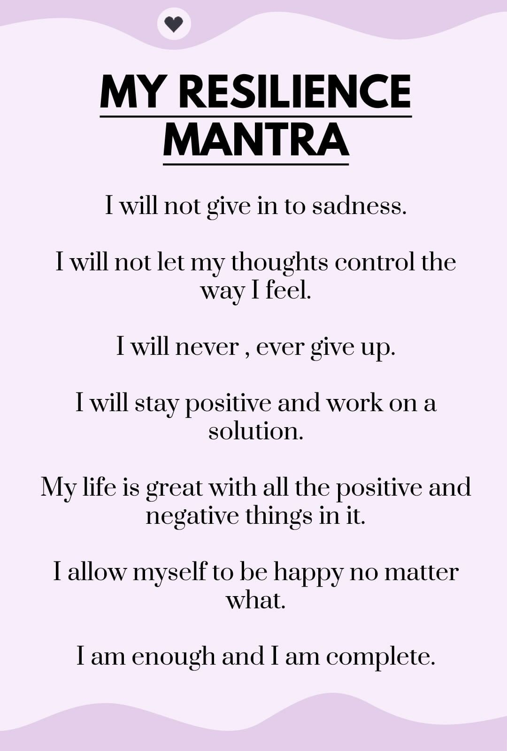
30-day challenge
Notes:
Roger bannister, my story swimming and sub 3 hour marathon – modelling. Consider exploring EFT tapping to deliver empowering beliefs into your subconscious mind.
Remember TFAR - Your Thoughts lead to your Feelings. Your Feelings lead to your Actions and Your Actions lead to your Results.
One cancer survivor (stage 4 twice) Ryan Leulf who dug into what people do to get over cancer observed the people who did the external thing but not the internal thing (emotions/mindset/reducing stress through meditation etc.) died whereas those who did both survived. He believes the external things (diet, exercise etc.) prolongs life but doing both heals and reverses.
We will do a little quiz (on a word document) give me the thumbs up if what I say increases neurogenesis (increase brain cells) or reduces it: Learning (up), stress (down); sex (up), sleep deprivation (down), (what about too much sex leading to sleep deprivation), getting older (down), running (up), vegetables (up), McDonalds (down). Fasting/calorie restriction (hormesis) will increase, alcohol (down), foods you chew increase,
Negative nellies have more hospitalization whereas ageing optimists live a lot longer.

Slide 25
This is where we watched the 3 minute video by Bob Proctor about visualisation
https://www.youtube.com/watch?v=2Z_mcq8mzqg

Slide 26
Action plan
As a result of todays masterclass what will you:
START DOING
STOP DOING
CONTINUE DOING
54321 DD
Notes:
Powerful thought, powerful action = powerful result. Eat well, think well live well.
String demo
Sway test/finger strength test
Hold your hands together in front of you with two fingers stuck up and then think strongly that they will come together and at the same time I say things like imagine those fingers coming together, totally believe that your fingers are coming together - they will
Do a positive affirmation with a friend, its an arm wrestle. Ask them to say with conviction ‘I am strong and resourceful’ and they will be strong, then ‘I am weak and feeble’.
Turn it into a daily ritual to give you the four P’s – purpose, psychological safety, performance and pride because what is discussed here really is the highest return habits to adopt along with other positive lifestyle factors – food, exercise, toxin awareness, sleep, water and managing stress (purpose, meditate not medicate)
Do remember that habits are hard to change so do commit to a 30-day challenge then do it for another 30 days then another 6 (need 66 days) and identify what you have to gain by staying where you are right now (its called a secondary gain) for example kids who get bullied at school will make and keep themselves sick to gain avoid going to school and be exposed to the bullying. Tie this to creating your own burning platform and compelling vision – you need to create new neuropathways to change habits by really understanding what keeps you where you are, creating a push and pull and practice positive daily habits.

Slide 27
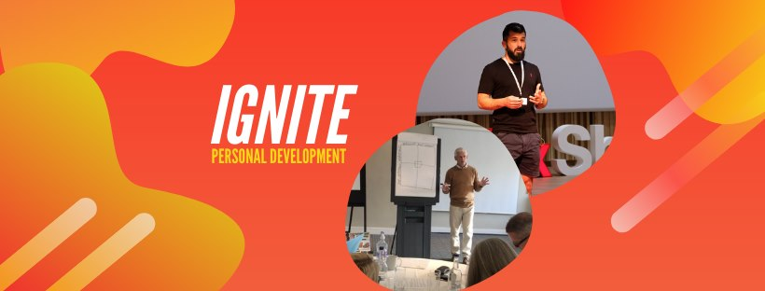
https://www.facebook.com/groups/216645969611627/?ref=share
bernard.genge@gmail.com

Slide 28
VIDEO
Are you a body with a mind or a mind with a body? - Maryam Alimardani
https://www.youtube.com/watch?v=ILDy6kYU-xQ
6mins
Our bodies – the physical, biological parts of us — and our minds — the thinking, conscious aspects — have a complicated, tangled relationship. Which one primarily defines you or your self? Are you a body with a mind or a mind with a body? Maryam Alimardani investigates. Lesson by Maryam Alimardani, directed by Ivana Bošnjak & Thomas Johnson.

Slide 29
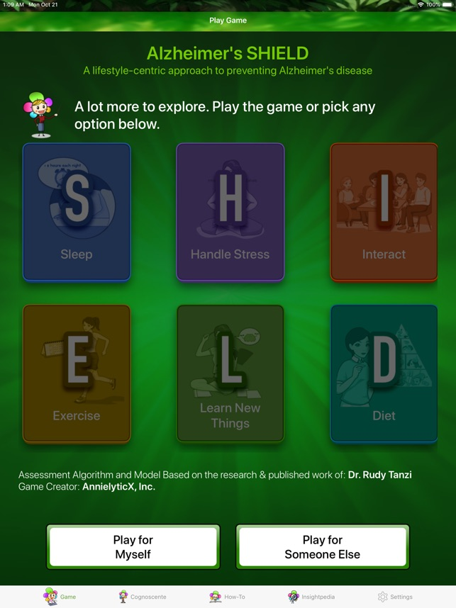
Notes:
S stands for sleep – get 7-8 hours Sleep serves to clear away the plaques that lead to cognitive decline. Plaques begin decades before signs of decline. So, getting good sleep at any age (even power naps) can improve your brain health.
H is for handling stress Establishing a meditation practice and managing expectations can reduce stress.
I is for interaction with friends Loneliness doubles risk for Alzheimer’s. The Benson-Henry Institute for Mind Body Medicine is a good source of information for caregivers and families on how to help avoid this risk.
E is for exercise Exercise induces new nerve cell growth to strengthen brain regions affected in Alzheimer’s disease, and triggers the breakdown of brain amyloid. Finding an exercise that works for you is key. Starting small and working up to the recommended 150 minutes per week, can have a great impact on our brain health.
L is for learning new things Learning new things strengthens and increases the number of synapses in your brain, the connections between nerve cells storing your memories. Synapse loss correlates most with the degree of dementia. The more synapses you make, the more you have to spare. Puzzles aren’t necessarily the answer, either. A Harvard Health article says “Practicing a new and challenging activity is a good bet for building and maintaining cognitive skills.” Learn a new language, take a class – these activities have major benefits.
D is for diet Dr. Tanzi says the best diet for the brain is the Mediterranean diet, which minimizes red meat and is rich in fiber from fruit and vegetables. A plant based diet balances the bacteria in your gut, called the “gut microbiome.” A healthy gut microbiome has also been shown to reduce amyloid plaque and brain neuroinflammation, a major killer of nerve cells in the brain.

Slide 30
Further information/watching
https://www.youtube.com/watch?v=hEStIACmjNE
https://www.youtube.com/watch?v=-3rGflix2q8
Both videos are by Tony Robbins about the power of beliefs and he also talks about a 7-day challenge.

Slide 31
SPECIAL FORCES: Advice Will Change Your Life (MUST WATCH) Motivational Speech 2021| Billy Billingham – YouTube https://www.youtube.com/watch?v=9IbfmdcYqQA 18 mins.
(Navy SEALs: How to build a warrior mindset | Big Think – YouTube
https://www.youtube.com/watch?v=qox43Tih8h0 15.55 mins
Do Ultra-Processed Foods Cause Cognitive Decline? - Emeran Mayer, MD
https://emeranmayer.com/do-ultra-processed-foods-cause-cognitive-decline/?inf_contact_key=f4a9e0fd35d850541efb0e146c016169850050e7915f41da51043c293c2d487f
Your Brain - Your Choice - David Perlmutter M.D. (drperlmutter.com) – an article about how our lifestyle choices impact our brain health
https://www.drperlmutter.com/your-brain-your-choice/?inf_contact_key=a7acd7c104ccb5586ac80b6c63c7bfa46284348d8861bd17e5bddf76463f0190
Why the Brain is Built for Movement | Anders Hansen | TEDxUmeå
https://www.youtube.com/watch?v=a9p3Z7L0f0U He shares compelling evidence regarding how aerobic exercise influences our brain in a massive way including better fitness = higher IQ – the brain is built for movement.

Slide 32
RTMS (Repetitive transcranial magnetic stimulation) where an electromagnetic coil is placed against your scalp near your forehead. The electromagnet painlessly delivers a magnetic pulse that stimulates nerve cells in the region of your brain involved in mood control and depression if interested see Rewiring the Brain | Andrew Leuchter | TEDxUCLA https://www.youtube.com/watch?v=jAqokhmK_a4
THIS IS HOW YOUR THOUGHTS AFFECT YOUR KARMA | LAW OF KARMA | Buddha story on karma | - YouTube https://www.youtube.com/watch?v=NXHxQPn69_8 We will receive what we give to others even our thoughts as they vibrate outwards then inwards.
The Psychology of Beating an Incurable Illness | Bob Cafaro | TEDxCharlottesville – YouTube https://www.youtube.com/watch?v=ZqoRGr3icTo After a shocking diagnosis that would begin stripping Bob Cafaro of his ability to perform, sheer willpower and changes to his daily life allow him to beat all odds.
Some recent research suggested giving our brains some mild stress through higher than normal temperatures (sauna’s) could impact a class of proteins called heat shock proteins (HSPs) that respond to stress from higher-than-normal temperatures. There have been some studies recently of people in Scandinavian countries who regularly use saunas suggesting that they may be at lower risk of developing dementia. The website is The One Kind Of Stress That’s Good For The Brain – Awakening From Alzheimers https://awakeningfromalzheimers.com/the-one-kind-of-stress-thats-good-for-the-brain/

Slide 33
Sleep is your superpower | Matt Walker – YouTube
https://www.youtube.com/watch?v=5MuIMqhT8DM
How to recover from depression’ by Dr Michael Yapko is well worth seeing (just over an hour long) https://www.youtube.com/watch?v=TVgQ_tgWMyU

