Slide 1
Making significant positive change
With
Bernard Genge

Slide 2
Aims and desired outcomes
Aims – To know how to make significant positive change in life – personally and professionally
Outcomes – To be a person who continually embraces change in life
As we go through this masterclass decide what you will START, STOP & CONTINUE doing
54321 DD
Notes:
On these masterclasses as we all learn in different ways there will be spoken words from me, written words on the ppt, pictures, quotes and for those that are very visual youtube clips to watch afterward. Share stories at the end. The key to learning however is doing and teaching – 54321 DD

Slide 3
Set scene
What makes change difficult is that we are often trying to do it from the outside in – that is, to change our external behaviour without making any change to our thoughts/beliefs. When there is no internal basis for change we need threats, reminders, or someone to nag us to make sure we keep up with the change. When we truly connect with the change from the inside it becomes so much easier.
Understand ‘why’ and what you want to change at a really deep level.
Think about the beliefs and biases you have that shape your mindset and drive the behaviour. For example, if you want to stop working so hard because of the resulting stress but you have a deep-rooted belief that to be successful you have to work long hours you will need to address this belief before change will work.
Notes:
Then we can make a Conscious Choice about the actual change we are going to make. Then we can embrace Conscious change many people make the big mistake of thinking that having made the decision to change they can make a few steps in the right direction and all will miraculously fall into place.
Whan you make conscious choices/decisions you create the right environment to make conscious/positive changes

Slide 4
Characteristics of a changing/growing person
High degree of self-awareness – they understand we live in an ever-changing world and to grow/survive in this world they must embrace change
Patience to think things through, be decisive and make the necessary sacrifices
Being prepared to be uncomfortable and stretch that comfort zone
Prepared to challenge and question self
Incrementally growing in confidence
Their life is changing for the better – even if its small changes
Notes:
6 – the importance of setting 30-day challenges so you can review progress

Slide 5
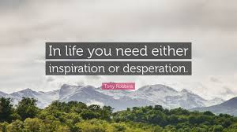
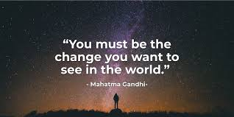
Why do we change?
Notes:
2 change because of your values
60 years – one example more info in a week than a lifetime, one constant,

Slide 6
CHANGE READINESS – a good gauge of your current levels of resilience/change readiness
THE RESISTERS
Critical, narrow minded, unconvinced, can be mischievous with their resistance
THE FLOURISHING
Enthusiastic & optimistic, embracing change & their own development. Open to lead
Low Levels of personal resilience High
THE DROWNING
Overwhelmed, loudly critical, withdrawn, resentful & dysfunctional
THE QUITTERS
Eager at the outset but get disillusioned when going gets tough. Feel betrayed by management
Low Change Readiness High
Notes:
This is the relationship between our ability to embrace change and our levels of personal resilience. Talk about self-awareness and honestly reflect on this – if you are a quitter building your personal resilience is a priority, if drowning both resilience and learning how to be confident with change, if a resister focus on learning to embrace change

Slide 7
THE LOSS CURVE
The Loss Curve
Shock
Denial
Relapse or make it stick
Anger such as blame, resentment, frustration
Guilt
Taking action, problem Solving
Anxiety
Relief and feeling positive
Performance
Stress
Acceptance
Despondency
Depression
Time
Notes:
Explain my gran and Steph visiting stories ask them to think about times when they’ve faced change and the emotions they experienced?

Slide 8
THE STAGES OF CHANGE
NEUTRAL ZONE
Your change plan
Begin with
ENDINGS – create a
burning platform
NEW BEGINNINGS
The compelling vision
Denial
Make it stick
Taking action & problem Solving
Blame
Shock
Performance
Self-Blame
Acceptance
Time
Notes:
Refer back to slide 5 we need desperation or inspiration

Slide 9
DIFFUSION OF INNOVATION
Organisational willingness to engage with change?
EARLY
MAJORITY
LATE
MAJORITY
EARLY
ADOPTER
SHEEP
ALOOF CAT
LAGGARD
Will follow the crowd that shouts the loudest, whether positive or negative. They need to receive effective communication and given more attention.
Your change is probably an inconvenience. They’ll adopt and change when they’re good and ready. They’ll want the change delivered on their terms. And they will need considerable care and attention.
STUBBORN MULE
INNOVATOR
GOOD DOGS
01
EAGER BEAVER
Enthusiastic and happy to be involved. Will respond positively. Supporters of the change. Their tails are wagging for the change.
The stubborn old mules. Prefers to stay put. You’ll need to push them uphill. Will only change when they are forced to.
Like an eager beaver the innovator excitedly embraces anything new. Wants to get involved. Recognises the positives. Is your advocate. These are the real change champions.
Notes:
Two questions for everyone to consider here:
1 – of course we react differently to different types of change but use your honest self-awareness to identify where you sit with personal change and organizational?
2 – what would it take for you to be an innovator in your own life and at least an early adopter (preferable innovator) with organizational change.
Innovatiors 2.5%; e adopters 13.5%; early and late majority 34%; laggards 16%
Self awareness
This theory seeks to explain why, how and at what rate new ideas/technology spread.
Everett Rogers, a professor of communication studies argues that diffusion is the process by which an innovation is communicated over time among the participants in a social system – use the example of climate change
It can also be useful as a self-reflection tool to ask ourselves, how do I accept new ideas and change, so imagine you are at work and someone suggests a good new idea how do you respond? How good are you with new ideas and suggesting change or improvements? Are you an:
Innovator. They are a small group of people exploring new ideas and technologies. It includes "gadget fetishists!" In an online marketing context there are a lot of specialist blogs and media sites to engage them, Engadget and Gizmodo for examples.
Early Adopter. Considered to be Opinion Leaders who may share positive testimonials about new products and services, seeking improvements and efficiency. Engagement requires little persuasion as they're receptive to change. Provide guides on how to use the product/service.
Early Majority. These are Followers who will read reviews by earlier adopters about new products before purchasing. They can be engaged with reviews and via YouTube, where they will look for your products/service.
Late Majority. To generalise, these are sceptics who are not keen on change and will only adopt a new product or service if there is a strong feeling of being left behind or missing out. They can be engaged with providing marketing material, evidence, reviews from Opinion Leaders and case studies to show how it works.
Laggard. The descriptor says it all! Typically they prefer traditional communications and will adopt new products when there are no alternatives. Laggards will come on board when 'others' have written about your products/services, they have research evidence, statistics or felt pressure from others.

Slide 10
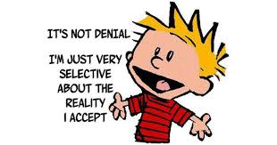
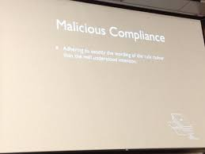
How we resist change
Deflection and avoidance
Notes:
As we look at these reflect on ones you’ve used when faced with change in the past
1 – confusion
2 – Denial is a big one
5 – Easy agreement

Slide 11
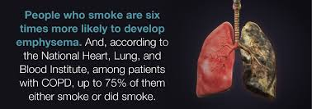
I want to give up smoking and need a ‘push’

Slide 12
I want to give up smoking and need a ‘pull’

Slide 13
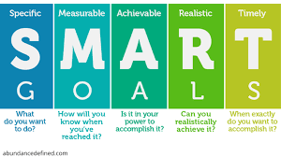
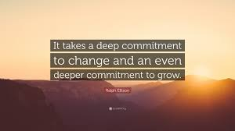
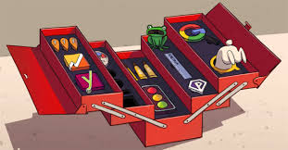
You have a push and pull now you need a plan

Slide 14
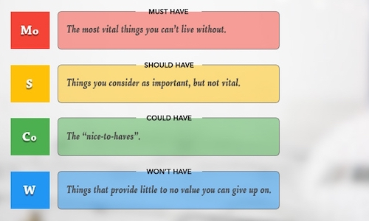
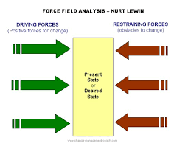
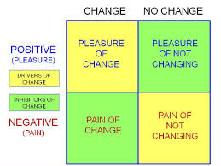
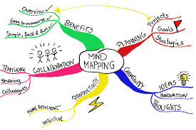
Tools for making change

Slide 15
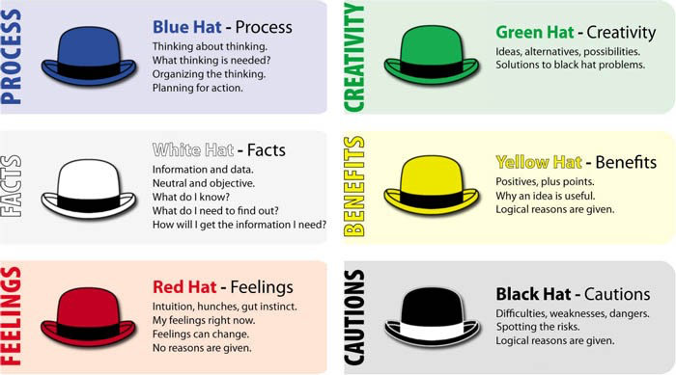
Tools for making change

Slide 16
30-day challenge
Use a number of ‘tools’ to deepen your commitment and see through with it

Slide 17
Action plan
As a result of todays masterclass what will you:
START DOING
STOP DOING
CONTINUE DOING
54321 DD
Notes:
54321 Decide/do

Slide 18
Further opportunities
Personal Resilience facebook group.
Ignite: Find Your Passion, Live Your Purpose & Re-Write Your Future
https://www.facebook.com/groups/216645969611627/?ref=share
Personal resilience online programme;
https://ignitepd.thinkific.com/courses/rock-solid-resilience?fbclid=IwAR1dt6Mw_cw8EqDPPJA3bpynSEVhFxwfMWBZpPKO1IZq04ZvxHHc0ty8KRc
bernard.genge@gmail.com

Slide 19
Further information/watching
Did you know 2019 – 6 minutes
https://www.youtube.com/watch?v=bTM06NZOyDQ
Who moved my cheese – 15 minutes
https://www.youtube.com/watch?v=jOUeHPS8A8g
Overcoming resistance to change – isn’t it obvious 6 minutes
https://www.youtube.com/watch?v=hcz1aZ60k7w
Jason Clarke – Embracing change 18 minutes
https://www.youtube.com/watch?v=vPhM8lxibSU

