Slide 1
Looking After your Health in Uncertain Times

Slide 2
10 tips to help if you are worried about coronavirus
Every Mind Matters (2020) *
*www.nhs.uk/oneyou/every-mind-matters/coronavirus-covid-19-anxiety-tips/

Slide 3
Stay connected with people
Maintaining healthy relationships with people we trust is important for our mental wellbeing. Now that the government guidelines allow more social activity outside, this may feel easier. Just make sure you follow the latest government guidance and stay at least 2 metres apart from others.
Think about how you can continue to stay in touch with friends and family, especially if you or they need to stay at home. You could try phone calls, video calls or social media – whether it's with people you normally saw often or reconnecting with old friends.

Slide 4
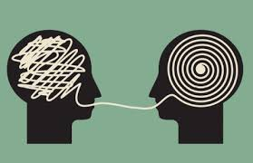
2. Talk about your worries
It's normal to feel a bit worried, scared or helpless about the current situation. Remember: it's OK to share your concerns with others you trust – and doing so may help them too.
If you cannot speak to someone you know or if doing so has not helped, there are plenty of helplines you can try instead.

Slide 5
3. Support and help others
Helping someone else can benefit you as well as them, so try to be a little more understanding of other people's concerns, worries or behaviours at this time.
Try to think of things you can do to help those around you. Is there a friend or family member nearby you could message? Are there any community groups you could join to support others locally?
Remember, it's important to do this in line with official coronavirus guidance to keep everyone safe.

Slide 6
EMM - Coronavirus anxiety - Connect with people
1. Stay connected with people
Maintaining healthy relationships with people we trust is important for our mental wellbeing. Now that the government guidelines allow more social activity outside, this may feel easier. Just make sure you follow the latest government guidance and stay at least 2 metres apart from others.
Think about how you can continue to stay in touch with friends and family, especially if you or they need to stay at home. You could try phone calls, video calls or social media – whether it's with people you normally saw often or reconnecting with old friends.
EMM - Coronavirus anxiety - Talk about your worries
2. Talk about your worries
It's normal to feel a bit worried, scared or helpless about the current situation. Remember: it's OK to share your concerns with others you trust – and doing so may help them too.
If you cannot speak to someone you know or if doing so has not helped, there are plenty of helplines you can try instead.
NHS-recommended helplines
EMM - Coronavirus anxiety - Support others
3. Support and help others
Helping someone else can benefit you as well as them, so try to be a little more understanding of other people's concerns, worries or behaviours at this time.
Try to think of things you can do to help those around you. Is there a friend or family member nearby you could message? Are there any community groups you could join to support others locally?
Remember, it's important to do this in line with official coronavirus guidance to keep everyone safe.
Helping others
EMM - Coronavirus anxiety - Make a plan
4. Feel prepared
As the outbreak continues, it can help to work through the implications of government guidelines so you feel more prepared and less concerned.
If you are continuing to stay at home, then it can help to think through a typical week: how will it continue to be affected and what will you need to do to solve any problems?
If you have not already, you might want to talk with your employer. Find out about government support for businesses and self-employed people and understand your sick pay and benefits rights.
GOV.UK: Coronavirus support
4. Feel prepared
As the outbreak continues, it can help to work through the implications of government guidelines so you feel more prepared and less concerned.
If you are continuing to stay at home, then it can help to think through a typical week: how will it continue to be affected and what will you need to do to solve any problems?
If you have not already, you might want to talk with your employer. Find out about government support for businesses and self-employed people and understand your sick pay and benefits rights.

Slide 7
5. Look after your body
Our physical health has a big impact on how we feel. At times like these, it can be easy to fall into unhealthy patterns of behaviour that end up making you feel worse.
Try to eat healthy, well-balanced meals, drink enough water and exercise regularly. Avoid smoking or drugs, and try not to drink too much alcohol.
Going for a walk, run or bike ride can really help lift your mood and clear your mind – just remember to stay at least 2 metres apart from others. Or you could try one of our easy 10-minute home workouts.

Slide 8
6. Stick to the facts
Find a credible source you can trust – such as GOV.UK or the NHS website – and fact-check information you get from newsfeeds, social media or other people.
You could also use the GOV.UK Coronavirus Information Service on WhatsApp.
Think about how possibly inaccurate information could affect others too. Try not to share information without fact-checking against credible sources.
You might also want to consider limiting the time you spend watching, reading or listening to coverage of the outbreak, including on social media, and think about turning off breaking-news alerts on your phone.
You could set yourself a specific time to read updates or limit yourself to a couple of checks a day.

Slide 9
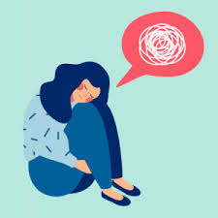
7. Stay on top of difficult feelings
Concern about the coronavirus outbreak is perfectly normal. However, some people may experience intense anxiety that can affect their daily life.
Try to focus on the things you can control, such as your behaviour, who you speak to, and where and how often you get information.
It's fine to acknowledge that some things are outside of your control, but if constant thoughts about coronavirus are making you feel anxious or overwhelmed, try some ideas to help manage your anxiety or listening to an audio guide.

Slide 10
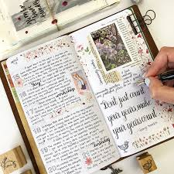
8. Do things you enjoy
If we're feeling worried, anxious or low, we might stop doing things we usually enjoy. Focusing on your favourite hobby, relaxing or connecting with others can help with anxious thoughts and feelings.
If you cannot do the things you normally enjoy because you're continuing to stay at home, think about how you could adapt them, or try something new.
There are lots of free tutorials and courses online, and people are coming up with inventive new ways to do things, like hosting online pub quizzes and music concerts.

Slide 11
9. Focus on the present
Focusing on the present, rather than worrying about the future, can help with difficult emotions and improve our wellbeing.
Relaxation techniques can also help some people deal with feelings of anxiety, or you could try a mindful breathing video.

Slide 12
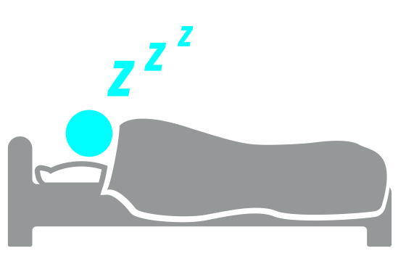
10. Look after your sleep
Good-quality sleep makes a big difference to how we feel mentally and physically, so it's important to get enough.
Try to maintain regular sleeping patterns and keep up good sleep hygiene practices – like avoiding screens before bed, cutting back on caffeine and creating a restful environment.

Slide 13
Living with Uncertainty
As lockdown eases “normal” is changing again; meaning, we will have to get used to a “new normal”.
Uncertainty, and managing risk, is going to be part of life for the foreseeable future for all of us.
As we face both challenges and opportunities, we may find these longed-for changes difficult for our mental health.
For many of us, this feels uncomfortable – especially when we are already struggling to cope with our mental health
For more information right click here and select open hyperlink: Mental Health Foundation (2020) Coping with Uncertainty

Slide 14
With so much of the media talking without certainty, it is difficult to predict what the foreseeable future may look like.
Therefore, the “new normal” for most of us will mean ‘what we need to get through today, or this week’
Mental Health Foundation (2020)

Slide 15
Managing Uncertainty* Mental Health Foundation (2020)
Over the last few months, we have been tested in ways we never imagined, have passed those tests and found new ways to manage – or even flourish.
Lockdown has challenged our values and what is important to us.
The life, values, and attitudes we had in early March might not be the ones we want to return to in July, and there may be opportunities for us to make positive changes in our lives as well.
It can help to focus on the things we have learned and achieved in the last few months.
Information from the Mental Health Foundation: Managing Uncertainty
(*right click on link above and select open hyperlink to take you to this site)

Slide 16
Some Tips on Managing Uncertainty from the Mental Health Foundation*
1) Focus on the present – Use Mindfulness to bring your mind back to the present moment.
you can only do your best with what you have today. With regulations changing frequently, and lots of conflicting media discussions, try and keep a focus on the moment.
2) Focus on what is certain – Keep a list of things to be grateful for; whilst a lot of things are uncertain at the moment, there are also things to be hopeful about.
3) Talk to people you trust – Talking about your feelings to people you trust is important; don’t be dismissive of your worries or fears, and be gentle with yourself.
* For more information fight click here and select open hyperlink

Slide 17
Reflecting on What We Have Learned During Lockdown*
The Wilderness Foundation offers some helpful tips for reflection
Try this….
1) Planning for the future me:
Use an old shoe box or a glass jar, decorate it and create a great label for it called ‘My Strengths’.
Each day write down what you did well.
At the end of a week or month – or if you are having a low moment or are being self critical – empty your box or jar out and read through all the things you noticed as your personal strengths.
*Right Click here and select open hyperlink

Slide 18
2) Things I don’t want to stop doing when lockdown ends:
Write on a piece of paper ‘Things I don’t want to stop doing when lockdown ends’.
Think of the things that you really appreciate doing now. Ask yourself some questions like: What makes me feel good? What have I done that has improved my relationships? What makes me feel healthy? What brings me joy in the day? What is a new discipline that makes my life run more easily?
Stick it on your fridge or anywhere that you will regularly see it.
Each week have a refresh and add to it or take things off that you don’t think work anymore for you
The more you keep doing the action, and the more you reinforce it with reading it, the more chance there is of this happening.

Slide 19
3) Reflect on the Language we Use
When we think about all the things we think and believe we ‘cannot do’ or ‘should’ do, or what we ‘must do’ better, this can create stress and anxiety – particularly when we use words such as ‘should’ or ‘must’ or ‘have to’.
Change our language to ‘I would love to’, ‘want to ‘, ‘care to’, ‘like to’…and see how different that feels.
The language we use has a definite impact on how we feel, and how we feel has an impact on how we act.
If we start with a simple thought, then a word… it will ripple through to a much more positive you.

Slide 20
4) Evening Reflection
Take time each evening to ask yourself:
What am I grateful for today?
Who can I thank for a kindness or considerate act today?
What made me laugh out loud?
One thing I will do differently tomorrow that I learned didn’t work today!

Slide 21
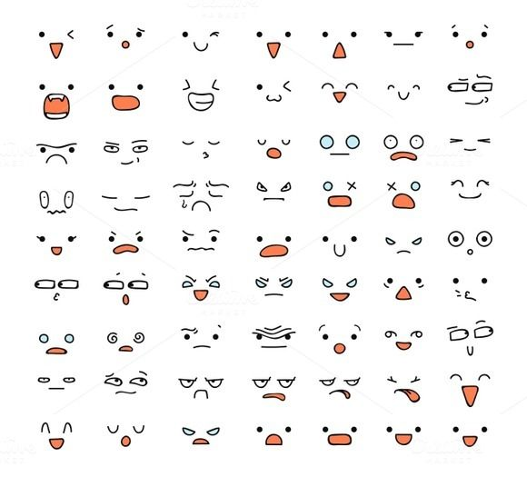
5) Reflecting on your Emotions
Reflect on your emotions and try to name them.
(for example: anger, pride, scared or fearful, loving, trusting, rejected, sad, happy, fulfilled, shameful, guilty, valued, confident) It is always easier to think of the negative emotion, so try to work hard on the positives (they are there!)
Think what these emotions do for you? How do they serve you? Where did they come from? How do negative emotions protect you?
What emotions would you like to feel?
How can you work to have more of these good emotions?
Listing them may make them easier to achieve.

Slide 22
6) Building self confidence
List out these things in a journal
What am I most happy about in my life? Why do these things make me happy?
What am I most proud of in my life? Why do these things make me proud?
What am I most excited about in my life? Why do these things make me excited?
Who do I love and enjoy spending time with? And why?
Who loves and appreciates me for who I am?
Reflecting on these questions can help increase confidence.

Slide 23
7) Mindful Bubbles*
Get some bubble mixture.
Take a deep breath in and slowly, gently exhale to see what is the biggest bubble you can make.
Concentrate on one bubble. Follow its journey around the garden. Watch how it floats and rises. How long you can float one bubble in the air before it pops. Attempt to keep the bubble floating in the air the longest by blowing gently underneath it. What happens to the bubble after it has popped?
Reflect on the future of the bubble and the journey it has been on.
Take another deep breath and see how many bubbles you are able to blow with one breath.
*wildernessfoundation.org.uk/mindfullness-zone/

Slide 24
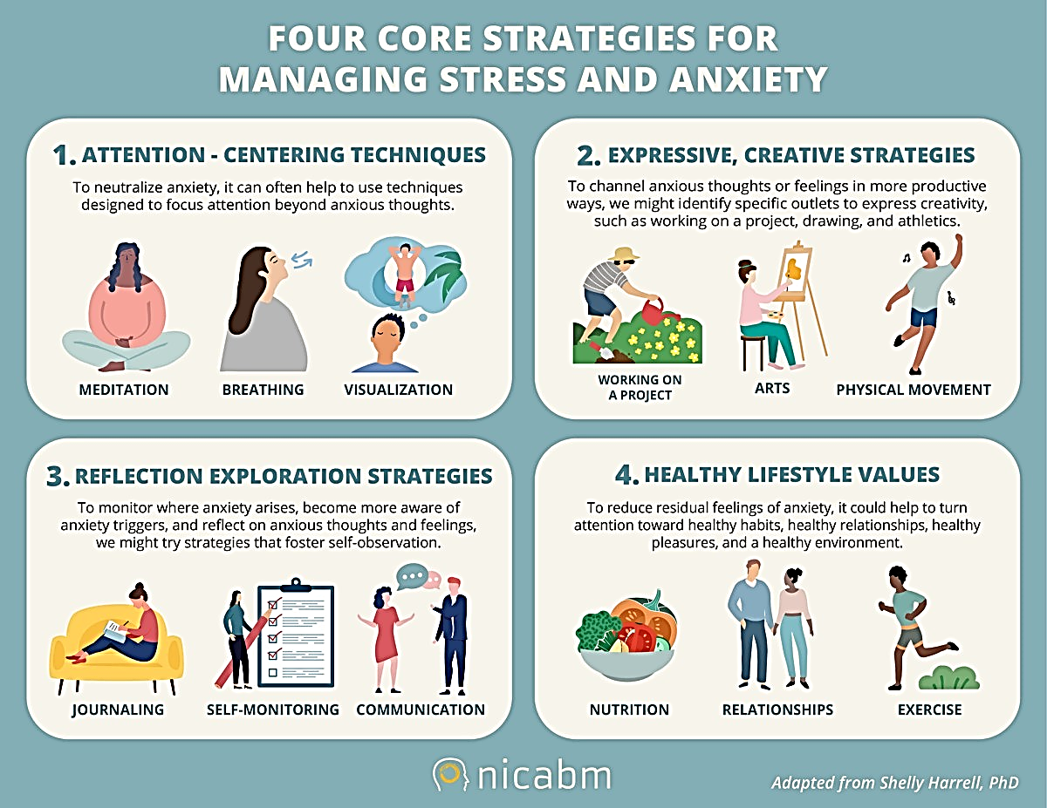

Slide 25
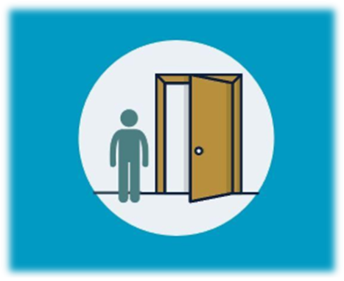
Looking after your mental health as we come out of lockdown*
Mental Health Foundation (2020)
For many of us, the gradual easing of lockdown brings longed-for opportunities (even if at a social distance) – to see friends, play sports, resume contact with family in ‘real space’ or get back to work that we value.
We should be prepared for the fact that the end of lockdown might be as hard for us as the start was.
Just as it took us time to find ways of coping during lockdown, we should also expect that it will take time to find our way back, and to reconnect with life.
*www.mentalhealth.org.uk/coronavirus/coming-out-of-lockdown

Slide 26
Looking after your mental health as we come out of lockdown* Continued
Mental Health Foundation (2020)
Looking after our mental health now is just as important now as it was at the start of lockdown – arguably even more so as we remain in a period of high stress but with more demands on us.
Our situations are unique to us, therefore, it is important to try not to judge ourselves harshly based on what other people are doing.
Everybody is facing uncertainty and challenge – and we have no choice but to move through it as best we can

Slide 27
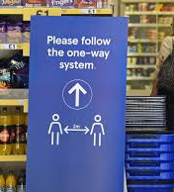
Fear and anxiety in Social Settings
Fear and anxiety will be common emotional responses we will feel as we approach the end of lockdown.
It took a lot of our emotional energy to make it through lockdown, and although we may have found a place that enabled us to cope, we might not feel ready to leave this behind just yet.
We may fear getting ill or passing infection on to family and friends.
As we begin to interact with more people, we may fear this risk increasing.

Slide 28
Every time we go back to something it is going to feel unusual or even scary. It may take longer to adjust to necessary changes
When we haven’t done an activity in a while, we may fear we have forgotten how it feels; for example going back to work, shop or socialise.
This might be because things have changed like our environment, or our routines in these once familiar places, like one-way systems and queues to enter shops.

Slide 29
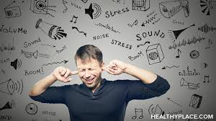
For many people lockdown has been relatively quiet and isolated. Therefore, going back into shops, traffic, transport, and work might cause a sensory overload. We may feel overwhelmed by sights, sounds or smells.
Headphones may be a good way to reduce some of this by helping you to focus and creating a distraction with calls, music, podcasts or audiobooks.

Slide 30
It’s important to acknowledge that these feelings are reasonable, and to expect them. It’s only by building up tolerance gently that we can move through these fears.
It is easy to allow the seclusion that was necessary in lockdown to become deliberate isolation as lockdown ends.
If possible, take things at your own pace – but try and challenge yourself to try something different each day or every couple of days.

Slide 31
Tips on coping with fear and anxiety in Social Settings*
Control what can be controlled
A lot of things you can’t control, and may cause fear and anxiety. But somethings we can plan for. Try making an action plan for things which you find more challenging.
Pace yourself
It is important to go at the right pace for you. Don’t be pressured into doing things you don’t want to – but try not to let that be an excuse not to push yourself, for example, when reconnecting with friends safely, outside your home, when rules allow and the time is also right for you.
Discuss concerns with those close to you, and allow others space to move at their own pace too.
*www.mentalhealth.org.uk/coronavirus/coming-out-of-lockdown

Slide 32
Build up tolerance
Try doing something that challenges you every day, or every few days. Don’t beat yourself up if it doesn’t go well but keep at it. Keep a note of things you’ve achieved, enjoyed or surprised yourself doing.
Vary your routines
try and vary your routines so that you see different people and encounter different situations. If one supermarket makes you nervous, try another. If a walk at one time of the day is very busy, try mixing walks at busy times with walks at quieter times.

Slide 33
Returning to Our Social Lives*
As lockdown eases we are beginning to our social lives – although with some changes. We may feel excited to do this, or we may be feeling nervous, or are un able to at present.
How can you help others in your social group to participate in social groups if they are not yet ready to take part face to face?
We may have become comfortable in our own space and with our own company in lockdown – it’s been intense in all sorts of ways and we might really have to push ourselves to reconnect with people and overcome initial awkwardness.
Whether it’s knowing how to insist on social distancing with friends or relatives, knowing where you have to wear a mask, or feeling odd not stopping to chat in the street many of us are keen to get it right, and worried about slipping up. It’s all new – and doing your best to follow the rules is good enough for most situations.
*www.mentalhealth.org.uk/coronavirus/coming-out-of-lockdown

Slide 34
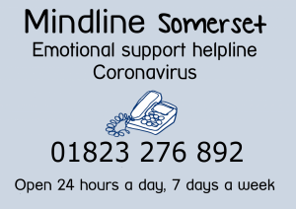
Other Sources of Support
Mind in Somerset
With an Emotional Support Helpline
Available 24/7: 01823 276 892
www.mindinsomerset.org.uk/
Spark Somerset
If you would like their help, call 01460 202970, email SUPPORT@SPARKSOMERSET.ORG.UK or get in touch via Live Chat.
www.sparksomerset.org.uk/covid-19

Slide 35
The Wilderness Foundation
Offers Free Mentoring and Coaching support:
Available to those seeking someone to talk through life experiences, worries about the present and future, wanting to be helped, due to feeling ‘stuck’ or wishing to do some life planning and strategy for the future.
Experienced mentors and coaches are all safeguarding trained and enhance DBS checked and have extensive experience in working with a range of ages, with particular experience in working with teens.
For more information: contact info@wildernessfoundation.org.uk or complete and return the referral form.
wildernessfoundation.org.uk/therapy-and-counselling-support-covid-nature-care-campaign/

Slide 36
Somerset Recovery & Wellbeing Alliance
For more information on the Alliance find it here:
www.rethink.org/aboutus/what-we-do/somerset-recovery-wellbeing-alliance/
See the Alliance Press Release:
www.rethink.org/news-and-stories/news/2020/01/somerset-to-be-a-trailblazer-for-mental-health-care/
The Somerset Recovery & Wellbeing Alliance aims to ensure a ‘no wrong door’ approach through providing a number of access points where people are skilled and trained to complete a mental health assessment. Trusted Assessors will know how to make sure people get the help they need, whoever they first got in touch with.
So if you need any other support for your mental health during this challenging time as we come out of lockdown, there are people and organizations to support you.

Slide 37
References
Mental Health Foundation (2020) How to look after your mental health during the coronavirus outbreak.
Available from: https://www.mentalhealth.org.uk/coronavirus. [Accessed on July10 2020].
Wilderness Foundation (2020) Covid Nature Care Campaign. Available From: https://wildernessfoundation.org.uk/covid-nature-care-mental-health-support/. [Accessed on July 10 2020].
Bupa (2020) Six ways to manage post-lockdown anxiety. Available from: https://www.bupa.co.uk/newsroom/ourviews/manage-post-lockdown-anxiety. [Accessed on July 10 2020].
Very Well Mind (2020) How to Cope With Anxiety About Coronavirus (COVID-19). Available from: https://www.verywellmind.com/managing-coronavirus-anxiety-4798909. [Accessed 0n July 10 2020].

