Slide 1
Understanding PTSD and what to do
With
Bernard Genge
Notes:
On these masterclasses as we all learn in different ways there will be spoken words from me, written words on the ppt, pictures, quotes and for those that are very visual youtube clips to watch afterward. The key to learning however is doing and teaching – 54321 DD

Slide 2
Aims and desired outcomes
Aims – To know what PTSD is, and what to do to eliminate or minimise it’s effect.
Outcomes – To take control of your PTSD and bring zest back into your life.
As we go through this masterclass decide what you will START, STOP & CONTINUE doing
Notes:
Personal resilience toolkit – STOP
Zoom – video/mute mic when I’m presenting. Please use the chat box, when you open it you can send a message to the whole group or a specific person. Please use it to ask questions, share thoughts, experiences or even to elaborate on points made in the masterclass – ones that perhaps really resonated with you and why.

Slide 3
Set scene
The UN estimates around 80 million people worldwide have been forcible displaced by war or violence, the highest number since the second world war. This along with worldwide, societal, community disharmony and events that happen to us individually has a massive impact on our mental health and wellbeing.
Psychological trauma results from an event or series of events deemed as physically or emotionally harmful or life threatening and that has long lasting adverse effects on the individual’s functioning and mental, social, emotional or spiritual wellbeing.
Notes:
It’s a persons psychological processing of an event that determines PTSD not the event itself.

Slide 4
Traumatic event
Exposure to actual or threatened death, serious injury, or sexual violence in one (or more) of the following ways:
Directly experiencing the traumatic event(s).
Witnessing, in person, the event(s) as it occurred to others.
Learning that the traumatic event(s) occurred to a close family member or close friend. In cases of actual or threatened death of a family member or friend, the event(s) must have been violent or accidental.
Experiencing repeated or extreme exposure to aversive details of the traumatic event(s). For example first responders collecting human remains; police officers repeatedly exposed to details of child abuse.
DSM-5 (American Psychological Association, 2013)
According to the DSM-5 definition, stressful events not involving an immediate threat to life or physical injury such as psychosocial stressors including divorce or job loss, are not considered traumatic events.
Can a traumatic event be associated with positive outcomes such as strengthening one’s spirituality and sense of purpose in life?
Notes:
Are there any problems with the scope of this definition. Traumatic events can affect a person, community or society. It can be abrupt or more subtle e.g. poverty, discrimination, homelessness, political repression, legal proceedings, sexual harassment in the workplace. Oppression, injustices and inequalities in a society should not be forgotten.
On the last bullet point mention later we will explore post traumatic growth.

Slide 5
What is PTSD?
Disordered psychosocial adjustment following a traumatic event.
Reports of soldiers experiencing mental health trauma after a battle go back hundreds of years. After the second world war is was reported that those that showed symptoms had a “failed adaptation to stress”.
In 1952 the term ‘Gross Stress Reaction’ was coined in the American Psychiatric Associations DSM 1 and DSM11 and classed as Transient Disorder which meant those affected were not entitled to a disability pension. PTSD was first mentioned in DSM 111 in 1980 and reactions to trauma were then unified under one diagnosis namely PTSD.

Slide 6
Notes:
Modern research/though is questioning whether PTSD can result from a single event
Complex PTSD next slide

Slide 7
Complex PTSD
May develop following exposure to an event or a series of events of an extremely threatening nature that are prolonged or repetitive such as: torture, slavery, genocide, prolonged domestic violence, and repeated sexual or physical abuse.
For a diagnosis of complex PTSD to be made, all the diagnostic requirements for PTSD are met. Additionally, complex PTSD is characterised by “severe and persistent:
problems modulating emotional state to adapt to the changing demands of the environment
beliefs about oneself as diminished, defeated or worthless, accompanied by feelings of shame, guilt or failure related to the traumatic event
difficulties in sustaining relationships and in feeling close to others.
These symptoms cause significant impairment in personal, family, social, educational, occupational or other important areas of functioning.” (WHO, 2019)

Slide 8
What is PTSD?
It is characterised by all of the following:
Re-experiencing the traumatic event or events in the present in the form of vivid, intrusive memories, flashbacks or nightmares. These are typically accompanied by strong or overwhelming emotions, particularly fear or horror, and strong physical sensations.
Avoidance of thoughts and memories of the event or events, or people present. Persistent perceptions of heightened current threat for example as indicated by hypervigilance or an enhanced startle reaction to stimuli such as unexpected noises.
The symptoms persist for at least several weeks and cause significant impairment in personal, family, social, educational, occupational or other important areas of functioning.

Slide 9
What is clinical depression?
The main symptoms are:
Depressed mood
Loss of interest or pleasure in all or most activities
Anergia - lack of energy
Sleep disturbances
Weight and appetite changes
Poor concentration and memory
Negative thoughts and cognitions which may lead to feelings of worthlessness
Suicidal thoughts or suicide attempts
Notes:
These symptoms must be sufficiently severe to cause an individual severe distress or impairment in completing tasks associated with their daily life, including at home and at work.
Following exposure to trauma, depression and PTSD frequently co-occur and are often not easily distinguishable, especially in the first few months following the traumatic experience (O’Donnell et al., 2004). Some evidence has suggested that approximately 50% of those diagnosed with PTSD also meet the criteria for MDD (Major depressive disorder) (Flory & Yehuda, 2015). The relationship between these disorders is not fully understood.
Risk factors that predispose people to MDD, would also be predisposed to PTSD. Frias and colleagues also reported that PTSD symptomatology is more severe in individuals with comorbid PTSD and MDD than in individuals with PTSD alone.
The effectiveness of therapies aimed at treating PTSD has produced mixed results, maybe this is part of the reason why.

Slide 10
Acute stress disorder and PTSD
Similarities
Develop immediately or very shortly after exposure to a traumatic event
Nightmares and sleep-related issues
Flashbacks and avoidant behaviour
Hypervigilance and difficulties concentrating
Symptoms interfere with ability to go about daily life
Differences
Symptoms: Individuals with Acute Stress Disorder often report experiencing dissociative episodes, which do not occur in PTSD
Onset: Acute Stress Disorder can develop immediately after, or up to four weeks after the event, whereas PTSD symptoms may develop several months after the event.
Duration: Symptoms of Acute Stress Disorder last between 3 days and 4 weeks, whereas PTSD symptoms must be present for at least a month and can persist for years
Notes:
dissociative disorder
feeling disconnected from yourself and the world around you.
forgetting about certain time periods, events and personal information.
feeling uncertain about who you are.
having multiple distinct identities.
feeling little or no physical pain.

Slide 11
Adjustment disorder and PTSD
Similarities
Negative reaction to one (or more) stressful event(s)
Excessive worry about the stressor(s)
Failure to adapt to the stressor(s)
Differences
Causes: AD is most often related to a stressful event which is part of normal life (such as divorce, redundancy, changing jobs), whereas PTSD is linked to exposure to an exceptional traumatic event or series of events.
Onset: In AD, symptoms develop within 3 months of the stressful event, whereas PTSD can develop more than 3 months after exposure to the event.
Duration: AD symptoms last no longer than 6 months, while PTSD symptoms can persist for more than 6 months.
Notes:
AD - The inability to adjust to the stressful event

Slide 12
General Anxiety disorder and PTSD
Similarities
Feeling restless, increased alertness, extreme sensitivity to surroundings
Irritability and other changes in mood
Sleep-related disturbances
Difficulty concentrating
Significant distress and impaired ability to go about daily life
Differences
Causes: Anxiety-related PTSD symptoms develop following exposure to a traumatic event or events, whereas individuals who suffer from GAD often have a long and consistent history of experiencing anxiety in a range of different contexts
Triggers: Symptoms of GAD occur in a range of situations which do not share any similarities or specific events, while PTSD anxiety-related symptoms are usually experienced in situations related to the trauma
Symptoms: No flashbacks with GAD
Notes:
As a footnote latest research says for anxiety disorders get more in touch with your heart and connect heart/brain!

Slide 13
Prevalence
In the general population of adults, PTSD rates tend to be between 1% and 5% (Ford et al., 2015).
The lifetime prevalence of PTSD tends to be around 7.8%, with some studies showing rates of around 10%.
PTSD occurs more frequently in women than men. The lifetime prevalence of PTSD is estimated to be between 10 and 12% in women compared to between 5 and 6% in men (Olff, 2017).
Ford and colleagues highlight that certain types of traumatic stressors - including childhood abuse, combat and the loss of a loved one - tend to significantly increase the incidence of the disorder in adults.
Adolescents experiencing multiple traumas at home have higher rates of PTSD than those experiencing multiple traumas out of the home.
Higher income countries = higher PTSD! Australia 7.3%. USA 6.9%. Brazil 3.2%. Bulgaria 1.9%. Peru 0.7%
Notes:
Most people will report at least one traumatic event in their lifetime
Last bullet point – exposure to a traumatic event 29% in Romania to 83% in Peru
However, findings from the World Mental Health Survey (WMHS) Initiative from 24 countries have shown that more than 70% of respondents had experienced at least one traumatic event in their lifetime, with more than 30% reporting four or more such events (Cardoso et al., 2020).
Individuals of Asian or African descent have been shown to be less likely than those of other ethnocultural groups to develop PTSD (Ford et al., 2015). One explanation for this may be the role of cultural beliefs, religious involvement, strong kinship bonds, respect for elders, communal orientation and holistic thinking.
Poverty is another socio-economic factor consistently linked to increased PTSD risk. Not only one’s restricted access to housing, healthcare, social participation, employment and education, but also one’s possible exposure to gang violence, drugs, high crime, underfunded institutions and other stressors. The exposure to violence and the effects of other chronic stressors such as income insecurity have been proposed as potential mechanisms explaining the poorer mental health outcomes observed in impoverished populations. Homelessness is another example with a vastly increased incidence of PTSD as is marganialised groups such as trasgender groups in Brazil.

Slide 14
Risk factors of PTSD
Age - younger age at the time of trauma
Gender - being a woman
Low education
Low social support
History of war and colonisation
Sexual violence
Pre-existing mental health conditions
Adverse childhood experiences
Hospitalisation – ICU especially
When others have been exposed to risk we must remember the importance of language.
Notes:
Last bullet point – reports of people experiencing hallucinations and horrible images as if they were in a horror movie when out of ICU, people avoiding anything that reminded them of being in ICU and if they can’t avoid it experiencing panic when faced with it for example one person froze when the phone rang because it was the same ring tone as in ICU, another person ordered a takeaway meal in the outlet and had to leave because one of the machines there made a similar noise to those in ICU. People can recover from their physical wounds post ICU often much more rapidly than their psychological ones. It is thought up to 25% of patients in ICU suffer psychological trauma as a result. Psychological support in ICU’s is very rare but the best predictor is those who have previously sufferered from things like anxiety.
Last point here - Insensitive discussions of trauma may directly or indirectly communicate messages of contempt, blame or shame. Trauma-sensitive language should be used when discussing trauma. Such language conveys empathy and avoids prejudice, discrimination and retraumatisation. Many of us have likely been affected by a potentially traumatic event in some way or another throughout our lives. It is therefore vital to interact with one another with kindness, respect, sensitivity and compassion.

Slide 15
Notes:
Mention that we will later challenge the assumption regarding causes and explore risk and protective factors. WHO World Mental Health (WMH) surveys - Unexpected death of a loved one was found to be a very common type of trauma, however, it was actually associated with a relatively low risk of PTSD. Sexual violence and intimate partner violence were associated with the highest risk of PTSD. The mean duration of PTSD symptoms in the sample was 72.3 months or approximately six years. Traumas involving combat experience were found to lead to the most persistent symptoms. Traumas from natural disasters were found to lead to the least persistent symptoms.
Unexpected events link COVID-19 can exacerbate any underlying mental health issues.

Slide 16
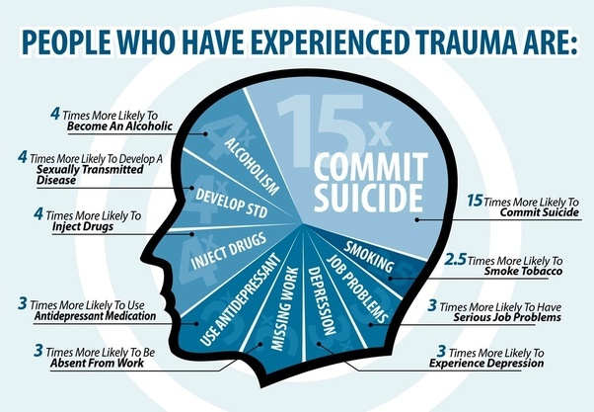

Slide 17
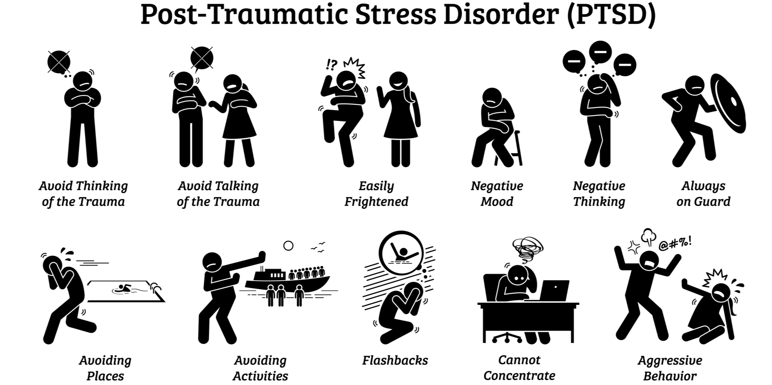
Symptoms
Notes:
In addition nightmares intrusive thoughts
PTSD often leads to very serious interpersonal and occupational challenges, and has been estimated to result in 3.6 days of lost productivity per month (Kessler, 2000). The disorder has been called a ‘life sentence’ due to its association
Most people don’t seek treatment with the highest only 50% and oof them only 58% receive care from a mental health professional.
It is worth also just asking ourselves what impact social context, cultural values and beliefs, class, race, and gender has in how problems are experienced, communicated and addressed. For example civilians in Afghanistan who experienced multiple traumas look to religious and spiritual practices, such as reading the Qur’an or praying to cope.
Ventevogel and Faiz (2018) observed that Afghan men and women tend to communicate emotional distress and wellbeing in distinct ways. For example, cultural norms may encourage women to publicly express sorrow and grief (gham) through culturally prescribed ways such as storytelling and mourning. Communicating sadness in public spaces may also help women acquire social supports. In contrast, men’s outward expression of emotions in the country is often viewed as a sign of weakness and a lack of self-control, and is culturally restrained. Those masculine norms, therefore, encourage concealing emotions to avoid shame and humiliation.

Slide 18
Symptoms must persist for at least 1 month following exposure in order for a diagnosis of PTSD to be made.
Symptoms which develop within a month of the event, and last less than one month, indicate a diagnosis of Acute Stress Disorder.
If PTSD symptoms persist after 1 month of the traumatic event but last less than 3 months, a diagnosis of Acute PTSD is appropriate.
If these symptoms persist beyond 3 months, a diagnosis of Chronic PTSD is applicable.
Finally, should symptoms develop 6 months after the event, a diagnosis of Delayed-Onset PTSD can be made.
Notes:
18
18
After 6 months = delayed onset PTSD

Slide 19
Risk and protective factors v causes
The belief that PTSD is simply ‘caused’ by a traumatic stressor is challenged by a large body of research highlighting a multitude of risk and protective factors that seem to influence whether or not PTSD occurs (Ford et al., 2015).
The majority of people who experience a traumatic event do not develop PTSD
PTSD is rarely caused by a single event
Development of PTSD comes from complex factors which can be psychological, social and biological
Pre-trauma factors occur before and can increase or lower the risk
Peritraumatic factors occur during or shortly after the event
Post-traumatic factors occur after the event and have a big influence in recovery
Notes:
19
19
3rd bullet point - Biological factors are microorganisms (bacteria, viruses, fungi and microscopic parasites), cell cultures, human endoparasites and components from microorganisms that can cause damage to health in humans.
Pre-trauma - Personal characteristics such as ethnicity, age, gender, personality, memory, learning style, motivation and genetic characteristics, access to socio-economic resources. History of psychiatric disorders and other medical history. Previous exposure to traumatic stressors.
Peritraumatic factors- Heightening physiological reactions such as increased blood pressure and exhaustion, impaired memory as a result of an overwhelming emotional response to a stressor.
Post-traumatic factors- Social support. Access to culturally-sensitive and evidence-based treatment options. Development of coping styles and self-efficacy.

Slide 20
Risk of PTSD is increased if:
The traumatic stressor involves gross violations of one’s dignity, basic needs or security of attachment relationships. Examples include torture and sexual abuse in the family.
There is severe and long-lasting physical injury or other health complications.
There is a history of adverse childhood events.
There is a reluctance or inability to disclose.
The traumatic stressor is characterised by unpredictability, lack of control and suddenness.
Notes:
20
20

Slide 21
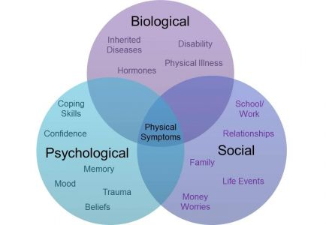
Risk and protective factors - Bio Psycho Social model
Notes:
Biological
An underlying genetic predisposition, sex (women more prone- is that to do with rape?)
Psychological factors - A subjective experience of loss of control and perceived negative effect of the traumatic event on the individual (Hasto et al., 2013). Extreme anxiety and intrusive reexperiencing. Guilt. Subjective reactions to terrifying or horrifying events. Dissociation. Social phobia. Anger. Trauma-related beliefs. Personality
Social factors
Multiple exposures to trauma, social isolation. Conflict
A PDF sheet is available ‘A biopsychosocial formulation of PTSD risk and trajectory’ that allows you to record the Bio Psycho Social factors in the pre, peri, post traumatic and protective factors – e-mail me to get a copy

Slide 22
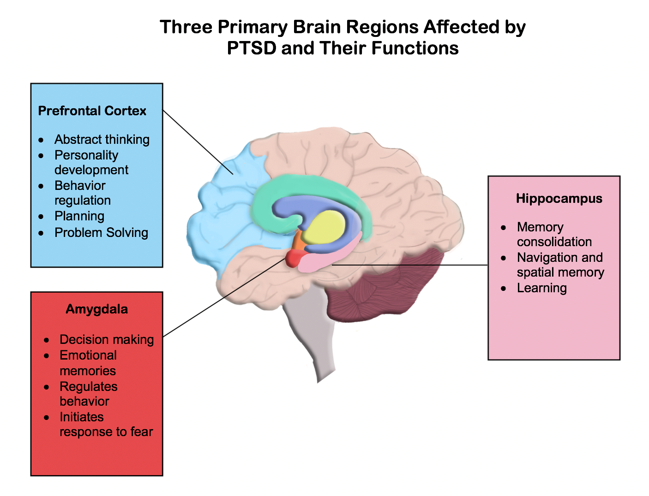
Notes:
It appears that parts of the brain involved in emotional responses are activated more in individuals living with PTSD – this is in the amygdala.
Prefrontal cortex has an important role in a process of lessening the fear response to stimuli. Studies have shown that individuals experiencing PTSD tend to have reduced medial Prefrontal Cortex volumes and activation. The consequence is reduced emotional regulation.
The hippocampus has been linked to the formation of emotional memories. Evidence suggests that the volume of the hippocampus is reduced in individuals with PTSD, and the activation of this region of the brain is decreased. Evidence seems to suggest that individuals with PTSD may experience an increased emotional response to stimuli, while also being less able to adapt to the stimuli and decrease their emotional response over time. Understanding how and why these changes come about is key to understanding PTSD and developing potential therapeutic strategies in future. We will now see a video how this increased emotional response to a stimuli maybe perceived by someone suffering PTSD – if there are any PTSD sufferers who get triggered by noise they might want to give this a miss

Slide 24
What character traits reduce risk and aid recovery? Hausler et al; 2017
Creativity
Curiosity
Judgement
Love of learning
Perspective
Teamwork
Fairness
Leadership
Bravery
Perseverance
Honesty
Zest
Forgiveness
Modesty
Prudence
Self-regulation
Love
Kindness
Social intelligence
Appreciation of beauty and excellence
Gratitude
Hope
Humour
Religiousness
Notes:
Leadership –mention servant leadership
Religiousness – a purpose/vision
Ask what character strengths/values (challenge them to develop 5 – 10 values related to building resilience) delegates helped attain positive wellbeing during times of high stress? If anyone is prepared to share at the end.
Connectedness to one’s family, community and physical environment is a core attribute of resilience. In other words, resilience is relational and situational – you can demonstrate resilience in one situation but crumble in another. Personal qualities such as belief in self, determination, vision, decisive are all important but so is having a support network. In addition to personal resilience, there is family, community (acceptance, community story telling – most resilient communities after the 2004 Boxing Day tsunami back up running quickest), organizational,

Slide 25
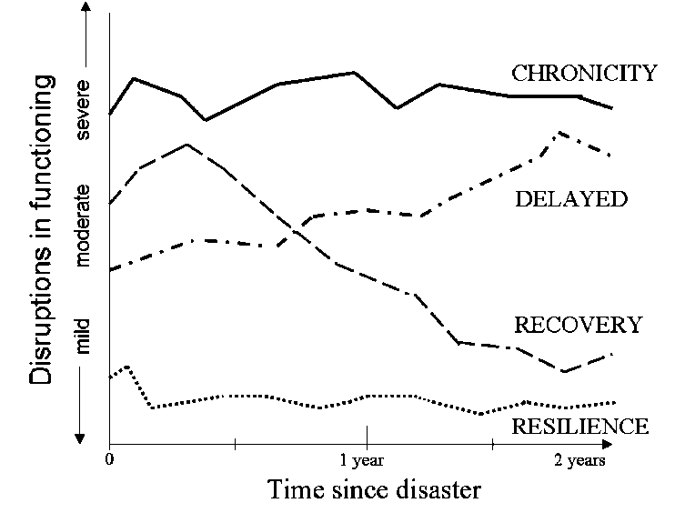
Notes:
Resilient trajectory is often characterised by successful adaptation to the trauma-induced stress leading to well-adjusted day-to-day life. Acute stress reactions may still occur such that the individual experiences shock, anguish, terror and confusion. However, individuals manage to regain mental and emotional balance relatively soon after exposure so that PTSD is very unlikely to develop.
Recovery involves experiencing PTSD and/or other severe post-traumatic problems but later regaining good general functioning. Recovery is often non-linear and can involve both periods of progress and setbacks. A range of factors have been proposed to affect recovery such as social and economic resources, access to care and personality characteristics. Notably, ‘natural recovery’, or recovery without formal interventions, has also been reported to occur although the reasons for that are not fully understood.
Delayed trajectory is defined by low levels of acute symptoms shortly after exposure, which gradually develops into symptoms and, eventually, into full diagnosis. In the case of delayed-onset PTSD, individuals develop full symptomatology after a prolonged symptom-free period.
Chronic is classic trajectory of PTSD representing an abrupt, severe and lasting change in the individual’s capacity to manage stress and cope with daily life. Some affected individuals and communities may experience a dramatic sense of loss, panic and hopelessness, which can quickly develop into a range of maladaptive responses such as unresolved grief, anxiety disorders, PTSD and others.

Slide 26
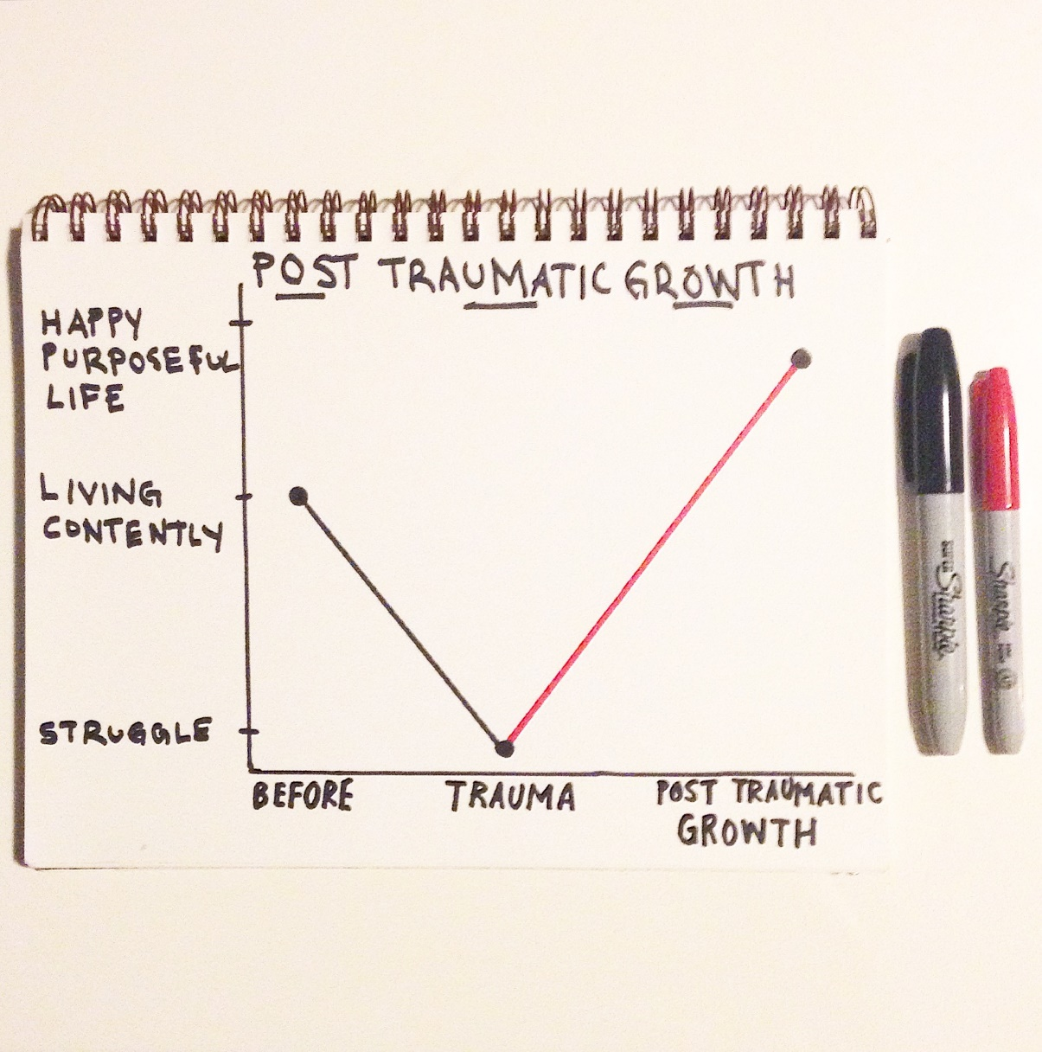
In contrast to the resilient trajectory, Post-traumatic growth entails the emergence of behaviours, attitudes and values that were not present before the traumatic event. Such changes may concern spiritual development, enhanced relationships with others, wisdom and gratitude. Distress can still occur during a growth trajectory. By definition, trauma and distress are key catalysts for growth. However, distress is expected to gradually diminish over time.
Notes:
Research is still unable to explain or predict with confidence one’s post-traumatic trajectory. Ongoing research into risk and protective factors will likely make health professionals, families and communities better equipped to successfully manage adverse trauma reactions.
Post traumatic growth is moving beyond a pre-trauma level of functioning. It is common in Buddhism and now gaining traction in the west.
PTG is rooted in the work of American psychologist Ronnie Janoff-Bulman. According to Janoff-Bulman, an individual’s development and behaviour are determined by a set of core assumptions they possess about the self, the world and the meaningfulness and randomness of events.
The most popular measure for PTG is Tedeschi and Calhoun’s Post-Traumatic Growth Inventory (Tedeschi & Calhoun, 1996) as seen here in blue.
A recent systematic review undertaken by Schubert and colleagues (2016) suggests that trauma survivors with PTSD exhibit higher PTG compared to trauma survivors without PTSD. However, the authors noted that there does appear to be a ‘critical point’ whereby if PTSD symptoms are profound, PTG would be inhibited (Butler et al., 2005).

Slide 27
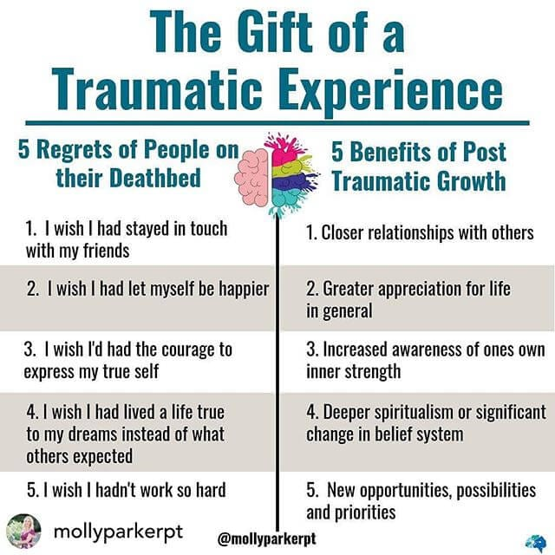
What to do to facilitate post-traumatic growth
Self-expression – writing, talking, painting
Reflection
Finding meaning & significance in the experience
Nurturing characteristics such as agreeableness, openness & extraversion
Practicing acceptance, forgiveness etc.
Notes:
Also purpose beyond self, personal vision/mission, goals to continuously improve, nurture trusting relationships, develop and live in accordance with values, emotional hygiene, positive social network, developing compelling beliefs about self and the world,

Slide 28
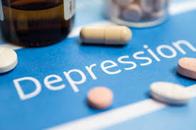
Even with widespread use of medication for ‘mental illness’ rates of anxiety and depression are increasing.
Evidence is continuing to show antidepressants perform no better than a placebo!
What if ‘mental illness’ like anxiety, depression and PTSD are not mental disorders at all but simply responses to adversity? A compelling paper from biological anthropologists states just this.
If this is true what impact would this have on the labels given and stigma?
Needless to say, rates of PTSD, depression and anxiety are much higher in conflict-affected areas.
Anxiety may be due to chronic activation of the fight or flight system. PTSD may occur when trauma triggers the freeze response which helps animals disconnect from pain before they die, and depression may be a chronic activation of that same freeze response.

Slide 29
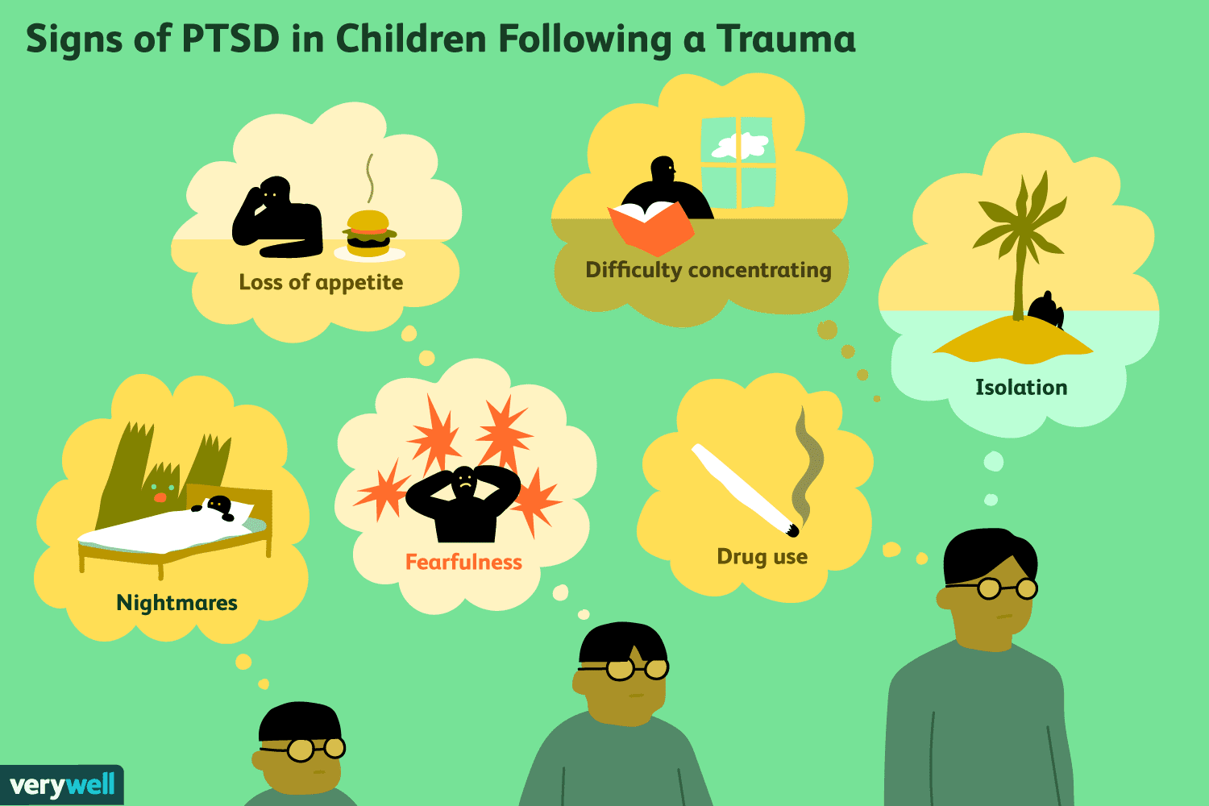
Highest rates of exposure to trauma have been found in early childhood.
Early childhood we posess a unique set of both psychological and physical vulnerabilities which increase the risk of experiencing longer-term negative outcomes.
Correct diagnosis of PTSD in young children is vital, as without an accurate diagnosis, if not they may develop further mental and physical health issues as they grow.
Symptoms of PTSD in young children are broadly similar to those found in older children
Developmental differences that exist between these age groups can lead to distress being expressed differently by children under the age of 6.
Challenges
What trauma means for children?
Difficulty identifying PTSD symptoms
Uaw of self-reporting and questionnaires
Notes:
Challenges: 1st - The types of events which can be described as ‘traumatic’ can be different for young children. For example, young children often find medical procedures following a severe injury to be more ‘scary’ than the injury itself (De Young & Landolt, 2018).
The way in which a child reacts to an event can also be influenced by their parents’ or caregivers’ reaction.
2nd - Certain PTSD symptoms are difficult to identify in young children,. These include symptoms such as intrusive memories, loss of interest, and hypervigilance. This is especially true for children in the 0-3 age bracket, as their cognitive and language capacities are limited.
It is difficult to distinguish between ‘normal’ child behaviours and behaviours which may be symptomatic of PTSD.
There is a lack of evidence regarding signs of PTSD-linked functional impairment in children between 0-6 years old.
3rd - People are generally unaware of how to recognise symptoms of PTSD. As a result, parents or health professionals may not identify potential symptoms of PTSD in children.
As children may find it difficult to express their thoughts and feelings, the diagnostic information they provide often needs to be supplemented by information given by their parents. However, research (Cohen & Scheeringa, 2009) has shown that child-parent agreement in relation to symptoms can be poor.
It is difficult to distinguish signs of avoidance from signs that a child is successfully coping following trauma. For example, if a clinician asks a child about a traumatic event and the child answers that they ‘never think about it’, is this a sign of avoidance or coping?
There are also challenges with diagnosis in the elderly – PTSD can increase risk of dementia. Elderly can find it diffcult to communicate symptoms. Stigma more common in old age. Memory issues make diagnosis harder.

Slide 30
When assessing the trauma history
Nature of the trauma
Identifying coping resilience
Identify treatment needs
Safety
Dont
Ass u me PTSD is present just because exposure or multiple exposures
Forget to make the individual aware that highlighting positive aspects of their trauma history does not mean the traumas they experienced was easy to cope with.
Be inflexible.
Be anxious or scared.
Be forceful.
Prolong the assessment for longer than needed. Allowing the individual to dwell on past traumas may increase their distress. A balance between not-too-rushed and not-too-lengthy is needed.
Ignore their culture and social context.
Ignore their values, beliefs etc.
Do’s
Assess a patient’s trauma history
Highlight coping strategies and personal resources they’ve used in the past.
An assessment of the individual’s current psychological wellbeing
Reflects cautious confidence and empathic interest.
Encourage the individual to open up and be honest about their experiences – build rapport
Allow enough time for the individual to be able to reflect on their answers.
Notes:
Frueh and colleagues (2012) identified these 4
1 - exposure to natural disasters is less likely to lead to PTSD than surviving an unprovoked physical assault.
2 - how an individual has adapted to previous trauma. Coping strategies and personal resources that an individual has relied upon in the past
3 – must be tailored to the individual
4 - discuss whether or not they are currently exposed to an ongoing stressor such as living in an abusive relationship.
Do’s – 3rd bullet - to ensure they are stable enough to cope with the potential distress associated with a trauma history assessment.
6th bullet - The individual should not feel rushed, and should not feel like they are being interrogated.
Don’ts 3rd bullet point - If it is apparent that an individual is getting distressed, offer the support required, even if you initial assessment suggested they would be able to cope with the trauma history assessment. 4th body language. 5th - Remind the individual that they should only disclose their experience(s) if they feel able and ready to do so.
A challenge in diagnosis of course is language, ethnicity, cultural beliefs etc. – person centred approach. Clusters of PTSD are more widely reported in some cultures for example. Examples of different somatic symptoms include; Refugees from Senegal - ‘General body pain’ & ‘body heat’ (Tang & Fox, 2001). Survivors of the Rwandan Genocide ‘Sudden shortness of breath’ (Hagengimana & Hinton, 2009)

Slide 31
Barriers to seeking help
Some core symptoms such as avoidance makes seeking help challenging
Scepticism about treatment (its for the weak, distrust of pharma etc.)
Insensitive ‘therapist’
Lack of knowledge of PTSD and services
Affording care/time taken for care
Lack of government funding & difficulty navigating the system
Stigma/judgment by others
Beliefs (that I can manage this on my own)
Negative past experiences
Counter intuitive to the tough culture in some sectors – military/police
Worry about things like ‘losing my job/harm my career’ so carry the burden
Overwhelming personal & professional responsibilities – psychiatric staff for example
Concerns about confidentiality
Difficulty trusting anyone

Slide 32
We all have a responsibility to:
Acknowledge and respect survivors of trauma
Provide unconditional acceptance
Encourage ownership for seeking help and encourage choice and flexibility – internet interventions have proven to be effective and cost-efficient and can overcome geographical barriers. Non-clinical interventions e.g. yoga
Encourage the use of peer support and be proactive in building own support network
Be culturally sensitive - culture-specific individual and collective meanings influence the meaning the patient attaches to the traumatic event.
Raise awareness of PTSD and general mental ill health
Be inquisitive but not interrogating - consider the type of trauma, its severity and consequences, as well as the individual’s own life history and context.

Slide 33
Substance use and PTSD
Substance Use Disorders (SUDs) and PTSD are both chronic and debilitating conditions which often co-occur.
Up to 41% of veterans with PTSD also have a co-occurring SUD
This co-occurrence has been associated with a range of negative outcomes, including physical health issues, homelessness, and increased risk of suicide.
Is the relationship between SUDs and PTSD is around the issue of ‘self-medication to block out the psychological pain?
individuals with PTSD and SUDs are likely to live in contexts which may potentially exacerbate their PTSD symptoms.
These individuals may find it more difficult to access health services, increasing the difficulty of getting a diagnosis for their PTSD and receiving the necessary care.
Access to those substances is often deemed easier than seeking professional help with prescribed medication.
If an event, or series of events in combat made an individual feel powerless, and this then leads to beliefs of hopelessness, then this logic inevitably leads to using alcohol or other drugs to make the here and now better,
Notes:
4th bullet point - in the large majority of cases of co-morbid PTSD and SUDs, PTSD emerges first and is then followed by the development of an SUDs (Ouimette et al., 2010). It has also been observed that individuals with PTSD and SUDs use substances in order to manage the symptoms of their PTSD.

Slide 34
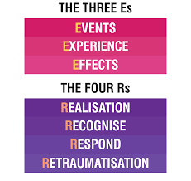
Trauma-informed care
A framework that is grounded in an understanding of and responsiveness to the impact of trauma that emphasises physical, psychological, and emotional safety for both providers and survivors and that creates opportunities for survivors to rebuild a sense of control and empowerment. Key principles are:
physical and emotional safety for service-users
service-providers’ trustworthiness and transparency
empowerment
voice and choice
peer support; collaboration
the understanding that cultural background influences help-seeking behaviours
The following assumptions are cornerstone of TIC:
Notes:
Individual trauma results from an event, series of events, or set of circumstances that is experienced by an individual as physically or emotionally harmful or life threatening and that has lasting adverse effects on the individual’s functioning and mental, physical, social, emotional, or spiritual wellbeing.
A program, organisation, or system that is trauma-informed realises the widespread impact of trauma and understands potential paths for recovery; recognises the signs and symptoms of trauma in clients, families, staff, and others involved with the system; and responds by fully integrating knowledge about trauma into policies, procedures, and practices, and seeks to actively resist re-traumatisation.

Slide 35
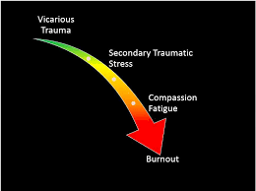
Challenges with TIC
Notes:
Vicarious trauma - This is also known as secondary exposure to trauma, this concept refers to the indirect experience of trauma as retold by another person, which can lead to secondary traumatic stress. This is especially common in healthcare and social care staff working with trauma survivors in settings such as accident and emergency units, homeless shelters, refuges for victims of domestic violence, hospice care and orphanages.
Compassion fatigue refers to the reduced ability to feel compassion and empathy towards service users. Certain client behaviours may be interpreted as unwillingness to engage with treatment, but may actually reflect efforts to cope with effects of trauma. For example, a service-user seemingly failing to engage in therapy sessions may be exhibiting dissociation and avoidance, both of which are common PTSD symptoms. This requires that service providers be well-trained in trauma awareness. Furthermore, services often use a one-size-fits-all approach and may fail to meet the unique needs of clients.
Self-care therefore is vital for professionals working in this field.

Slide 36
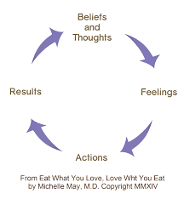
Treatment options – Trauma-focused cognitive behaviour therapy (TF-CGT)
One of the psychological therapies with the strongest evidentiary support recommended for PTSD (NICE, 2018).
CBT is a type of therapy which explores the way in which thoughts (or cognitions) affect the way individuals feel and behave. It is used in the treatment of a range of mental health disorders such as depression and anxiety. CBT can be modified to treat other disorders such as PTSD and eating disorders like anorexia nervosa.
The aim of CBT is to identify how thinking styles can be challenged and modified to improve feelings and behaviours. For example, if an individual interprets a situation negatively, a ‘negative cognition’, this can have a negative impact on their feelings, for example causing anxiety, low mood and sadness. These negative feelings can lead to potentially unhelpful behaviours such as avoidance or reduced activity.
Notes:
Its about helping individuals recognise and identify negative cognitions/thoughts. Over time, these cognitions can be challenged and feelings and behaviours-altered to improve mental health/wellbeing and results/outcomes in life.
Trauma-Focused CBT (TF-CBT) is a specific type of CBT which has been modified to help treat PTSD. It can be delivered as an individual TF-CBT or as a group TF-CBT.
Individual TF-CBT specifically focuses on: - Managing reactions to trauma - Developing strategies for managing symptoms of hyper-arousal and flashbacks - Safety planning - Processing of the trauma memories - Processing trauma-related emotions such as anger, loss, guilt and shame - Overcoming avoidance - Restabilising functioning be that in work, school or personal situations - Restructuring meaning for the individual in relation to their trauma
It needs commitment from the person to put it into practice – it needs time and don’t forget wider implications such as the family situation.

Slide 37
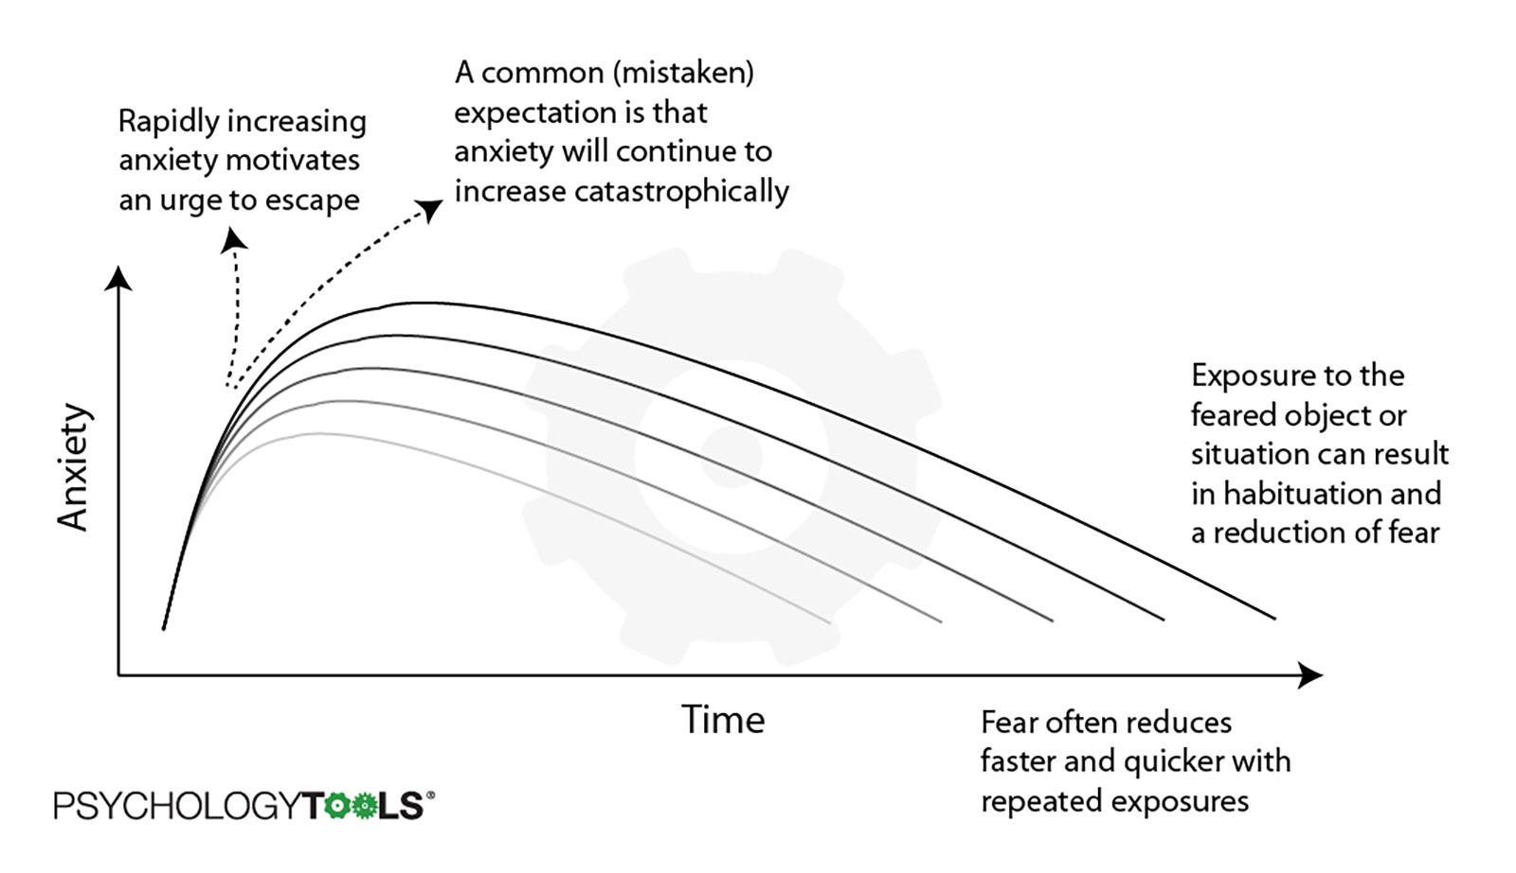
Treatment options – Graded exposure therapy
Gradual and controlled exposure to the source, for example someone suffering PTSD as a result of their time in ICU it could involve working up to going back to the ICU and seeing the machines there, go through the patient diary to separate the fact from fiction and meeting the staff.
Notes:
Habituation is the diminishing of an innate response to a frequently repeated stimulus. Peer mentors are something to consider here i.e. someone who has gone through the same experience and can metaphorically ‘hold-the-hand’ of the person currently suffering.
There is a youtube clip at the end about prolonged exposure therapy

Slide 38
Treatment options – Narrative exposure therapy
Create a safe environment and clear boundaries/expectations
individuals are encouraged to establish a coherent life story by reflecting on key life events and putting the traumatic experience(s) into context. Do a ‘lifeline’ (significant life events on a written timeline)
Often delivered in small group settings
Telling their life story chronologically, focusing on both positive and negative life events, describing those experiences in detail, and focusing on feelings and emotions that those events arouse.
Aim is to help the individual restore a positive self-identity and meaningfully integrate the traumatic event(s) into a coherent life story.
Needs compassionate understanding, active listening, rapport and unconditional positive regard.
Useful for family and community functioning, particularly in low-resource settings (video on next slide).
Can be emotionally taxing on the facilitator
In an imaginal exposure the facilitator reads the timeline events aloud in chronological order, exposing each traumatic event and allowing the integration of affective (mood, feelings, & attitudes), cognitive, physiological and sensory details into the present moment.
Notes:
There can be reluctance by many PTSD sufferers to do this because they don’t want to revisit the trauma, so some anxiety busters need to be at the ready. It can be written or recorded so the sufferer can read/listen to it regularly to de-sensitise. There is evidence from smaller-scale studies that NET may be effective for reducing PTSD and related psychological and comorbid symptoms in a range of post-conflict settings such as Uganda, Rwanda and Sri Lanka (Cooper et al., 2019).
It is recognised that traumatic stress can be intergenerational, meaning it can be passed on from generation to generation, and that it can have severe consequences for family and community cohesion. Therefore, involvement of the family and the community in the treatment for trauma and PTSD seems integral to individual and collective wellbeing (Cooper et al., 2019).

Slide 39
Notes:
1 min 36 Narrative exposure therapy: A treatment option for survivors of war living with PTSD

Slide 40
Treatment options – Telehealth
Interactive technologies such as videoconferencing
Ideal for those who don’t have transport, unemployed etc.
Confidential and comfortable for many users
Time effective
With unexpected events like COVID this is an option well worth considering
Potential to reach more people
Convenient
No time in waiting rooms
People can feel there is always support on hand
Notes:
Mention I have a sheet on the most commonly prescribed pharmacological treatments that can be senton request.

Slide 41
Treatment options – Debriefing and screening
Introduced to try and reduce the psychological morbidity associated with experiencing traumatic events.
Aims to reduce both the acute distress and prevent the development of psychiatric disorders, particularly PTSD.
Initially delivered to soldiers who had experienced combat, but it became more widely used in the 1980s - natural disasters, road traffic accidents, sexual assaults, industrial accidents and fatal accidents.
Not evidence based, but a systematic review suggested receiving a single session of debriefing people were at an increased risk of PTSD compared to those not receiving debriefing.
This review changed practice in that compulsory debriefing stopped. Instead, a ‘screen and treat’ model was suggested.
Consider a validated screening tool used 1 month after the event such as Harvard Trauma Questionnaire or the Post-Traumatic Diagnostic Scale. These are recommended in the National Institute for Clinical Excellence (NICE) Guidelines for PTSD (NICE, 2018).
Notes:
It has become increasingly recognised that there is no evidence to support psychologically-focused debriefing for the prevention of PTSD after a disaster or an emergency. Community interventions which focus on strengths, resources and supports, assessment of need and psychoeducation are more appropriate to prioritise in the aftermath. For populations at high risk of PTSD, such as those which have survived a major disaster, consideration should be given to using a validated screening tool for PTSD at one month after the disaster.

Slide 42
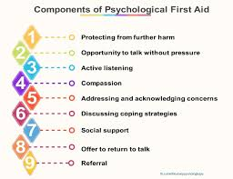
Treatment options – Psychological First Aid
Rather than implementing debriefing sessions, psychological or mental health first aid (PFA) can be used to support people experiencing disasters or other crisis events.
Recommended by the World Health Organization (2011).
A framework for supporting individuals and ensures dignity and culture are respected.
Notes:
2nd bullet point endorsed by many international agencies
PFA is NOT:
Something that only professionals can do
Professional counselling
‘Psychological debriefing’ in that PFA does not necessarily involve a detailed discussion of the event that caused the distress
Asking someone to analyse what happened to them or to put time and events in order
Although PFA involves being available to listen to people’s stories, it is not about pressuring people to share their feelings and reactions to an event

Slide 43
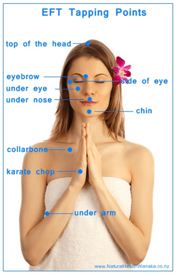
Notes:
It works by the retrieval of fear memories, incorporation of new emotional experiences and learnings into the memory, and finally reinforcement of the new learning. The greater the negative intensity the better, you need to ‘feel it to heal it’.
EFT relies on the premise that acceptance of, rather than resistance to, a particular condition can reduce suffering. Its like watching a movie rather than continually re-living it.
We can think of EFT as helping reboot our personal energy system in relation to the issue at hand, similar to the way we reboot a computer, which has got stuck or has crashed.
We can’t change our past but we can release it!
Is energy imbalance and unresolved emotional trauma the underlying cause of many physical chronic conditions? What if they were? To avoid or cure disease we need to stop causing it! 98% efficacy rate

Slide 44
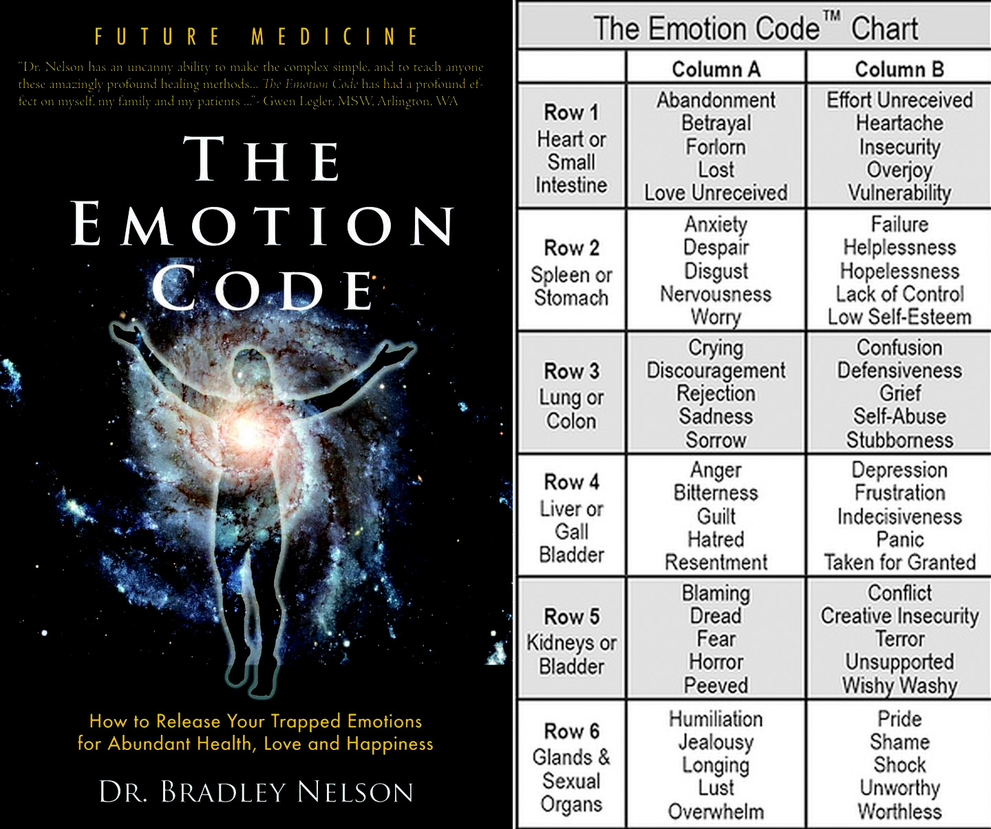
Notes:
There is a video about this at the end – do the sway test about our name so they understand yes and no which is on the video – you need a magnet when doing it

Slide 45
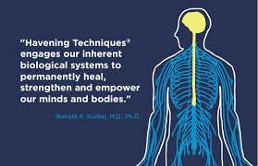
Notes:
The 'havening' technique is a very powerful technique for stress, overwhelming emotions or mental blocks. It is based on research, and with a group of volunteers nearly all of them were able to boost their self-esteem, concentrate better, eliminate worry and let go of disturbing thoughts. Plus, nearly all of them were still benefitting from those changes two months later. Its been used successfully for depression and anxiety.
Dr. Ronald Ruden said that the anecdotal evidence around the technique is "so beyond clinically significant that it is almost not necessary to do these studies.“
I can do another masterclass on this subject

Slide 46
Treatment options – Eye Movement Desensitisation and Reprocessing (EMDR)
Usually considered when individuals have not responded to CBT/EFT
Can be delivered to children and adults.
An evidence-based psychological therapy.
Based on the premise that the brain stores memories in an organised or ‘processed’ manner, but when a traumatic event occurs, it can be so overwhelming that the memory of the event is not stored in the usual way and so can be considered ‘unprocessed’.
The memory is unusually ‘accessible’ and as a result, can replay in an unplanned manner, or as a result of a trigger, often as a flashback.
In general, the brain processes daily experiences during sleep, especially during a particular phase of sleep known as REM or Rapid Eye Movement sleep. It is thought that in some people, when a traumatic event occurs, the usual daily processing of that memory during REM sleep does not occur.
The main aim of EMDR therapy is therefore to help the brain process distressing memories allowing individuals to manage them more effectively.
Notes:
Can be considered for those who are highly introverted and don’t talk about their feelings, emotions experiences. Its important however that the person understands there is a powerful sub-conscious mind.
The person brings up the disturbing memory and using bilateral movements of the eyes (or something else) the memory is processed. Before they start they will be in a very relaxed state as we want to try and replicate the sleep state (REM) – REM sleep is the reason EMDR works. When the person is processing the memory they don’t speak they are doing it by visualisation as if they are playing it as a movie and it gets ‘paused’ in the worst part and they reflect on the vision/thoughts/feelings of that part, then the EMDR (bilateral movement) starts then we ask what came up and that is worked with – the image may be altered (slowed down, speeded up, turned into black and white, volume turned down etc.) which is part of the processing and some positive cognitions are brought in such as a supportive friend/relative – its about getting control of it so you’re not helpless. Its based on free association so the mind/memory takes us where it wants to go. Its about processing small bits of the traumatic memory at a time by bringing up the memory of the past in the mind then the eye movements process it in the present, the bilateral eye movements keep the person in the present so the traumatic memory doesn’t take over. There is no set number of sessions. Some therapists use bilateral sounds using ‘beeps’ or a visual cue going from left to right, or tapping on the arms.

Slide 47
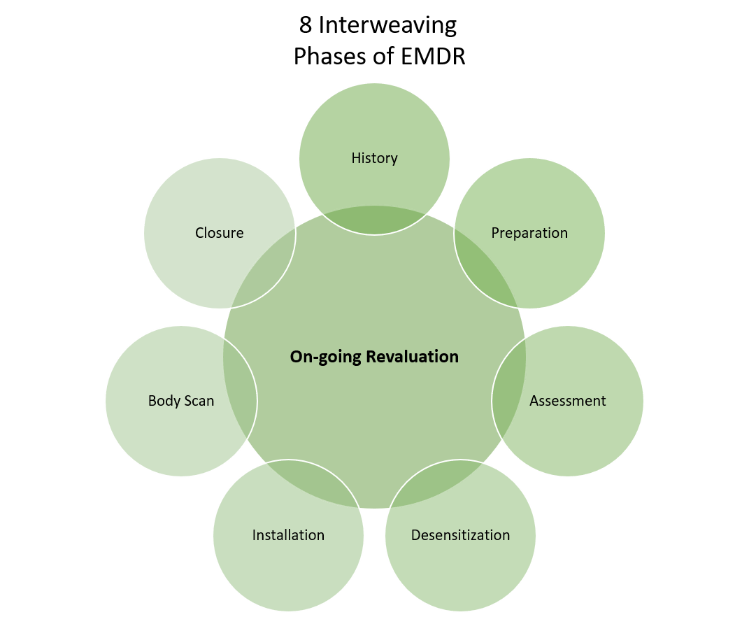
Treatment options – Eye Movement Desensitisation and Reprocessing (EMDR)
Notes:
History/Treatment planning and assessment - a detailed history allowing the treatment to be planned.
Preparation - a relationship between the therapist and the patient is established. A range of techniques which aim to stabilise emotions is developed. Completion of the preparatory phase is essential before the next phases of therapy can begin.
Memory assessment - identify an image of the most distressing part of the memory. In addition to the image identified, the individual will be asked to identify a negative belief associated with the memory and the emotions and sensations associated with it. Some people find it hard to share with another but will record it on a device.
Desensitisation - the distressing memory is evaluated with the aim to change the trauma-related beliefs and emotions associated with it. The individual is asked to hold the belief, image, emotion and sensation in their mind while attending to a series of eye movements. After each series of eye movements, the individual is asked to ‘blank out’ the memory.
Installation - consolidate the positive cognitions now associated with the image.
Body scan - the individual is asked to scan the body to determine if any sensations associated with the traumatic memory remain. If sensations are identified target this for further processing.
Closure - stabilising techniques developed in the preparatory phase are used to bring the individual ‘back to equilibrium’ before the reprocessing is complete.
On-going revaluation - final phase during which an assessment is made of the benefit of the treatment.

Slide 48
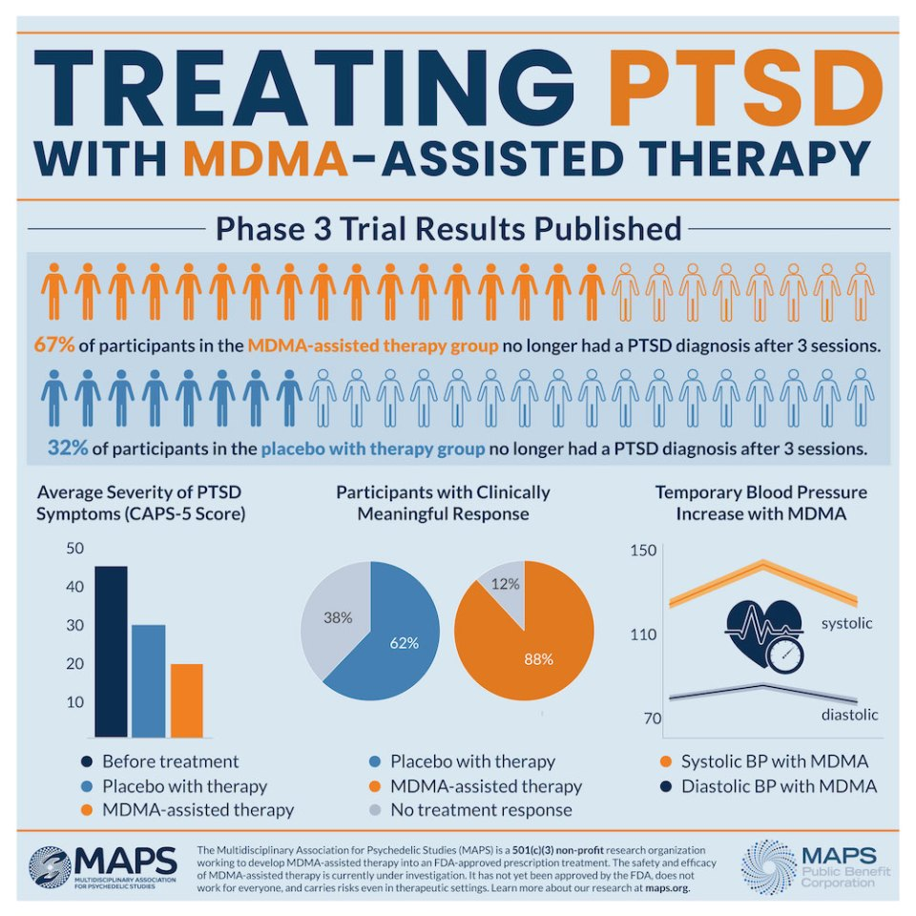
https://www.clinicaltrialsarena.com/comment/mdma-ptsd-treatment/
Notes:
The Multidisciplinary Association for Psychedelic Studies (MAPS) is developing the first-in-class innovator drug midomafetamine (MDMA) for use in treating chronic and delayed-onset post-traumatic stress disorder (PTSD). The drug is currently in Phase III development in the US and Europe. Following positive Phase II trial data showing that midoafetamine resulted in a significant reduction in PTSD symptoms, the FDA granted it Breakthrough Therapy Designation in 2017. Further results continue to demonstrate its effectiveness for treating PTSD. For more information look at the website here, also an overview of the pharmacological treatments for PTSD can be sent.

Slide 49
Treatment options – Community based responses
Immediate response
Educate the affected community, reach out to survivors, engage in efficient early identification of those at risk
Implement community-wide early intervention MH first aid services
Monitor those at risk
Train and support providers
Large-community interventions and programs encompassing both trauma survivors and their family – EFT; Trauma-Informed Multidimensional Family Therapy (MDFT) (used after Hurricane Katrina); rebuilding community cohesion and resilience, increase local awareness, knowledge and skills to cope with the mental health and psychosocial challenges, and leverage healing cultural practices; sociotherapy - fostering dignity and respect, rebuilding social ties and reducing mental distress, particularly among the survivors of war and genocide (used in Rwanda).
Online interventions into community-based service delivery
Program monitoring and evaluation.
Notes:
6th bullet point - MDFT was implemented targeting youth and their families after Hurricane Katrina. It intervened at multiple levels in the youth’s lives and involved work individually, with parents, as a family, and in connection with other interventions and community and social supports. It was also evaluated in several studies targeting youth with substance use problems. Concrete target outcomes included youth’s coping skills and substance use.
Sociotherapy - weekly meetings are typically held in participants’ direct living environment such as a church, a school, or under a tree in the open air. Facilitators guide the groups through the phases of safety, trust, care, respect, rules, and memories. Foundational principles of this therapeutic approach are equality, democracy, participation and responsibility. Sessions often involve participants talking about their present-life challenges.
Sociotherapy is seen by participants as a medicine for the heart, and as healing from the social disconnection and chronic community violence. Sociotherapy is also believed to promote ubwiyunge – which translates as ‘thick’ reconciliation and involves restoring social relations, trust, respect and dialogue with others.

Slide 50
30-day challenge
The character traits on slide 24 & post-traumatic growth on slide 27 choose 2 – 5 things a week to focus on for the next 30-days then review your progress
Familiarise yourself with EMDR, EFT, The Emotion Code and the Havening technique – they are all non invasive, life-changing for many people, and whether you are a PTSD sufferer, health professional or ‘just interested’ these are worth exploring.
Notes:
1 STOP – whether you are a carer or PTSD sufferer – Stop for a moment, Think about what we’ve done; Observe (if you’re a sufferer how it makes you feel); Plan what you will do/use now
2 – if you’re a sufferer make a committed decision to take control
3 – Break any cycles you’re in.
On the next slide is Start, Stop, Continue then spend 30 minutes doing your 30-day challenge – if you don’t do it now, you never will.

Slide 51
Action plan
As a result of todays masterclass what will you:
START DOING
STOP DOING
CONTINUE DOING
Notes:
54321 Decide/do

Slide 52
Further opportunities
Personal Resilience facebook group.
Ignite: Find Your Passion, Live Your Purpose & Re-Write Your Future
https://www.facebook.com/groups/216645969611627/?ref=share
Personal resilience online programme;
https://ignitepd.thinkific.com/courses/rock-solid-resilience?fbclid=IwAR1dt6Mw_cw8EqDPPJA3bpynSEVhFxwfMWBZpPKO1IZq04ZvxHHc0ty8KRc
bernard.genge@gmail.com
Notes:
Email me if you would like to attend an EFT session

Slide 53
Further information/watching – refugees & asylum seekers
https://www.youtube.com/watch?v=tY7WWD6tCAM&feature=emb_title
The 1%: UNHCR’s global trends report in forced displacement for 2019 5 mins 24
Forced displacement now affects more than one percent of humanity – 1 in every 97 people – and with fewer and fewer of those who flee being able to return home, according to UNHCR’s annual Global Trends report. The UN Refugee Agency’s flagship report, issued two days ahead of World Refugee Day, shows an unprecedented 79.5 million were displaced as of the end of 2019.
Studies have consistently found that PTSD, depression and anxiety are highly prevalent in refugee populations (Nosè et al., 2017). Some studies indicate that refugees are 10 times more likely to experience PTSD compared to the host population. A range of factors likely accounts for this observed burden of mental health difficulties in refugees-such as the exposure to war and other acute traumatic events, resettlement stress, along with perceived and actual stigma.
The presence and accessibility of emotional and social support were shown to decrease the severity of symptoms of PTSD, anxiety and depression over time.
The treatment of PTSD in refugees and asylum-seekers in the resettlement country presents numerous challenges. For example, it is often difficult to distinguish between the temporary distress experienced as a result of displacement and longer-term, more severe mental health conditions such as PTSD. Furthermore, individuals from different linguistic and cultural backgrounds may experience, communicate and make sense of distress differently, which also means they are likely to respond to interventions differently.
Of the few studies available EMDR & NET seem effective.

Slide 54
Further information/watching
https://www.youtube.com/watch?v=BEHDQeIRTgs&t=562s 16mins
Understanding PTSD's Effects on Brain, Body, and Emotions | Janet Seahorn | TEDxCSU
PTSD disrupts the lives of average individuals as well as combat veterans who have served their country. The person experiencing the trauma often then impacts the lives of his/her family, friends, and workplaces. PTSD does not distinguish between race, age or gender and often goes undiagnosed. Even with proper diagnosis, many individuals do not know where to turn to get help. Society needs to understand the aftermath of trauma especially combat trauma and how to prepare for warriors when they return home. Janet Seahorn, Ph.D has been a teacher, administrator, and consultant for over thirty years. She currently teaches a variety of classes on neuroscience and literacy as an adjunct professor for Colorado State University in Fort Collins, CO. Jan has a Ph.D in Human Development and Organizational Systems. Her background includes an in-depth understanding of human development and neuroscience research as well as effective practices in organizational systems and change. She conducts workshops on the neuroscience of learning and memory, the effects of “at-risk” environments (i.e., poverty), brain development, and researched-based instructional practices. Jan has worked with many organizations in the business and educational communities in creating and sustaining healthy, dynamic environments. Dr. Seahorn has researched and studied the effects of trauma on the brain and how excessive or extreme trauma can impact changes in the brain’s neuro network and how that change impacts behaviors.

Slide 55
Further information/watching
https://www.youtube.com/watch?v=ORs3-tRokGU 12 mins 15
Return from Chaos: Treating PTSD | Peter Tuerk | TEDxCharleston
Peter Tuerk, the director of a VA PTSD program, introduces how we process experiences and trauma. Using examples from his research, he describes how it's possible to process memories and their associated meanings to overcome a traumatic incident. When active avoidance impedes natural recovery the most effective healing is facilitated through treatment designed to limit avoidance and to assist with the processing of relevant information.
https://www.youtube.com/watch?v=0rb3UK1Jg8Q&t=1s 7 mins
Learn how EFT or "tapping therapy" can help reduce PTSD and anxiety
We had Dr. Joseph Weiss come on to show how Emotional Freedom Technique can help you realign your energy and better your health.
https://www.youtube.com/watch?v=N7S66OSNDiI 13 mins
Emotion Code - Process of Releasing Trapped Emotion
Dr. Bradley Nelson walks you through the process of releasing your first trapped emotion (look at what people have said under the video)

Slide 56
Further information/watching
https://www.youtube.com/watch?v=1IPsBPH2M1U 3 mins 20
What is Eye Movement Desensitization Reprocessing Therapy
EMDR is an evidence-based treatment where repetitive eye movement is used to make telling a story easier.
https://www.youtube.com/watch?v=_mv-NUhRmIk 1min 35
CBT as Treatment for PTSD
Cognitive Behavioral Therapy can help people with PTSD look at their behaviors and then use strategies, like relaxation techniques, to overcome the fears and anxieties related to their traumatic experiences.
https://www.youtube.com/watch?v=HHfUdOM8QIQ 5 mins 49
Graded Exposure Dr Paul Stone
https://www.youtube.com/watch?v=7ZG41R9I4MU 3mins 54
What is meant by psychological first aid? Dr Frank Ochberg

