Slide 1
Recovery College Emotional Skills Course

Slide 2
Group Agreement
Phones on silent.
We ask that you have your video cameras on if possible and mics on mute when not speaking.
We will do our best to come to everyone during discussions, but we do have to be mindful of time.
Please can we ask that you be mindful of what you say so we can keep everyone safe. So, we ask, for example, not to talk about past traumas, abuse and self harm, drugs etc.
Free from distractions.
Ιf anyone is struggling or feels uncomfortable with the topic of conversation, please take a few minutes away from the group. You can also use the numbers on the following page.
Confidentiality. Please ensure that your space is confidential and you do not have others in the room with you. This means you can feel safe in the sharing of knowledge. It is important not to disclose any information that you do not feel comfortable sharing with the group.
All discussions are kept confidential and are not discussed outside of the group setting.

Slide 3
Useful Helplines
Local Crisis Spaces in Somerset to get out of hours support:
Taunton (Mind in Somerset): Monday – Sunday: 6PM – 11:00PM Saturday and Sunday 12-4PM
Sussex Lodge, 44 Station Rd, Taunton Somerset TA1 1NS
Yeovil (Mind in Somerset): Monday – Sunday: 6PM – 11:00PM Saturday and Sunday 12-4PM
Yeovil Foyer, Peter St, Yeovil BA20 1PN
Bridgwater (Second Step): Friday – Monday: 6PM – 11:00PM
Town hall, High St, Bridgwater, TA6 3BL
Mendip (Second Step): Sunday – Monday 6PM- 11PM
Please phone 01823 276 892 before so they know that you are coming, and note that they cannot take anyone under eighteen or under the influence of drugs or alcohol. Due to health and safety procedures they cannot guarantee there is an accessible toilet facility on site.
Further information: https://www.mindinsomerset.org.uk/get-support/crisis-space/
Mindline (24/7): 01823 276892
Shout (24/7): Text SHOUT to 85258
Samaritans (24/7): 116 123
Life threatening/emergency situations (24/7): 999
Urgent medical help and advice but not a life-threatening situation (24/7): 111

Slide 4
Session 1

Slide 5
Session 1
The Limbic System
Goals Of Mindfulness Practice
Mindful Breathing
Mindful Observing
Skills Practice for the week:
Mindful Breathing Daily Practice
Mindful Observing Daily Practice

Slide 6
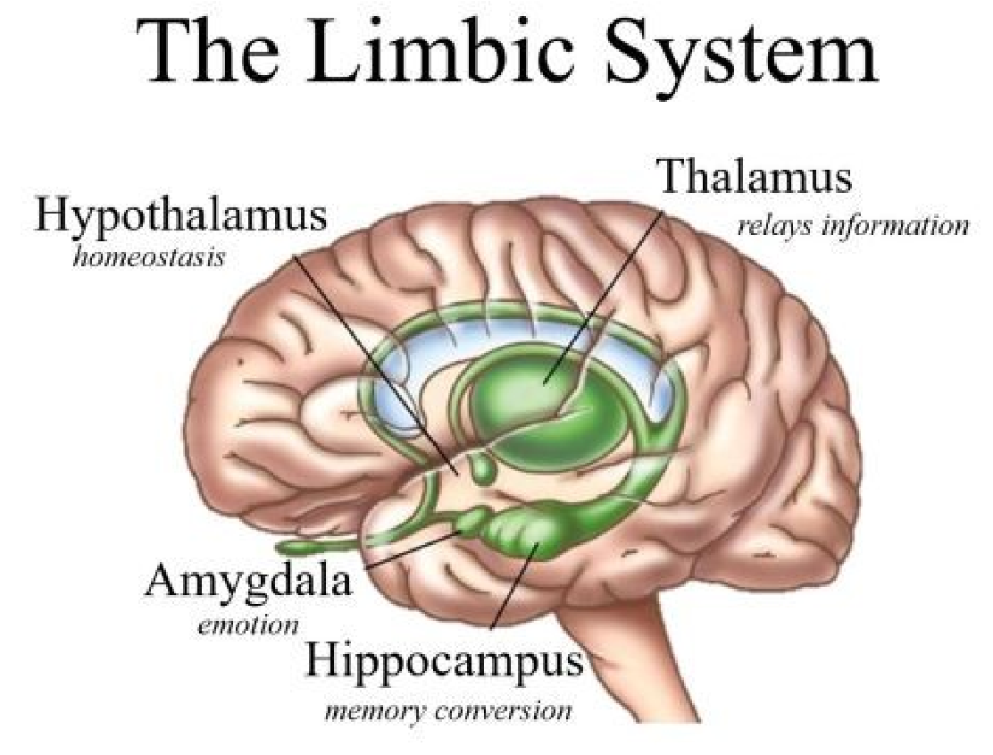

Slide 7
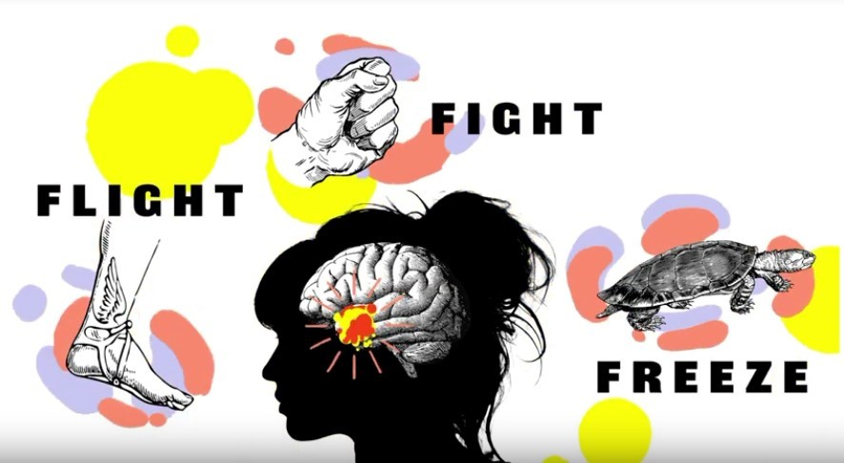
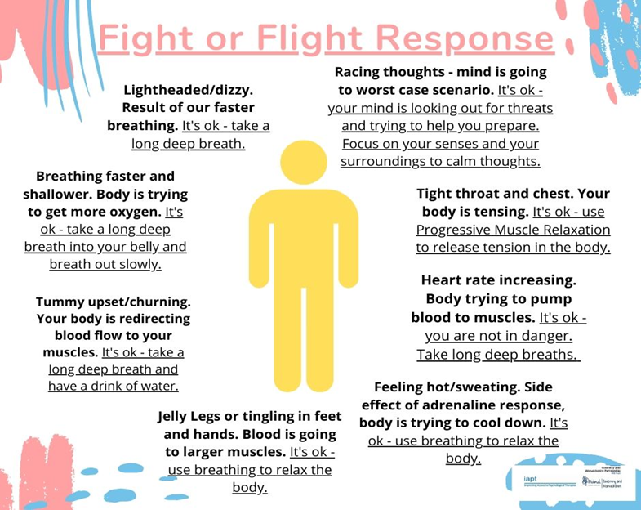

Slide 8
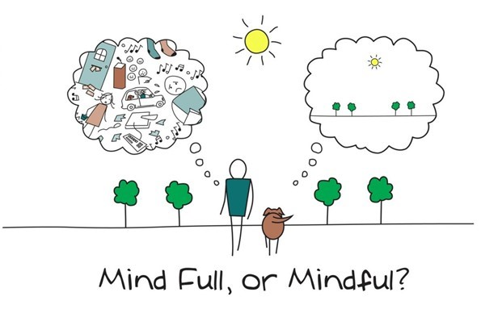

Slide 11
Mindful Breathing
Breathe in 1… 2… 3…
Hold 1… 2…
Out 1… 2… 3… 4…

Slide 13
Session 2

Slide 14
Session 2
TIPP skill
Mindfulness Five Things
Window of Tolerance
PLEASE
Skills Practice for the week:
TIPP skill
Three elements of PLEASE

Slide 16
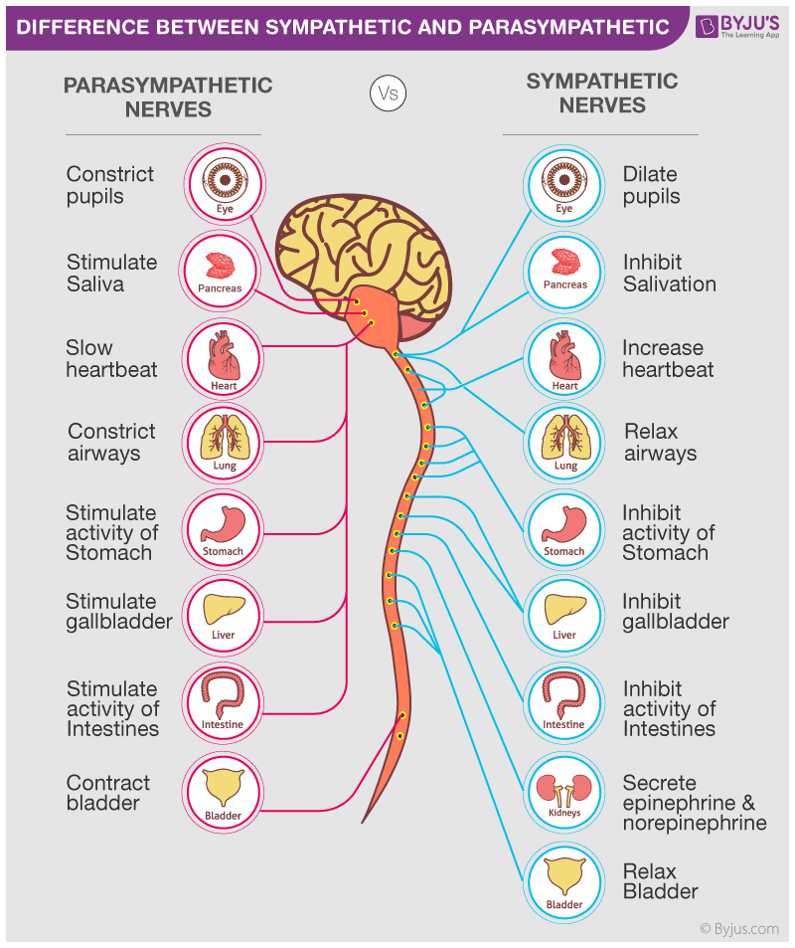

Slide 17
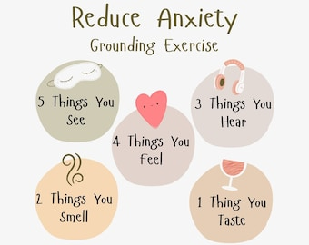

Slide 18
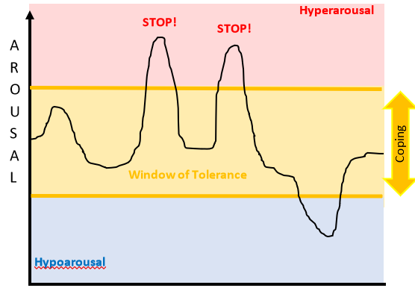
Window of Tolerance
Overwhelm! Choices are lost and your body wants to fight or run away. Reactions just take over.
Here, you feel like you can cope. You may feel stressed and you will experience emotions, but they don’t bother you too much. This is the ideal place to be!
Numb, disconnected, freeze. Here your body shuts down. You don’t make choices about how you act, your reactions take over.

Slide 19
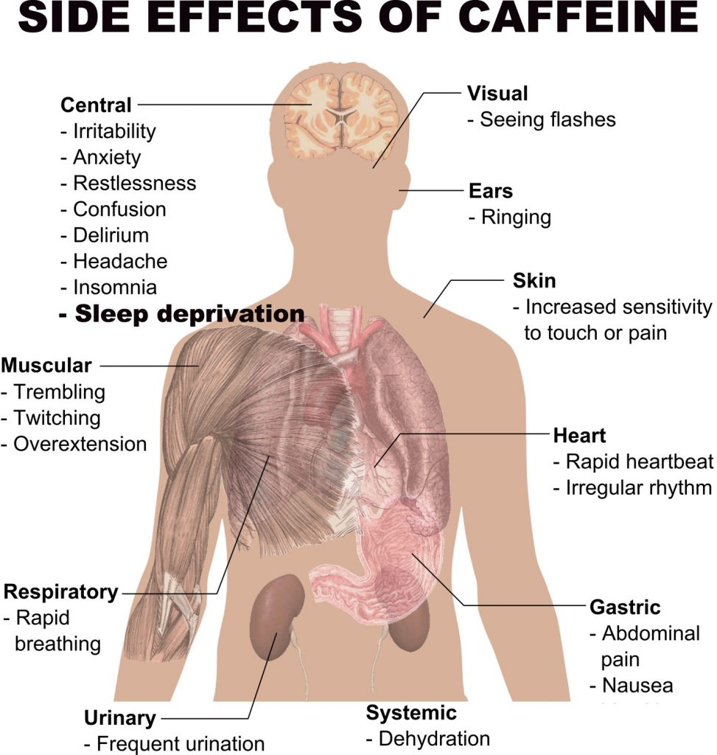
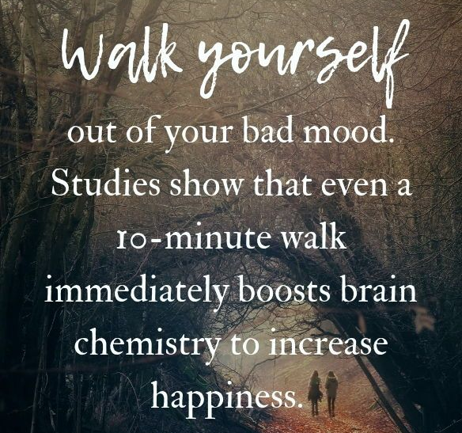

Slide 20
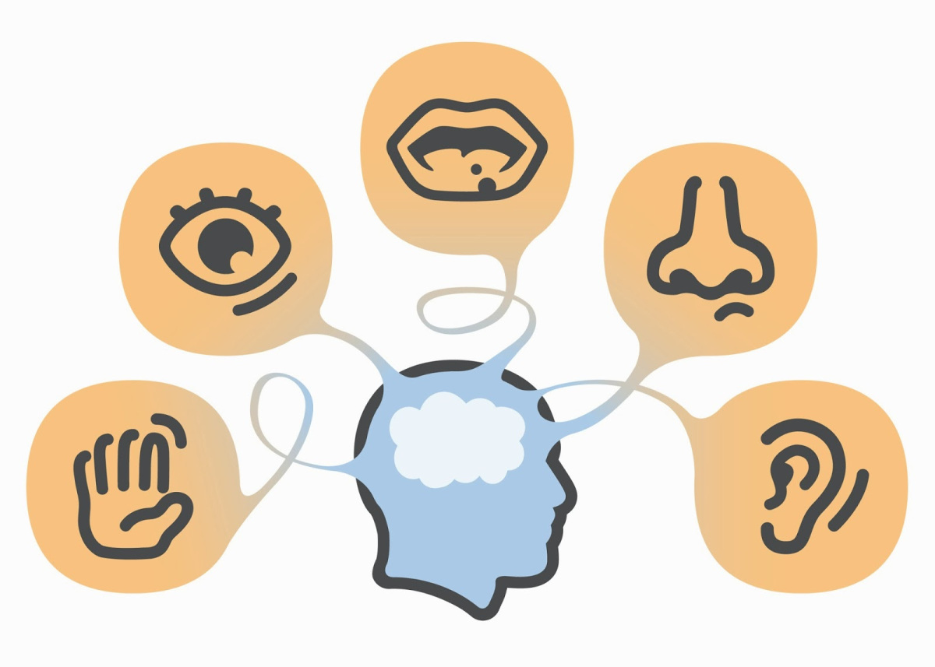

Slide 21
Session 3

Slide 22
Session 3
Recognising Emotions
The Wave of Emotion
STOP skill
Using techniques to self soothe
Skills Practice for the week:
Identifying the wave of emotion
Rehearse STOP

Slide 23
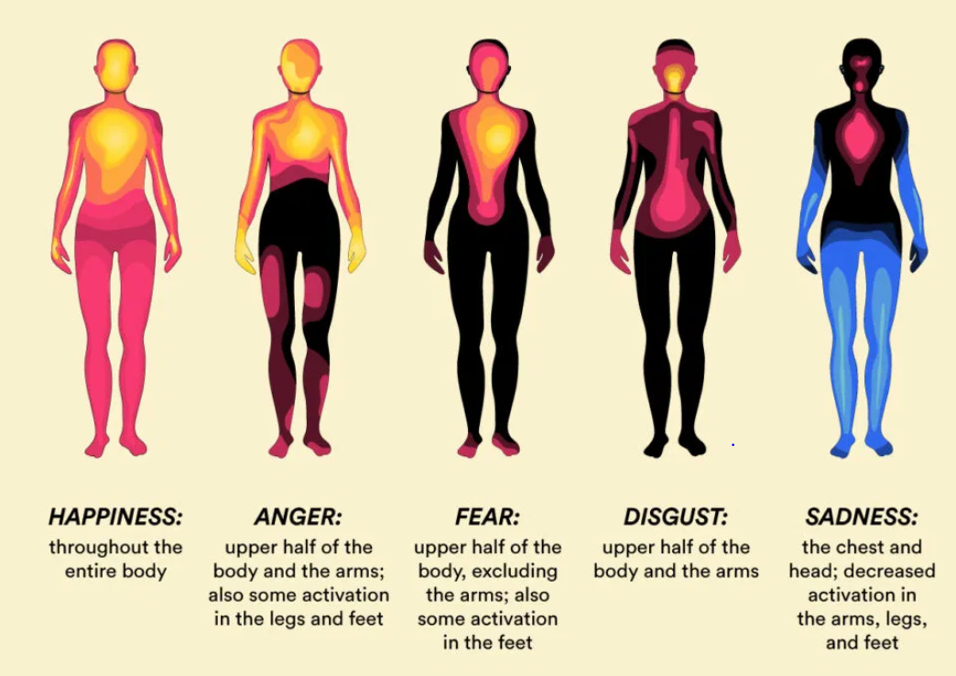

Slide 24
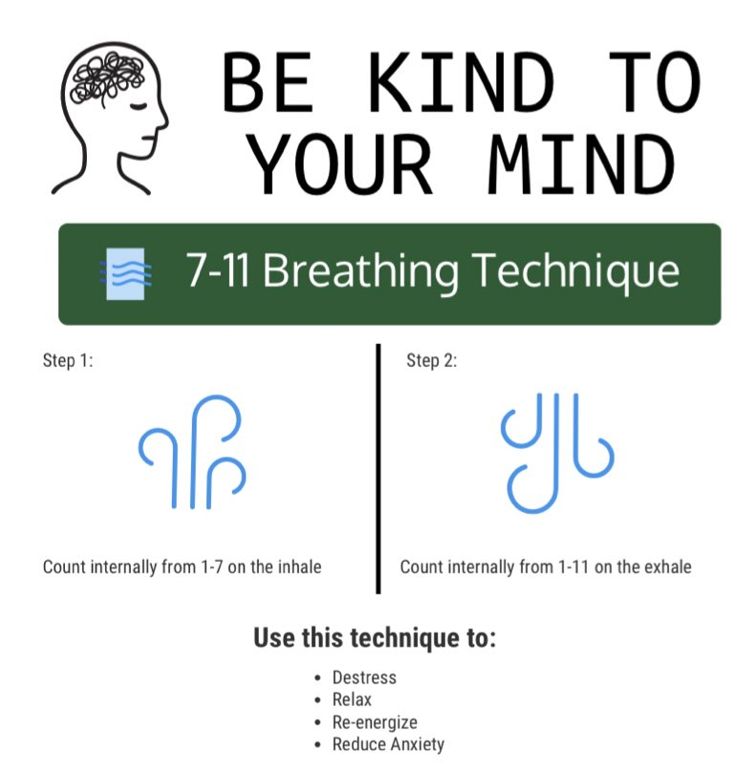

Slide 25
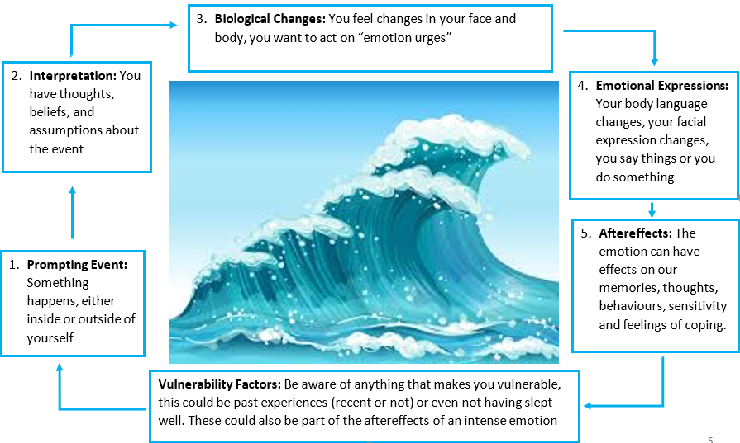

Slide 26
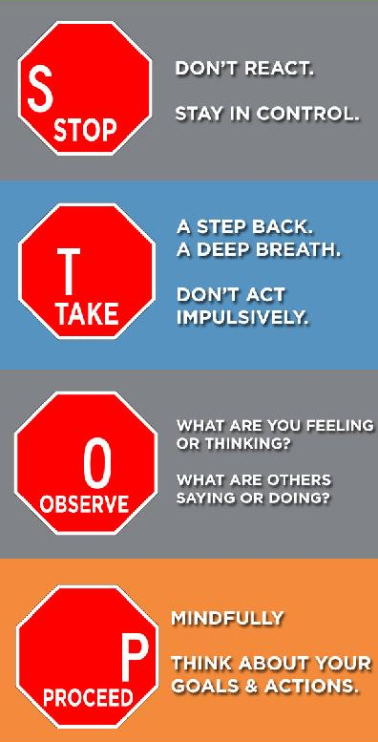

Slide 28
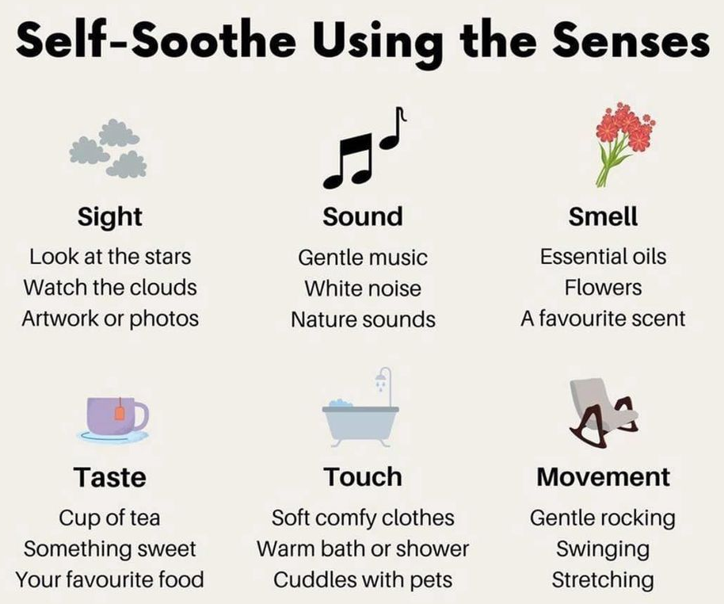

Slide 29
Session 4

Slide 30
Session 4
Mindful observation of Emotions and Thoughts
Mindfulness to Current Emotion
Myths about Emotions
Mindfulness Describe Skill
Skills Practice for the week:
Mindfulness to Current Emotion
Reflect on overall learning, plan how to continue using skills

Slide 31
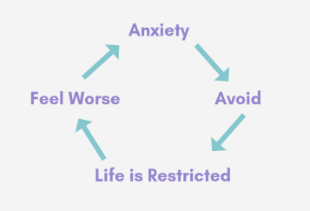

Slide 32
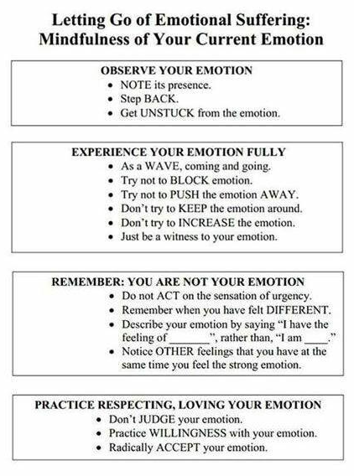
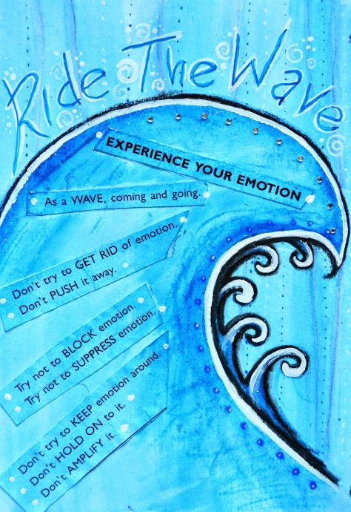

Slide 33
What makes it hard to regulate emotions?
Biology
Lack of skill
Reinforcing emotional behaviour
Emotional Overload
Emotion Myths

Slide 34
Emotion Myths
There is a right way to feel in every situation Challenge:________________________________________________________
Letting others know that I am feeling bad is a weakness Challenge:________________________________________________________
Negative feelings are bad and destructive Challenge:________________________________________________________
Being emotional means being out of control Challenge:________________________________________________________
If others don’t approve of my feelings, I obviously shouldn’t feel the way I do Challenge:________________________________________________________
Acting on your emotions is the mark of a truly free individual Challenge:________________________________________________________
My emotions are who I am Challenge:________________________________________________________
Emotions should always be trusted Challenge:________________________________________________________

Slide 36
