Slide 1
Embracing personal continuous improvement
With
Bernard Genge

Slide 2
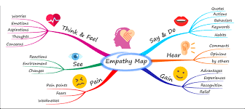
Aims and desired outcomes
Aims – To understand the principles of great learning, personal maturity and personal continuous improvement
Outcomes – Achieve your personal best by embracing continuous improvement
As we go through this masterclass decide what you will START, STOP & CONTINUE doing
Notes:
On these masterclasses as we all learn in different ways there will be spoken words from me, written words on the ppt, pictures, quotes and for those that are very visual youtube clips to watch afterward. The key to learning however is doing and teaching – 54321 DD
Zoom – video/mute mic when I’m presenting. Please use the chat box, when you open it you can send a message to the whole group or a specific person. Please use it to ask questions, share thoughts, experiences or even to elaborate on points made in the masterclass – ones that perhaps really resonated with you and why.

Slide 3
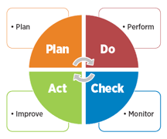
Set the scene
“Persistence, perseverance and continuous improvement are the ingredients for forming a successful person.” Debasish Mridha
Failure proof system for personal growth by adapting, being flexible and building your personal resilience.
Based on small incremental continual improvements
1% gains = what athletes do
Never ends! You won’t lose motivation if you embrace this and also never go through the emotional pain of giving up because it became too hard
CPD, is the ongoing process of developing, maintaining and documenting your professional skills.
Notes:
Not random bursts of improvement
Continual 1% gains = massive improvements

Slide 4
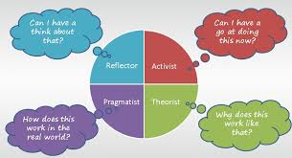
Learning styles
Notes:
Next slide how to use all to be a great learner.
Here are a few affirmations you might choose: I am decisive and all the answers lie within me; I am a calm problem solver; I find great pride in being decisive and finding solutions; when I put my attention to finding an answer, it always comes to me; I am an expert problem solver; I am decisive and patient and persistent implementing my chosen solutions.

Slide 5
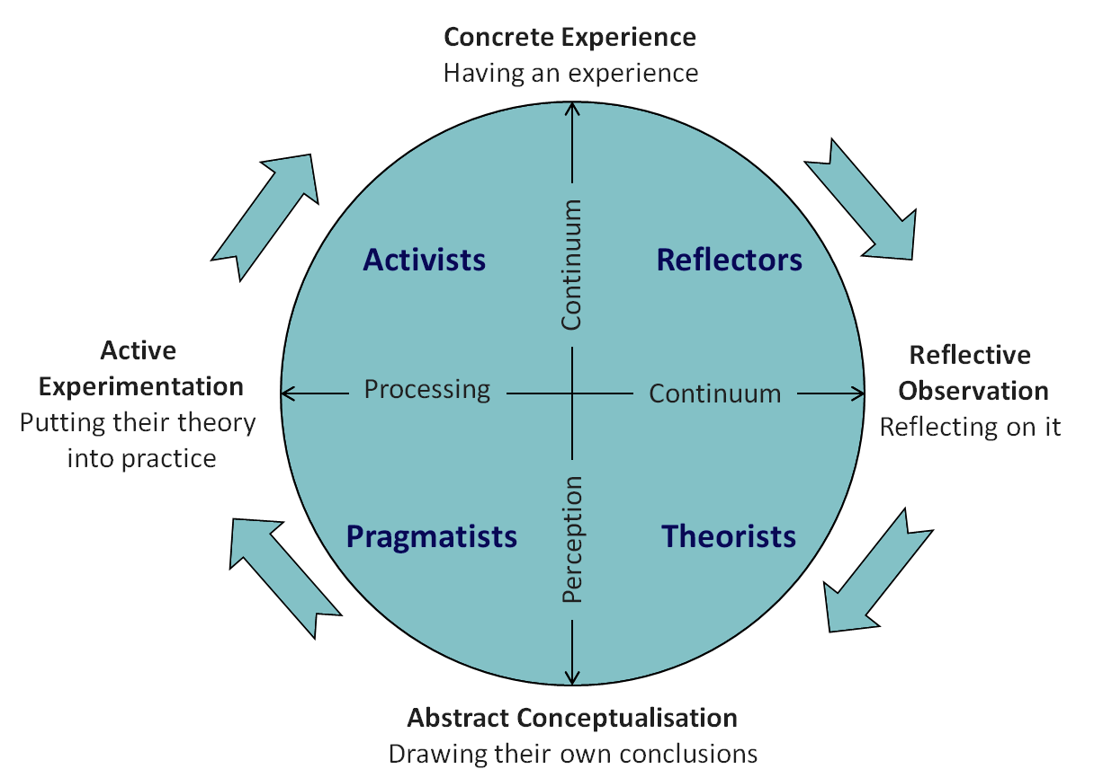
To learn best and be a continual improver we should …..
Notes:
Use highlighter pen to - Do something, have an experience
Reflect on the experience
Conclude from the experience, developing a theory
Planning the next steps, to apply or test the theory
Repeat

Slide 6
Notes:
USA after WWII incremental progress in production rather than no progress at all. The Japanese took this successful concept of continuous improvement and adapted it into Kaizen – why they are so successful today.
The Kaizen philosophy of continuous improvement is a failure proof system that enables us to achieve and sustain our personal goals and dreams in life. The concept of continuous improvement offers us a way to live our lives to the fullest by continuously learning, growing and thriving.
We live in a world of never-ending disruption and change. By adopting the philosophy of Kaizen, we become more adaptable, flexible, and resilient to dealing with the constant demands and disruptions we face in our lives.

Slide 7
Don’t forget
Notes:
Working in ways that align with your values makes it easier for you to prioritise and less likely that you'll second guess the decisions you make.
They are your brand and tell the world who you want to be.
Understanding your values helps you differentiate between what’s an excuse and what’s a valid reason for not moving forwards.
Few people choose their values
Right or wrong and important.
Character values are the universal values that you need to exist as a good human being. Work values are values that help you find what you want in a job and give you job satisfaction.

Slide 8
How resilient people develop and mature

Slide 9
The big picture
Evaluate
VISION
MISSION
Take Action with commitment
Roles
Plan Weekly
Goals
SMARTER
Notes:
VISION - cathedral = compelling vision. GOALS – SMARTER = marathon, Roger Bannister, goals v new years resolutions (a wish that people talk about), something red
Next we will explore a PDCA cycle which is the weekly planning, but we also need to have thought about or vision, mission, roles and goals.

Slide 10
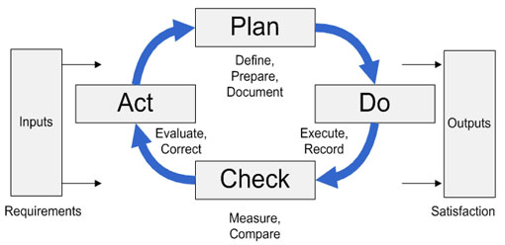
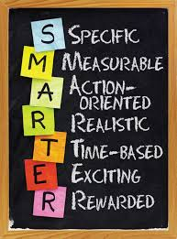
Embracing our PDCA cycle to continually improve to be resilient
YOUR PLAN
Where are you now?
Where do you want to be?
How will you audit the gap? Feedback, honest reflection etc.
How will you close the gap? Formal or informal learning?
Identify problems and challenges
Then set
Notes:
Make your plan visible

Slide 11
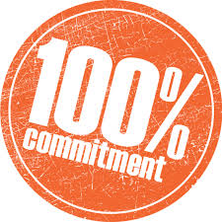
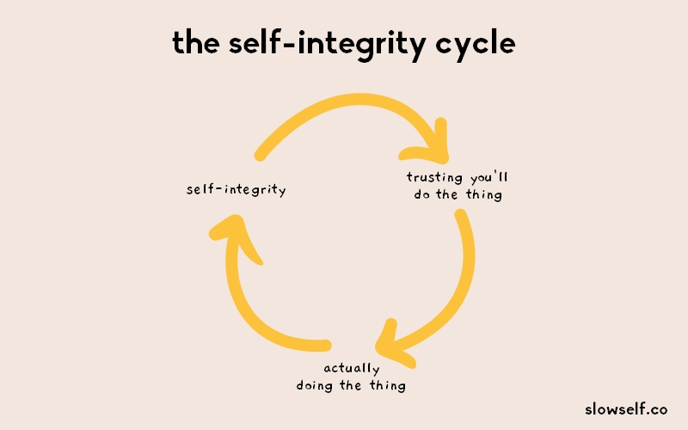
Embracing our PDCA cycle to continually improve to be resilient
DO
Small daily tasks/reminders
Prioritise them – do the worst first!
Note tasks completed & problems encountered
Use your self-awareness and learn how you can do things better – it will make the next stage easier
You need

Slide 12
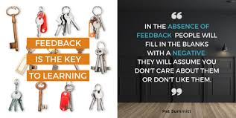
Embracing our PDCA cycle to continually improve to be resilient
CHECK
Assess, inspect and analyse what you did, the outcome and how successful you were
Did you reach your goal (s)? What was the reasons?
Was your plan feasible and realistic?
What did you learn?
You need
Notes:
Honest self-awareness needed

Slide 13
Embracing our PDCA cycle to continually improve to be resilient
ACT
Adjust your goals – CHANGE your plan; ADD to your plan
Did any external factors affect your plan
You need to

Slide 14
DEVELOP THE 3 C’s
COMPETENCE
COMMITMENT
CONFIDENCE
ENJOY AND RELISH THE FINAL C - celebration
Notes:
Competence – knowledge/skill
Commitment – visualize what is important
Confidence – setting SMARTER goals (achievable and realistic)

Slide 15
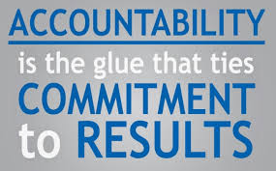
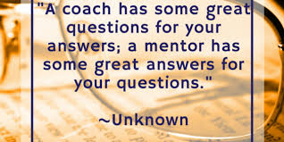

Slide 16
Notes:
Vison board, mission, roles, goals, plan weekly, do it, evaluate success is another process to adopt

Slide 17
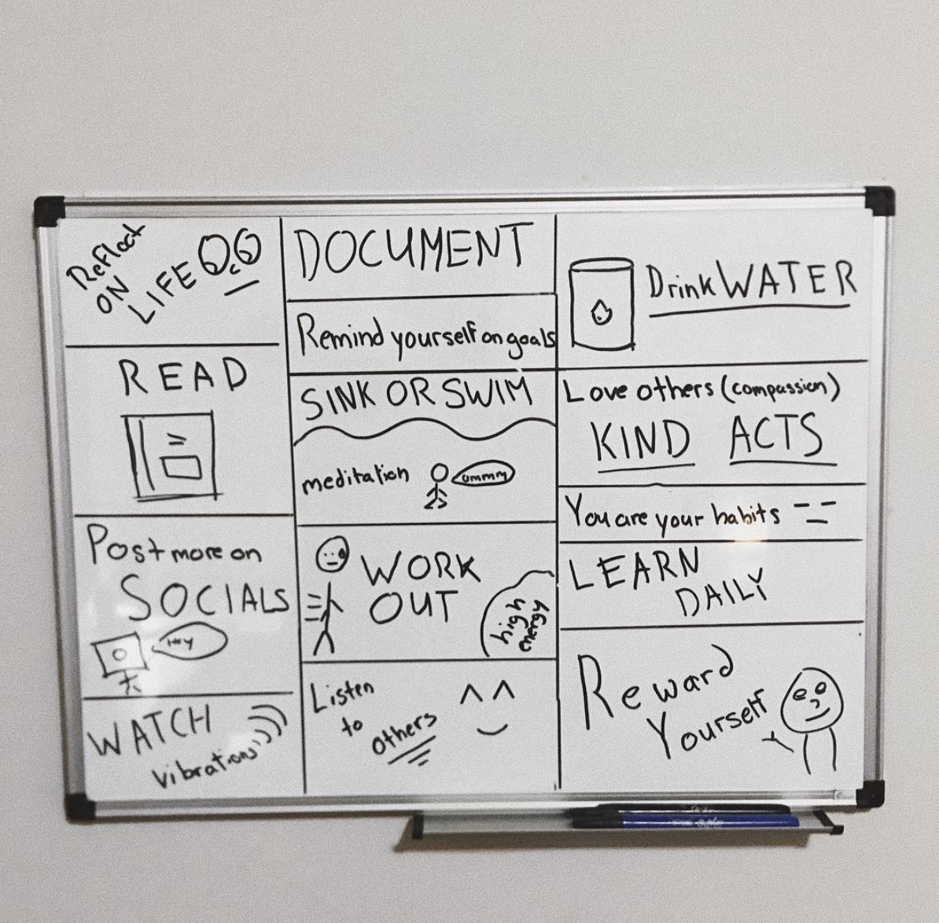
Notes:
Make your plan visual

Slide 18
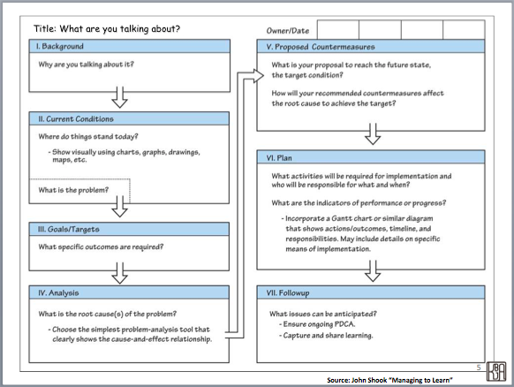
Notes:
A3

Slide 19
30-day challenge

Slide 20
Action plan
As a result of todays masterclass what will you:
START DOING
STOP DOING
CONTINUE DOING
Notes:
54321 Decide/do

Slide 21
Further opportunities
Personal Resilience facebook group.
Ignite: Find Your Passion, Live Your Purpose & Re-Write Your Future
https://www.facebook.com/groups/216645969611627/?ref=share
bernard.genge@gmail.com

Slide 22
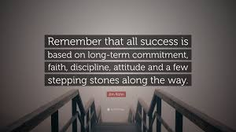
Further information/watching
https://www.youtube.com/watch?v=4TcVZNjQp9Q
A very brief look at PDCA and how to use it to get better at everything you do. 5mins 50.
It’s a great video.

