Slide 1
Welcome to Session 2
This time we will be venturing a bit further afield to explore Parks or taking time to discover a Garden, if we have one or have access to one

Slide 2
Parks and Gardens
Is there a park near you or do you or one of your friends have a garden you can take some time to be in?
You can have a look on Google and type in ‘parks near me’ and see if there is one near you.
There might also be a churchyard near where you live, that has all sorts of flowers and wildlife in it.
There might be a communal garden or community orchard?
Where have you come up with? Where will you explore?

Slide 3
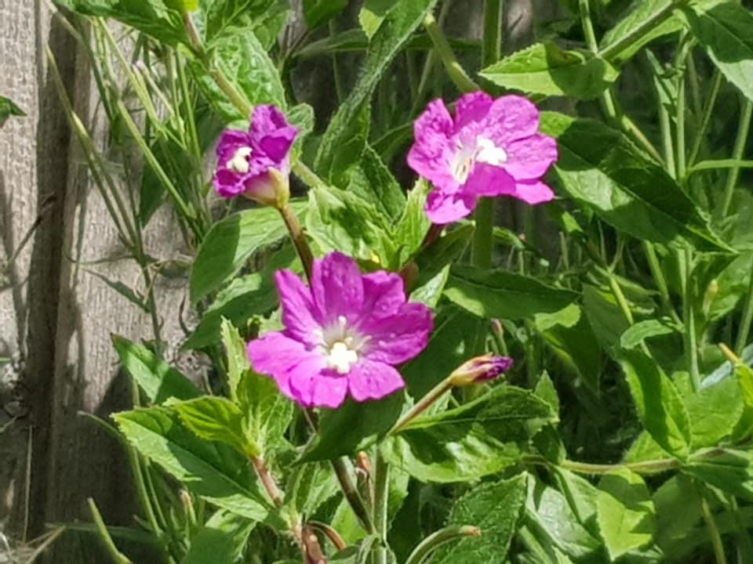
We often don’t take time to notice what we can see in our own garden or what grows in the borders and verges of the park or churchyard near where we live.
I know I often think that having a walk for ‘leisure’ means I have to be in a stately home garden or somewhere miles from home, that I see on holiday, but lately I have been noticing much more what is in ‘my own back yard’, so to speak, or things that are nearby.

Slide 4
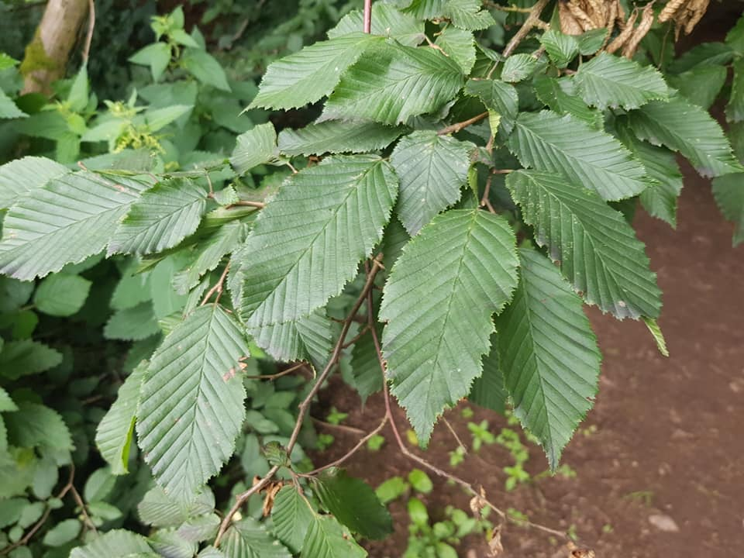
So…
So where do you find yourself now? Perhaps you can see some trees that have been planted formally in a park, to give the outlook some shape and variety?
Are there leaves on the trees?
What colours are they?
I know, you might be thinking, green! But take some time to look more closely… are there the same green?
Are there other colours too?
Do you think some have leaves only in the summer or are they in leaf all year round?

Slide 5
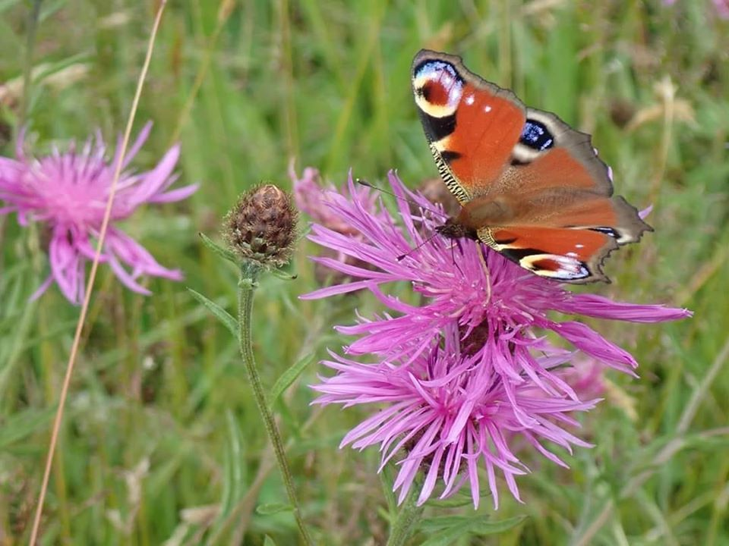
Looking further…
And can you see any flowers?
Are these planted in the borders or are they growing in the grass?
Are they short, hunkering down in the grass, like daisies, dandelions or clover or are they tall and slender and blowing in the breeze?
What are their colours and shapes?
Are there insects drinking nectar from them?

Slide 6
Take your time…
Take some time, just looking or wandering slowly. What can you see?
As you walk along, take time to breathe calmly and tune in to where we are…
Perhaps jot down things if that’s practical, or make a mental note of what you are seeing for writing down later
You might what to focus on a few of your senses to start with – what can you see and what can you hear? What can you smell?
What can you see? Is the sky cloudy? Is it rainy or sunny or somewhere in between?! What colours can you see in the sky or on the ground, or among the treescape?

Slide 7
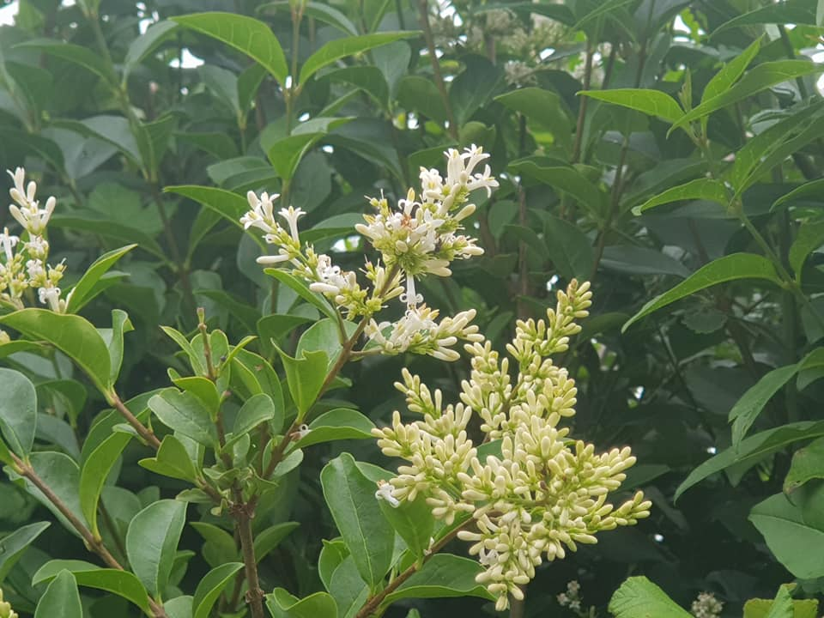
Looking around…
What can you see?
Is the sky cloudy?
Is it rainy or sunny or somewhere in between?!
What colours can you see in the sky or on the ground, or among the treescape?

Slide 8
Making time and space to look around, right where you are…
You don’t have to be on the move for miles, so go slowly
Be patient, take your time;
sometimes if we are moving too fast and too purposefully we can miss out on what right under our feet or miss out on a lovely view,
perhaps the way the sunlight falls on the ground between a couple of trees;
perhaps you can find a place along the way we feel comfortable to stop, become aware of the sounds, smells and sights around us…

Slide 9
“Adopt the pace of nature: her secret is patience.” Ralph Waldo Emerson

Slide 10
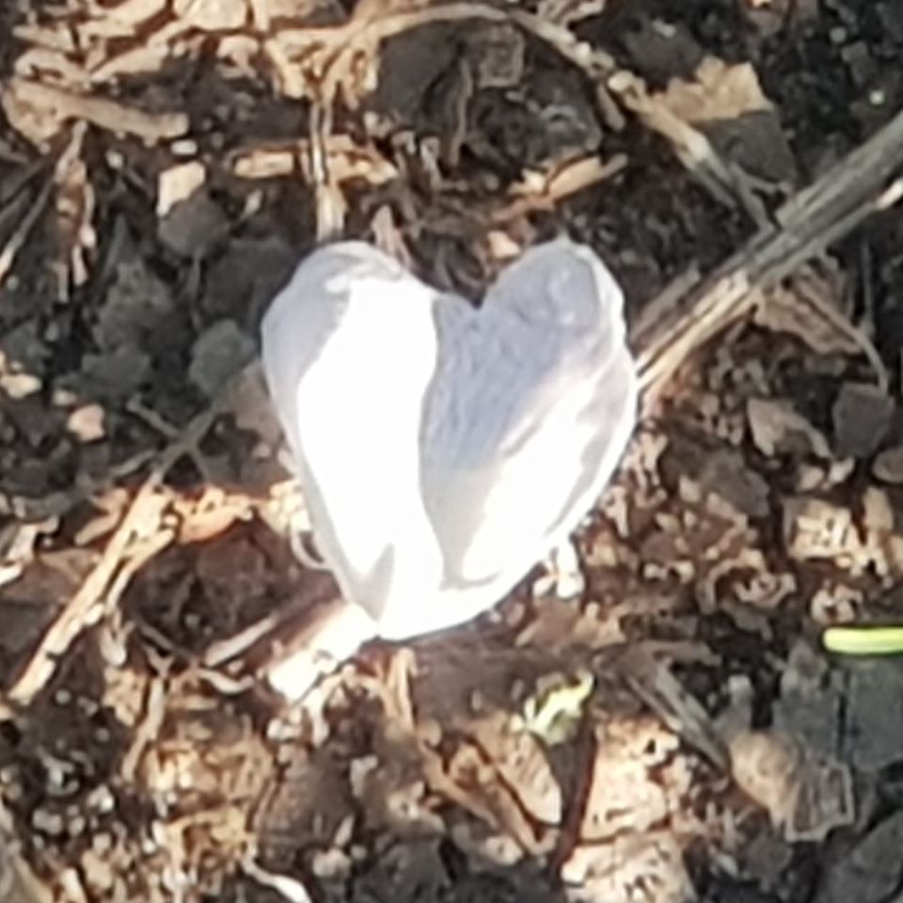
What are you noticing?
Your thoughts and jottings…
What you write down does not have to be fancy writing or like poetry, but over time and as you grow in confidence, with being out and about, and noticing nature
In this session, perhaps you can be a little more flowery with your language and explore your sense in words a bit more creatively, if you like!

Slide 11
It is just interesting to make notes of what we are seeing and how these sights and sounds make us feel…….
Here is a short reflection I wrote last week while walking in a park near me which I was visiting for the first time with a photo I took …

Slide 12
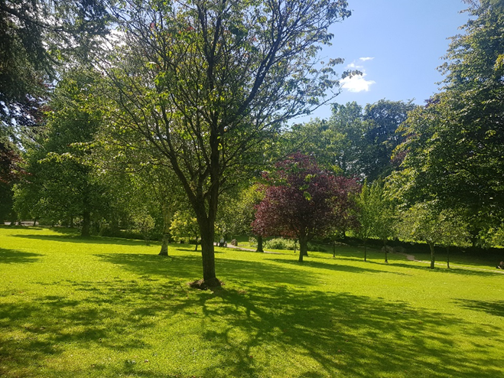
Exploring a park near me…
“It was a warm day with a light breeze. I had been out and about quite a bit near where I lived, so I decided to venture to the next town to visit a park I had not been to before but had seen signs for.

Slide 13
I think I was a bit worried as it all felt a bit unfamiliar, but I could see and hear all sorts of different people enjoying the pathways, so I carried on!
The sky was blue with a few light wispy clouds about. A few older people were sitting on park benches, reading; some were walking dogs on leads. I could see children bravely clambering in the playground and squealing as they went down the slide.
Further on, there was the noise of more activity, where some gardeners were trimming the hedge with machinery!

Slide 14
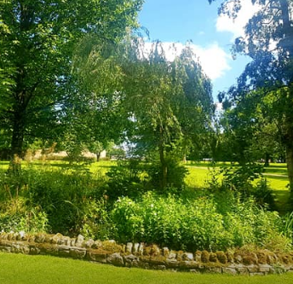
Park life!
As I walked on into the park, I began to tune out of the busy sounds and tune in to the gentle breeze in the trees.
Some trees made more rustling in the wind that others. I took some time to look at the leaves and the colours. Some were light green, like the peel of a lime, some were much darker; some were a pinky purple. The shape of each of the trees was quite different too and some had been planted along the paths and others were in amongst the grassy areas.

Slide 15
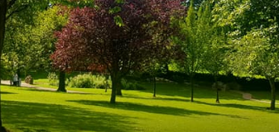
I loved the way the sunshine and shadow danced on the grass and made different shapes and patterns. I was glad to have had the chance to visit a new place. There was quite a queue at the ice-cream stall, so I decided to walk on! Next time I visit perhaps I will have an ice-cream!

Slide 16
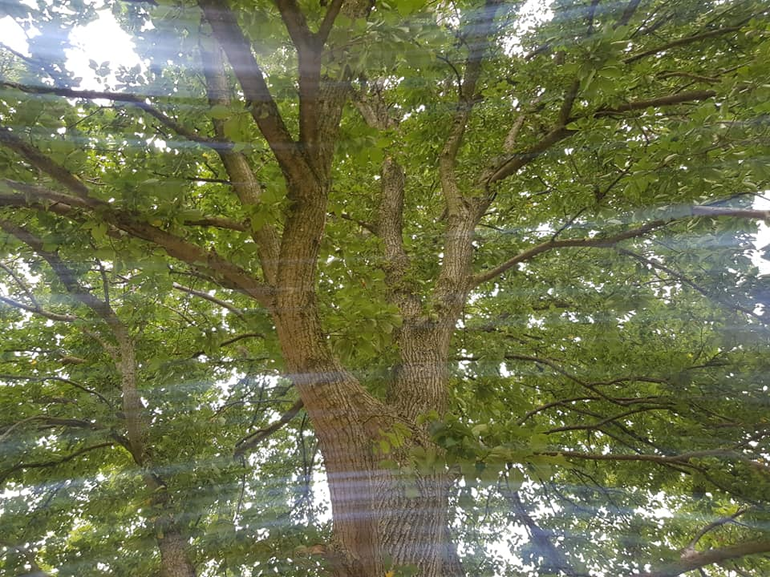
Where are you exploring?
Are you in a park or a garden? What can see you see where you are?
Perhaps you could take a photo of something you notice about the park or garden, perhaps the shape of the trees or a photo from below a tree, beside its trunk, looking up into its canopy… or a smaller object you have become aware of (like a flower, a beechnut, a insect at rest on a flower or a cloud… anything you like which appeals to you!)

Slide 17
Making notes on your journal sheet when you return home.
Take time to reflect on what we have seen and sensed…
Perhaps you could consider what you are thankful for…
What you might like to learn more about…?

Slide 18
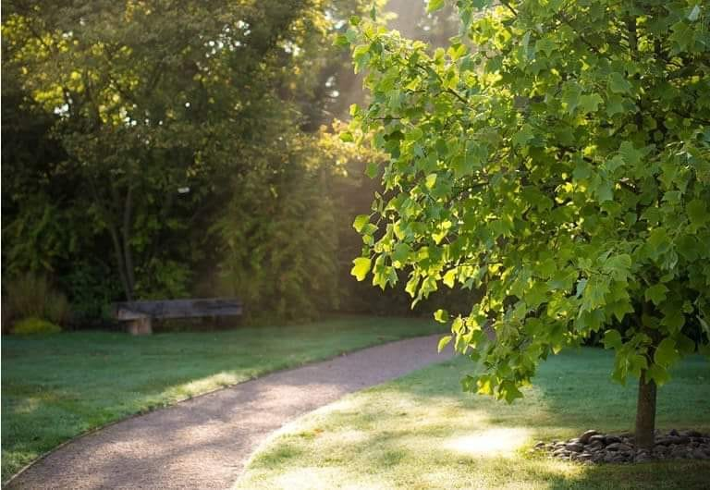
Parks and gardens…
You have the opportunity for sharing what you have seen and reflected on in the Course Forum, if appropriate.
That’s session two complete for now! Thanks for joining me!
Feel free to have another go at this one in the same space you visited before or in a new place or move on to session three when it next suits you!

