Slide 1
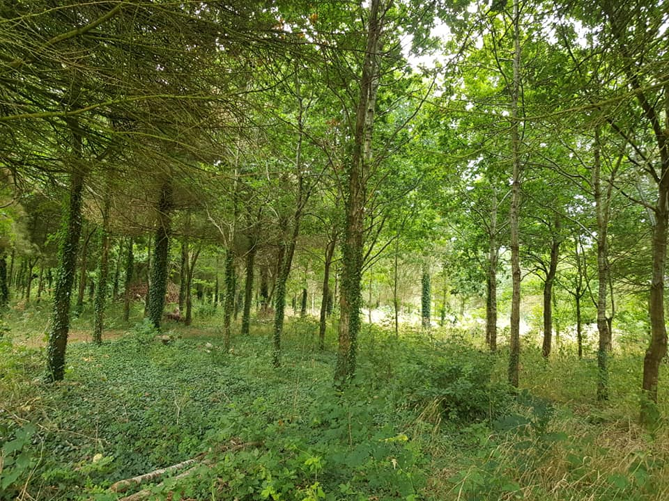
Connecting with Nature

Slide 3
Learning Outcomes
Over the next 3 sessions we aim to:
Spend time in the fresh air
Connect to nature and the world around us
Create a journal of reflections, thoughts, feelings, observations from spending time outdoors
Try out new ways of looking at the natural world and spark enthusiasm and interest to find out more / to continue this practice
Building a sense of hope and confidence in and with the natural world

Slide 5
Learning Outcomes (cont’d)
Over the next 4 sessions we aim to:
Develop a sense of awe and joy from observing nature and have a reservoir of good memories to inspire
Feel encouraged to share the joy with others on the course forum and SWALC Facebook page
Develop different ways of being creative inspired by experiencing the natural world
This will all work towards us pursuing opportunities and embracing new challenges!

Slide 7
So let’s begin!
The course is made up of an introductory session followed by 3 sessions, where we take our time to explore places nearby where we live…
The programme is a series of PowerPoint presentations I, as the tutor, have designed for us to work through, enjoy and use as a springboard for our wanderings and observations in nature. All the photos used are ones I have taken while out and about since March this year…
Feel free to use these, at your own pace, as a resource to encourage your walks and your time out and about.
The places we plan to explore are: on our home patch; parks and gardens; woods and hedgerows.
For each session, I will guide you to look out for things while you are out and about and through the course forum, we can support each other as we venture out!

Slide 8
When you are ready to make a start, move on to the Introduction slides…

