Slide 1
Understanding and resolving conflict
With
Bernard Genge

Slide 2
Aims & desired outcomes
Aims – To know your conflict style, how to use it effectively and when to use another style
Outcomes – To be both confident and competent dealing with conflict and potential conflict
As we go through this masterclass decide what you will START, STOP & CONTINUE doing
Notes:
54321 decide/do

Slide 3
Set scene
Conflict resolution is the process by which two or more parties reach a peaceful resolution to a dispute. Conflict may occur between colleagues, or between supervisors and subordinates, or between groups, such as management and the work force, or between whole departments.
It can of course also evolve in our personal lives.
Conflict is a of course normal part of any healthy relationship. After all, two people can’t be expected to agree on everything, all the time. The key is not to avoid conflict but to learn how to resolve it in a healthy way.
When conflict is mismanaged, it can cause great harm to a relationship, but when handled in a respectful, positive way, conflict provides an opportunity to strengthen the bond between two people. Whatever the cause of disagreements and disputes, by learning skills for conflict resolution, you can keep your personal and professional relationships strong and growing.
As with everything our ‘mindset’ is vital – can you see conflict as an opportunity to strengthen a relationship with another person?
﻿

Slide 4
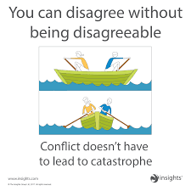

Slide 5
What causes conflict?
Disagreement over values, motivations, perceptions, ideas, or desires.
Differing needs
Misunderstanding about objectives/roles
Differing expectations about how things should be done
Different personalities/communication styles
Lack of recognition, respect and trust
Poor communication, planning
Frustration, stress, high emotional states

Slide 6
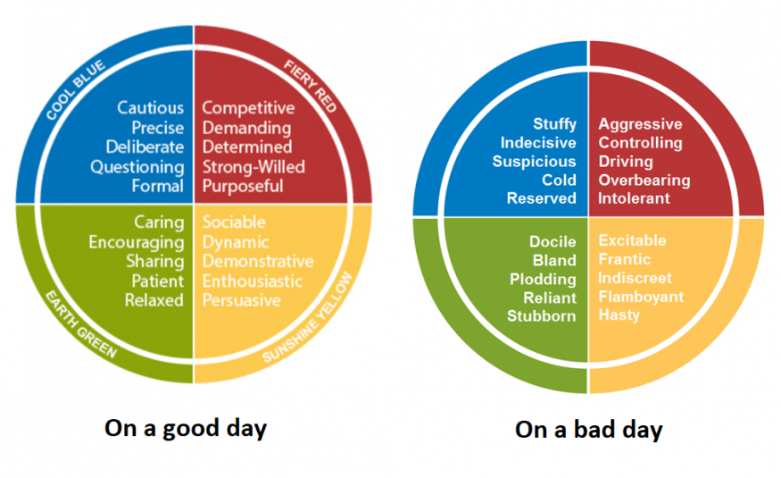
THINKING
INTROVERT
EXTROVERT
FEELING

Slide 7
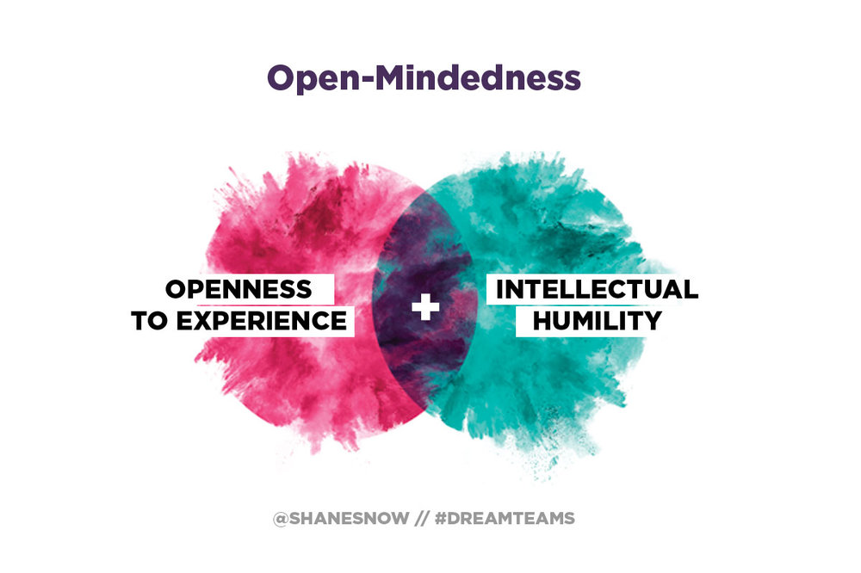
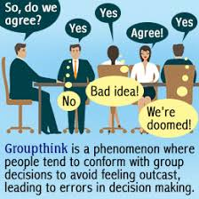
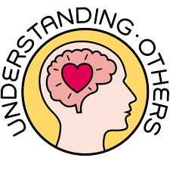
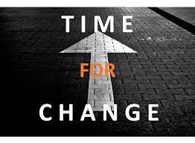
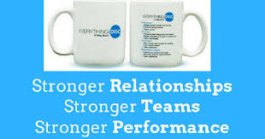
Are there any positives?
Notes:
1 encourages open mindedness
2 discourages group think
3 encourages listening and understanding and good communication
7 It can signal a need for change

Slide 8
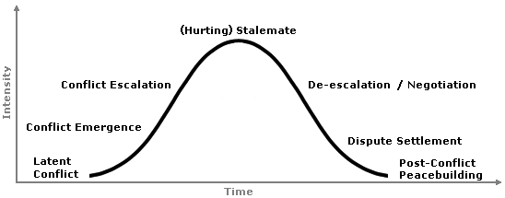
How it escalates if we avoid it

Slide 9
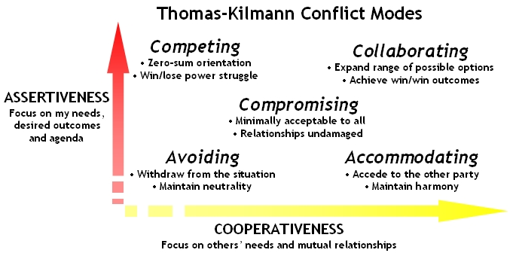
Resolving Conflict –Styles of Conflict Management

Slide 10
Accommodating
“It would be my pleasure”
Goal is to “yield”
Ignoring your concerns in order to satisfy the concerns of another person
Can be seen as selfless generosity or obeying others
Assertiveness
Useful for:
Keeping the peace
Creating good will
When the issue is of low importance to you
Accommodating
Cooperativeness

Slide 11
Avoiding/withdrawing
“I’ll think about it tomorrow”
Goal is to delay
Do not satisfy own concerns or concerns of others
May be stalling on an issue, or ignoring it
Assertiveness
Useful for:
Buying time
Allowing others (and you) to cool down
When issue is not the real cause of the problem
Avoiding
Cooperativeness

Slide 12
Competing/forcing
“My way or the high way”
Goal is to win
Assert your position without considering opposing viewpoints
May be seen as standing up for your rights, or throwing your weight around
Competing
Assertiveness
Useful for:
Quick action
Unpopular decisions
Vital issues – compliance
Protection
Cooperativeness

Slide 13
Compromising
“Lets make a deal”
Goal is to find a middle ground
Forgoing some of your concerns in order to have others met
Negotiating, or splitting the difference
Assertiveness
Compromising
Useful for:
Temporary solutions
Time constraints
Back-up when collaborate or compete fail
Cooperativeness

Slide 14
Confront/collaborate
“Two heads are better than one”
Goal is to find a win-win situation
When you are fully concerned with satisfying both sides of an issue
Working with the other person to find an optimal solution
Collaborating
Assertiveness
Useful for:
Gaining commitment
When concerns of both parties are too important to compromise
Merging perspectives on important issues
Building great relationships
Cooperativeness

Slide 15
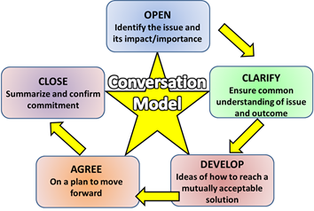
Decide on a structure- OCDAC conversation model

Slide 16
The conversation
Its easier being prepared
Be flexible
If it gets heated agree an adjournment
Self-awareness – during and after
Know the boundaries – what is acceptable and unacceptable during the conversation
Focus on the outcome, not personalities
Agree the follow up – vital for long term commitment to the outcome
Know when there is a need for an independent facilitator

Slide 17
The ‘Peace & reconciliation’ process
Choose right time
Prepare people – explain the process
One talks whilst the other listens
Then swop around so the other talks – the aim is to create mutual understanding
Active dialogue to problem solve & find a win/win outcome
Its simple but effective.
If you are the ‘facilitator’, do not make any judgments.
If the conflict is between you and someone else – be the listener first

Slide 18
Summary
Use your self-awareness to think back to times you’ve experienced conflict and ask yourself ‘what was the underlying cause, what was your thoughts/mindset about it, what conflict style you used and what was the outcome’?
In the future can you see conflict as something to be embraced (in the right way) as it can build relationships, solve problems, understand other people and a something that prevents ‘group think’.
Once you see conflict or potential conflict in a constructive way you can embrace the 30-day challenge and rationally select the right conflict style for the situation you are facing.
Remember to always use a structure for the conversation such as OCDAC conversation model as shared on this programme.

Slide 19
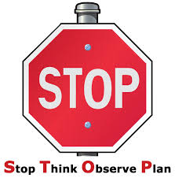
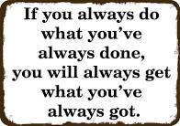
30-day challenge
Think about the situation and which of the 5 conflict styles is the best one to use
Over the next 30-days when there is an ‘issue’, do not get emotional but:
Observe the situation and most importantly how you are feeling about it, then
Plan to meet the person(s) and address the issue using one of the 5 conflict styles or the peace and reconciliation process. Don’t wing it, plan it. Remember…….

Slide 20
Action plan
As a result of todays masterclass what will you:
START DOING
STOP DOING
CONTINUE DOING
Notes:
54321 decide/do

Slide 21
Further opportunities
Personal Resilience facebook group.
Ignite: Find Your Passion, Live Your Purpose & Re-Write Your Future
https://www.facebook.com/groups/216645969611627/?ref=share
Youtube channel:
https://m.youtube.com/channel/UCOEQFv-O8IqgyjaR7TxRuCQ
Personal resilience online programme;
https://ignitepd.thinkific.com/courses/rock-solid-resilience?fbclid=IwAR1dt6Mw_cw8EqDPPJA3bpynSEVhFxwfMWBZpPKO1IZq04ZvxHHc0ty8KRc
bernard.genge@gmail.com

Slide 22
Further information/watching
https://www.youtube.com/watch?v=PFIydyH2H8Y
Thomas Kilmann Conflict Mode Instrument
The Thomas Kilmann Conflict Mode Instrument is based on a five-category scheme for classifying interpersonal conflict-handling modes: competing, collaborating, compromising, avoiding, and accommodating.
https://www.youtube.com/watch?v=RPpw3E7wfcg&t=8s
Facing The Truth (1 of 2) [couchtripper] 5th March 2006
Convicted extremists and victims from both sides of 'The Troubles' in Northern Ireland meet and talk about what they've been involved in. Archbishop Desmond Tutu moderates.
Notes:
Michael Stone (on the facing the truth video is back in prison now

