Slide 1
Co-production
The What, The Why, The How

Slide 2
Learning Outcomes
By the end of this course, participants will:
Understand the background to Co-Production working
Understand why Co-Production working matters
Understand Co-Production working in Somerset NHS Foundation Trust
Understand some of the challenges involved in Co-Production working
Understand how to overcome potential challenges in Co-Production working

Slide 3
Discuss
(in pairs or as a group)
What does Co-Production mean to you –
why are you here and what are you hoping to gain?
What experience have you had with Co-Production working?
Where have you seen Co-Production working done well?
What benefits can you see with Co-Production working?
What challenges can you see with Co-Production working?

Slide 4
Co-Production
The What

Slide 5
Co-Production is…
A meeting of minds coming together to find shared solutions.
Involves people who use services being consulted, included and working together from the start to the end of any project that affects them.
Service users, and carers are valued by organisations as equal partners, share power and have influence over decisions made.
TLAP National Co-Production Advisory Group

Slide 6
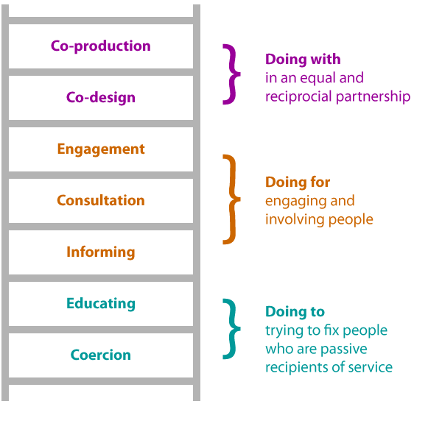
Co-Production Ladder
Co-production builds upon a range of similar approaches such as consultation, engagement and co-design.
This ladder shows the difference between these related, but different approaches.
TLAP Co-production Ladder/

Slide 7
Consultation, engagement and co-design encourage people to input by asking for their ideas, experience and opinions. Service users are involved in the designing of the service, but this does not lead to their delivering of it - actually making it happen.
Co-production is different because it also needs people's actions.
Co-production means that power is shared more equally between those who use services and those who provide them.
Everyone's skills and personal resources are put to use

Slide 8
Co-production means delivering public services in an equal and reciprocal relationship between professionals, people using services, their families and their neighbours. Where activities are co-produced in this way, both services and neighbourhoods become far more effective agents of change.
Boyle and Harris (2009)

Slide 9
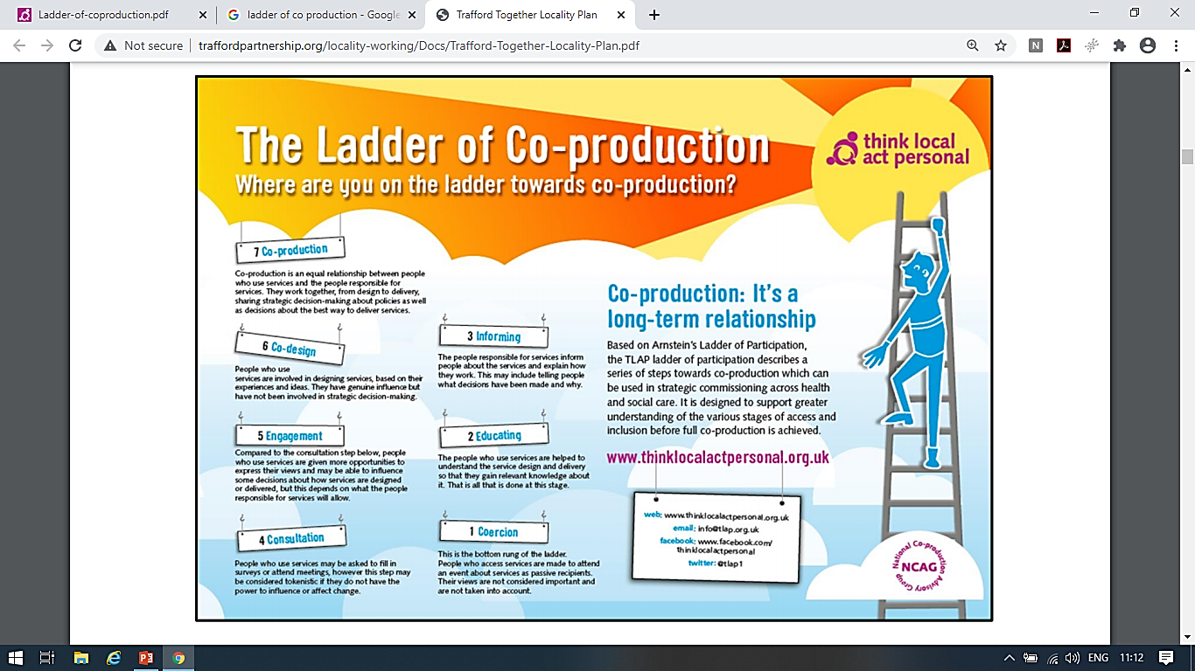

Slide 11
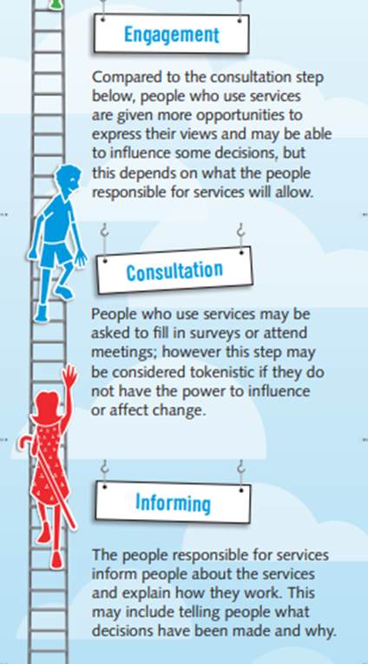
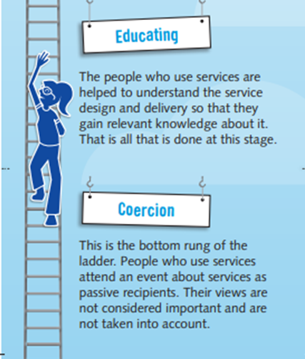

Slide 16
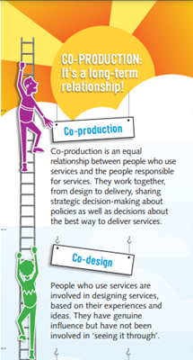
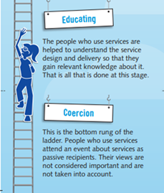

Slide 17
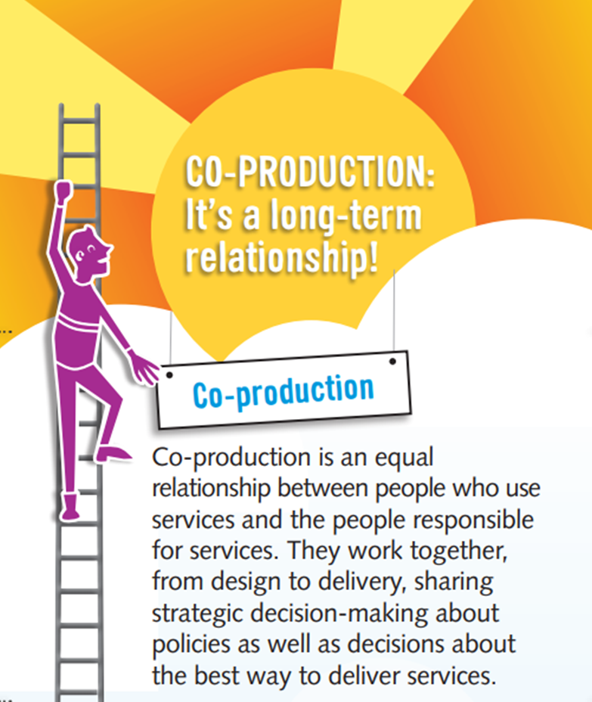

Slide 18
Six important components of Co-Production
According to New Economics Foundation
Recognising people as assets
Building on people's capabilities
Developing two-way reciprocal relationships
Encouraging peer support networks
Blurring boundaries between delivering and receiving services
Facilitating not delivering to
(Boyle, Slay and Stephens, 2010)

Slide 19
Three levels of co-production
According to SCIE
Basic Co-Production
Recognises that people are usually inevitably participating in most public services.
People who use these services will not have any influence on how the services are designed or delivered.
2. Intermediate Co-Production
More actively recognises that people using services have skills to offer.
Services recognise and support people's contributions and ideas for improvement.
People's contribution is only looked for in helping to deliver services.
3. Transformational Co-Production
The power and control changes, so that people who use services are actively involved in all aspects of designing, commissioning and delivering services.
People are encouraged to be involved even if their skills are not directly relevant to the service.
(Needham and Carr, 2015)

Slide 20
Co-Production
The Why

Slide 21
Co-Production Is Not Consultation
But…
Is a shift in the balance of power between professionals and service users thus making improved effectiveness possible.
Is the antidote to constantly asking for people’s opinion, then handing the service back to the professionals to deliver: The service user will be involved in the delivery as well.
Harris and Boyle (2009)

Slide 22
Co-Production Is Not Volunteering
But...
Does require actively giving time
Is not just more volunteers ministering to ever more passive needy individuals on the fringes of public services, whilst the professionals continue with business as usual.
Emphasises mutual support and networks of relationships rather than a clearly defined separation between service providers and service users
Transformative power comes when people who are usually on the receiving end of volunteering or services are invited to help.
Harris and Boyle (2009)

Slide 23
Co-Production Is Not Individual Budgets
By themselves, individual budgets can encourage service users to ‘buy solutions’ or consume passively,
But…
Ensures service users have an active stake in devising and delivering their own solutions.
Harris and Boyle (2009)

Slide 24
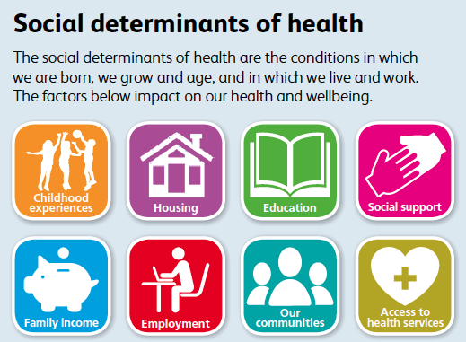
Co-Production Promotes Equal Participation
Creates equal partnership between providers and service users, giving equal value to different kinds of knowledge and skills, recognising that everyone is an asset.
Enables everyone to participate, not just those who are already more able, articulate and socially advantaged.
Encourages us to consider the underlying causes of inequality and how these could be approached.
Harris and Boyle (2009)

Slide 25
Co-production Has The Capacity To Transform Public Services
Services delivered in this way are likely to be more participative, equitable, responsive, creatively designed and delivered.
Service users will have a stronger and more tangible stake in services, this will therefore more likely encourage wider public support.
Harris and Boyle (2009)

Slide 26
Co-production Is Essential To Building Sustainable Public Services
All about sustainability:
Co-Produced services tap into the abundance of human assets, enabling them to flourish and expand, and then bringing them into play .
Co-Production can help to safeguard public resources for meeting needs that cannot be prevented.
Help to guarantee the long-term viability of essential public services.
Harris and Boyle (2009)

Slide 27
Co-production Can Play A Significant Role In Developing Service Innovations
The antidote to narrowing down public services to contracted outputs, impoverishing services and communities
They enable providers and users of services to play an important role in designing and delivering service that ensure the most important ingredient of any public service – people – is at their heart.
Real resources built into the service design, make the service better value for money, and better for those involved.
Harris and Boyle (2009)

Slide 28
For this to work…
Co-production can’t be a bolt-on innovation.
But…
Fundamentally changes the way public services are delivered: reducing need, rebuilding the social infrastructure and shifting the balance of power.
Harris and Boyle (2009)

Slide 29
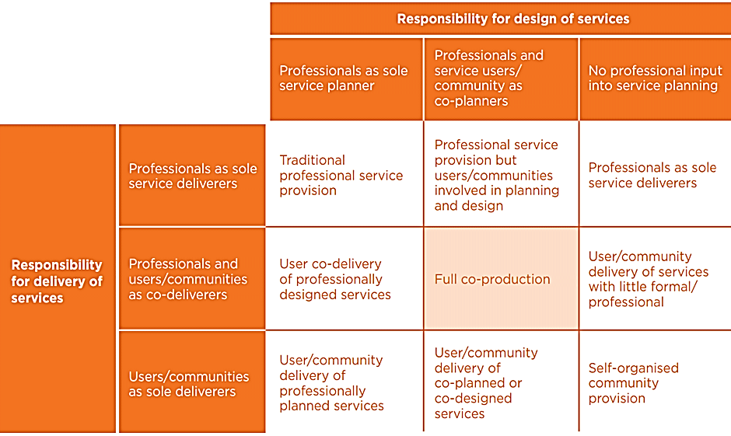
Co-production occurs in the critical middle ground with the combined contribution of both professional and service user (Boyle and Harris, 2009).
Source: Adapted from Carnegie Trust (2006), ‘Commission for Rural Community Development – Beyond Engagement and participation, user and community co-production of services.’ By Tony Bovaird, Carnegie Trust.

Slide 30
The table shows what co-production isn’t: the elements in isolation are insufficient for full co-production
Much of the official discussion about coproduction shows only partial awareness of what it means, where it came from and how it works. Even the Cabinet Office, which broke new ground to promote the idea in mainstream policy debate, defined it too broadly as “establishing a partnership between citizens and government to tackle a social problem”.
Co-design and other forms of asking the advice of users may be helping to create space for co-production, but can lack any continuing involvement in delivery. Similarly, when communities or users organise provision with no involvement from public service professionals, whilst this is a very valuable intervention, it is not co-production.
As the table demonstrates co-production occurs in the critical middle ground when user and professional knowledge is combined to design and deliver services.
Boyle and Harris (2009)

Slide 31
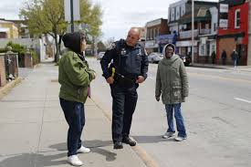
History of Co-Production
First described in the 1970s by Elinor Ostrom an Economist at Indiana University.
The word co-production was used to explain why crime rates rose when the police changed from walking the beat to patrolling in cars.
The relationships that police developed with people and the informal knowledge that they exchanged with the community when they walked the beat were critical in preventing and solving crimes.
Ostrom argued that the police need communities as
much as communities need the police, and used the
term co-production to describe this relationship.

Slide 32
In the 1990s, market driving improvement in public services was seen as more important; people stopped talking about co-production.
More focus was on the importance of management and the division between 'service providers' and 'service consumers'.
Health and social care was treated in the same way as other goods and services that are bought and sold.
People who used services were seen more as needing to have things done 'to' or 'for' them rather than being involved themselves in developing services or support.

Slide 33
Mid-2000s onwards, people have become interested in co-production again…
Strong link with disability movement and the mental health user movement.

Slide 34
Disability Movement
Society disables people through barriers in the environment, in organisations and through other people's attitudes (stigma).
Advocates that disabled people are the best people to make decisions about their own lives; and by working together they can make changes in society that currently disables them.
Environmental
Barriers
Organisational
Barriers
Disabling
World
Attitudinal
Barriers
Communication
Barriers

Slide 35
Mental health user movement
Opposes the medical model of mental health and promotes recovery and empowerment
Has a long history of developing ideas and ways of working in equal partnerships with professionals.

Slide 36
Co-Production
ThE How

Slide 37
Co-production People
Structure
Paid Experts
by Experience
Volunteers
Recovery Partners
Patient & Public Involvement

Slide 38
Think About It: Have Your Thoughts Changed?
Understand the background to Co-Production working
Understand why Co-Production working matters
Understand Co-Production working in Somerset NHS Foundation Trust
Understand some of the challenges involved in Co-Production working
Understand how to overcome potential challenges in Co-Production working

Slide 39
References and Further Reading
Boyle, D. and Harris, M (2009) The Challenge Of Co-production How equal partnerships between professionals and the public are crucial to improving public services. London: NESTA.
Boyle, D., Slay, J. and Stephens, L. (2010) Public Services Inside Out: Putting co-production into practice. London: New Economics Foundation
Department of Health (2010) Equity and excellence: Liberating the NHS [White paper]. Crown. https://assets.publishing.service.gov.uk/government/uploads/system/uploads/attachment_data/file/213823/dh_117794.pdf.
King’s Fund (2002) Claiming The Health Dividend Unlocking the benefits of NHS spending. Available from: https://www.kingsfund.org.uk/sites/default/files/field/field_publication_file/claiming-health-dividend-unlocking-benefits-nhs-spending-summary-anna-coote-kings-fund-1-may-2002_0.pdf. [Accessed on October 25 2020].
Mind (2013) Co-production in mental health - why everybody wins. Available from:
https://www.mind.org.uk/information-support/your-stories/co-production-in-mental-health-why-everybody-wins/. [Accessed on November 2 2020]

Slide 40
Mind (2020) Co-production – Deciding Together. Available from: https://www.mind.org.uk/workplace/influence-and-participation-toolkit/how/methods/co-production/.
[Accessed on November 2 2020].
National Collaborating Centre for Mental Health (2019) Working Well Together: Evidence and Tools to Enable Co-production in Mental Health Commissioning. London: National Collaborating Centre for Mental Health.
Slade M, McDaid D, Shepherd G, Williams S, Repper J (2017) Recovery: the Business case, Nottingham: ImROC.
Skills for Care (2018) Co-production in mental health Not just another guide. Available from: https://www.skillsforcare.org.uk/Documents/Topics/Mental-health/Co-production-in-mental-health.pdf. [Accessed October 25 2020].
Think Local, Act Personal (2020) People not process - Co-production in commissioning. Available from:
https://www.thinklocalactpersonal.org.uk/_assets/COPRODUCTION/Ladder-of-coproduction.pdf. [Accessed October 25 2020].

