Slide 1
Developing a resilient mindset
With
Bernard Genge

Slide 2
Aims and desired outcomes
Aims – To know how to control your thoughts and mindset so you can develop resilient, confident and empowering beliefs
Outcomes – With practice to automatically ‘think’ like a confident, resilient person to handle the challenges life throws at you.
As we go through this masterclass decide what you will START, STOP & CONTINUE doing
54321 DD
Notes:
On these masterclasses as we all learn in different ways there will be spoken words from me, written words on the ppt, pictures, quotes and for those that are very visual youtube clips to watch. The key to learning however is doing and teaching – 54321 DD
Based on latest neuroscience research in particular Dr Jo Dispenza, Dr Bradley Nelson and modelling – 140 marathons etc.

Slide 3
Set scene
Often resilience is seen as being really tough and bouncing back easily from traumatic or difficult situations. But what is the true meaning of a resilient mindset? Resilience is the ability to navigate life, adapting to change, learning through adversity and understanding your feelings and emotional responses to situations.
Resilience is an evolving way of being and takes personal understanding and awareness.
Resilient people don’t wallow or dwell on failures – they acknowledge the situation, learn from their mistakes and move on. Resilience doesn’t mean being tough – you can be resilient and still show emotion. The characteristics of resilience refer to your capacity to deal with discomfort and adversity and are traits that enrich your life.
Notes:
Insecure thoughts lead to a feeling of insecurity which leads to more other insecure thoughts/feeling and we tell ourselves ‘I am insecure’. Our thoughts are the language of the brain and is very past focused – we are programmed in the past and can change that by starting to change our thoughts which will change our biochemistry, feelings, mood/attitude, what you do and inevitably our results – this is exciting! New thoughts = new choices/decisions = new behaviours = new experiences = new feelings = new state of being = new outcome! Unfortunately we get addicted to negative feelings/thoughts (anger/fear/rage etc – its borne out in research.
You can not be resilient, successful, confident or assertive without ‘thinking’ as a resilient, successful, confident or assertive person would.

Slide 4
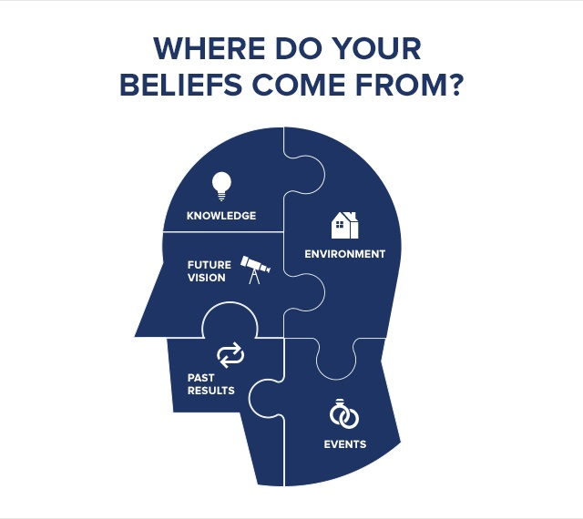
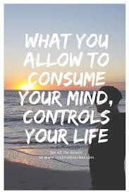
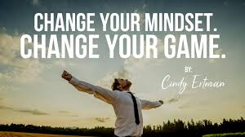

Slide 5
Empowering and disempowering thoughts/beliefs
DISEMPOWERING THOUGHTS | EMPOWERING THOUGHTS
Notes:
Write down one or two disempowering thoughts such as a time you’ve recently been frustrated, disappointed, angry guilty, regretful, overwhelmed etc. Now STOP – Stop/Sit down, think, Observe, Plan – be detailed about the disempowering thought, observe how it feels, now replace it with the opposite positive thought and write it on the right and then focus on it and observe how it feels.

Slide 6
THINKING LIKE A RESILIENT PERSON
Success
Skill. How to
Do it
Attitude. Want to
do it
Knowledge.
What to do
Belief
Our success is determined by ……..
Visualisation
Positive self-talk
What we do, which in turn is determined by …..
Our thoughts/mindset, but how do we shape them?
Our attitude, but what moulds our attitude?
Notes:
Link attitude – to vision of success (doctor story). Listen to how you talk to yourself you are listening – if you say you can’t you are absolutely right – won’t try, if you say you can, you stretch that comfort zone and who knows the result – this is exciting! Kids in a tree.
90% of todays thoughts are the same as yesterday and neauroscience tells is 50% of thoughts from the past are not true – we stay attached to them because its comfortable whereas change, any change is uncomfortable. Taking control of our thoughts and bringing more empowering thoughts/feelings into our life within 4 days releases 50% more healing chemicals into your body and within 60 days it starts lengthening your life. Change your thoughts – change your personality – change your personal reality.
A lady was diagnosed with cancer and given 6 months to live and died 6 months later, then the doctors realised they had muddled up the records and there was nothing wrong with this lady but she ‘believed’ – there are numerous stories of the opposite

Slide 7
Positive self-talk affirmations – choose at least 5
I choose to be in a good mood
I choose to have a positive attitude
I forgive myself for not being perfect
I make the best of every situation
I have control over my thoughts and feelings
I treat others with respect
I practice patience and understanding with others and myself
I choose to smile and enjoy life to the fullest
I eat well, exercise, and get plenty of rest to help balance my life
I have huge inner strength
I am resourceful and resilient
My life is full of unlimited possibilities
I learn from every situation in life and grow stronger as a result
I choose a vital and authentic life
I immediately bounce back from any set-backs in life
Notes:
7
7
Choose 5 and use them for the next 7 days then review how you feel

Slide 8
Positive self-talk affirmations – choose at least 5
I am extremely proud of all that I have achieved, and I am determined to fulfil my dreams, hopes and desires.
I choose to live my life positively, and reject all negative thoughts, self-judgement and criticism.
I deserve the best that life can provide and I will fulfil my dreams
I reject all that is negative and damaging in my life, and embrace all that is positive, kind and strength building
I choose to be strong, positive and resilient today, and reject all that is destructive and self-harming.
I will fulfil my dreams, hopes and desires, and eradicate all self-doubt, fear and criticism.
No matter how difficult or challenging today may become, I will always remain calm, positive and in control at all times.
I am strong against negative life circumstances
I can face anything that confronts me
I face life head-on
I have willpower
Notes:
8
8

Slide 9
Positive self-talk affirmations – choose at least 5
I am in control of my life
I use my inner strength in necessary situations
I have insurmountable amounts of inner strength
I practice building my personal resilience continually
I am naturally strong
I stand up to anything
I am bold and brave
I have full confidence in myself
I am resilient and strong
I believe in myself
At the end of each day record three positive/good things that have happened during the day. At the end of each week/month review the list to get a sense of all the good things.
Try issuing a ‘STOP’ command when you experience a negative thought or use a ‘cue’ such as an elastic band
Notes:
9
9
With the 5 statements delegates have chosen choose one of them and for the next minute focus on it, visualize it, feel it – get rid of any distractions for the next minute.
The next slide we will see why this is so important

Slide 10
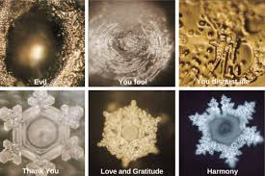
Notes:
These are images of how water cystalises differently depending on what it is exposed to, we human beings are 70% water so what impact does positive words and images have on us?? Talk about the power of words – kids in a tree

Slide 11
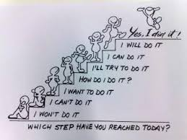
Notes:
See others who are always negative with empathy, why? Because what is going on is inside they have a struggle with the positives and negatives so ignore the negatives and project them outside or look for them outside!

Slide 12
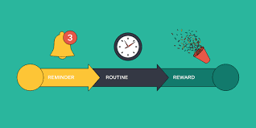
Spot your dots
This is what you do:
Stick a load of these dots around your house and workplace (if you are allowed)
Make three lists: 1 – Three happy memories; 2 – Three people you love or who love you; 3 – Three things that could make you happy in the future
Implant everything on your list in your mind so you can recall each memory (use your senses), imaging been with each of those special people and imagine those future events happening.
When you see a dot think of an item on your list. The more you do this the bigger the impact it will have.
Make this into a habit so strong positive thoughts are part of every day.

Slide 13
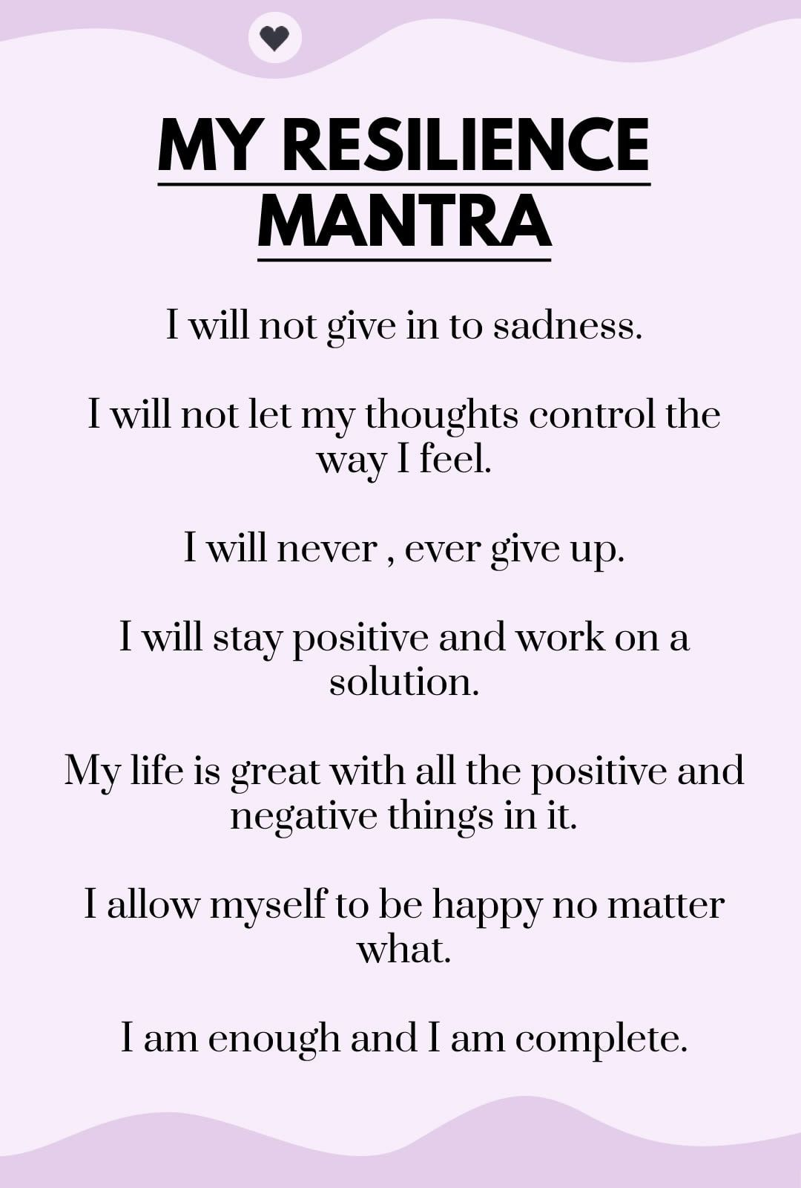
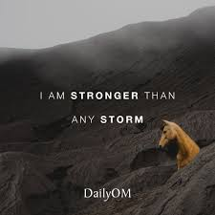
30-day challenge
Notes:
Roger bannister, my story swimming and sub 3 hour marathon – modelling

Slide 14
Action plan
As a result of todays masterclass what will you:
START DOING
STOP DOING
CONTINUE DOING
54321 DD
Notes:
54321 Decide/do

Slide 15
Further opportunities
Personal Resilience facebook group.
Ignite: Find Your Passion, Live Your Purpose & Re-Write Your Future
https://www.facebook.com/groups/216645969611627/?ref=share
Personal resilience online programme;
https://ignitepd.thinkific.com/courses/rock-solid-resilience?fbclid=IwAR1dt6Mw_cw8EqDPPJA3bpynSEVhFxwfMWBZpPKO1IZq04ZvxHHc0ty8KRc
bernard.genge@gmail.com

Slide 16
Further information/watching
https://www.youtube.com/watch?v=hEStIACmjNE
https://www.youtube.com/watch?v=-3rGflix2q8
Both videos are by Tony Robbins about the power of beliefs and he also talks about a 7-day challenge.
Notes:
String demo/sway test

