Slide 1
Self-awareness – the foundation for Personal Resilience and Development
With
Bernard Genge

Slide 2
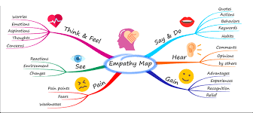
Aims & desired outcomes
Aims – To be committed to deepening individual self-awareness as a foundation for your personal resilience and development
Outcomes – To understand the areas to develop individual self-awareness
As we go through this masterclass decide what you will START, STOP & CONTINUE doing
Notes:
On these masterclasses as we all learn in different ways there will be spoken words from me, written words on the ppt, pictures, quotes and for those that are very visual youtube clips to watch afterward. The key to learning however is doing and teaching – 54321 DD
Zoom – video/mute mic when I’m presenting. Please use the chat box, when you open it you can send a message to the whole group or a specific person. Please use it to ask questions, share thoughts, experiences or even to elaborate on points made in the masterclass – ones that perhaps really resonated with you and why.

Slide 3
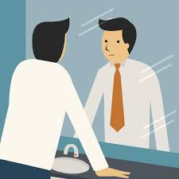
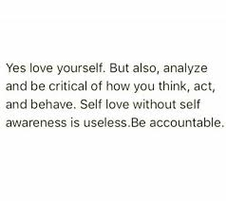
Notes:
When you are self aware you can see yourself as the unique person that you are.
Self-awareness is the foundation of emotional intelligence. The ability to monitor our emotions and thoughts, moment by moment, is key to understanding ourselves better, and to be at peace with who we are. It is more than that however, it is the ability to focus on yourself and how your actions, thoughts, or emotions do or don't align with your internal standards. If you're highly self-aware, you can objectively evaluate yourself, manage your emotions, align your behavior with your values, and understand correctly how others perceive you.
An example of self-awareness is your ability to distinguish your own beliefs from others. You can step back and ask yourself, Am I being true to myself at this moment? It is also understanding what traits you have, good/destructive habits and any cycles you are in such as worrying cycles so you can then break those cycles.

Slide 4
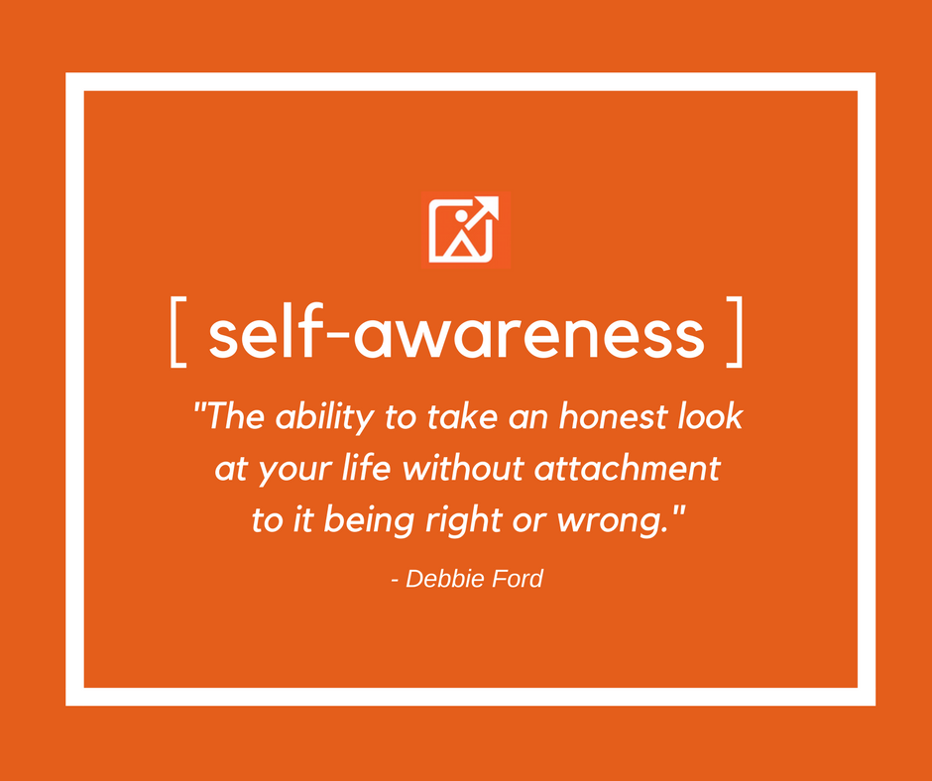
Set scene
Notes:
Definition: having a clear perception of your personality, including strengths, weaknesses, thoughts, beliefs, motivation, and emotions. Self Awareness allows you to understand other people, how they perceive you, your attitude and your responses to them in the moment.
Do we assume we are more self-aware than we actually are?
On a score of 0 -10 how self-aware are you now?
When we are self-aware, we then become aware of others and then aware of, prepared to question and confident to face the reality of the world we live in

Slide 5
Why?
Foundation for making significant personal change.
Foundation for emotional intelligence and awareness of thoughts and their impact
First step in creating what you want and mastering your life.
Aware people know what they want to have, do and be
The platform to respond appropriately to life’s challenges & stress
It short it’s the foundation to taking CONTROL
Notes:
An important question to ask ourselves is ‘can I make significant positive change in my life without hight self-awareness?’ It’s the foundation for success with high self-awareness you can change your thoughts/emotions and in turn your actions.

Slide 6
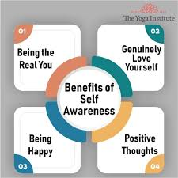
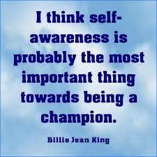
What are the benefits?
Notes:
The ability to act consciously instead of on impulse.
The ability to develop genuine self-esteem.
Being authentically confident, happy & honest with yourself.
Greater depth of enjoyment of life.
The ability to transfer negative thoughts/emotions to positive ones.
Behaving positively & focus on solutions.
‘Nice people’ enjoy fruitful interpersonal relationships – you’ll be empathic.
Being the real you & more inner peace.
Making the ‘right’ decisions becomes easier, but also more intuitive.
Living courageously and without limits.
Less guilt & regrets
Know what you really want in life.
What would your life look like if you did all these things on a regular basis?
In short you’ll know your triggers and your reactions to them, how you're landing with others and how your routine behavior impacts your future opportunities.

Slide 7
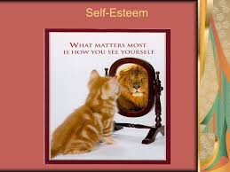
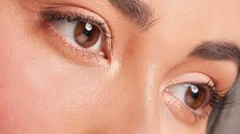
Do you have an accurate perception of ……
Notes:
Your strengths, weaknesses, personality?
Your thoughts, beliefs, values?
How you react to challenges?
What causes you to feel stressed?
How others perceive you?
Why you do what you do?
Our eyes look outwards, we are aware of others shortcomings but not so much our own

Slide 8
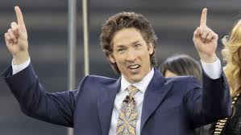
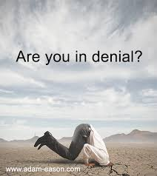
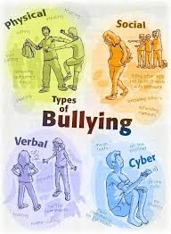
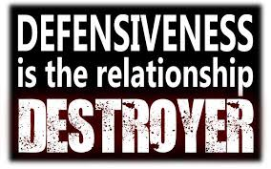
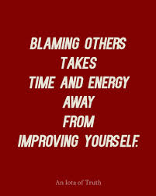
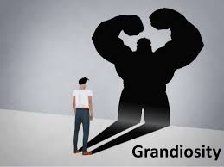
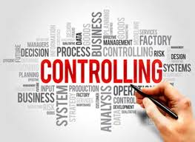
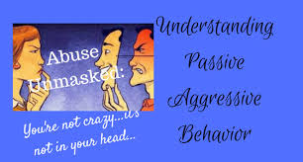
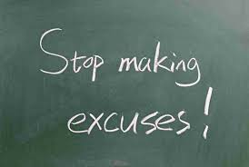
Signs we are not as self-aware as we think!
Notes:
1 – preach too much
My behaviour changes a lot
Grandiose - making over-the-top overtures to how confident I am in my ideas

Slide 9
Homework - Exercise- I am
1. At the top of a piece of paper write ‘I am’ and then a number of statements that describe you e.g. sporty, energetic, a smoker, sarcastic etc. etc.
2. Then write a summary statement in the third person tense as if you were reading this about someone else in the newspaper.
3. Give your first statement to a friend/colleague and ask them to write a summary of the person they have read about, maybe e-mail it to them, but don’t tell them it is you just ask ‘how would you describe this person’ and maybe choose someone who will not recognise it is you from the statements you have written.
This crude exercise tells us: 1st piece of paper – how we see ourselves; 2nd – how we would like others to see us; 3rd – how others may actually perceive us

Slide 10
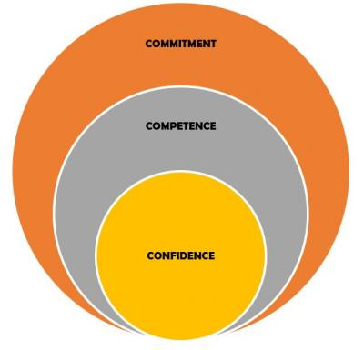
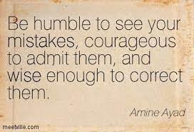
What to consider to develop self-awareness
Notes:
Lacking confidence? Over confident/ego-centric? Level of skill, knowledge, competence? Level of commitment/motivation in life – do you have goals/vision?

Slide 11
Our internal standards that guide our behaviour
On the left write down the standards you set yourself or aspire towards, then on the right times when you behaved in a way that demonstrated those standards i.e. you led by example:
My standards Times when I demonstrated them
Notes:
11
11

Slide 12
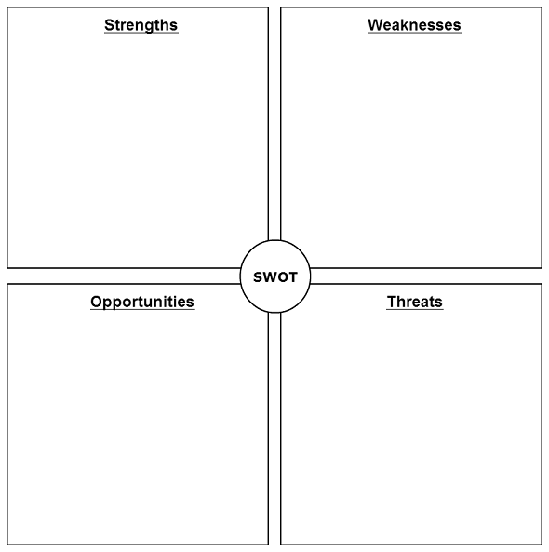
Personal SWOT
Notes:
12
12

Slide 13
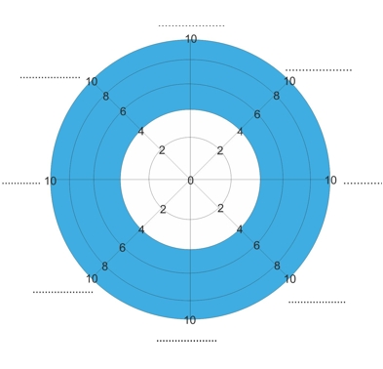
Wheel of life – how smooth or bumpy is your ride in life?
Health/fitness
Friends and family
Career
Personal Development
Finances
Notes:
13
13

Slide 14
Weekly/daily reflection
Start your reflection now. Make notes about the following
Your thoughts
Your beliefs
Your values
Your blind spots
The actions you take
Your level of confidence
Notes:
14
14
Consider doing a journal

Slide 15
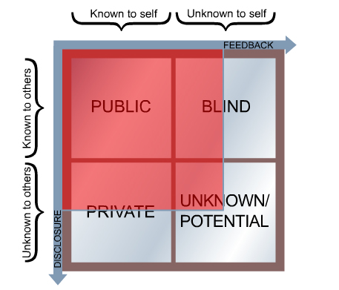

Slide 16
Embracing feedback
Notes:
16
16

Slide 17
Ask for feedback regularly and ……
Don’t react defensively
Ask yourself “is there any truth in what is being said”?
What can I learn about myself?
Use it as a means of testing your self-control
Don’t react - it does not make it go away!
Look for the merit and substance in what is being said rather than fault
Thank them and then think about it take action and let them know what you’ve done
Notes:
17
17
Consider a 360

Slide 18
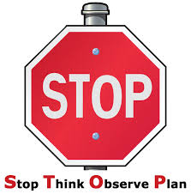
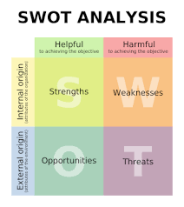
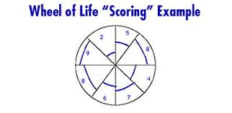
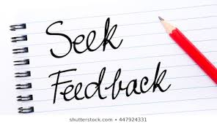
30-day challenge
Notes:
Self awareness leads to human awareness which leads to world awareness which leads to spiritual awareness. We begin to see things differently – nature as a relative rather than a resource, animals as friends not food and food as fuel not fun perhaps.
It also helps you be more inquisitive – I recently found out that men and women respond differently to prescribed drugs to such a degree that the Doctor who did the research says there is nothing more important than our sex for how we respond to drugs. Drug trials have been done on men which led me to ask did drug companies know this?

Slide 19
Action plan
As a result of todays masterclass what will you:
START DOING
STOP DOING
CONTINUE DOING
54321 DD
Notes:
54321 decide/do

Slide 20
Further opportunities
Personal Resilience facebook group.
Ignite: Find Your Passion, Live Your Purpose & Re-Write Your Future
https://www.facebook.com/groups/216645969611627/?ref=share
bernard.genge@gmail.com

Slide 21
Further information/watching
https://www.youtube.com/watch?v=tGdsOXZpyWE
17 minutes. 95% of people think that they’re self-aware, but only 10-15% actually are! Tasha Eurich has a simple solution that will instantly improve your self-awareness. As a third-generation entrepreneur, Dr. Tasha Eurich was born with a passion for business, pairing her scientific savvy in human behavior with a practical approach to solving business challenges. As an organizational psychologist, she’s helped thousands of leaders improve their effectiveness, from Fortune 500 executives to early-stage entrepreneurs.
https://www.youtube.com/watch?v=R9qVa4LoJx8
The Power of Self-Awareness | William L. Sparks | TEDxAsheville 18mins 09
Will’s talk, “The Power of Self-Awareness,” illustrates the transformative potential of giving and receiving feedback. In his talk, he recounts his first class during his doctoral program at George Washington University when his professor gave him an “A” on his final paper, but an “F” in life. During their exchange, Professor Jerry B. Harvey introduced Will to his “Shadow” and helped him see that the dysfunction in his failed marriage had been largely brought by himself, not his ex-wife. Confronted with this reality, Will discusses the implication of understanding how our Shadow often brings about the very thing we are trying to avoid. He closes his talk with the broader implications of this exchange, and the moral responsibility we have to give and receive honest and candid feedback with those in our lives.

Slide 22
Further information/watching
https://www.youtube.com/watch?v=o4d8UNDeKuE
Self Awareness: The Key to Success | Danielle Brown | TEDxCityUniversityLondon 14 minutes
Success is psychological - our brain determines whether we are successful or failures, even in sport which is predominantly seen as a display of physical prowess. Inspirational Danielle truly believes that strength of character has an important role to play in everybody’s journey to success, regardless of the field. Danielle Brown is a double Paralympic gold medallist in archery and three time World Champion. She also won a gold medal at the 2010 Commonwealth Games in Delhi, where she was the first disabled athlete to represent England in an able-bodied discipline. Currently Danielle holds all 12 Paralympic world records, and was ranked world number 1 for her entire career. Whilst competing at a world class level Danielle also attained a first class law degree. Danielle achieved heights that others didn’t even realise were possible until she did it, setting the standards for others and proving that disability is no bar to achieving.

