Slide 1
Weekly planning to achieve your goals and in turn your personal vision
With
Bernard Genge

Slide 2
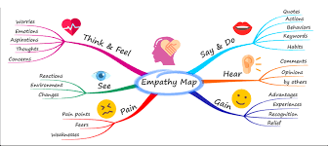
Aims & desired outcomes
Aims – To commit to weekly planning to take incremental steps towards your vision and then remain focused on a weekly basis and review progress.
Outcomes – To generate the empowering habit of weekly progress towards your self chosen vision.
As we go through this masterclass decide what you will START, STOP & CONTINUE doing
Notes:
On these masterclasses as we all learn in different ways there will be spoken words from me, written words on the ppt, pictures, quotes and for those that are very visual youtube clips to watch afterward. The key to learning however is doing and teaching – 54321 DD

Slide 3
Set scene
When you commit to weekly planning, where you evaluate your past weeks success, look at and regenerate your commitment to your vision and mission and quickly review your roles and then set an action plan for the next week that takes you in small incremental steps towards your dreams, magic will happen in your life.
In one or two years time when this is habitual to you, you’ll be just able to do it, but for now you’ll need massive amounts of self-discipline to do this every week then extraordinary focus to do what you commit to.
If you’ve chosen a personal value of commitment, integrity, focus or determination this is where its really put to the test.
Its where the rubber hits the road.
Is the commitment worthwhile? Reflect back to your visualisation of your 100th birthday and the answer will be a resounding yes.
﻿

Slide 5
Linking goals to your vision and mission
Evaluate
VISION
MISSION
Take Action with commitment
Roles
Plan Weekly
Goals
SMARTER

Slide 6
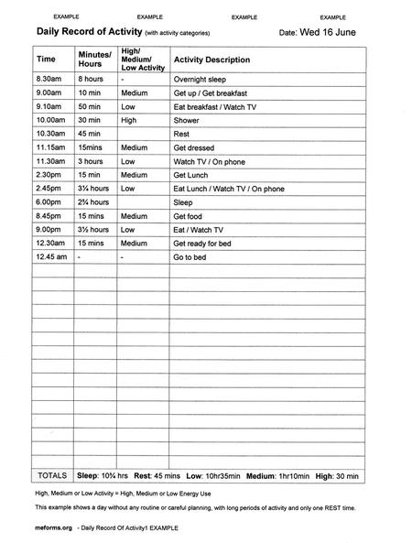
Notes:
Self awareness is a good starting point and maybe do an activity record to see how you spend your time now

Slide 7
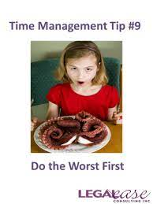
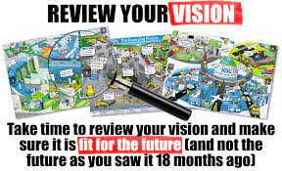
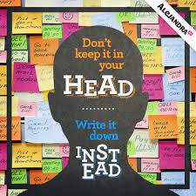
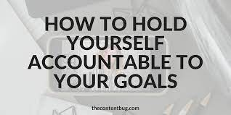
How to plan weekly
Notes:
Review your vision, mission, roles and longer-term goals then make a detailed list of every little thing you need and want to get done this week that will take you one small incremental step towards achieving your longer-term goals and vision
Know exactly what you will do to make sure you achieve those priorities and actions for this week
Taking it out of your head and into your heart deepens your commitment to it

Slide 9
Now we need to take action with personal integrity, commitment and focus
Personal integrity involves being the best, most honest and morally-sound version of yourself. Your integrity may stem from your beliefs, your personal goals in life, or from some other formative experience.
Notes:
Remind delegates of the two hand analogy – one hand is your values, the other what you do, when they meet this is integrity.

Slide 10
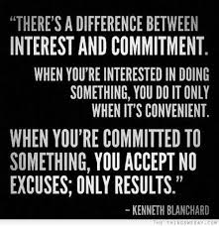
Commitment
A true commitment is the meeting between what is already true, and what wants to become real. It is the commitment to becoming who you aspire to BE. And it is one that we must make, if we are to manifest the purpose for which we have been born.

Slide 11
Focus
Focus is so important because it is the gateway to all thinking: perception, memory, learning, reasoning, problem solving, and decision making. Without good focus, all aspects of your ability to think will suffer. Here's a simple reality: if you can't focus effectively, you can't think effectively.
Get rid of distractions and focus, but not just focus, generate pin-point focus.

Slide 12
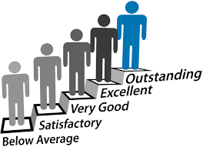
Evaluate your success
Review your vision, mission, roles and values. Highly motivated people often focus too much on execution without spending enough time to think about “am I doing what is really most important to me”
Compare yourself only to yourself
Measure results not intention
Learn and make changes
Let others know how you are doing – it will build accountability into your mind
Do a monthly review
Tracking helps you stay focused on what's important to reaching your goal. It helps you identify potential obstacles and strategies for how to overcome them. It can help you set more realistic goals and stay positive along the way.
Were you:

Slide 13
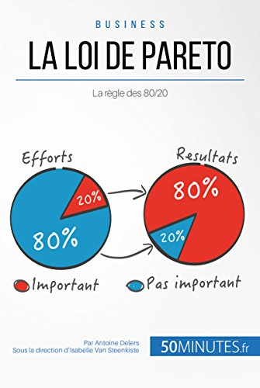
To-do lists
If you’ve seen the film Schindlers List, well Oskar Shindler’s list saved lives! We’ve all made lists, whether its for shopping, organising the kitchen, making a list of people we need to phone and the pure act of writing that list helps to force you to do it. It also helps us remember important information. So here are the steps:
Choose a medium – writing it on paper or a whiteboard deepens commitment to it. You can use different colours for different tasks.
How many lists do you need? Personal? Professional? Project list etc?
For daily lists try and keep it to a maximum of 10 important activities.
Make the tasks specific not vague, so rather than ‘work on x project’ detail the exact tasks you’ll be doing, remember SMARTER when setting goals? You don’t need that depth of detail but do make the tasks specific and achievable for you.
Make sure you include the information you need. If the task is ‘book that fitness session’ add the telephone number.
Notes:
Remember the Pareto principle also known as the 80/20 Rule. So with your list of 10 things the Pareto principle says 2 of those will deliver greater results that the other 8 combined, so know what that 20% is and do them first.

Slide 14
To-do lists
Give a time slot for each task
Don’t be too rigid (it will cause you stress), be flexible if something else important comes along and you need to deal with it, so be it. You are in control.
Know how you will make yourself accountable – tell someone else, if its digital can you share it with someone else.
Set a time every day to do this. Many people choose first thing in the morning when they get up or last thing in the evening.
Celebrate the small daily victories will give you the confidence to make your to-do lists more bold and more rewarding.
We all know things that hang around too long don’t get done, so don’t let things slip – do them.
Build in breaks and be kind to yourself – you are on a journey. You need self-discipline, but also pleasure, relaxation, family/friends and hobbies, and of course don’t forget things like exercise.
Finally remember you need to dominate your list not allow it to dominate you, we will say it again, you are in control.

Slide 15
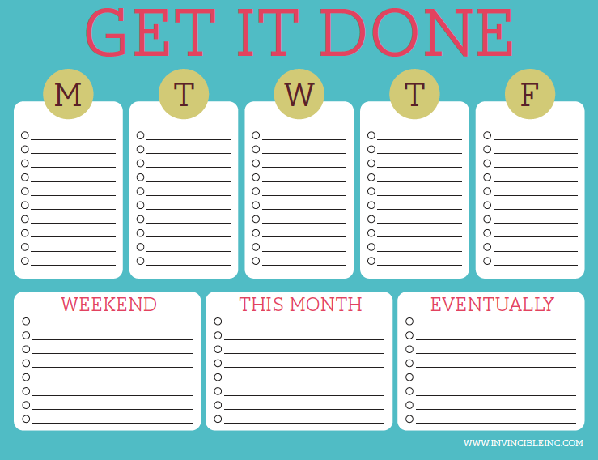
Notes:
Visual management have your vision board next to this. You need your vision, mission, roles and goals.

Slide 16
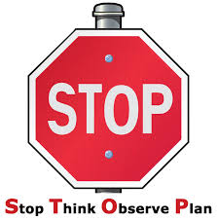
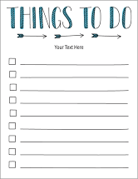
30-day challenge
Get a system in place for doing your weekly planning
Prioritise personal integrity, commitment and focus and know how you will maintain that

Slide 17
Action plan
As a result of todays masterclass what will you:
START DOING
STOP DOING
CONTINUE DOING
Notes:
54321 decide/do

Slide 18
Further opportunities
Personal Resilience facebook group.
Ignite: Find Your Passion, Live Your Purpose & Re-Write Your Future
https://www.facebook.com/groups/216645969611627/?ref=share
bernard.genge@gmail.com

Slide 19
Further information/watching
https://www.youtube.com/watch?v=7yMh2QNRc_M
Weekly Planning- A Video from The 7 Habits of Highly Effective People 7 mins 11
To live a more balanced existence, you have to recognize that not doing everything that comes along is okay. There's no need to overextend yourself. All it takes is realizing that it's all right to say no when necessary and then focus on your highest priorities.
In this video Dr Covey talks about quadrant 2 activities – these are things in life that are important but not necessarily urgent. Quadrant 1 things are the important/urgent things that are in effect crisis’s, and quadrant 3 are not important/not urgent things that distract us.
https://www.youtube.com/watch?v=aBi8M3DehQ0
How Ben Franklin Structured His Day 8 mins 20
In his 1791 autobiography, Ben Franklin laid out his daily routine. Let's go through it, see what's useful, and also highlight what's missing.

