Slide 1
Returning To Work As Lockdown Eases*
Our working lives were changed enormously when lockdown started – whether we stayed working as a key worker, worked from home, were placed on furlough or lost our jobs.
As lockdown eases, our working lives will change again, and some people will be looking for new work.
For many of us, coming out of lockdown is not a choice. Across the country people are being called to return to work, even when the official advice is to work from home wherever possible.
For many of us this isn’t possible and the prospect of return carries with it a need to weigh up the potential safety risks to ourselves and family, with the need to earn money, restart the economy and/or provide service to others.
*www.mentalhealth.org.uk/coronavirus/looking-after-your-mental-health-during-coronavirus-outbreak-while-working

Slide 2
Things to Consider When Returning to Work As Lockdown Eases*
Our working lives were changed enormously when lockdown started. As lockdown eases, our working lives will change again.
For many of us coming out of lockdown is not a choice. Across the country people are being called to return to work, even when the official advice is to work from home wherever possible.
Sometime this won’t be possible and the prospect of return carries with it a need to weigh up the potential safety risks to ourselves and family, with the need to earn money, restart the economy or provide service to others.
*www.mentalhealth.org.uk/coronavirus/looking-after-your-mental-health-during-coronavirus-outbreak-while-working

Slide 3
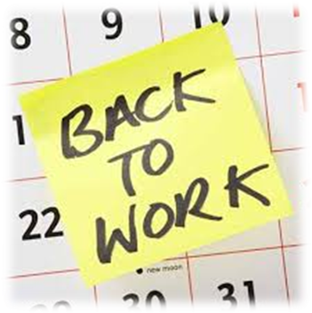
Anxieties over Returning to Work As Lockdown Eases*
We may have a lot of mixed feelings about coming back to work – it may be exciting and something we’ve wished for or we may be angry that we are being forced back too fast.
We may be worried about public transport and social distancing on the job. We may be or angry or frustrated with our employers, or at the guidelines available from government for our industry.
It may be that the circumstances of our work cause us anxiety or frustration– especially if other people’s choices or behaviours increases our risk of catching the virus.
*www.mentalhealth.org.uk/coronavirus/looking-after-your-mental-health-during-coronavirus-outbreak-while-working

Slide 4
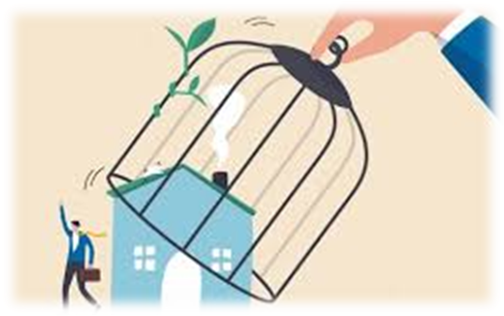
Returning to Work Post-Furlough*
If you are on furlough, you may have found ways to occupy your time – with family commitments, volunteering, hobbies or by learning new skills. Reconnecting with work might take time, and hopefully you will have time to plan when you are likely to back, or even have the opportunity to return gradually.
It’s worth approaching a return to work like a return from any long absence – gradually picking up routines and setting down the things you’ve been doing during lockdown. Equally, you may have been furloughed recently as the scheme closed for new entrants. If so there is a lot of advice out there from people who have furlough experience – but rest might by high on your agenda and if so, that is OK.
*www.mentalhealth.org.uk/coronavirus/looking-after-your-mental-health-during-coronavirus-outbreak-while-working

Slide 5
Speaking to your Work if you are Concerned Over Returning*
Many workplaces are allowing more flexible working even if people need to return. If you are finding it hard to get to work, or do particular shifts or activities because of anxiety or fear, speak to your manager or a colleague you trust if that feels right.
If you have or have had longer term mental health problems, you may be entitled to reasonable adjustments as a disabled person under the Equality Act - even if you haven’t disclosed before, if it feels safe to do so now you might be able to benefit from doing so.
*www.mentalhealth.org.uk/coronavirus/looking-after-your-mental-health-during-coronavirus-outbreak-while-working

