Slide 1
Leaving pessimism and embracing optimism
With
Bernard Genge
Notes:
On these masterclasses as we all learn in different ways there will be spoken words from me, written words on the ppt, pictures, quotes and for those that are very visual youtube clips to watch afterward. The key to learning however is doing and teaching – 54321 DD
Do ask questions – the one who does might feel silly for a few seconds the one who doesn’t appears silly for a lifetime.

Slide 2
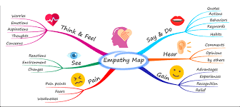
Aims and desired outcomes
Aims – To know how to leave pessimism in the past and embrace optimism
Outcomes – To create a steady state of optimism in life
As we go through this masterclass decide what you will START, STOP & CONTINUE doing
Notes:
Imagine if every morning you could determine what your day could be like? Who says we can’t? Can we get out of bed every day and set an optimistic intention for that day? Of course we can, but will it effect our day?????
But why make the effort as its easier to be pessimistic, well if you are positive, optimistic and happy = 50% less chance of a heart attack, if you are doing any exams you’ll perform better and if you coach/teach your kids they will perform 50% better in tasks as well as improve our immune system (35% less chance of getting a disease), you’ll live 9 years longer and 32% less cortisol the stress hormone that contributes to chronic illness, sleep better and experience less pain. Only 10% of happiness is circumstances so 90% is habits and genetics and modern science tells us we can change our genetics.
But what is your happiness thermostat? We all have one but the research says whatever ours is now we can improve it.
Key message on each slide.

Slide 3
Notes:
Pragmatic people deal with things sensibly and realistically in a way that is based on practical rather than theoretical considerations. Optimistic people are hopeful and confident about the future. The two combine to outline an approach this is both hopeful and realistic.
A blind optimist is so determined to stay positive that they ignore the problems around them instead of addressing them. They lack the capacity to understand and react to the natural highs and lows of life. But what is worst is a super negative and overly critical person. The answer combine them.
Pragmatic optimists see the potential for the way things could be. They don’t hide in the past clinging to the way things were. They point out flaws and weaknesses with extreme speed and then align every fiber of their being to the goal of improving and perfecting.
Pragmatic optimism is also the deep realization that you are able to choose to see the world in your own way. Above all else, you become an independent thinker. You don’t let others dictate the rules of the game or set the standard of how and what to think.
Key message - Its important because we are hard-wired to be negative when we were gatherers (not hunter gatherer’s) we were wired to be aware or a threat (wild animal) not a juicy compliment and if we don’t prioritise this we will continue to have 80% negative thoughts (based on research).

Slide 4
Notes:
Don’t deny reality as our subconscious mind knows it (fewer people watch programmes about the climate crisis than dramas/soaps that is full of negativity because its not happening to them but this leads to pessimism, low mood/depression, were as facing reality leads to action), believe in future, live in the moment, learn from past, take control of what matters (health, wellbeing etc.) = optimism.
Being optimistic is having an honest reflective view of life, problems and enthusiastically taking action, whereas pessimism is over-exaggerating a perceived negative impact of life or a problem. Optimists realise we have earned the difficult times so we can ‘earn’ the good times and they manage what comes into their lives as they know if you have negative in then negative comes out so they focus on positive in so positive comes out.
Optimism is a mental attitude characterised by hope and confidence in success and a positive future. Optimists are those that expect good things to happen, where pessimists instead predict unfavorable outcomes. Optimistic attitudes are linked to a number of benefits including better coping skills, lower stress levels, better physical health, and higher persistence when pursuing goals.
Its worth remembering that grapes must be crushed to make wine, diamonds form under pressure, olives are pressed to make oil and seeds grow in darkness, so whenever you feel crushed, under pressure, pressed or in darkness with the right attitude you are in a powerful position of transformation.
Key message - Optimists tend to view hardships as learning experiences or temporary setbacks. Even the most miserable day holds the promise for them that "tomorrow will probably be better.“
If you always see the brighter side of things, you may feel that you experience more positive events in your life than others, find yourself less stressed, and even enjoy greater health benefits.
Mystics and spiritualist firmly believe we attract what we give out, so if we give out optimism what will we attract?

Slide 5
Notes:
I will use the term ‘January’ here as his is the formula for January blues which is a day in January we feel the most depressed (but lets apply it to our month now) – not convinced of the science behind it but if we unpick it – make your own weather and carry it with you, question whether what we’ve been told that debt is OK, don’t set resolutions – goals/CI, make the decision to take action 54321DD, go outside, try something new in January, commit to daily reflection/visualisation, exercise every day in January, only eat healthy food, read/watch/listen to something inspirational every day, talk to an inspirational person about a thought provoking subject – you won’t get the blues.
Key message – commit to optimism throughout the whole day, week, month and year – it’s a worthy commitment to make and use your refined self-awareness to recognise times you feel pessimistic (people, times of day, certain tasks etc.)

Slide 6
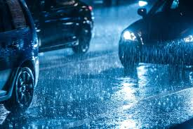
Notes:
These are 2 realities of winter, reflect on how you see it and if you can shift your thoughts – ask what is stopping us changing our thoughts? Use an example of yesterday and think about the most stressful part of your day, then focus on the best part of that day – you can choose. This is a difference between pessimism and optimism. SAD – seasonal affective disorder – low energy, poor concentration, avoiding people, worst sleep, feeling sad, low, miserable, guilty, loss of appetite. SAD is also the ‘standard American diet’ and yes that does have an impact on our mindset, mood levels, brain health and levels of optimism.
SAD as in seasonal affective disorder it affects 5% of people and the winter blues 20% of people
Winter – cold – shorter days – less social interaction – more time alone – financial worries = lower mood = more effort needed to be optimistic in winter. Make the winter months your purposeful optimistic time – plan optimistic things as I’ve suggested
All of our stories in life are different, but so many of our struggles are similar so perhaps we need to love ourself more, compare ourself with others less, give more compassion and receive more respect and be our own wellness warrior.
Key message – always take your own weather with you.

Slide 7
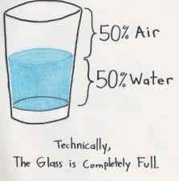
Notes:
How do you see life, be honest with yourself when you answer that? Make the decision now to commit to focus on half-full optimism.
Key message - look for positive signs everywhere and never say you are a pessimist, it’s a very unhealthy label and labels in our physical/psychological and emotional health are often very unhelpful. .

Slide 8
Notes:
This is the essence of the study: Researchers discovered that those with positive age beliefs who carry the ε4 variant of the APOE gene were nearly 50 percent less likely to develop dementia than their negative peers.
Other study findings were striking, as well. A review of the entire study group reveals that those with a positive attitude toward aging experienced a 19 percent reduced risk of dementia.
Researchers can’t be sure why the remaining 53 percent don’t develop dementia, but “the results of this study suggest that positive age beliefs, which are modifiable and have been found to reduce stress, can act as a protective factor, even for older individuals at high risk of dementia.”
In other words, the gene is not a death sentence, and a positive outlook is one of the tools we have available to thwart it.
APOE explained below
Science Proves the Power of Optimism
A 2018 study published in the journal PLOS One¹ found that older Americans with negative aging beliefs were more likely to develop dementia than their positive counterparts.
A team led by Becky Levy of the Yale School of Public Heath used survey results from the Health and Retirement Study, a nationally representative study of more than 30,000 individuals 50 and older. Over a four year period, the researchers evaluated 4,765 people, with an average age of 72 years, who were free of dementia at the start of the study.
Participants were surveyed on their aging beliefs. For instance, they were queried on whether they were as happy now as they were when they were younger; whether they believed that things got better or worse with age, and if they felt less useful with age.
In addition, the researchers assessed the cognitive status of each participant by a standard test conducted over the phone. The assessment included such things as counting backward from 20, naming the president and vice president (it was done in the US), and recalling a list of ten items. Participants were reassessed every two years.
Importantly, study participants provided saliva samples to see whether they had the APOE gene, which is linked with an increased risk of Alzheimer’s disease.
Even with Alzheimer’s Gene, Positive Attitude Staved Off Dementia
Researchers discovered that those with positive age beliefs who carry the ε4 variant of the APOE gene were nearly 50 percent less likely to develop the disease than their negative peers.
Other study findings were striking, as well. A review of the entire study group reveals that those with a positive attitude toward aging experienced a 19 percent reduced risk of dementia.
“Age beliefs tend to be internalized early in life and then remain stable over the lifespan, without interventions, Levy and her fellow researchers wrote. “Our finding could provide a rationale for a public-health campaign to combat the societal sources of negative age beliefs.”
According to the study, one-fourth “of the population carries the ε4 variant of the APOE gene” but only 47 percent of those carriers will develop dementia.
Researchers can’t be sure why the remaining 53 percent don’t develop dementia, but “the results of this study suggest that positive age beliefs, which are modifiable and have been found to reduce stress, can act as a protective factor, even for older individuals at high risk of dementia.”
In other words, the gene is not a death sentence, and a positive outlook is one of the tools we have available to thwart it.
It’s Never Too Late to Get a Good Attitude
it’s never too late to rewire your brain. In a previous study, Levy and colleagues observed a group of 100 individuals 61 and older. They found that brains could be trained to be positive and “that strengthened positive self-perceptions of aging … improved physical function.”
The way we talk to ourselves is important and never say anything to yourself that you wouldn’t say to anyone else.
Allow yourself to smile or laugh about things that concern you or you can’t change. It’s a crazy world and, as the expression goes, you have to laugh.
Our physical habits also have a huge effect on our mental state. Follow a healthy lifestyle with daily exercise, good sleep and healthy food. Exercise is one of the most potent medicines for depression.
If you have any kind of negative thoughts about ageing for example write down a list of all the positives of getting older such as been more connected, having more friends, more experiences and you can be the expert more often, you have more resources, you don’t make as many silly mistakes, by recognising your own mortality you will do what is important and what matters most each day and finally grey hair is a crown of glory!
Eleanor Roosevelt said: “Today is the oldest you’ve ever been, and the youngest you’ll ever be again.” Your best days are yet to come

Slide 9
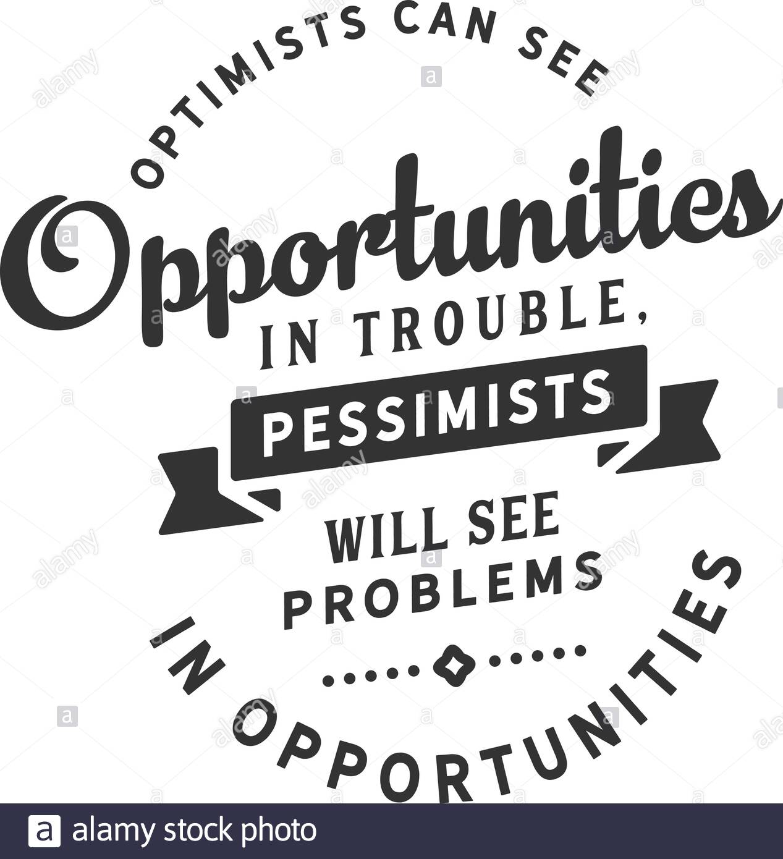
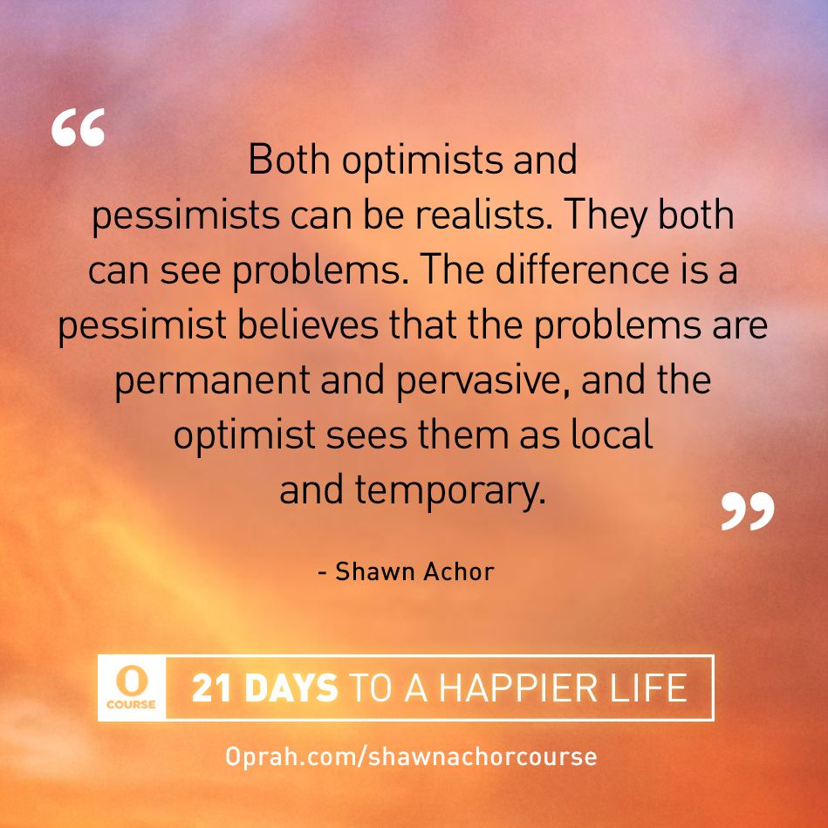
Notes:
Optimist see problems as impersonal, temporary and in context whereas pessimists see problems as personal, permanent & pervasive. This can lead to what is called; ‘learned helplessness’.
How do you see problems? Language is important, if you talk about what you do want rather than what you don’t want that is what your mind will focus on. Words are also important stop saying you have problems and instead say situations. Problems are really behaviours so what behaviours contribute to my ‘problems’? Every human problem (the climate emergency, war, social inequality etc. etc) are all human behaviours, so changing the behaviour would solve the problem
Learned helplessness occurs when an individual continuously faces a negative, uncontrollable situation and stops trying to change their circumstances, even when they have the ability to do so. For example, a smoker may repeatedly try and fail to quit. He may grow frustrated and come to believe that nothing he does will help, and therefore he stops trying altogether. The perception that one cannot control the situation essentially elicits a passive response to the harm that is occurring.
The term was coined in 1967 by the American psychologists Martin Seligman and Steven Maier. The pair were conducting research on animal behavior that involved delivering electric shocks to dogs. Dogs who learned that they couldn’t escape the shock stopped trying in subsequent experiments, even when it became possible to avoid the shock by jumping over a barrier. The researchers later realized they had picked up on a slightly different behavior, learning control, but studies have since confirmed that learned helplessness occurs.
Seligman later developed the concept of learned optimism By explaining events to ourselves in a constructive manner and developing a positive internal dialogue, people can break free from their cycle of helplessness.
Seligman subjected study participants to loud, unpleasant noises, using a lever that would or would not stop the sounds. The group whose lever wouldn’t stop the sound in the first round stopped trying to silence the noise subsequently. Not trying leads to apathy and powerlessness, and this can lead to all-or-nothing thinking. Nothing I do matters. I always lose. This phenomenon exists in many animal species as well as in humans.
Overparenting - The concept may also manifest in educational settings when children feel they cannot perform well and therefore stop trying to improve. The experience is characterized by three main features: a passive response to trauma, not believing that trauma can be controlled, and stress. When parents do everything for their kids, helplessness can follow. Kids do not learn to take care of themselves, and they lose personal agency. A good example of helplessness: When parents do their children’s chores for them.
Something else worth discussing whilst exploring helplessness is Dopamine - involved with the “pleasure system” of the brain and functions to create a feeling of enjoyment and a sense of reward in order to motivate performance. People that suffer with low dopa often experience hopelessness, worthlessness and struggle to handle stress. These individuals will often isolate themselves from others and have self-destructive thoughts and behaviours. Solutions include managing your stress - we produce too little because the cells are burned out. Our dopamine secreting cells can be overwhelmed with stimulus to produce dopamine and begin to shut down, effectively reducing our ability to produce stress hormones on demand. Practice Hormesis. Better sleep, healthy diet (prevents leaky gut - Organic green tea, avocado, green Leafy Vegetables, beets, nuts & Seeds, fermented foods, anti-microbial and carminitive herbs such as garlic, onions, oregano, basil, thyme, peppermint, ginger, are all great as they nurture healthy gut microbiom) and ensuring you have enough B6 in your diet/supplement. Set goals, be focused and exercise are all good for dopamine production. Do all of these before considering supplements.
Key message – always see problems as impersonal, temporary and in context to prevent any learned helplessness

Slide 10
Notes:
Shoes in Africa story

Slide 11
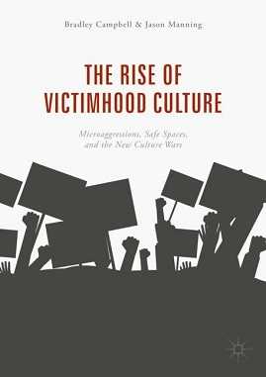
Notes:
Sometimes victimhood can feel like a never-ending state. This person never feels in control of their life, and this loss of control is compounded as time goes on. They are powerless, and they engage in negative self-talk, putting the self down, and having no self-worth. Being helpless can get the victim what they need, namely sympathy and attention.
Key message - learned helplessness & victimhood can emerge from and contribute to depression, anxiety, and post-traumatic stress disorder. During a depressive episode, for instance, someone may believe that nothing will end their suffering, so they stop seeking help completely. When a person experiences high self-efficacy and independence, they also enjoy better health outcomes. Learned helplessness typically manifests as a lack of self-esteem, low motivation, a lack of persistence, the conviction of being inept, and ultimately failure. It is more common for people who have experienced repeated traumatic events such as childhood neglect and abuse or domestic violence so regard building confidence & self-esteem a life-time project. Proactively develop your maturity to interdependence and always perceive you are in control.

Slide 12
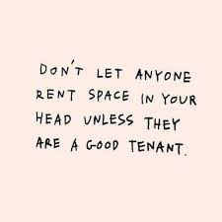
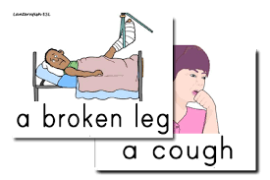
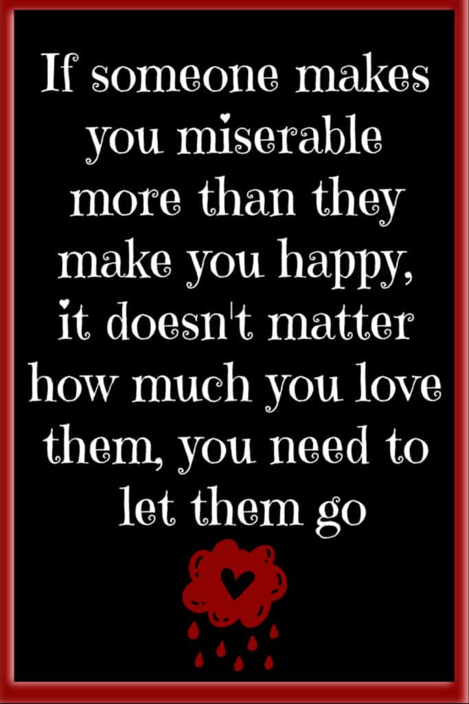
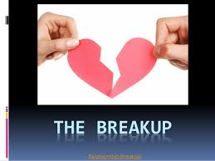
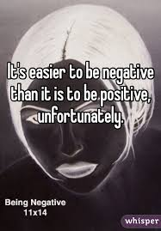
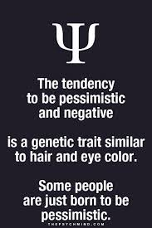
What impact do these have?
Notes:
1 – media During the pandemic rather than building our resilience/wellbeing our society and especially the media gave us fear which depletes our immune system – how many lives we lost needlessly? What would the impact have been if we were constantly fed information about how to build our immune systems, resilience, sense of control to name but a few?
Key message - Talk about the belief things are worst than they are, pose the question are humans naturally pessimistic – if so is it because we know its easier.

Slide 13
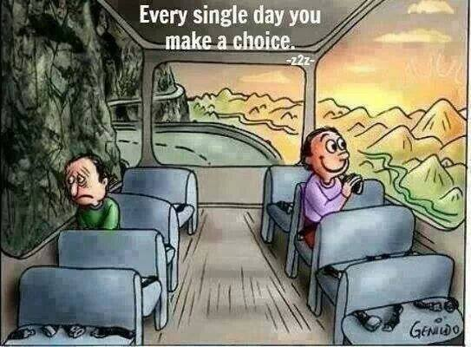
Notes:
Its an important choice/attitude to make every morning. Make the first step out of your bed in the morning a ‘choice step’ and choose optimism – optimism with a heart/brain connection = 50% more healing in your body. Then step into the bathroom and choose a positive emotion of the day - dental and emotional hygiene together. Viktor Frankly said we can choose our attitude. If the first question you ask in the morning how great is today going to be, by practising this question your brain will soon answer ‘great’ then ‘really great’ and it will get to work on it – you are now on the road to happiness. Physical movement/exercise is proven to enhance the impact of these positive emotions by creating more positive neuropathways.
Key message - We change for one of two reasons inspiration or desperation, many people focus on creating neuropathways when they are desperate (spinal injuries) but lets be inspired to do this.

Slide 14
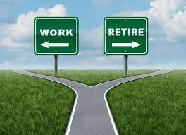
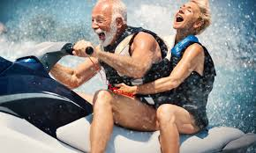
Notes:
For some, retirement is like jumping off a cliff, with structureless days and a loss of identity that fills them with a sense of dread.
But for others, retirement can’t come quickly enough. They take the first opportunity to exit the workforce early and begin a life of leisure. Very few consider the question, what is the impact of early retirement on the brain?
A new study has the answer. And it will have you thinking about retirement in a whole new light
A new study found early retirement may be good for the body, but it’s not good for the brain. It can accelerate cognitive decline, and it’s not the first research to uncover this disappointing news.
A study published in 2010 looked at a substantial amount of data from the United States and eleven European countries. The investigators concluded that: “Early retirement has a significant negative impact on the cognitive ability of people in their early 60s that is both quantitatively important and causal.”
The word “causal” (causes) should be noted. This word is rarely found in human population studies. Ordinarily, the language “strongly associated with” is about as direct as it gets.
A few years later, another study also documented considerable harmful effects on cognitive performance with early retirement. Now, for the latest research
The latest study was conducted by social scientists at Binghamton University, New York. They were interested in whether the harmful effects on cognitive function demonstrated in folks who retired early in Western countries also applied to a rural Chinese population.
The researchers used survey data from a high quality nationally representative sample of over 17,500 individuals aged 45 and over in rural China. From this data set they were able to determine changes in cognition over time by analyzing a variety of memory tasks given to the participants.
Then, they applied the data to those who were also beneficiaries of the National Rural Pension Scheme (program), introduced in 2009, and compared the findings to those not in the program. At first, the news was very good
When the New York team analyzed the early results of data among this cohort they found that pension benefits and retirement led to positive health changes overall via improvements in sleep and the reduction of alcohol consumption and smoking.
Since these factors can negatively impact brain health, the researchers expected early retirement would be good for memory and cognition. But their hopes were soon dashed.
As the researchers wrote in their paper, published in the Journal of Economic Behavior & Organization in January 2023, “the provision of pension benefits negatively impacts immediate recall, delayed recall, and total word recall for program participants.
This finding is significant, as lower performance on delayed recall memory measures has been a highly accurate detector of dementia among senior individuals.”
There was a five percent drop in the average total word recall score, which is equivalent to a decline in general intelligence of 1.7 percent. The decline began about four years after the onset of program benefits.
Joint author Plamen Nikolov explained, saying, “We were surprised to find that pension benefits and retirement actually resulted in reduced cognitive performance.
“The fact that retirement led to reduced cognitive performance in and of itself is a stark finding about an unsuspected, puzzling issue, but a finding with extremely important welfare implications for one’s quality of life in old age.”
Why did this happen?
Dr. Nikolov believes any brain benefits from better health behaviors, as suggested in the earlier set of results, were outweighed by other factors.
“Participants in the program report substantially lower levels of social engagement, with significantly lower rates of volunteering and social interaction than non-beneficiaries. We find that increased social isolation is strongly linked with faster cognitive decline among the elderly.
“Social engagement and connectedness may simply be the single most powerful factors for cognitive performance in old age.”
That’s a remarkable statement and bears repeating: “Social engagement and connectedness may be the single most powerful factors for cognitive performance in old age.”
While distressing, this is news we can all certainly use to stay on top of our mental game in retirement, so our golden years are just that, golden.
Stay socially engaged as you get older whether you’re working or not. Isolation might be the very worst, or at least one of the worst, things you can do for your memory.
While early retirement can play a significant role in explaining cognitive decline at older ages, it doesn’t mean early retirement itself is a problem, even if it was unplanned, a situation millions of people found themselves in during the COVID-19 pandemic.
What this research does show is that once your brain power is no longer put to use for work, it needs to be redirected to other activities to compensate. In other words, use it or lose it.

Slide 15
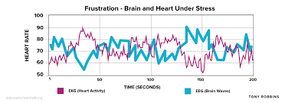
Debilitating emotions such as anger raises brain waves by over 200 times the norm, its no wonder we can’t think/act rationally when angry.
Notes:
Its interesting that here we have heart and brain waves, although we think they are separate recent neuroscience research tells us they are closely related – in this image here is one trying to compensate for the other? What is also interesting is both cardiac and neuro-surgeons recommend similar lifestyles to prevent heart attack and stroke
Key message – focus on creating coherence – hand on heart deep breaths, positive emotion of the day, deep breaths with fingers in the ears and hum on the out breath – this vibration talks to the parasympathetic system

Slide 16
Your optimism self-assessment checklist
With each of the following statements score each between 0 – 10
You expect good things to happen in the future
You expect things to work out for the best
You’re confident you will succeed in the face of even the toughest challenges
You expect a bright future
You expect that good things can come from negative events
You see a challenge as an opportunity to learn
You feel grateful and really do appreciate the good things in your life
You are always looking for ways to make the best of situations
You have a positive mindset/attitude about yourself and others
You accept responsibility for mistakes but you don't dwell on them
You don't let one bad experience dampen your enthusiasm and optimism for the future
Notes:
Key message – any you scored lower than 7 on prioritise.

Slide 17
Optimism test
What do you do when you are late to a function?
I cancel?
I go but I imagine the worst happening?
I’m never late?
I go and make it go well?
In psychology, expecting the best possible outcome from any given situation is referred to as which of the following? ?
Dispositional optimism?
Unrealistic optimism?
Comparative optimism?
Situational optimism?
How do you treat strangers?
With extreme caution?
They are always after something?
Like a friend, they could be?
Kind, but don’t trust them?
What do you expect in uncertain times?
The worst, so be prepared?
The best, but with reservations?
I only expect the best?
I’ve learn not to have expectations?
When you enter a competition do you expect?
To try your best?
Be somewhere in the middle?
To come towards the top?
To win?
Your chances of achieving your life goals?
Achieved them to date and setting new ones?
I’ve achieved a few?
Don’t see the point of life goals?
Too much to knock me off course?
How do you react to a seeming hopeless situation?
Ok because I expected it?
Be surprised?
I will turn it around?
It always happens to me?
The term ‘glass half full’ was derived from the Latin word?
Excellent?
Best?
Worst?
Progress?
Notes:
Circle the answer on your slides that you think is the most optimistic answer
Competition question – to win is the optimistic answer?
Achieving your life goals? Number one is most optimistic
Hopeless situation – number 3
Glass half full question – number 2
Function – number 4 as we are all late from time to time
Psychology – answer - dispositional optimism. People are considered unrealistically optimistic if they predict that a personal future outcome will be more favorable than that suggested by a relevant, objective standard. Unrealistic optimism also occurs when people unduly predict that their personal outcomes will be more favourable than the outcomes of peers (Shepperd et al., 2013). Comparative optimism (Radcliffe and Klein, 2002) introduces relativity of expectation of good outcomes for the self compared with a similar other. Situational optimism refers to the general expectations of a good outcome in a specific context.
Strangers question – 3 like a friend
What do you expect in uncertain times – 3 only expect the best
Key message – prioritise any you got wrong

Slide 18
Notes:
Benefits of realistic optimism.
Have a stronger immune system = longer life – grounded in research
Be better at dealing with stress
Be prepared for the worst/best
Take preventative measures to potential threats to health/wellbeing
Look for solutions
Have an uplifted mood and be a pleasure to be around = better relationships
Dare to be great
Key message – never under-estimate the impact on our health of being optimistic.

Slide 19
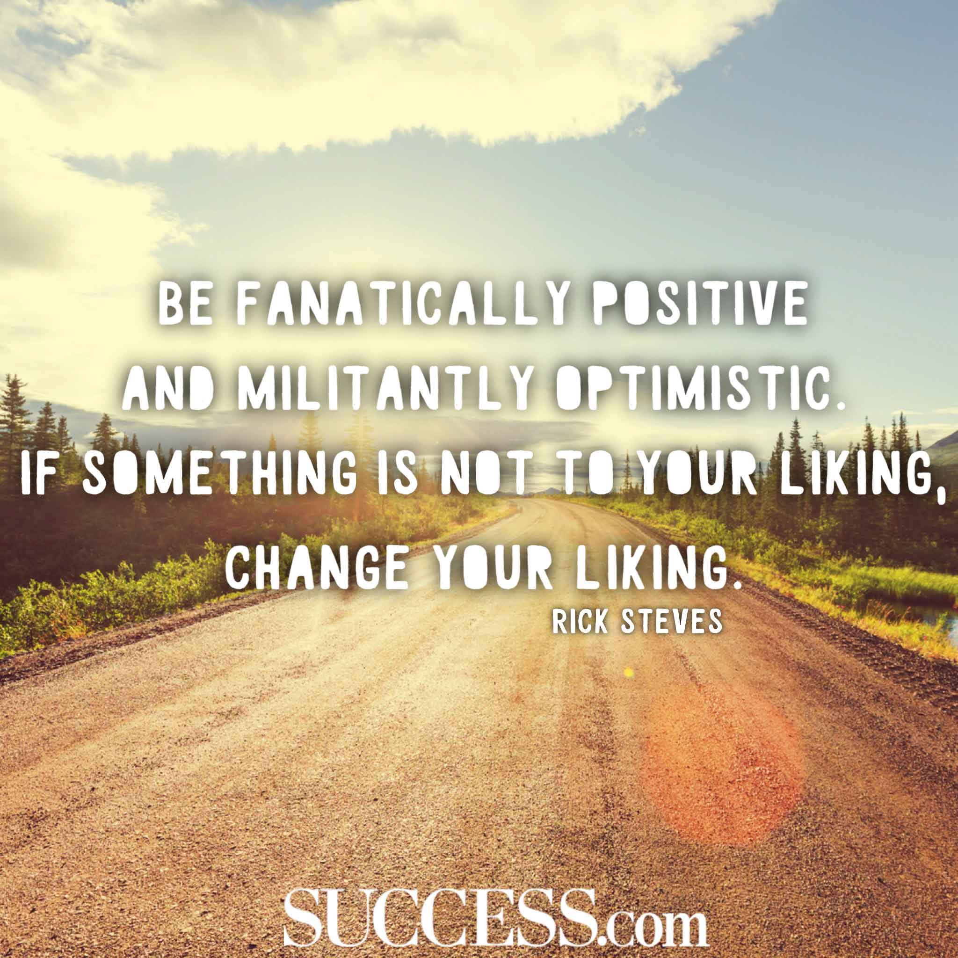
Notes:
Do challenge yourself to stretch that comfort zone, because comfort stops us growing, working (even if we turn up), being creative and been the best version of ourself we can be. When you are green you grow when you ripen you don’t and be busy been born or re-born because he/she that doesn’t is busy dying. Success is buried on the other side of comfort, frustration at times and even rejection so become comfortable with these by experiencing them more and finally give to receive – if you went to the soil to receive fruit it would not matter how persuasive you are you’ll get noting back because you haven’t planted the seed, watered it and nurtured it to bearing fruit.
Key message – never ever under-estimate the power of your mindset, practice self-awareness and take control of your thoughts and thinking patterns.

Slide 20
https://www.youtube.com/watch?v=6Pm0Mn0-jYU
Notes:
In short, happiness is reality – expectation.
Dopamine is a neurotransmitter that directly affects the reward and pleasure centres in the brain, which in turn affects mood. If you can relate to the feel good factor related to learning and positive reinforcement we want more of it.
This system is designed, from an evolutionary standpoint, to reward you when you’re doing the things you need to do to survive — eat, drink, compete to survive and reproduce. As humans, our brains are hard-wired to seek out behaviors that release dopamine in our reward system. When you’re doing something pleasurable, your brain releases a large amount of dopamine. You feel good and you seek more of that feeling.
This is why junk food and sugar are so addictive.
If you have the right balance of dopamine, you feel:
Happy.
Motivated.
Alert.
Focused.
With low dopamine you feel the opposite and high dopamine euphoric, highly energised but poor impulse control and aggression.
Serotonin’s main function is to stabilize your mood, as well as your feelings of happiness and well-being. Serotonin also plays a role in the digestive system and sleep cycles.
The body needs serotonin, but too much or too little can lead to health issues. For example, too little serotonin can cause depression. Too much, however, can cause a rare condition called serotonin syndrome often caused by high stress levels.
People with low serotonin may experience aggression, poor impulse control, insomnia, irritability, and low self-esteem. Psychological conditions related to low serotonin include anxiety and panic disorder, depression, eating disorders, and obsessive-compulsive disorder (OCD). Also digestive issues and fatigue.
Then we have cortisol – hippocampus – amygdala gang up on pre-frontal cortex that stops us doing stupid things and makes it dysfunction where you can’t see the future, just live for the moment just like dogs and just like a dog you need your reward and can’t cognitively say no (ever seen a dog say no to food or control its impulse to chase a cat?), this results in dopamine going higher and this dopamine and cortisol = addictions – do you ever want a reward (drink of alcohol) when stressed. Cortisol impairs serotonin by down regulating it and that can lead to depression.
So chronic stress = higher dopamine = addiction and lower serotonin = depression.
Reward/pleasure and contentment/happiness are not the same as we see in the picture here. To elaborate on a few:
Pleasure is taken/taking – casino, drugs alcohol), happiness is giving – your time, a compliment, a good deed, forgiveness etc.
pleasure experienced alone – a cake, happiness comes in social groups – parties
Achieved with substances (cocaine etc.) or behavioural – internet shopping, gambling etc. and is addictive whereas you cannot have too much happiness.
The bottom paragraph is interesting and worth elaborating on because dopamine is the excitatory transmitter and it transmits this excitement to the next transmitter and they feed on this, but in the long-term it leads to cell death, so its protective mechanism is to down regulate the receptors sp we then need more and more to get the hit which is what we know as addiction of course.
Serotonin is not excitable so we don’t need to down regulate it so you can’t overdose on it/happiness, so it really is true that the more pleasure we seek the lass happy we become – we can’t get happy with a substance, even a prescribed one.
Great natural ways to stabilise serotonin include exercise, sunshine, meditating, swimming, walking, cycling.
Its also interesting to note that the pleasure and pain parts of the brain are in the same place and they work in balance, and that balance wants to stay level so any deviation from neutrality the brain will work hard to restore the balance, similar to a principle of physics that I don’t know much about but I think it clearly demonstrates that our brains know the difference between pleasure and happiness and if we only every pursue pleasure we will always experience pain.
Other ways to increase happiness according to Nick Keomahavong a Buddhist monk is to cultivate been in the present moment and practice gratitude, lower greed by practice giving and do meditation and he says we need to practice all three.
The website link is called Why Finland And Denmark Are Happier Than The U.S. Its almost 26 minutes long but worth a look at.

Slide 21
What we can do
Take control of negative thoughts and challenge them
Identify situations/thoughts that are causing pessimism STOP.
If you are prepared to look closely enough there is often very little evidence for the pessimistic thinking
Make the decision to learn from the past, live in the moment and focus on the future
Secret mirror technique – tell yourself how great you are
Create your own optimistic mantra
Never label yourself (failure, useless etc)
Avoid pessimistic phrases (‘I will never’, ‘I always screw up’)
Visualise and positive self talk – DAILY
Attitude of gratitude – do a gratitude diary
Record good things every day
Positivity – people/literature/watching – ALWAYS
Pay it forward – when someone does/says something good to you pass it on
Adopt a healthy diet, hydrate, exercise, manage stress/toxins, good sleep hygiene & nature (take in a sunrise/sunset)
Get together with family/friends and play the ‘appreciation game’
Notes:
The foundation is challenging yourself as to whether you are a victim or victor, if you blame, shame and complain you are a victim, then making that all important decision to be optimistic/happy NOW – for no reason, don’t wait for a circumstance as it will be short-lived make that decision today and practice every day.
3 - De a detective for the good, search it out and find it, there is loads out there.
4 – There are two days every year you can do nothing about yesterday and tomorrow, so yes have a vision but focus on what you can control.
5 – generate the energy of expansion rather than contraction – if you contract you body, arms shoulders and say ‘I feel happy’ and you won’t feel happy whereas if you expand your arms and say the same you will feel happy, but even if you expand your arms and say I feel miserable you won’t feel miserable. Tune into your body and be aware of your body language – see an athlete when they have won and gone over the finish line they practice expansion
6 – when someone asks how are you say “I’m absolutely fantastic, it’s a beautiful day and I am so grateful to be alive and well” or “Fantastic, in fact I am so happy if I had any more happiness I’d need to be twins to share all my joy” then ask them how they are, make a list of optimistic words you will use regularly.
8 – as well as pessimistic phrases avoid pessimistic people, surround yourself with those that lift you up rather than push you down. Meditation – which is a way of accessing our deepest and highest consciousness, it is the science of intuition
15 – Take it in turns to find things you appreciate about the others
Key message – do 5 of these right now and plan to build the others into your life – the difference will be profound.

Slide 22
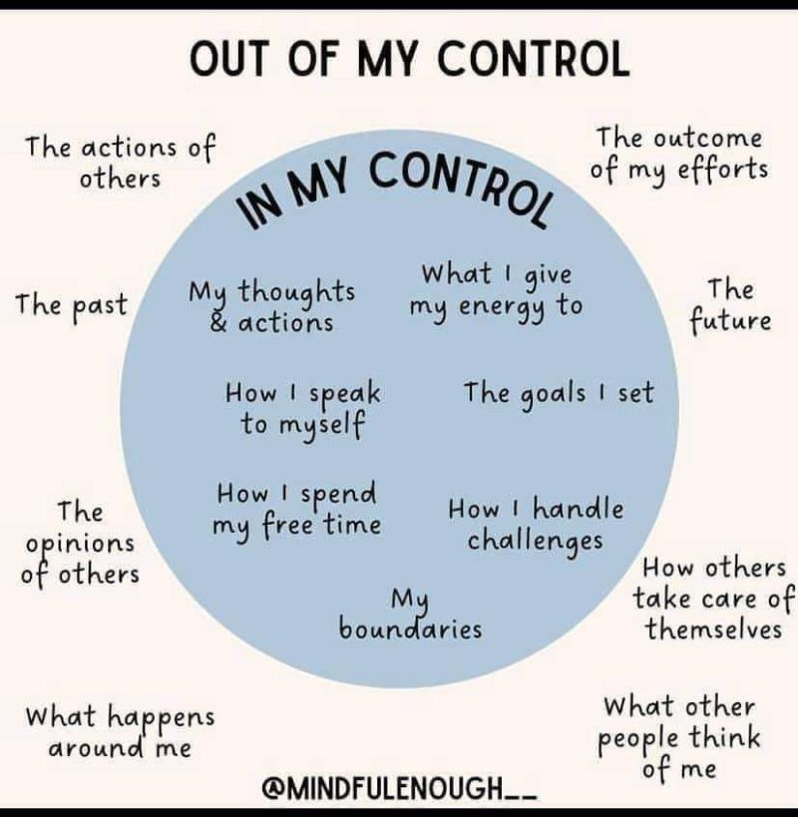

Slide 23
Notes:
Key message – the outcomes/results in your life will be so profoundly different based on the choice of your thoughts, attitude and approach to life (optimistic or pessimistic).

Slide 24
Did these people ‘fail’?
Stephen King’s first novel was rejected by publishers close to 50 times, and he threw it in the bin. His wife pulled it out urged him to not give up – his books have now sold more than 350 million copies.
J. K. Rowling was divorced, skint and depressed but she progressed from living on benefits to being named by Forbes as the world’s first billionaire author and in 2010 named the “most influential woman in Britain”.
Steven Spielberg was rejected by the California School of Cinematic Arts but has gone on to direct some darn good films.
Walt Disney was told had no imagination had an unhappy childhood along with countless business failures and setbacks. With the loss of his first business, Disney packed his bags, and with just $40 to his name, took off to Los Angeles to try his hand at acting. But he failed at that, too. Disney found his first major success with the creation of Oswald the Lucky Rabbit which became a huge star in one-reel animation, but Disney himself would find his luck had run out. Traveling to New York to renegotiate his contract, he discovered that his producer had taken his team of animators from under him and that he no longer had any legal rights to Oswald the Lucky Rabbit. But instead of fighting the loss or plotting his revenge, Disney decided to walk away and start over again. It was on the train ride back to California that he created Mickey Mouse. Any special qualities? If the right mind-set, belief, commitment and a stubborn determination are special qualities then yes.
Notes:
Winston Churchill in World War 1 as Britain’s Lord of Admiralty, made the fateful decision to attack Turkey at Gallipoli. The eight-and-a-half-month-long battle involved a total of about a million men on both sides, of whom nearly one half became casualties. The failed campaign led to the humiliation of the British. Churchill was dismissed from his cabinet position, excluded from the War Council, and allowed no hand in the further conduct and administration of the war.
Key message - Winston Churchill did what we challenge you to do today, he learnt by his makes and went on to be great.

Slide 25
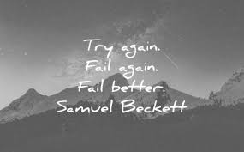
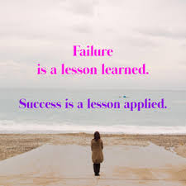
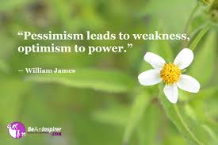
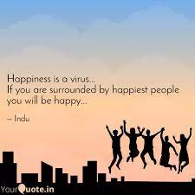
Notes:
FAILURE – tackle it head on and learn from your mistakes. Take the time to organize your thoughts after a failure and realize what you did wrong. Above all else, be willing to learn, grow, build muscle (physical & mental) – it builds character, humility and helps yo make better decisions in the future.
4 be contagious with optimism and happiness – spread a positive virus.
Key message – true leaders inspire others through their words, actions, ability to get back on the bike when they fall off, focus on solutions and the things they can control.

Slide 26
Notes:
Every day write down the things you can be grateful for and once a week review it. What can you be grateful for – life, parent’s, friends, air, water, roof, food, heart, mind, your strength, your senses, your tears, jobs, teachers, heatbreaks, your body, the sun, trees, privileges, choices, electricity to name but a few.
Harvard did a study and found that 3 gratitudes a day lowered depression by 60% if we continued with it.
Key message - Lissa Rankin MD research suggests optimists have a 70% less chance of heart disease than pessimists.

Slide 27
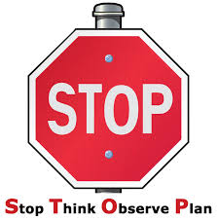
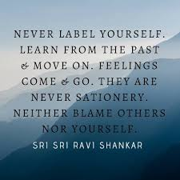
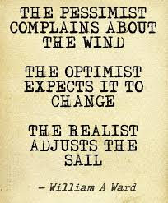
30-day challenge
So stop pessimistic talk. Take control of your thoughts and life, avoid pessimistic people, and remember problems are not stop signs but guidelines. Finally,
Notes:
2 – do this now – write down 5 things you admire about yourself
3 – be proactive and focus on what you can control
5 – Let your fears make you fierce
Key message – internalise STOP – make it your word of the month
Are you a thermometer or thermostat
We all have a happiness thermostat set point, so for example if you win the lottery your happiness increases for a period of time then it comes back down to the set point. The scientific research behind this is interesting as it says 50% of happiness is genetic, 10% circumstance and 40% thoughts, beliefs & actions, but by focusing on the 40% you change neuro pathways in the brain which in turn change the 50% that is genetic, so perhaps this tells us to stop seeking happiness from external events and find it within, in fact its 90% and it really is a myth when we say “I’ll be happy when”…….. So what can we do to raise the happiness set point? 1 – take responsibility for your own happiness 2 – Control your thoughts, 3 - have an open heart (kindness, gratitude etc), 4 - healthy body 5 – purpose and be inspired 6 – surround yourself with optimistic people and be very aware of the impact of negative people – don’t set yourself on fire to keep others warm 7 – read, watch, listen to inspiration every day 8 – consciously and proactively do loving things to yourself every day – purposely catch yourself thinking good thoughts, 9 – set a goal of 5 (or 10) good things to see each day – nature for example, BUT THIS IS THE KEY, YOU NEED TO SAVOUR IT FOR 30 SECONDS AS THIS IS WHAT CHANGES THE NEURO PATHWAYS IN YOUR BRAIN. When in nature if you can close your eyes and let the sun plant itself on those closed eyelids you get an extra hit of serotonin (the happiness chemical) 10 – use the 3 to 1 rule (anytime you experience a negative thought replace it with 3 positives. It you are angry for 5 mins it supresses your immune system for 6 hours whereas when practising love, forgiveness, gratitude etc in increases our immune system for 6 hours.If in the next hour you receive on criticism and 10 compliments you remember the criticism, that’s why this is so important. 11 – your fast-track to happiness is forgiveness (it helps you more than the other person – if Mandela didn’t focus on it he thinks he would have died through his anger – one of his aggressive prison guards became one of his most trusted bodyguards)

Slide 28
This is where we watched the video
Mel Robbins the difference between optimism and pessimism
https://www.youtube.com/watch?v=W1GJShTlCtw

Slide 29
Action plan
As a result of todays masterclass what will you:
START DOING
STOP DOING
CONTINUE DOING
54321 DD
Notes:
Make it something to look forward to, base it on great intent and repetition.
Do remember that habits are hard to change so do commit to a 30-day challenge then do it for another 30 days then another 6 (need 66 days) and identify what you have to gain by staying where you are right now (its called a secondary gain) for example kids who get bullied at school will make and keep themselves sick to gain avoid going to school and be exposed to the bullying. Tie this to creating your own burning platform and compelling vision – you need to create new neuropathways to change habits by really understanding what keeps you where you are, creating a push and pull.
Key message - practice positive daily habits that you turn into a daily ritual – 4 p’s = performance, psychological safety, purpose and pride.

Slide 30
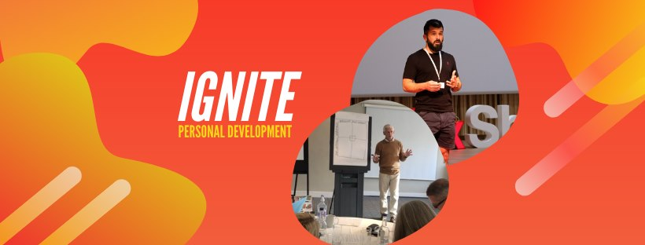
https://www.facebook.com/groups/216645969611627/?ref=share
bernard.genge@gmail.com

Slide 31
Further information/watching
https://www.youtube.com/watch?v=2hHNq45rEnU
Learned Optimism by Martin Seligman – Animation 4mins 44
https://www.youtube.com/watch?v=mZbzrtnvMjs
Choosing Optimism | Caroline Allen | TEDxYouth@MBJH 6mins 26
What makes someone an optimist? Caroline Allen explores the benefits of having a positive outlook and the actions that are necessary to becoming an optimist. Caroline Allen is a ninth-grade student at Mountain Brook Junior High. She enjoys music, hanging out with friends, and focusing on the bright side of things.
The happiest man on earth: 99 year old Holocaust survivor shares his story | Eddie Jaku | TEDxSydney – YouTube https://www.youtube.com/watch?v=scCvi3vY4jQ 12 mins

