Slide 1
Stress – Understanding the causes, early warning signs and coping mechanisms
With
Bernard Genge
Notes:
On these masterclasses as we all learn in different ways there will be spoken words from me, written words on the ppt, pictures, quotes and for those that are very visual youtube clips to watch afterward. The key to learning however is doing and teaching – 54321 DD

Slide 2
Aims & desired outcomes
Aims – To know the real cause of your stress the early warning signs and how to cope with it
Outcomes – To Always be in control of your stress
As we go through this masterclass decide what you will START, STOP & CONTINUE doing
Notes:
Ask everyone to think about something that causes stress and focus on that for 30 seconds, then stop thinking about that and imagine walking through a beautiful peaceful forest - stress is in our mental makeup, the more you think about something stressful the more stress it will cause, so catch yourself cooking stressful thoughts and take control of them – my resilience mantra STOP
Then write down on a piece of paper what you want from others when you are feeling stressed? Then what you want others NOT to do?

Slide 3
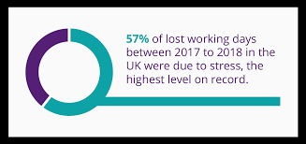
Notes:
Silent killer, costing the NHS over 165,000 bed days per year with a cost to the public of £71.1 million. Work-related stress and mental illness accounts for over half of work absences – and costs British businesses an estimated £26 billion per annum. In addition, studies have revealed that 460,000 people transition from work to sickness and disability benefits a year, which costs employers £9 billion a year.
The mental health foundation has reported that those with the highest levels of distress compared to those with the lowest have a 32% increase of cancer

Slide 4
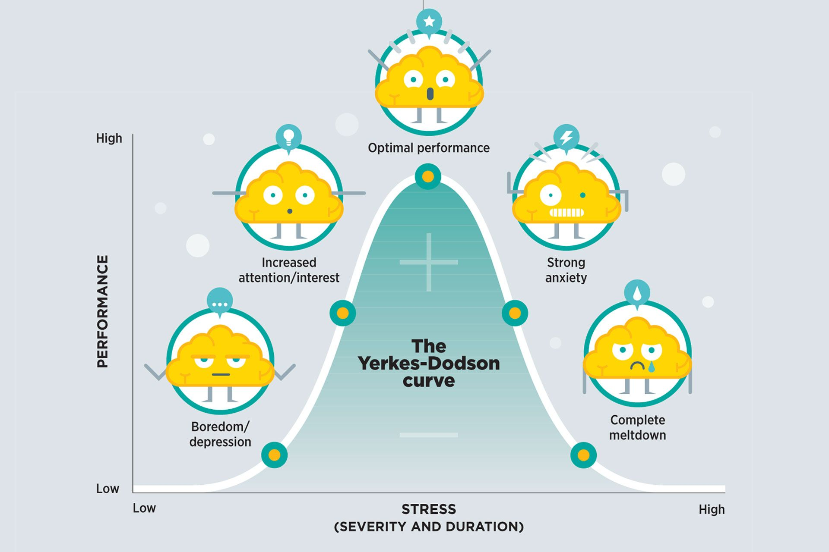
Notes:
Optimal performance – vision/purpose, SMART goals, decisive, focus on what you can influence, deal with things, say no to unimportant yes to important, help others, conflict, assertive, manage emotions to name but a few.

Slide 5
Set scene
Stress is your body's way of responding to any kind of demand or threat. When you sense danger—whether it's real or imagined—the body's defences kick into high gear in a rapid, automatic process known as the “fight-or-flight” reaction or the “stress response.” The stress response is the body's way of protecting you.
When working properly, it helps you stay focused, energetic, and alert. In emergency situations, stress can save your life—giving you extra strength to defend yourself, for example, or spurring you to slam on the brakes to avoid a car accident.
But too much ‘stress’ can weaken the immune system and cause high blood pressure, fatigue, depression, anxiety and possible many other chronic illnesses? In particular, too much epinephrine (adrenaline) can be harmful to your heart. It can change the arteries and how their cells are able to regenerate.
﻿
Notes:
Pressure (Eustress) v distress (next slide). Fight or flight Dr Hans Seyle
A zebra doesn’t suffer from ulcers or chronic stress – when it is chased by a lion it goes into flight and if it survives and another zebra has been succomed to the lion it goes back to eating grass and surviving.

Slide 6
Notes:
Self imposed pressure v stress
Fight or flight – short term Ok (increases immunity) long term bad decreases immunity and this is especially relevant for me as recent research shows us men are more susceptible to viruses, cancer and other diseases because females have different genetics and estrogen which increases immunity

Slide 7
Some terms
Pressure – expectation we should do something in a certain way
Frustration – when there is an obstacle to achieving a goal
Conflict – when two or more goals are incompatible and a decision needs to be made
Life changes – readjustments to our circumstances in response to something significant
Acute stress – caused by a major event, usually short in duration and has an endpoint
Chronic stress – contact stress with no clear end point
Traumatic – stressful event that can lead to PTSD
Episodic acute stress – stress caused by repeated stressful events

Slide 8
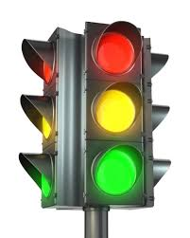
TOXIC – prolonged activation of the stress response accompanied by limited resilient resources. THIS IS THE DANGER ZONE AND CAN CAUSE EMOTIONAL, PYSCHOLOGICAL OR PHYSICAL BURNOUT. PREVENT AT ALL COSTS.
TOLERABLE – serious temporary stress response which is managed by changing what you do and using your resilience. DON’T NEGLECT THIS AS IT WILL LEAD TO TOXIC STRESS
POSITIVE – brief increase in heart rate and mild elevations in stress hormones. THIS IS GOOD FOR OUR HEALTH.
Notes:
We will now look at a few models that explain stress and the stress response
Can you think of times when you’ve experienced all of these?

Slide 9
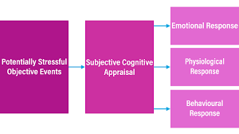
Notes:
1 Event - A major exam, a big date, trouble with one’s boss, a financial setback, which may lead to frustration, conflict, change, or pressure.
2 SC appraisal - Personalised perceptions of threat, which are influenced by familiarity with the event, its controllability or its predictability.
3 – Emotional response - Annoyance, anger, anxiety, fear, dejection, grief. But we could choose positive ones such as determination and excitement – ask how things could be different?
3 – Physiological response - Autonomic arousal, hormonal fluctuations, neurochemical changes.
3 – Behavioural - Coping efforts, such as lashing out at others, blaming oneself, seeking help, solving problems and releasing emotions.

Slide 10
Notes:
Use pointer to go through this.
Lazarus and Folkman (1986) developed a model of stress known as the Cognitive-Transactional model, in which stress is defined as the “relationship with the environment that the person appraises as significant for his or her wellbeing and in which the demands tax or exceed available coping resources”.
Lazarus (1970) proposed a two-stage cognitive appraisal model. The first stage involved a primary appraisal, in which an individual determines whether a potential stressor represents a threat. If the potential stressor is not deemed a threat, no stress is experienced. However, if the stressor is appraised as threatening, a secondary appraisal takes place, during which the individual assesses whether they can cope with the threat. If the individual decides that they can cope with the threat, then no stress is experienced. If the individual determines that they cannot cope with the threat, stress is experienced.

Slide 11
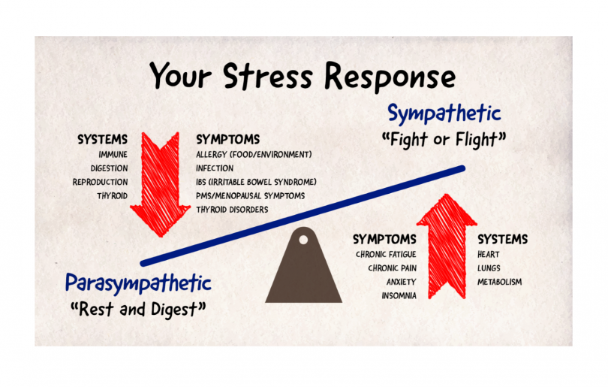
Notes:
The autonomic nervous system (ANS) is the part of the nervous system which is responsible for regulating many aspects of the body, including digestion, respiration, and temperature. The ANS is divided between the sympathetic (SNS) and parasympathetic nervous systems (PNS). In simple terms, the SNS is responsible for getting the body ready for action, while the PNS works to relax the body.

Slide 12
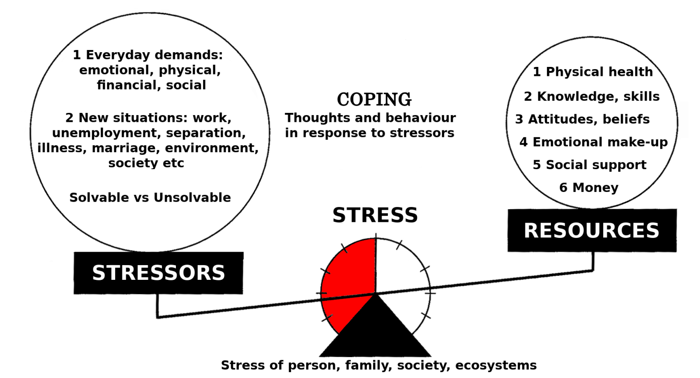
Notes:
Look at the resources and ask yourself ‘how resourceful am I in these areas’? Physical – next masterclass. Knowledge/skills of yourself, your role, what causes you stress (later), how you deal with conflict etc. Attitudes/beliefs – optimist/pessimist, what are your beliefs? Emotional make up – knowing the positive/negative emotions you experience, controlling –ve emotions, releasing emotional baggage from the past. Social support – 1st question asked by clinicians dealing with PTSD. A part of resilience that is never discussed is financial resilience and its not about what we get in our pay packet its about how we manage it, prepare for unforeseen circumstances. So many people are 3 pay packets away from homelessness. We are all aware of national debt figures – November 2020 PER ADULT THIS WAS £31,867, AROUND 109.1% OF AVERAGE EARNINGS.

Slide 13
Health problems related to stress
Depression and anxiety
Physical pain
Sleep problems
Autoimmune diseases (more prone to flue, colds etc.)
Digestive problems
Skin conditions, such as eczema
Heart disease/heart attacks/strokes
Weight problems
Reproductive issues
Thinking and memory problems
Increased blood cholesterol

Slide 14
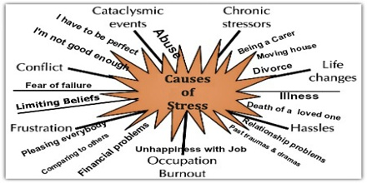
Notes:
These are the superficial causes we tend to focus on! Underlying causes next slide

Slide 15
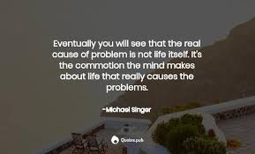
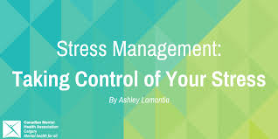
Cause Remedy
Conflict Know your conflict style & how to manage it
Workload Prioritise
Life changes Learn how to embrace change
Past trauma Emotional hygiene EFT, EMDR
Limiting belief Use positive
affirmations
Pleasing everyone Say no
Notes:
Is stress the hidden biggest killer
Mention Havening technique also mentioned in the anxiety masterclass and another masterclass I can provide.

Slide 16
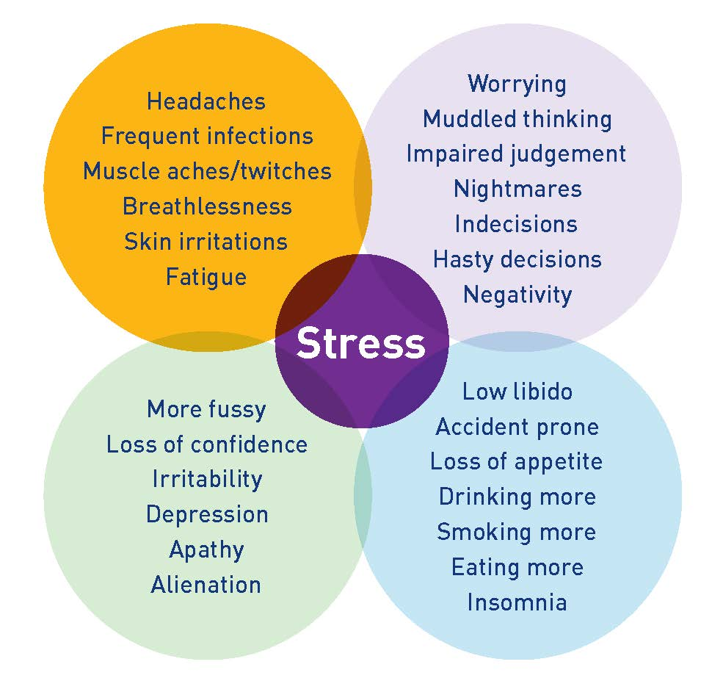
Early warning signs
Notes:
Key is early warning signs – deal with it before it affects us emotionally, psychologically, physically.

Slide 17
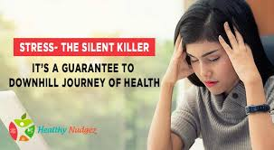
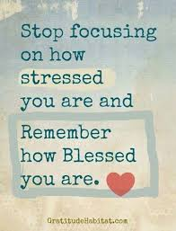
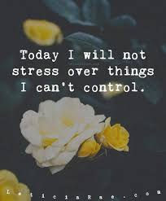
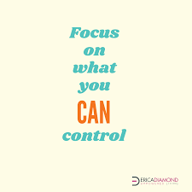

Slide 18
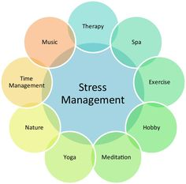
Notes:
Deep breathing is often forgotten and its power for releasing stress and oxygenating our cells. Think of this we can go weeks without food, days without water but minutes without air.
EFT/emotion code

Slide 19
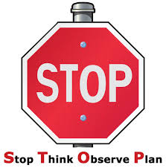
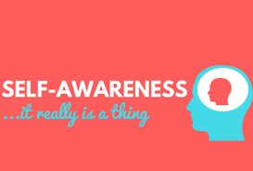
What to do
Prevention is better than cure, so STOP use your self-awareness to understand what is the real underlying cause of your stress then put a strategy in place to reverse it, then commit to it so you take control for ever.
But you need to know the early warning signs and have some general coping strategies in place.
Notes:
Key word – CONTROL

Slide 20
Summary
Learn how to use the power of your senses to relieve stress on the spot and stay calm, productive, and focused—no matter what life throws at you.
One of the speediest and most reliable ways to stamp out stress is to engage one or more of your senses—sight, sound, taste, smell, touch or through movement. You’ll need to do some experimenting to discover which technique works best for you. You can stay calm, productive, and focused when you know how to quickly relieve stress.
Social interaction is your body’s most evolved and surefire strategy for regulating the nervous system. Talking with a considerate listener can help you quickly calm down and release tension. Although you can’t always have a friend to lean on in the middle of a stressful situation, maintaining a network of close relationships is vital for your mental health. Between sensory-based stress relief and good listeners, you’ll have many of your bases covered.
Longer term you need to understand the real cause, the early warning signs, put in place strategies to keep stress away for ever and have some tried and tested generic coping strategies.
Notes:
Sight
Look at a cherished photo or a favorite memento.
Use a plant or flowers to enliven your work space.
Enjoy the beauty of nature: a garden, the beach, a park, or your own backyard.
Surround yourself with colors that lift your spirits.
Close your eyes and picture a place that feels peaceful and rejuvenating.
Smell
Light a scented candle or burn some incense.
Experiment with different essential oils.
Smell the roses or another type of flower.
Enjoy clean, fresh air in the great outdoors.
Spritz on your favorite perfume or cologne.
Touch
Wrap yourself in a warm blanket.
Pet a dog or cat.
Hold a comforting object (a stuffed animal, a favorite memento).
Give yourself a hand or neck massage – havening technique (e-mail me if you want to attend a workshop on this)
Wear clothing that feels soft against your skin.
Taste
Slowly savoring a favorite treat can be very relaxing, but mindless eating will only add to your stress and your waistline. The key is to indulge your sense of taste mindfully and in moderation.
Water/squash
Indulge in a small piece of dark chocolate.
Sip a steaming cup of coffee or tea or a refreshing cold drink.
Eat a perfectly ripe piece of fruit.
Enjoy a healthy, crunchy snack (celery, carrots, or nut mix).
Movement
If you tend to shut down when you’re under stress or have experienced trauma, stress-relieving activities that get you moving may be particularly helpful.
Run in place or jump up and down.
Dance around.
Stretch or roll your head in circles.
Go for a short walk.
Squeeze a rubbery stress ball.
Sound
Sing or play a favorite tune.
Listen to calming or uplifting music.
Tune in to the soundtrack of nature—crashing waves, the wind rustling the trees, birds singing.
Buy a small fountain, so you can enjoy the soothing sound of running water in your home or office.
Hang wind chimes near an open window.

Slide 21
Summary
A great way to quickly relieve stress relates to your specific stress response:
Overexcited stress response: If you tend to become angry, agitated, overly emotional, or keyed up under stress, you will respond best to stress relief activities that quieten you down.
Under-excited stress response: If you tend to become depressed, withdrawn, or spaced out under stress, you will respond best to stress relief activities that are stimulating and energising.
Do you freeze when under stress? When faced with stressful situations, you may find yourself totally stuck and unable to take action. Your challenge is to break free of your “frozen” state by rebooting your nervous system and reactivating the body’s natural “fight-or-flight” stress response. Physical movement that engages both your arms and legs, such as walking, swimming, running, dancing, climbing, or tai chi, can be particularly helpful. As you move, focus on your body and the sensations you feel in your limbs rather than on your thoughts. This mindfulness element can help your nervous system become “unstuck” and move on.
Notes:
These over excited and under excited responses can be situational as well, sometimes you can be one other times the other

Slide 22
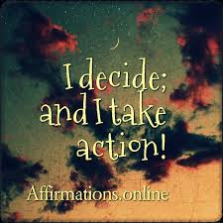
30-day challenge
Depending on whether you have an over-excited, under-excited or freeze stress response know how you will deal with any stress that comes into your life.
Know the real underlying cause of your stress, look for any patterns in your past so you can put something in place to prevent it in the future.
Understand the early warning signs for you, so you can immediately put a coping strategy in place.
Try a number of generic coping strategies over the next 30 days so you know what ones you like and will use in the future.

Slide 23
Action plan
As a result of todays masterclass what will you:
START DOING
STOP DOING
CONTINUE DOING
Notes:
54321 decide/do

Slide 24
Further opportunities
Personal Resilience facebook group.
Ignite: Find Your Passion, Live Your Purpose & Re-Write Your Future
https://www.facebook.com/groups/216645969611627/?ref=share
Personal resilience online programme;
https://ignitepd.thinkific.com/courses/rock-solid-resilience?fbclid=IwAR1dt6Mw_cw8EqDPPJA3bpynSEVhFxwfMWBZpPKO1IZq04ZvxHHc0ty8KRc
bernard.genge@gmail.com

Slide 25
Further information/watching
https://www.youtube.com/watch?v=NyyPZJrDfkM
How stress is killing us (and how you can stop it). | Thijs Launspach | TEDxUniversiteitVanAmsterdam 16 minutes
What cause us to have so much stress these days? And why are especially young people vulnerable to this? What is stress? What happens in the brain and in the body during stress? What are the consequences of stress, if you’re not careful? What is burn-out? Which 5 steps can you take to reduce stress in your life? Final message: is IS possible experience less stress in life – with some practical solutions. But YOU have to make the choice to do this! This is a psychologist who has written two books: Quarterlife, about the quarterlifer crisis, and The Millenial Manifesto, about the societal factors which lead to the high prevalence of mental health issues among young people. This talk was given at a TEDx event using the TED conference format but independently organized by a local community

