Slide 1
Session One
Window on the world / our home patch

Slide 2
Beginning… but where can we begin?!
Beginning a new course or starting out with anything unfamiliar can be exciting, but it can also be a bit daunting….
In these recent times, like many of us, I have been staying close to home or making the most the places near where I live…
At first this felt like quite a restriction and of course, in many ways, it is…! but taking the time to ‘be local and stay local’ has yielded all sorts of unexpected treasures and nature surprises…
So let’s start where we are…

Slide 4
Window on the world / our home patch
We often don’t take time to notice what we can see from our own window or what grows along the paths where we live.
Perhaps you can see some birds along the roofline, seeing who can get to be the highest up on the ‘perch’ of the roof?
Or perhaps there are some gulls gliding high in the sky?
Or perhaps you can see dandelions or daisies growing up between the cracks in the pavement. Take some time, just looking or wandering slowly….
What can you see?
What are you noticing?

Slide 5
Noticing…
As you walk along or look out of your open window, take time to breathe calmly and tune in to where we are…
Perhaps jot down things if that’s practical, or make a mental note of what you are seeing for writing down later
You might what to focus on a couple of your senses to start with – what can you see and what can you hear?
What can you see?
Is the sky cloudy? Is it rainy or sunny or somewhere in between?! What colours can you see in the sky or on the ground?

Slide 6
Near or far…
You don’t have to walk far!
If you are outside, perhaps you can find a place along the way we feel comfortable to stop, become aware of the sounds, smells and sights around us… If you are indoors, gazing from your window, perhaps open the window and feel the air temperature on your face and look out at the sky…
Make a few notes about what you are observing and feeling…
What you write down does not have to be perfectly polished writing or wonderfully poetic! It is just good to make notes of what we are seeing and how these sights and sounds make us feel?

Slide 7
“Those who contemplate the beauty of the earth find reserves of strength that will endure as long as life lasts. There is something infinitely healing in the repeated refrains of nature - the assurance that dawn comes after night, and spring after winter.” Rachel Carson, Silent Spring

Slide 8
Here is a short reflection I wrote last week while walking in a street near me with a photo I took …
The other day I went for a walk near where I live…. It was a cloudy day and things all felt a bit gloomy

Slide 9
I wasn’t in the best frame of mind and seemed to have lots of little jobs to sort out and getting bits and bobs from different shops, which all felt like a drag.
The streets were quite busy and everybody else seemed to be in a rush too and not having a good day!

Slide 10
I took some time, standing by a wall, to calm my breathing. I focused for a while on what I thought were just grey clouds, but after looking for a while, some of them were quite dark, the background was bluer than I had first noticed and some clouds were more silvery.
Some were moving fast in the wind and others looked like they were creating a backdrop for the busier ones… Then I looked down at the pavement….

Slide 11
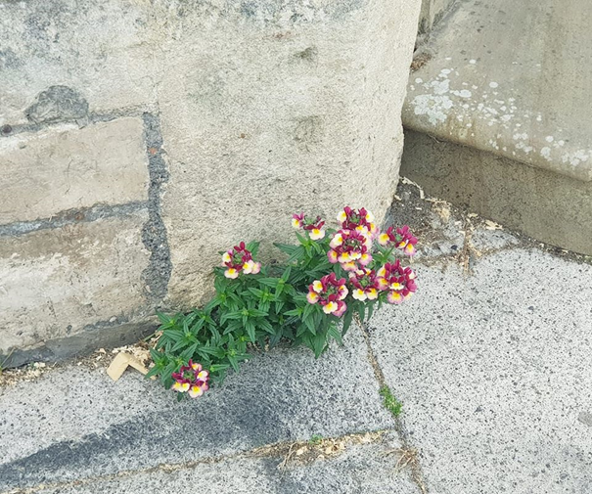
As I looked down, I noticed a bright beautiful flower growing in the most unpromising place.
There could hardly have been any soil for this amazing flower to be growing in, but there is was, shining out and blooming wonderfully. My busy gloomy mood eased a little and the little flower gave me a lift!

Slide 12
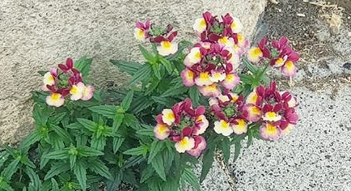
Thank you, little flower, for growing against the odds, in such a stony place and thank you for letting me see you today!

Slide 13
What can you see?
Perhaps you could take a photo of something you notice about the street where you are or a smaller object you have become aware of (like a flower, the wood grain on a fence, a cloud… anything you like which appeals to you!)
What are you particularly thankful for today? I said thank you to the little flower I saw, growing against the odds, in the cracks in the pavement – what would you like to say “Thank you!” to?
Making notes on your journal sheet when you return home. Take time to reflect on what we have seen and sensed…
…………………………….

Slide 14
Your thoughts and notes
You have the opportunity for sharing what you have seen and reflected on the Course Forum, if you wish.

Slide 15
That’s session one all done! Thanks for making a start on this course with me. Feel free to have another at this one or move on to session two when it next suits you! Sara

