Slide 1
Understanding fatigue and what to do
With
Bernard Genge
Notes:
On these masterclasses as we all learn in different ways there will be spoken words from me, written words on the ppt, pictures, quotes and for those that are very visual youtube clips to watch at the end and afterward. The key to learning however is doing and teaching – 54321 DD

Slide 2
Aims and desired outcomes
Aims – To know what fatigue is, its causes and what to do.
Outcomes – To take control of your fatigue and bring zest back into your life.
As we go through this masterclass decide what you will START, STOP & CONTINUE doing
Notes:
54321 DD
Personal resilience toolkit - STOP

Slide 3
Set scene
We all experience tiredness at times, which can be relieved by sleep and rest. Fatigue is when the tiredness is often overwhelming and isn't relieved by sleep and rest.
Fatigue can make it hard to get out of bed in the morning and prevent a person from fulfilling their daily tasks.
Most of the time fatigue can be traced to one or more of our habits or routines, particularly lack of exercise. It's also commonly related to depression. On occasion, fatigue is a symptom of other underlying conditions that require medical treatment.
Being self-aware and taking an honest look at the things that might be responsible for your fatigue is often the first step toward relief.
Physical and mental fatigue are different, but they often occur together. Repeated physical exhaustion can lead to mental fatigue over time.
Notes:
Talk about self-awareness and ask everyone to honestly reflect on: do I suffer from fatigue? What in my lifestyle is causing it? How do I respond to stress or fight/flight? Do I get anxiety? Is what I have now fatigue, anxiety, stress, over-worrying, emotional trauma or something else? How does my personality impact how I cope with fatigue, anxiety, stress? Am I prepared to change my lifestyle to protect me?

Slide 4
Some terms
Pressure – expectation we should do something in a certain way
Frustration – when there is an obstacle to achieving a goal
Conflict – when two or more goals are incompatible and a decision needs to be made
Life changes – readjustments to our circumstances in response to something significant
Acute stress – caused by a major event, usually short in duration and has an endpoint
Chronic stress – contact stress with no clear end point
Traumatic – stressful event that can lead to PTSD
Episodic acute stress – stress caused by repeated stressful events
Fatigue is a term used to describe an overall feeling of tiredness or lack of energy. It isn't the same as simply feeling drowsy or sleepy.
Notes:
When you're fatigued, you have no motivation and no energy. Being sleepy may be a symptom of fatigue, but it's not the same thing.

Slide 5
Physical or mental fatigue
Physical fatigue is our inability to maintain optimal physical performance and is made worst with intense physical exercise. A person with physical fatigue may find it physically hard to do the things they usually do, such as climbing the stairs. Symptoms include muscle weakness, weariness, sleepiness or irritability and diagnosis may involve completing a strength test.
With mental fatigue, a person may find it harder to concentrate on things and stay focused. They may feel sleepy or have difficulty staying awake while working. This decrease in maximal cognitive performance often results from long periods of cognitive activity.
A study suggested that tough mental tasks can cause people to tire more quickly at physical exercise.
Either can be chronic or acute.
Burnout is a state of emotional, physical, and mental exhaustion caused by excessive and prolonged stress. It occurs when you feel overwhelmed, emotionally drained, and unable to meet constant demands. As the stress continues, you begin to lose the interest and motivation that led you to take on a certain role in the first place.

Slide 6
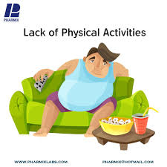
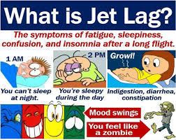
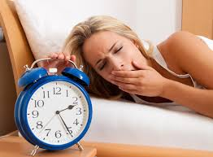
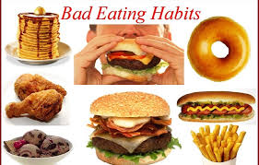
Lifestyle causes
Notes:
As we look at these use honest self-awareness to ask which ones apply to me
1 overuse of alcohol and drugs but also prescribed drugs such as cough medicines and antihistimines and antidepressants
5 Lack of sleep but also extended periods of emotional stress – also mention being overweight
Challenge delegates to use their self awareness again to understand any lifestyle causes
9 trapped emotions if we try to suppress them need a lot of energy

Slide 7
BEWARE – there are a lot of conditions that cause fatigue – consult your doctor
Acute liver failure
Anaemia
Anxiety disorders
Cancer
Chronic infections or inflammation (malaria etc.)
Chronic kidney disease
Concussion
COPD
Coronavirus
Severe depression
Diabetes
Coeliac disease
Restless legs syndrome
Electrolyte problems
Trapped emotions
Inflammatory bowel disease
MS
Obesity
Chronic pain
Sleep apnoea
Chronic stress
Traumatic brain injury
Emphysema
Fibromyalgia
Grief
Heart disease
Overactive and underactive thyroid
Glandular fever
Pregnancy
Hormonal contraception
Notes:
Trapped emotions mention EFT & the emotion code and the sessions I do once a month

Slide 8
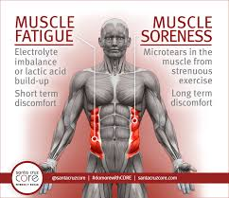
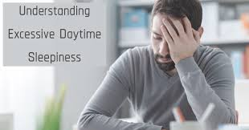
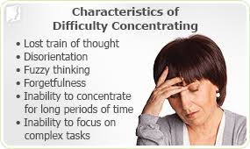
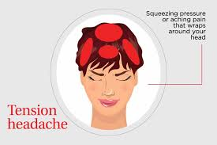
Symptoms
Notes:
8
8
gastrointestinal problems
Also mention irritability, moodiness, slow response time, more accident prone, vision problems such as blurriness,

Slide 9
Time to see your doctor if
You can’t think of anything that is causing it
You have a high temperature
You have unexplained weight loss
Trouble falling or staying asleep when you’ve tried good sleep hygiene
You believe you are depressed, feelings of self-harm or harming another
Vomiting blood or rectal bleeding
Severe headache
Chest pain, irregular heartbeat or short of breath
Feeling faint
Pain in your abdomen, back or pelvis
Don’t ignore these, they are big ticket
Notes:
9
9

Slide 10
To get a diagnosis your doctor may well ask
The signs and symptoms you experience
The patterns of the fatigue, such as the times of day when the symptoms are worse or better and whether or not taking a nap helps
The quality of your sleep
Your emotional state and stress levels
What medications you are on
Lifestyle factors such as your diet, caffeine use, drug use, alcohol consumption, and work and sleep patterns.
They may also order some tests such as a urine test, imaging scans, blood tests and mental health questionnaires
To treat fatigue effectively, a health care professional needs to find and diagnose the underlying cause.
Notes:
10
10

Slide 11
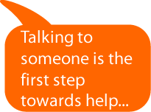
Strategies we can all use to reduce fatigue
Notes:
11
11
1 – purpose, mention positive self-talk, visualization (perfect world, community, society, life), SMART goals, say no, avoid perfectionism and create a plan to reduce your fatigue
2 – Good sleep and get in a routine and to bed early
3- eat foods that build immunity and strength – fruit & veg (gamechangers and what the health)
4 – physical activity but also yoga, meditation and mindfulness and stick at it to lose weight of maintain a good weight
5 – EFT/emotion code
8 – reduce caffeine and alcohol

Slide 12
Driving
A survey they carried out found that around 1 in 25 drivers aged 18 years and above had fallen asleep while driving in the previous 30 days.
If a you notice you are doing any of the following, pull over and take a nap or change drivers:
yawning and blinking
not remembering the last few miles you’ve driven
missing an exit
drifting across the lane
driving onto a rumble strip
having trouble staying focused
This also applies of course to operating machinery

Slide 13
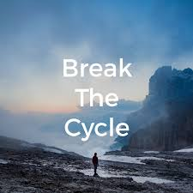
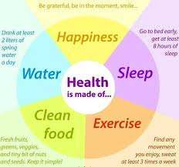
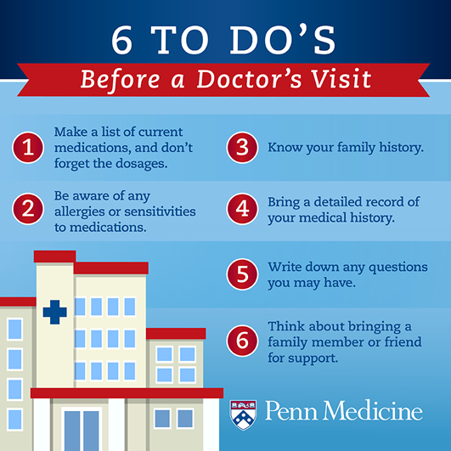
30-day challenge
Notes:
4 - Set yourself a 30-day lifestyle plan. 95% of chronic conditions are lifestyle related. Then do it again until a healthy lifestyle is habitual and something you ‘just do’
5 – make it easy for the doctor to diagnose

Slide 14
Action plan
As a result of todays masterclass what will you:
START DOING
STOP DOING
CONTINUE DOING
54321 Decide/do
Notes:
54321 Decide/do

Slide 15
Further opportunities
Personal Resilience facebook group.
Ignite: Find Your Passion, Live Your Purpose & Re-Write Your Future
https://www.facebook.com/groups/216645969611627/?ref=share
Personal resilience online programme;
https://ignitepd.thinkific.com/courses/rock-solid-resilience?fbclid=IwAR1dt6Mw_cw8EqDPPJA3bpynSEVhFxwfMWBZpPKO1IZq04ZvxHHc0ty8KRc
bernard.genge@gmail.com
Notes:
Email me if you would like to attend an EFT session

Slide 16
Further information/watching
https://www.youtube.com/watch?v=Oht0-qKeUGE
Burn Out to Brilliance. Recovery from Chronic Fatigue | Linda Jones | TEDxBirminghamCityUniversity 13 mins
In 2001 Linda Jones’s world changed. As a young and successful business woman she was living a happy and fulfilled life; working long hours travelling the country, a fitness fanatic who enjoyed a full social life. Looking back there was recognition that this was unsustainable. Early recognition signs and symptoms were ignored, and led to complete burn out. Linda’s journey to full recovery sparked a passion to help others as she set up Salus Fatigue Foundation In 2001, after illness, Linda Jones, CEO Salus Fatigue Foundation & Life4Changing was diagnosed with Chronic Fatigue Syndrome. She lost everything. Her relentless attitude, which caused her burnout in the first place, meant she wasn’t going to just accept that diagnosis and become a statistic. Determined to recover and get her life back she took a holistic approach and coached herself back to health. In the last 10 years, her journey to full recovery sparked a passion to help others and this idea became the Salus Fatigue Foundation. To date 15, 000 people have been helped to create a self-managed path to recovery through raising awareness and support programs.
https://www.youtube.com/watch?v=VE5OwMUU5sM
Chronic fatigue syndrome (CFS) | NHS 4 minutes
Dr Charles Shepherd, medical adviser to the ME Association, and who has ME, describes the symptoms, diagnosis and treatments for chronic fatigue syndrome.

