Slide 1
Leaving pessimism and embracing optimism
With
Bernard Genge
Notes:
On these masterclasses as we all learn in different ways there will be spoken words from me, written words on the ppt, pictures, quotes and for those that are very visual youtube clips to watch afterward. The key to learning however is doing and teaching – 54321 DD

Slide 2
Aims and desired outcomes
Aims – To know how to leave pessimism in the past and embrace optimism
Outcomes – To create a steady state of optimism in life
As we go through this masterclass decide what you will START, STOP & CONTINUE doing
Notes:
Imagine if every morning you could determine what your day could be like? Who says we can’t? Can we get out of bed every day and set an optimistic intention for that day? Of course we can, but will it effect our day?????

Slide 4
Set the scene
Being optimistic is having an honest reflective view of life, problems and enthusiastically taking action, whereas pessimism is over-exaggerating a perceived negative impact of life or a problem.
Optimism is a mental attitude characterised by hope and confidence in success and a positive future. Optimists are those that expect good things to happen, where pessimists instead predict unfavorable outcomes. Optimistic attitudes are linked to a number of benefits including better coping skills, lower stress levels, better physical health, and higher persistence when pursuing goals.
Optimists tend to view hardships as learning experiences or temporary setbacks. Even the most miserable day holds the promise for them that "tomorrow will probably be better.“
If you always see the brighter side of things, you may feel that you experience more positive events in your life than others, find yourself less stressed, and even enjoy greater health benefits.
Notes:
Mystics and spiritualist firmly believe we attract what we give out, so if we give out optimism what will we attract?

Slide 5
Notes:
This is the formula for January blues which is a day in January we feel the most depressed – not convinced of the science behind it but if we unpick it – make your own weather and carry it with you, question whether what we’ve been told that debt is OK, don’t set resolutions – goals/CI, make the decision to take action 54321DD

Slide 6
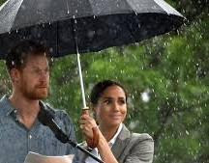
Notes:
These are 2 realities of winter, reflect on how you see it and if you can shift your thoughts – ask what is stopping us changing our thoughts? Use an example of yesterday and think about the most stressful part of your day, then focus on the best part of that day – you can choose. This is a difference between pessimism and optimism. SAD – seasonal affective disorder – low energy, poor concentration, avoiding people, worst sleep, feeling sad, low, miserable, guilty, loss of appetite it affects 5% and 20% winter blues.
Winter – cold – shorter days – less social interaction – more time alone – financial worries = lower mood = more effort needed to be optimistic in winter. Try the 3 A’s – Adapt, Alter, Avoid, Accept.

Slide 7
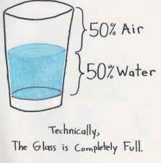
Notes:
How do you see life, be honest with yourself when you answer that?

Slide 8
Developing a positive approach
Optimist see problems as impersonal, temporary and in context whereas pessimists see problems as personal, permanent & pervasive. This can lead to what is called; ‘learned helplessness’.
How do you see problems?
Notes:
‘Lucky’ people expect good fortune
Here are a few affirmations you might choose: I am decisive and all the answers lie within me; I am a calm problem solver; I find great pride in being decisive and finding solutions; when I put my attention to finding an answer, it always comes to me; I am an expert problem solver; I am decisive and patient and persistent implementing my chosen solutions.

Slide 9
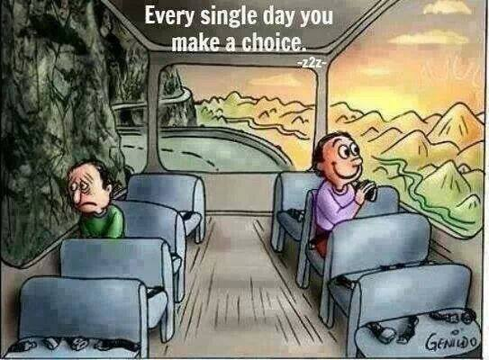
Notes:
Its an important choice to make every morning. It is as much a choice as an attitude. Make the first step out of your bed in the morning a ‘choice step’ and choose optimism – optimism with a heart/brain connection = 50% more healing in your body.

Slide 10
Your optimism self-assessment checklist
With each of the following statements score each between 0 – 10
You expect good things to happen in the future
You expect things to work out for the best
You’re confident you will succeed in the face of even the toughest challenges
You expect a bright future
You expect that good things can come from negative events
You see a challenge as an opportunity to learn
You feel grateful and really do appreciate the good things in your life
You are always looking for ways to make the best of situations
You have a positive mindset/attitude about yourself and others
You accept responsibility for mistakes but you don't dwell on them
You don't let one bad experience dampen your enthusiasm and optimism for the future

Slide 11
The caveat – can there be any benefits to being ‘realistically pessimistic’?
Better at dealing with stress at certain times
Because they have low expectations of an event they examine the worst possible outcomes
Prepared for the worst (so no shock when it happens)
Might take preventative measures to potential threats to health/wellbeing
But perhaps realistic optimism is the choice?

Slide 12
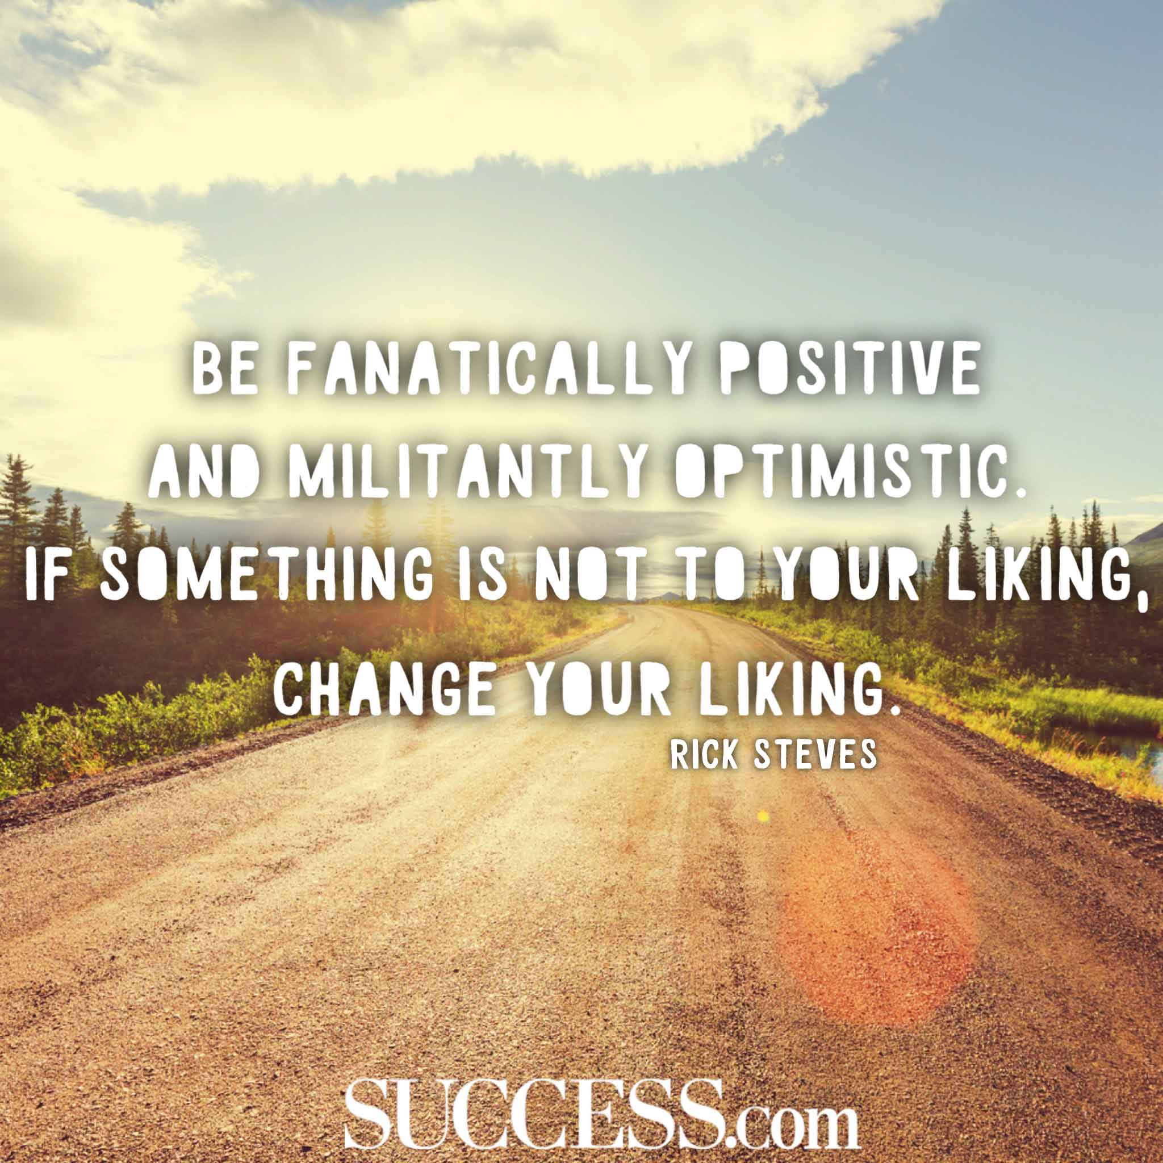

Slide 13
The benefits of realistic optimism
Although they take on more stress they are well-equipped to handle it
If something goes wrong they look for solutions
They achieve more
Less anxiety/depression
Tend to be more physically active
Tend to experience more excitement in life and mmm - make more memories
More interesting to be around
Live longer

Slide 14
What we can do
Take control of negative thoughts and challenge them
Identify situations that are causing pessimism STOP – Stop, Think (about the negative thought you are experiencing and even name it), Observe (how its making you feel), Plan (to replace the negative with a more empowering, optimistic thought).
If you are prepared to look closely enough there is often very little evidence for the pessimistic thinking
When you STOP - listen to your rational and logical mind to put it into perspective and focus on objective facts
Make the decision to learn from the past, live in the moment and focus on the future
Secret mirror technique – tell yourself how great you are
Create your own optimistic mantra
Never label yourself (failure, useless etc)
Avoid pessimistic phrases (‘I will never’, ‘I always screw up’)

Slide 16
Did these people ‘fail’?
Stephen King’s first novel was rejected by publishers close to 50 times, and he threw it in the bin. His wife pulled it out urged him to not give up – his books have now sold more than 350 million copies.
J. K. Rowling was divorced, skint and depressed but she progressed from living on benefits to being named by Forbes as the world’s first billionaire author and in 2010 named the “most influential woman in Britain”.
Steven Spielberg was rejected by the California School of Cinematic Arts but has gone on to direct some darn good films.
Walt Disney was told had no imagination had an unhappy childhood along with countless business failures and setbacks. With the loss of his first business, Disney packed his bags, and with just $40 to his name, took off to Los Angeles to try his hand at acting. But he failed at that, too. Disney found his first major success with the creation of Oswald the Lucky Rabbit which became a huge star in one-reel animation, but Disney himself would find his luck had run out. Traveling to New York to renegotiate his contract, he discovered that his producer had taken his team of animators from under him and that he no longer had any legal rights to Oswald the Lucky Rabbit. But instead of fighting the loss or plotting his revenge, Disney decided to walk away and start over again. It was on the train ride back to California that he created Mickey Mouse. Any special qualities? If the right mind-set, belief, commitment and a stubborn determination are special qualities then yes.
Notes:
Winston Churchill in World War 1 as Britain’s Lord of Admiralty, made the fateful decision to attack Turkey at Gallipoli. The eight-and-a-half-month-long battle involved a total of about a million men on both sides, of whom nearly one half became casualties. The failed campaign led to the humiliation of the British. Churchill was dismissed from his cabinet position, excluded from the War Council, and allowed no hand in the further conduct and administration of the war.
Winston Churchill did what we challenge you to do today, he learnt by his makes and went on to be great.

Slide 17
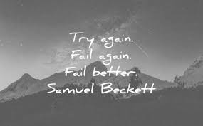
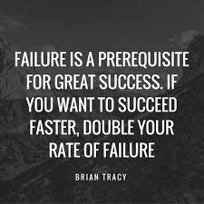
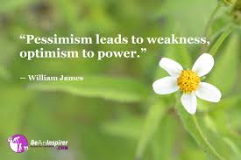
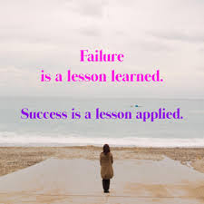
Notes:
FAILURE –reflect on any past perceived failure and ask yourself what you’ve learned and what you can learn now.
Optimism is as much a choice as it is an attitude

Slide 18
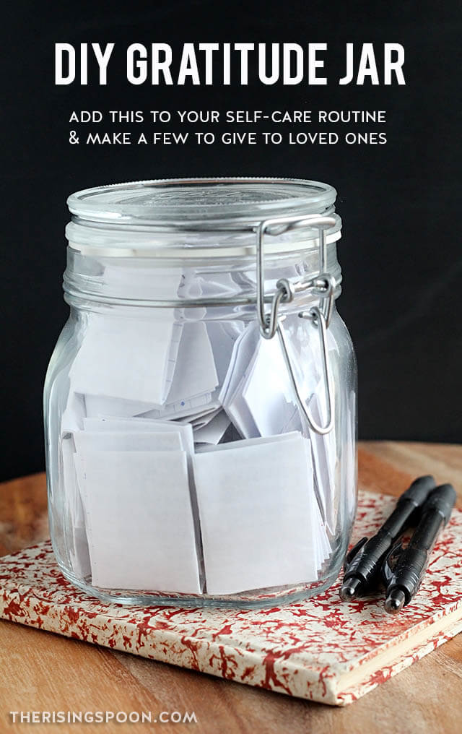
Notes:
Every day write down the things you can be grateful for and once a week review it. Inspirational music, reading, DVD, write down all your strengths, journal of the great things in your life,

Slide 19
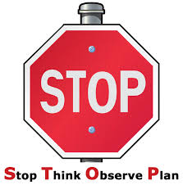
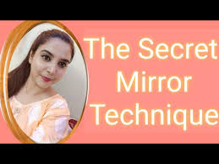
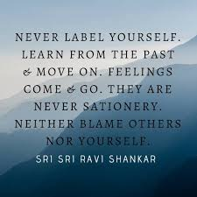
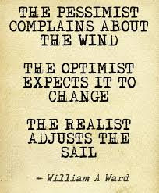
30-day challenge
So stop pessimistic talk. Take control of your thoughts and life, avoid pessimistic people, and remember problems are not stop signs but guidelines. Finally,
Notes:
2 – do this now – write down 5 things you admire about yourself
3 – be proactive abd focus on what you can control

Slide 20
Action plan
As a result of todays masterclass what will you:
START DOING
STOP DOING
CONTINUE DOING
Notes:
54321 Decide/do

Slide 21
Further opportunities
Personal Resilience facebook group.
Ignite: Find Your Passion, Live Your Purpose & Re-Write Your Future
https://www.facebook.com/groups/216645969611627/?ref=share
Personal resilience online programme;
https://ignitepd.thinkific.com/courses/rock-solid-resilience?fbclid=IwAR1dt6Mw_cw8EqDPPJA3bpynSEVhFxwfMWBZpPKO1IZq04ZvxHHc0ty8KRc
bernard.genge@gmail.com

Slide 22
Further information/watching
https://www.youtube.com/watch?v=2hHNq45rEnU
Learned Optimism by Martin Seligman – Animation 4mins 44
https://www.youtube.com/watch?v=mZbzrtnvMjs
Choosing Optimism | Caroline Allen | TEDxYouth@MBJH 6mins 26
What makes someone an optimist? Caroline Allen explores the benefits of having a positive outlook and the actions that are necessary to becoming an optimist. Caroline Allen is a ninth-grade student at Mountain Brook Junior High. She enjoys music, hanging out with friends, and focusing on the bright side of things.

