Slide 1
Becoming decisive and overcoming procrastination
With
Bernard Genge

Slide 2
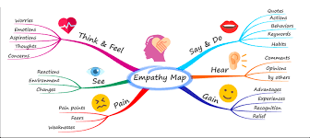
Aims and desired outcomes
Aims – To know how to be both decisive and make regular good quality decisions
Outcomes – To see significant change happen in your life due to the decisions you make
As we go through this masterclass decide what you will START, STOP & CONTINUE doing
Notes:
On these masterclasses as we all learn in different ways there will be spoken words from me, written words on the ppt, pictures, quotes and for those that are very visual youtube clips to watch afterward. The key to learning however is doing and teaching – 54321 DD
Zoom – video/mute mic when I’m presenting. Please use the chat box, when you open it you can send a message to the whole group or a specific person. Please use it to ask questions, share thoughts, experiences or even to elaborate on points made in the masterclass – ones that perhaps really resonated with you and why.

Slide 3
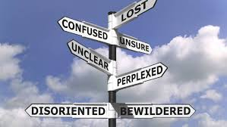
Set scene
Decision making is the process of making choices by identifying a decision, gathering information, and assessing alternative resolutions.
A good decision maker chooses actions that give the best outcome for themselves and others. They make decisions rationally, after researching alternatives and understanding the consequences. Good decision-makers involve others when appropriate and use knowledge, data and opinions to shape their final decisions.
Notes:
3 – mention different personality types
4 if you are not decisive you’ll experience these

Slide 4
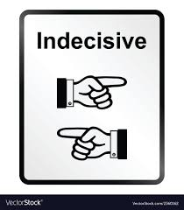
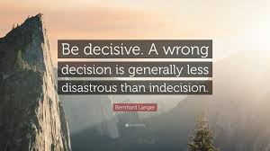
How does it feel when you are:
Notes:
1 – anxious, under pressure, stressed, confused, sitting on the fence, agitated, aggressive,
2 – relived, some anxiety (is it the right decision), empowered.

Slide 5
Characteristics of decisiveness
High degree of self-awareness – can pay attention to emotions so you are aware when you’re indecisive
Patience to think things through
Can think of the big picture so the decision made is the right one
Ability to communicate with others
Awareness of a need to please other people
Banish a perfectionist mindset – sometimes you just need to be instinctive and make that decision
Let go of bad decisions of the past
Visualise a great outcome as this provides motivation
Being prepared to be uncomfortable and stretch that comfort zone
Prepared to challenge and question self
Incrementally growing in confidence
Expanding network – people want to be around decisive people
Conscious of their values so they can make decisions in accordance with them
Their life is changing for the better

Slide 6
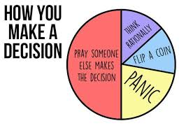
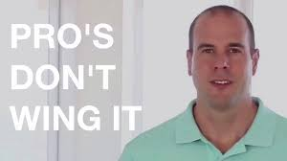
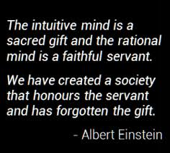
Notes:
1 50% of us avoid it or pray someone else will make it
The things that can hinder effective decision making include:
Νοτ ενουγη ινφορματιον ορ τοο μυχη ινφορματιον
Τοο μανψ πεοπλε ινϖολϖεδ ορ σομε ϖεστεδ ιντερεστσ
Τοο μυχη ορ τοο λιττλε εμοτιοναλ ατταχημεντ
Ιτ σεεμσ τοο βιγ σο ιτσ εασιερ το ϕυστ πρετενδ ιτσ νοτ τηερε

Slide 7
Benefits of decisiveness
Gives you a clearer focus
Seen by others as an ‘achiever’ so you gain their respect
Less stress because of increased personal satisfaction and less conflicting demands
Increased motivation and commitment
Achievement of results
Greater personal control, assertiveness and self-confidence
Helps you overcome putting things off
Because you feel in greater control and more positive with increased emotional and mental wellbeing
When you’re decisive you learn more
You’re more open to change

Slide 8
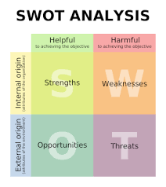
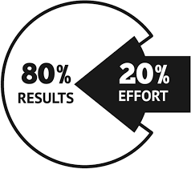
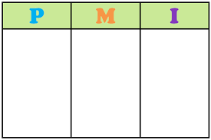
Tools for decision making
Notes:
2 – comparing the costs and benefits of different options with a monetary value to both
3 – pareto - solutions that will provide the most benefit. – list problems, identify root cause of each problem, score each, look for common causes, make decision and take action.
4 – PMI - weigh the pros and cons of a decision

Slide 9
Making good/accurate decisions - DECIDE
Define the decision that needs to be made
Examine the alternatives (do your homework)
Communicate – involve all those who will be impacted by the decision (involvement = commitment)
Include all alternatives (listen to your team – they will have good ideas)
Decide – make your decision
Educate & implement (make it happen!)

Slide 10
Making good/accurate decisions - SORTED
S- Situation: describe the current and desired situation
O – Options: what are the options available to you? Who can help you?
R – Resources: what resources do you need to make your decision happen? Have you got them? Where will you get them from? What will you exchange to get those resources?
T – Timescales: set realistic, achievable but challenging timescales. Write then down
E – Embed: Tell other people so you are more committed, involve the ones who could be impacted and do anything you can to make this decision embedded within you so you don’t relapse into any comfort zones and old ways. What will you do to embed this decision?
D – Deliver: Create a momentum that is unstoppable and even contagious. Winston Churchill said during the second world war as prime minister “We will never give in” – say that to yourself 20 times right now and see how you feel about delivering this decision into your life. Are you excited?

Slide 11
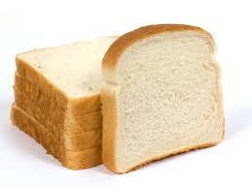
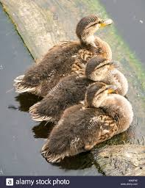
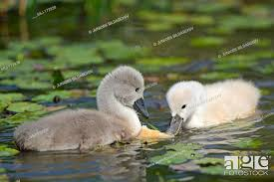

Slide 13
Every day could start with a decision it could be a special day
Make a decision that tomorrow is going to be a special day and you are going to handle everything in a cool and calm way. If you need to meet someone or do something that usually makes you feel nervous or irritated, you will have a talk with yourself beforehand. Tell yourself that you are going to stay calm and relaxed, and that you are going to handle everything in the best way. If you feel you need it, make several mental rehearsals. Visualise yourself going through the situation in a very efficient way, and achieving a positive outcome.
Your destiny really is determined by your decisions, decide to have a special day every day.

Slide 14
Procrastination
Is delaying, postponing or avoiding a task often because of fear of failing.
Procrastination has been linked to a number of negative associations, such as depression, irrational behavior, low self-esteem, anxiety and neurological disorders such as ADHD. Others have found relationships with guilt and stress.
Highly-driven, accomplished people procrastinate, too. Procrastination is a habit, and if you understand how it shows up for you, you can replace it with a better one.
A big reason is stress and not knowing what is important

Slide 15
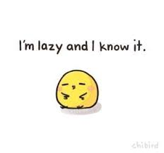
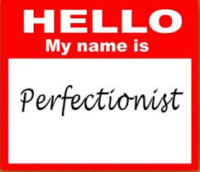
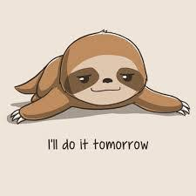
Procrastination - types
Notes:
1 – challenge is getting started so 54321 decide do
2 – self depreciation – they beat themselves up so decide to take control
3 - Shiny Object Syndrome. They're constantly coming up with new projects to take on — and then getting bored with them a week later. They're intrigued by the latest trend and will be quick to implement but not follow through.
They are great at making decisions and taking action. However, they end up inadvertently losing a lot of time and burning out because they don't take consistent action in one direction long enough to see results.
4 – address your fears and insecurities, see the big picture, adjust your standards and create a new checklist/to do list and break that cycle of putting stuff off

Slide 16
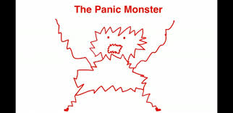
Procrastination
Notes:
The Panic Monster is dormant most of the time, but he suddenly wakes up anytime a deadline gets too close or there's danger of public embarrassment, a career disaster or some other scary consequence.

Slide 17
What to do
Forgive yourself for procrastinating in the past
Use your self-awareness to understand how and why you do it
Commit to your vision, mission, goals (SMARTER) and weekly tasks
30-day challenges
Celebrate your success and promise yourself a reward
Get an accountability coach - ask someone to check up on you
54321 decide and do
Positive affirmations ‘I am decisive and act immediately’
Never get put off by distractions – be purpose driven
Do the worst first – every day
Never use excuses anymore “I’ll do it when I have time”
Focus on continuous improvement not perfectionism

Slide 18
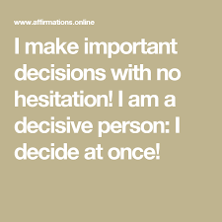
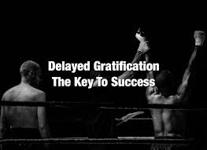
30-day challenge

Slide 19
Action plan
As a result of todays masterclass what will you:
START DOING
STOP DOING
CONTINUE DOING
54321 DD
Notes:
54321 Decide/do

Slide 20
Further opportunities
Personal Resilience facebook group.
Ignite: Find Your Passion, Live Your Purpose & Re-Write Your Future
https://www.facebook.com/groups/216645969611627/?ref=share
bernard.genge@gmail.com

Slide 21
Further information/watching
https://www.youtube.com/watch?v=KkyzYjPuxK8
How to make good decisons | Mikael Krogerus & Roman Tschappeler | TEDxDanubia 18 mins
Mikael and Roman’s funny but profound talk presents us with decision‐making strategies most of us practice and reveals typical problems like TMI (too much information), PDF (post‐decision feeling) and the truth about perfection (that no one has ever seen but is rumoured to exist). With a remarkable casualness the duo gives us a summary of their bestseller book titled The Decision Book: 50 Models for Strategic Thinking. Finnish-born, but raised in Sweden and Germany, Mikael is an editor of Switzerland’s biggest weekly magazine “Das Magazin”. Prior to that he was a staff writer for NZZ FOLIO, and worked as a copywriter for various advertising agencies. A graduate from the Zurich University of Arts, Swiss-born Roman is a Biel-based creative producer, consulting and producing various projects ranging from documentary movies and campaigns to art installations, pop music and cook books. This talk was given at a TEDx event using the TED conference format but independently organized by a local community.

Slide 22
Further information/watching
https://www.youtube.com/watch?v=542qgGgL1s4
THE POWER OF DECISION-MAKING | BENEDIKT AHLFELD | TEDxGraz 17 minutes
Every day we make 20.000 decisions. Most of them with lightning speed; brain research proves that. The least of them, on the other hand, are rational and well thought through; the behavioral economy shows that. Benedikt Ahlfeld reveals which three decision traps you should certainly avoid and how you can utilize the findings of brain research. Decision-making runs like a golden thread through Benedikt Ahlfeld’s life – decisions that meet his standards hold-no-barred. At the age of 13 you would have found him sitting on the rooftops meditating. Aged 16, with little more than 2 months work experience, he decided for himself to become an entrepreneur. Today, Benedikt enables people and companies to live and work smart by sharing his expertise on the psychology of decision-making. This talk was given at a TEDx event using the TED conference format but independently organized by a local community

