Slide 1
Introductions
Ground Rules
Why have you chosen to participate in this course?
What are you hoping to gain from participating in this course?
Goal Setting: SMART Goals
Goal Setting: The GROW Model
Appreciative Inquiry: A Strengths Based Approach to Goal Setting
Techniques to Manage Stress and Anxiety
Before the Practical Session
During the Practical Session
After the Practical Session
Motivational Quotes
Next Steps

Slide 2
SMART Goals
SPECIFIC
Be very clear in what you want to achieve. Consider breaking the goal down into smaller steps.
MEASURABLE
How will you know when you have achieved your goal? What will you be doing at that time? What will others notice you doing? What will be different? What will you have started or be doing regularly? What will you have stopped or be doing less of?
ACHIEVABLE
Ensure your goals are not too high. Don’t set yourself up to fail! Consider setting smaller goals on your way to the big one. Celebrate your successes. If you don’t achieve what you set out to, then ask what you could do differently, what would make it more likely to succeed next time?
REALISTIC & RESOURCED Is this achievable with the resources I have? Are there any other resources you need before you can, or to help you, achieve your goal? How can you access these resources? What problems might you have? What can you do to minimise those problems?
TIME LIMITED Set a reasonable time limit to achieve your goal. 1 week, 1 month, 6 months, 1 year, 5 years? Consider different (smaller) time limits for smaller steps.
Carol Vivyan 2010

Slide 3
Discussion: What are Some of Your SMART Goals?
S
M
A
R
T

Slide 4
The GROW Model of Goal Setting
GROW is an acronym for goal setting:
G – Goal (aspirations)
R – Reality (current obstacles or situations)
O – Options (strengths, resources)
W – Way Forward (accountability and personal actions) (What, When, by Whom and the WILL to do it)
This model takes goal setting to a higher level. Well set goals are inspirational and challenging. When reaching for a broader goal perspective with this approach, leaders are more productive, self-motivated, and fulfilled.
Empowered people don’t need someone else to have the solutions; they are given opportunities to find solutions for themselves.
-Kelly Miller

Slide 5
Goal
What would you like to focus on today?
What’s important to you at the moment?
What does your ideal future look like?
What will you be doing in five years?
What new skills do you want to learn or develop?
Where is your life out of balance?
What challenges are you facing at the moment?
What would make you feel that this time has been well spent?
What are you currently working toward?
How can you word your goal in positive language?

Slide 6
Reality
What is working well at the moment?
What do you need?
What excuses have you always used for not achieving your goals?
What have you done so far to improve things?
What parts of your life will be impacted by you achieving your goal?
What is the biggest obstacle you are currently facing?
What does self-sabotage look like for you?
What is your inner critic saying to you?
What fears are present?
What are you passionate about?

Slide 7
Options
What is your first step?
If you had 50% more confidence, what would you be doing that would be different?
If success was guaranteed, what would you do?
If money was not an obstacle, what would you do?
What action step is the best use of your time at this moment?
If someone else came to you with your obstacle, what would you tell them?
What strengths can you use to move forward?
If you could do only one thing this week, what would it be?
What would you do if you answered to no one?
What is the most efficient use of your time in this moment?

Slide 8
Way Forward
On a scale of 1 to 10, how motivated are you to achieving your goal?
What will it take to get that motivation closer to a 10?
Whatever your first step is, can you think of anything that might stop you from doing it?
How committed are you to achieving this goal?
How do you want to be held accountable for this goal?
How will you celebrate when you’ve achieved your goal?
What are you going to do in the next 24 hours?
What will you do when you’ve achieved your goal?
Who do you need to include in your journey to that goal?
What else do you need to consider before starting?

Slide 9
Reflect on these over the next week in preparation for our practical session.
If you find it helpful, make some notes around these and bring them with you next week to jog your memory, and keep you motivated.
Bring with you a note book or piece of paper with thse refelections for the practical session to refer to and motivate you.

Slide 10
Appreciative
Inquiry

Slide 11
Appreciative Inquiry (AI) was developed by David Cooperridge in the mid-eighties. His wife, an artist, educated him about the “appreciative eye” – an idea that assumes that in every piece of art there is beauty. AI applies this principle to business.
In every piece of art
there is beauty
AI is a way of looking at change which focuses on identifying and doing more of what is already working, rather than looking for problems and trying to fix them.
AI is a STRENGHS based approach to managing change
"The Kiss" by Gustav Klimt

Slide 12
AI starts from a POSITIVE perspective.
Instead of thinking about what is not currently working, AI asks: WHAT IS WORKING WELL? and building upon this.
Focusing on what is working well generates enthusiasm, energy and engagement necessary to recreate the positive and deal with the negative more effectively then the traditional approach by focusing only on the negative.

Slide 13
AI is based on FIVE Principles:
1.Words create worlds reality is not an objective fact, it is a subjective experience. This means that we can change how we view the world, and how we feel, by changing the way we describe our experience, and the stories we tell.
2. Asking questions starts the process of change.
3. Our individual experience is a story which can be reinterpreted and told in different ways.
4. We can create positive change effectively by creating positive images of the future.
5. An in-depth review of what went well and what is working now is significantly more helpful then just analysing what went wrong.

Slide 14
You begin your Appreciative Inquiry by focusing on the POSITIVE future that you want to create,
Rather then the problem that you want to solve

Slide 15
Stage 1: Discovery – What’s Best?
Asking positively framed questions about the future you want to create and reflecting on the answers.
Through being curious and asking questions you create the environment for discovery.

Slide 16
The Miracle Question
Imagine that in the middle of the night, when you were fast asleep, a miracle happens: all the problems you are having are solved. But since the miracle happened in the middle of the night, nobody tells you that it happened. When you wake up the next morning, how will you know that the miracle happened. WHAT WILL BE DIFFERENT?
This is a good exercise to do to help you visualise clearly what this positive future looks like and feels like; as well as helping you to imagine the part you play in this.
Record your answers and reflections in a journal or note book or on a smart phone in preparation for next weeks practical session.

Slide 17
Stage 2: Dream – What's Next
Creating a positive and compelling vision for the future, based on the reflections from the discovery stage.

Slide 18
Create a positive and compelling vision of the future, based on the descriptions and stories described in stage one:
WHAT MIGHT BE?
Projecting the image of the best of what you want and what you value in to the future.
Envisioning what will be EVEN BETTER
Starting to create the conditions were this future might start to exist.
Make a note of these in a journal or note book or on your smart phone ready for next weeks practical session

Slide 19
Questions to Reflect On:
What is the future you want?
What vision do you have of your future?
What words/pictures/images/thoughts/feelings come to mind?
Can you draw the vision?
Try making a collage of pictures from magazines or photos which describe your vision for the future that you want to create.
Do this in preparation for next weeks practical session.

Slide 20
Stage 3: Design – How Might We?
Answering the question: How can it be?
Positive images of the past rather then its problems and difficulties.
You get MORE of what you focus on.

Slide 21
Try This:
Keep the vision you created in step 3 in a place where you can see it everyday; either on a piece of card or paper you can put up on a mirror of the fridge or a cupboard, or look at the vision collage page in your Wellbeing Journal throughout the day.
What words describe the future you want to create? Write them down and display them where you can see them regularly.

Slide 22
Stage 4: Destiny – What Will We
The practical work of making your vision into a reality.
Focusing on the positive creates its own momentum.
By spontaneously developing and improving; always building positively on what went on before you are developing the ability to improvise.

Slide 23
Reflect further on the image of the future that you want,
and ask yourself the following questions.
What exactly is happening?
What are you doing differently?
What parts of your life would you keep? What would you let go?
What would you be doing differently?
What new things would you do?
Who else is involved?
What part are they playing in supporting you? What are they saying or doing?
What does this positive future look and feel like in detail?
Try to do this reflective activity by next weeks practical session.

Slide 24
Before Going out on our Practical Session,
Here are some tips to try:
Do you have any others you could share with us?
What have you found helpful in the past?
What have you found not helpful?
Choose one or two (or more if you prefer) to use on the day of
the practical session.
Try these out in the next week so you have
them practiced for the practical session.

Slide 25
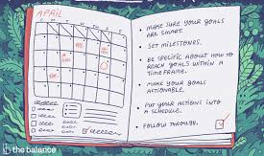
Plan ahead*
Consider which situations you’re feeling particularly anxious about and decide what you could do in this situation to help ease your concerns.
If you’re anxious about taking public transport, can you find another way to travel? If not, could you travel at a quieter time of day when there may be less people around?
If you’re worried about returning to work, could you speak to your manager and ask to compress the hours you spend in the office?
Plan ahead where possible, and take a positive, problem-solving approach.
Bupa (2020 )*www.bupa.co.uk/newsroom/ourviews/manage-post-lockdown-anxiety

Slide 26
Arm Yourself With Trustworthy Information*
The guidance on what to do and how to stay safe during coronavirus is constantly evolving. So it’s understandable if you’re feeling unsure what hygiene precautions you should take, or what social distancing measures to follow.
Knowledge is power here! Arming yourself with the correct facts will help you feel confident that you know what to do, and can help ease your worries. But if watching or reading the news about coronavirus makes you feel anxious, limit this to once a day.
It’s important to make sure the information and advice you’re reading comes from sources that are up-to-date, trustworthy and evidence-based. Keep up to-date with the latest guidance on coronavirus at gov.uk.
Bupa (2020)
*www.bupa.co.uk/newsroom/ourviews/manage-post-lockdown-anxiety

Slide 27
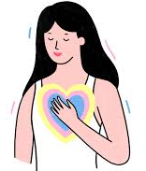
Practise self-awareness and compassion*
It’s completely understandable to feel a mixture of emotions right now – particularly as the situation continues to change daily.
On one hand, you might be craving some structure to your day, or looking forward to a socially-distanced catch up outside with a friend. But on the other hand, you might feel concerned or anxious about returning to situations you haven’t been in for some time.
The key is to recognise this and be kind to yourself. If you find you’re being self-critical – ask yourself – how would I speak to a friend right now? You deserve to show yourself the same care and compassion that you would to someone else.
Bupa (2020)
*www.bupa.co.uk/newsroom/ourviews/manage-post-lockdown-anxiety

Slide 28
Speak to someone you trust*
Share your fears and concerns with someone you feel comfortable talking to.
The chances are they’re experiencing similar feelings. Sharing how you’re both feeling can help you both to feel supported and understood.
If you have specific concerns about returning to work, speak to your line manager and colleagues.
Bupa (2020)
www.bupa.co.uk/newsroom/ourviews/manage-post-lockdown-anxiety

Slide 29
Responding to the Unfamiliar*
You may witness people around you panicking. On the other hand, you may experience those don't seem concerned at all when a pandemic is on the rise, assured that it won't affect them. You may find yourself feeling all kinds of emotions—or maybe, you are confused and don't know how to feel.
People tend to overreact to unknown threats as easily as they underreact to familiar threats. What we know less about is more likely to make us nervous.
Being bombarded with news that constantly talks about death tolls, and reports that emphasize how many are sick, can cause people to overestimate the risks they face in contracting the illness.
However, reliable sources of media can also have positive effects during a pandemic.
*Very Well Mind (2020) www.verywellmind.com/managing-coronavirus-anxiety-4798909

Slide 30
On The Day of the Practical Session
Here are some tips to try before socially engaging
What else have you found useful in the past?
What have you found unhelpful in the past?
Choose one or two (or more if you prefer) to try, practice them before the practical session.

Slide 31
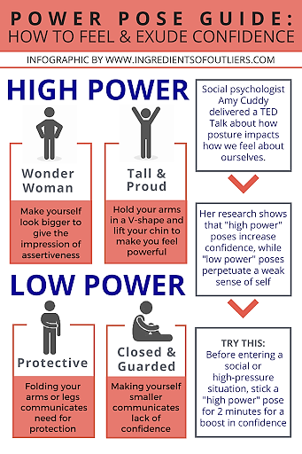

Slide 32
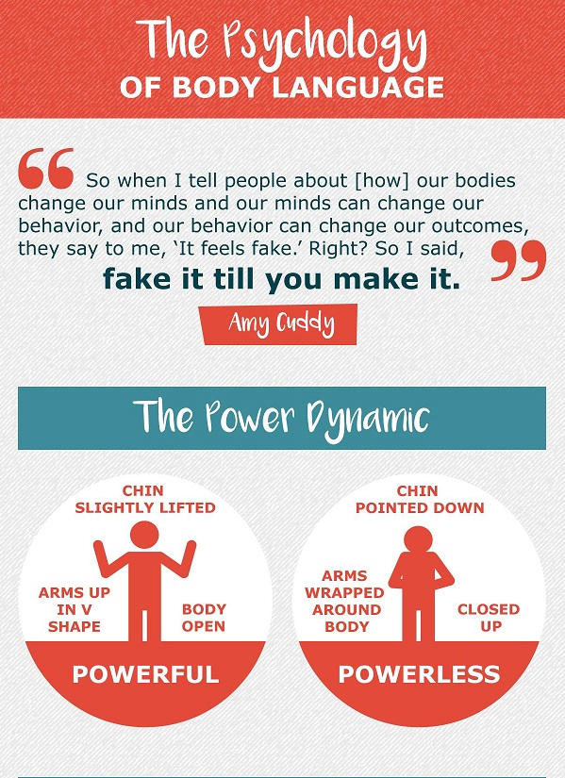

Slide 33
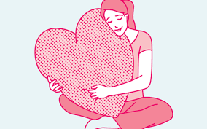
Practice Loving Kindness Meditation*
The following is a simple and effective loving kindness meditation technique to try.
Imagine yourself experiencing complete physical and emotional wellness and inner peace. Imagine feeling perfect love for yourself, thanking yourself for all that you are, knowing that you are just right—just as you are.
Focus on this feeling of inner peace, and imagine that you are breathing out tension and breathing in feelings of love.
Repeat three or four positive, reassuring phrases to yourself.
*www.verywellmind.com/how-to-practice-loving-kindness-meditation-3144786

Slide 34
Loving Kindness Scripts to Try
May I be happy
May I be safe
May I be healthy, peaceful, and strong
May I give and receive appreciation today
Bask in feelings of warmth and self-compassion for a few moments. If your attention drifts, gently redirect it back to these feelings of loving kindness. Let these feelings envelop you.
You can choose to either stay with this focus for the duration of your meditation or begin to shift your focus to loved ones in your life.
Begin with someone who you are very close to, such as a spouse, a child, a parent, or a best friend. Feel your gratitude and love for them. Stay with that feeling. You may want to repeat the following phrases or similar ones that bring about feelings of loving kindness within you:

Slide 36
Techniques to try at the beginning of the practical Session, (or when needing some support during the exercise)
Reflect on these tips and record some ideas in a note book or journal or on a piece of paper.
What have you found helpful in the past?
What has not been helpful?
Choose one of two (or more if you prefer to use on the day of the practical session. Practice beforehand so you are comfortable using them if you need to.

Slide 37
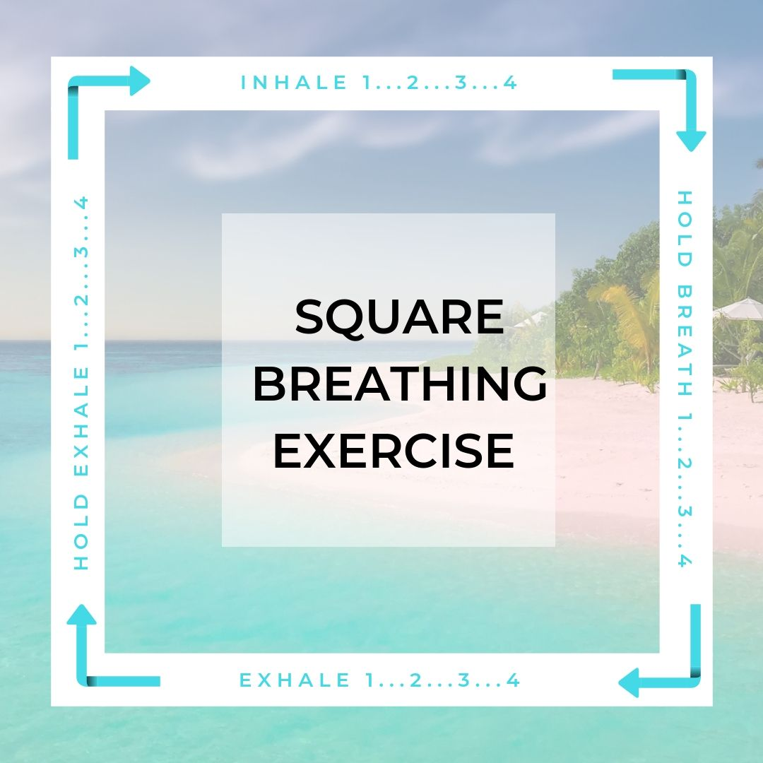

Slide 38
Feel your body
You can do this sitting or standing. Focus on how your body feels from head to toe, noticing each part.
Can you feel your hair on your shoulders or forehead? Glasses on your ears or nose? The weight of your shirt on your shoulders? Do your arms feel loose or stiff at your sides? Can you feel your heartbeat? Is it rapid or steady? Does your stomach feel full, or are you hungry? Are your legs crossed, or are your feet resting on the floor? Is your back straight?
Curl your fingers and wiggle your toes. Are you barefoot or in shoes? How does the floor feel against your feet?

Slide 39
The 5-4-3-2-1 method
Working backward from 5, use your senses to list things you notice around you.
Start by listing five things you hear
Four things you see
Three things you can touch from where you’re sitting
Two things you can smell
One thing you can taste

Slide 40
Try these grounding exercises use mental distractions to help redirect your thoughts away from distressing feelings and back to the present.
Play a memory game
Look at a detailed photograph or picture (like a cityscape or other “busy” scene) for 5 to 10 seconds. Then, turn the photograph face-down and recreate the photograph in your mind, in as much detail as possible. Or, you can mentally list all the things you remember from the picture.
Think in categories
Choose one or two broad categories, such as “musical instruments,” “ice cream flavours,” “mammals,” or “football teams.” Take a minute or two to mentally list as many things from each category as you can.

Slide 41
Use maths and numbers
Even if you aren’t a maths person, numbers can help centre you.
Try This:
Running through a times table in your head.
Counting backward from 100
Choosing a number and thinking of five ways you could make the number (6 + 11 = 17, 20 – 3 = 17, 8 × 2 + 1 = 17, etc.)

Slide 42
Use An Anchoring Phrase
This might be something like: “I’m Full Name. I’m X years old. I live in town, county. Today is ddmmyy. It’s 10:04 in the morning. I’m standind outside a shop. I am safe”.
You can expand on the phrase by adding details until you feel calm, such as, “It’s raining lightly, but I can still see the sun. It’s my break time. I’m thirsty, so I’m going to buy a drink.

Slide 43
Visualize a daily task you enjoy or don’t mind doing
If you like doing laundry, for example, think about how you’d put away a finished load.
“The clothes feel warm coming out of the dryer. They’re soft and a little stiff at the same time. They feel light in the basket, even though they spill over the top. I’m spreading them out over the bed so they won’t wrinkle. I’m folding the towels first, shaking them out before folding them into halves, then thirds,” and so on.

Slide 44
Describe a common task
Think of an activity you do often or can do very well, such as making coffee, locking up your office, or tuning a guitar.
Go through the process step-by-step, as if you’re giving someone else instructions on how to do it.

Slide 45
Recite something
Think of a poem, song, or book passage you know by heart. Recite it quietly to yourself or in your head.
If you say the words aloud, focus on the shape of each word on your lips and in your mouth.
If you say the words in your head, visualize each word as you’d see it on a page.

Slide 46
Describe what’s around you
Spend a few minutes taking in your surroundings and noting what you see.
Use all five senses to provide as much detail as possible.
“This bench is red, but the bench over there is green. It’s warm under my jeans since I’m sitting in the sun. It feels rough, but there aren’t any splinters. The grass is yellow and dry. The air smells like smoke. I hear kids having fun and two dogs barking.”

Slide 47
Practice Self-kindness
Repeat kind, compassionate phrases to yourself:
“You’re having a rough time, but you’ll make it through.”
“You’re strong, and you can move through this pain.”
“You’re trying hard, and you’re doing your best.”
Say it, either aloud or in your head, as many times as you need.

Slide 48
List Favourites
List three favorite things in several different categories, such as foods, trees, songs, movies, books, places, and so on.
Visualize Your Favourites Place
Think of your favourite place, whether it’s the home of a loved one or a foreign country. Use all of your senses to create a mental image. Think of the colours you see, sounds you hear, and sensations you feel on your skin.
Remember the last time you were there. Who were you with, if anyone? What did you do there? How did you feel?

Slide 49
List positive things
Write or mentally list four or five things in your life that bring you joy, visualizing each of them briefly.
Listen to music
Put on your favourite song, but pretend you’re listening to it for the first time. Focus on the melody and lyrics (if there are any).
Does the song give you chills or create any other physical sensations?
Pay attention to the parts that stand out most to you.

Slide 50
Additional tips to help you get the most out of these techniques
Practice. It can help to practice grounding even when you aren’t dissociating or experiencing distress. If you get used to an exercise before you need to use it, it may take less effort when you want to use it to cope in the moment.
Start early. Try doing a grounding exercise when you first start to feel bad. Don’t wait for distress to reach a level that’s harder to handle. If the technique doesn’t work at first, try to stick with it for a bit before moving on to another.

Slide 51
Avoid assigning values. For example, if you’re grounding yourself by describing your environment, concentrate on the basics of your surroundings, rather than how you feel about them.
Check in with yourself. Before and after a grounding exercise, rate your distress as a number between 1 and 10. What level is your distress when you begin?
How much did it decrease after the exercise? This can help you get a better idea of whether a particular technique is working for you.
Keep your eyes open. Avoid closing your eyes, since it’s often easier to remain connected to the present if you’re looking at your current environment.
Health Line (2019) 30 Grounding Techniques to Quiet Distressing Thoughts https://www.healthline.com/health/grounding-techniques#bonus-tips

Slide 52
After the Practical Session
It’s important to reward yourself, as soon as you complete a key task or achieve a goal.
By rewarding yourself in the moment, your brain elicits positive emotions, leading to the realization that your efforts result in a positive reward.
By doing this continuously, your brain will start to link pleasure to accomplishing the task or goal and move towards it in the future.
“You can only build on success!”
-Tony Robbins

Slide 53
How Can You Reward Yourself for Achieving Your Goal?
Ideas…
Buy something nice to eat or drink (e.g. smoothie or ice cream)
Do something you enjoy when you get home
Treat yourself to a luxury bubblebath
Any other ideas?

Slide 54
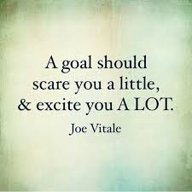
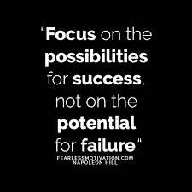
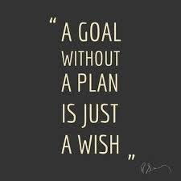
Some Inspiration for You…
Try to find your own this week, and bring it with you for the practical session.
Share it on our Facebook Page too and encourage others!

