Slide 1
Coach Yourself
Be Your Own Wellbeing Coach:
The What, the Why and the How

Slide 2
By the end of this sessions, you will:
Understand what we mean by the term coaching
Understand the concept of self-coaching
Understand the importance of the CHIME model in self-coaching
Learn how to use the Individual Learning Plan in self-coaching
Understand what self-assessment tool are and how to use them in self-coaching
Understand what Positive Psychology Interventions are and how to use them in self-coaching

Slide 3
The What

Slide 4
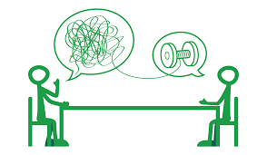
What thoughts come to mind when you hear the word coaching?
What does coaching mean to you?
What do these pictures say about coaching?

Slide 5
“Unlocking a person’s potential to maximise their own
performance.
Helping them to learn rather than teaching them – a facilitation approach”
(Whitmore, 1992)

Slide 6
Coaching focuses on specific goals and measurable achievements; the client takes an active approach and the majority of the responsibility involved in accomplishing these goals.
(Passmore, Stopforth, and Lai, 2018)

Slide 7
Uses psychological theories, approaches, and interventions to help get you from the starting line to the finish line.
(Passmore, Stopforth, and Lai, 2018)

Slide 8
The Why

Slide 9
The heart of positive psychology, like coaching, lies in the practitioner’s choice to shift attention away from pathology and pain and direct it toward a clear-eyed concentration on strength, vision, and
dreams.
(Seligman, 2007)

Slide 10
Coaches focus on the practical, and
help their clients link their thinking to action, taking concrete steps toward their goals.
Self coaching “is a way of cultivating your inner coach by building self-awareness and self-reflection that helps to get you un-stuck so that you can take charge of your problems and maintain control of your own successes.”
(Ali, 2017)

Slide 11
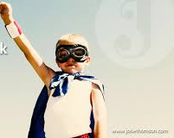
Coaching in mental health can increase a growth mindset and a strengths focus to recovery (Oades, et al., 2009).
Coaching can:
Help and guide a person seeking a change in the way they wish and support them to go in the direction they want.
Support a person to become who they want to be in every area of life.
Constructively build personal awareness to empower choice leading to positive change. (Mead, 2020).

Slide 12
The How

Slide 13
Self Leadership
Self-leadership is an important life skill that enables us
to live life with purpose and intent.
Everyone leads themselves to some extent, but sometimes we do so more intentionally.
We can improve our self-leadership skills by using them more.
If you want to lead yourself, you need to know who you are and what’s important to you.
Identifying your talents, skills, and strengths enables you to pursue goals by leveraging your strong points.
positivepsychology.com/developing-self-leadership/

Slide 14
Using the CHIME Framework for Personal Recovery (Leamy et al. 2011)
And the Somerset Recovery College Student Handbook

Slide 15
What is a Positive Psychology Intervention?
A positive psychology intervention (PPI) is an activity aimed at raising positive feelings, positive thinking or positive behaviour, based on positive psychology theory.
(Boiler et al., 2013)

Slide 16
Choosing the Right PPI
Not all PPIs are best for everyone
It is important to assess your needs first
Using a self-assessment tool can help you do this
Focus on the CHIME letter you score lowest in

Slide 17
Connectedness
Peer support and support groups
Relationships
Support from others
Being part of the community
If civilization is to survive, we must cultivate the science of human relationships – the ability of all peoples, of all kinds, to live together, in the same world at peace.
Franklin Roosevelt

Slide 18
Social relationships have been well researched by psychologists.
A significant link between quality social relationships and improved health (Umberson & Karas Montez, 2010).
How did you score on the CHIME outcome measure in connectedness?
We can improve our relationships using PPIs

Slide 19
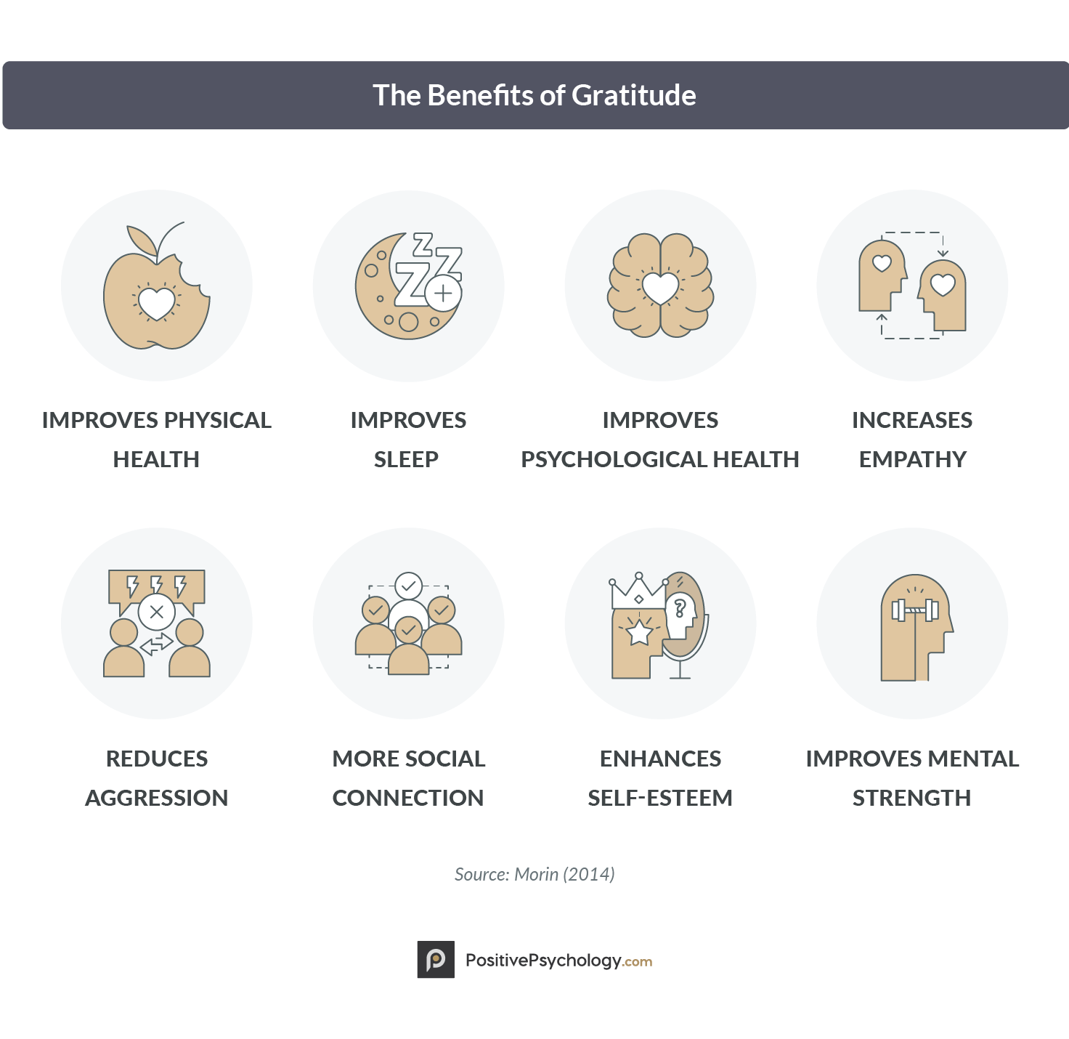

Slide 20
Measuring Gratitude
Use the Gratitude questionnaire (GQ-6 self-assessment tool) to measure your gratitude (McCullough, Emmons & Tsang, 2002).
Rate yourself on a scale from 1-7:
1 = strongly disagree 2 = disagree 3 = slightly disagree 4 = neutral 5 = slightly agree 6 = agree 7 = strongly agree
1. I have so much in life to be thankful for.
2. If I had to list everything that I felt grateful for, it would be a very long list.
3. When I look at the world, I don’t see much to be grateful for.*
4. I am grateful to a wide variety of people.
5. As I get older I find myself more able to appreciate the people, events, and situations that have been part of my life history.
6. Long amounts of time can go by before I feel grateful to something or someone.*
* Items 3 and 6 are reverse-scored

Slide 21
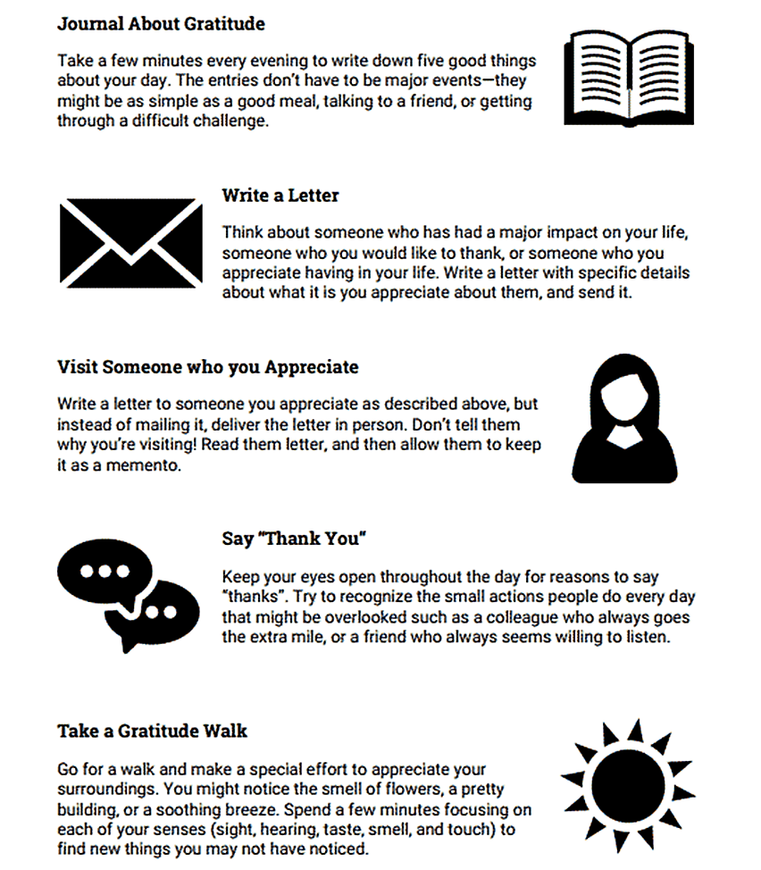
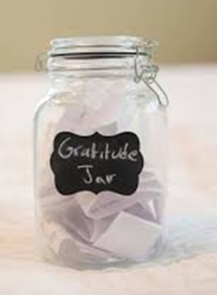
Interventions to Increase Gratitude
from:
www.therapistaid.com/worksheets/gratitude-exercises.pdf
Get lots more ideas from: positivepsychology.com/gratitude-exercises/

Slide 23
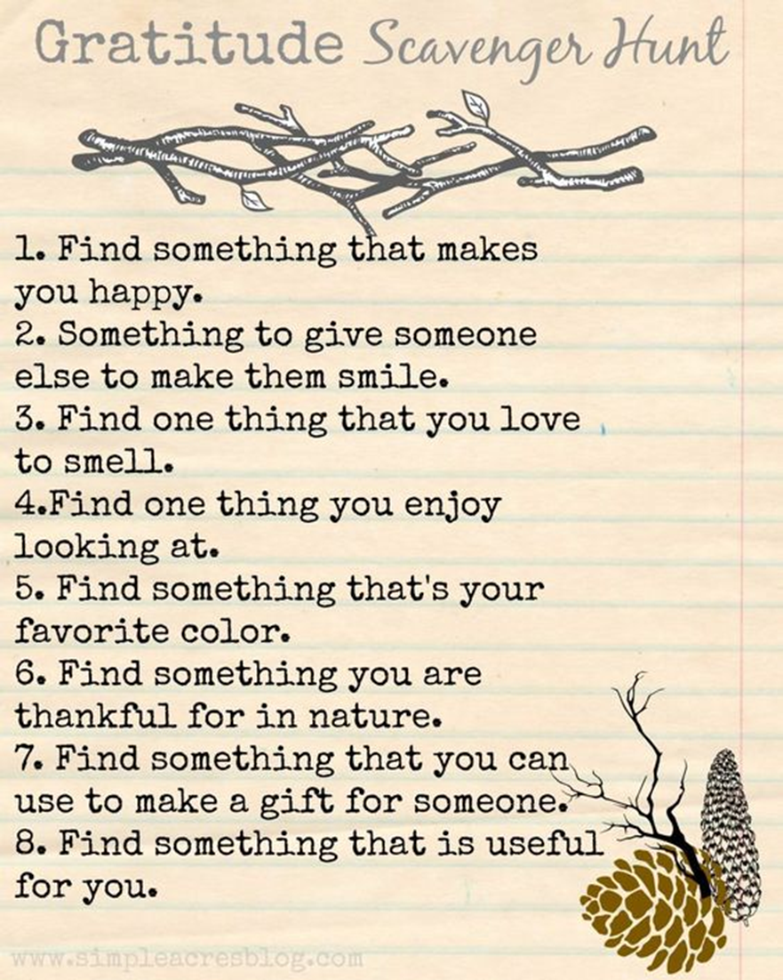

Slide 24
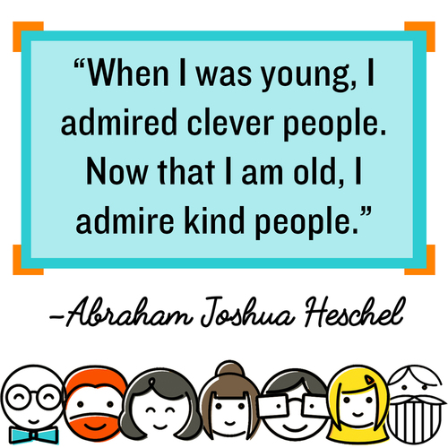
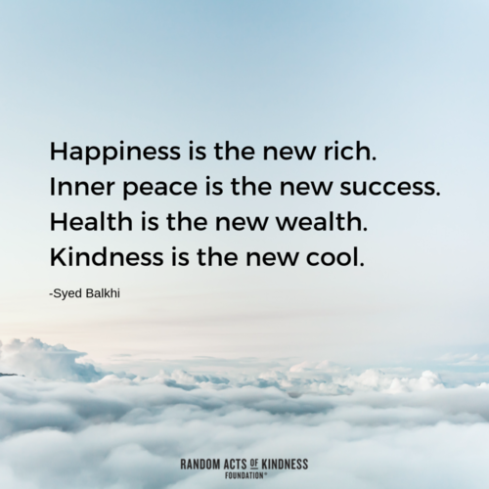
www.randomactsofkindness.org/

Slide 25
Random
Acts of
Kindness
Calendar
assets.randomactsofkindness.org/calendars/neighborhood/2021/202102_kindness_calendar.pdf

Slide 26
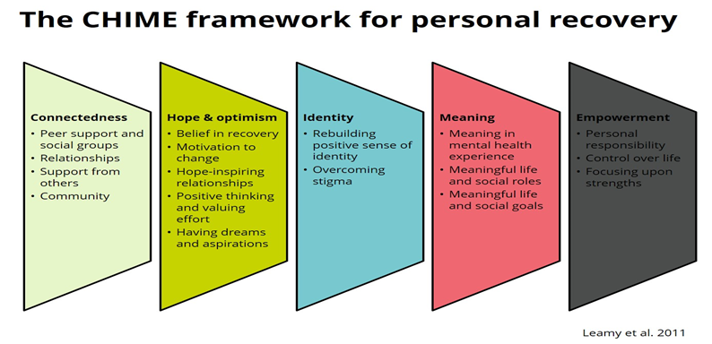
Hope and Optimism
Belief in possibility of recovery
Motivation to change
Hope-inspiring relationships
Positive thinking and valuing success
Having dreams and aspirations
Hope does not necessarily fade in the face of adversity it endures.
No one is exempt from experiencing challenging life events, but hope fosters optimism even in the most challenging of circumstances.

Slide 27
Hopefulness is a life-sustaining human strength comprised of three distinct but related components:
Goals Thinking – the clear conceptualization of valuable goals.
Pathways Thinking – the capacity to develop specific strategies to reach those goals.
Agency Thinking – the ability to initiate and sustain the motivation for using those strategies
(Snyder, 1991)

Slide 28
Measuring Hope
The Trait Hope Scale (Snyder, 1991)
On a scale of 1-8 how would you rate yourself:
1= Definitely False 2= Mostly False 3= Somewhat False 4= Slightly False 5= Slightly True 6= Somewhat True 7= Mostly True 8= Definitely True
Scoring:
The agency subscale score is derived by adding items 2, 9, 10, and 12
The pathway subscale score is derived by adding items 1, 4, 6, and 8.
The total Hope Scale score is derived by adding the four agency and the four pathway items.
ppc.sas.upenn.edu/resources/questionnaires-researchers/adult-hope-scale

Slide 29
I can think of many ways to get out of a jam.
I energetically pursue my goals.
I feel tired most of the time.
There are lots of ways around any problem.
I am easily downed in an argument.
6. I can think of many ways to get the things in life that are important to me.
7. I worry about my health.
8. Even when others get discouraged, I know I can find a way to solve the problem.
9. My past experiences have prepared me well for my future.
10. I’ve been pretty successful in life.
11. I usually find myself worrying about something.
12. I meet the goals that I set for myself.

Slide 30
Interventions to Increase Hope
Keep a Hope Journal
The exploration of hope can be facilitated through the self-reflective practice of journaling (Crain & Koehn, 2012).
While journaling is a common practice for many, it is also an effective tool to improve wellness, foster greater self-awareness, and cultivate hope.
Writing about challenges, what gives hope and what could potentially give hope can highlight the factors which may impede the development of a more hopeful outlook.
Keep a Hope journal for at least two weeks and include entries about any factors that can impact the potential to foster more hope.

Slide 31
Exploring Beliefs About Hope
The objective of this exercise is to begin the process of thinking about hope and what it means to have hope.
Write some hope-focused questions on pieces of paper and answer at random.
The following are guide questions that can be used at home, with clients or with groups to explore the ritual of hope and evaluate different methods of expressing hope:
What does it mean to have hope?
What are the benefits of having hope?
In your opinion, what does a hopeful person look and sound like?
How have you used hope in your own life?
Are there any risks with having hope?
If a picture on your wall could remind you of hope every morning, what would that picture be?
What is the smallest possible change that could increase your hope?
Try to think about some communities or individuals that might benefit from hope?
Consider different ways of expressing hope within different communities. Do you think some methods would be more effective than others and why?

Slide 32
Your Internal Movie
Write a short internal movie in which a chosen goal is the protagonist.
Throughout the exercise, the visualization of barriers and obstacles that may occur during the process of achieving that goal will encourage the creation of alternative pathways around and through challenges.

Slide 33
Hope Rising
(from Hope Rising: How the Science of HOPE Can Change Your Life by Gwinn & Hellman, 2019).
By describing goals in detail you create one or more possible pathways to goal attainment.
Describe your goal in as much detail as possible.
How much do you desire this goal?
Describe why you want to achieve the goal. List what is motivating you.
Imagine you have just achieved your goal. Describe how you think you will feel in this future memory.

Slide 34
List the pathways (actions/strategies) you can use to achieve your goal.
Describe potential barriers for each pathway you listed.
Describe a time when you achieved a goal by overcoming barriers. What were the barriers and how did you overcome them?
Choose the best pathway and describe how you will overcome the barrier.
What are two or three things that must be accomplished for you to attain your goal?
Identify people and/or resources in your community with whom you can rely on as a source of support in pursuing your goal.
Describe something that motivates you (e.g., music, movie, a person). Think of how you can use this inspiration to help you to pursue your goal.

Slide 35
Hope Theory
(from Kate Snowise, 2016, derived from Snyder’s Hope Theory)
Focuses on hope as a cognitive and emotional concept that allows one to move toward goals, enhances motivation, and facilitates the development of a plan that will be actively carried out.
Hope: What is one goal you hope to achieve in the future?
Plan & Action: What small actions can you take that will start moving you closer towards this goal?
Believe: Write down 3 short sentences that will help remind you of your capabilities, for instance, “I am capable and resourceful.”

Slide 36
Identity
The condition of being oneself or itself, and not another
The state or fact of remaining the same one or ones, as under varying aspects or conditions
The condition or character as to who a person or what a thing is; the qualities, beliefs, etc., that distinguish or identify a person or thing
Rebuilding a positive sense of identity
Overcoming stigma

Slide 37
Our identity is a unique combination of personality characteristics, abilities, interests, physical attributes and biography.
Personality and personal identity are bio-socially determined, which means that both are genetically pre-defined and socially reshaped.
Max Haller et Bernadette Müller 2008

Slide 38
Identity and Mental Health
For some identity focusses upon being valued as an individual in spite of mental health problems: The Person, not the Label
For others the experience of ill health and recovery is embraced and is a focus of value: Identity is of an overcomer, expert by experience and mental health survivor
For many identity is about personal growth and development and change internally: It has made me the person I am today

Slide 39
Measuring Identity: Authenticity Scale
(Wood, Linley, Maltby, Baliousis, & Joseph, 2008)
On a scale of 1-7 (1= does not describe me at all, to
7= describes me very well)
Where do you rate yourself?
1. “I think it is better to be yourself, than to be
popular.”
2. “I don’t know how I really feel inside.”
3. “I am strongly influenced by the opinions of others.”
4. “I usually do what other people tell me to do.”
5. “I always feel I need to do what others expect me
to do.”
6. “Other people influence me greatly.”
7. “I feel as if I don’t know myself very well.”
8. “I always stand by what I believe in.”
9. “I am true to myself in most situations.”
10. “I feel out of touch with the ‘real me.’”
11. “I live in accordance with my values and beliefs.”
12. “I feel alienated from myself.”

Slide 40
Scoring Instructions
Add up items 1, 8, 9, and 11 = Authentic Living
Add up items 3, 4, 5, and 6 = Accepting External Influence
Add up items 2, 7, 10, and 12 = Self-Alienation

Slide 41
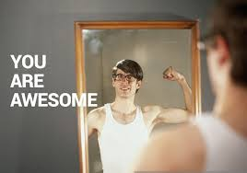
Interventions to Improve Identity
Self-acceptance: positivepsychology.com/self-acceptance/
Self-confidence and self-belief: positivepsychology.com/self-confidence-self-belief/
Self-confidence: positivepsychology.com/self-confidence/
Self-concept: positivepsychology.com/self-concept/
Self-esteem: positivepsychology.com/self-esteem/
Self-acceptance: positivepsychology.com/self-acceptance-quotes/
Self-expression: positivepsychology.com/self-expression/
The Self: positivepsychology.com/category/the-self/
Take the VIA character strengths assessment and find out what your signature strengths are and how to use them in your life: www.viacharacter.org/

Slide 42
Meaning
A meaningful and fulfilling life is unique to each of us, consisting of:
Purpose: The pursuit of a life goal
Understanding: of who you are and your significant role in life
Responsibility: Only you are responsible for deciding your meaning in life, and what is significant to you, and taking responsibility for your actions.
Enjoyment: A deep sense of significance comes when you actively take responsibility, to pursue life goals (Wong, 2010).

Slide 43
We have four needs which when met, lead to a sense of meaning in life:
Purpose: The belief that what we do now affects our future. Pursuing life goals which lead to a sense of fulfilment.
Values: The fundamental attitudes guiding our mental processes and behaviour.
Efficacy: The belief that you are competent meet challenges and achieve goals
Self-worth: reasons for believing that one is a good and worthy person
(Baumeister and Vohs, 2002).

Slide 44
Measuring Meaning in Life
MEANING IN LIFE QUESTIONNIARE
(Steger, Frazier, Oishi, & Kaler, 2006).
A 10-item questionnaire designed to measure two dimensions of meaning in life: (1) Presence of Meaning (how much you feel your life have meaning), and (2) Search for Meaning (how much you strive to find meaning and understanding in your life).
What makes your life and existence feel important and significant to you?

Slide 45
On a scale of 1-7 how would you rate your self?
1. I understand my life’s meaning _____
2. I am looking for something that makes my life feel meaningful _____
3. I am always looking to find my life’s purpose _____
4. My life has a clear sense of purpose _____
5. I have a good sense of what makes my life meaningful _____
6. I have discovered a satisfying life purpose _____
7. I am always searching for something that makes my life feel significant _____

Slide 46
Interventions to Increase Meaning
Best Possible Self
(King, 2001)
Imagine your life in the future.
What is the best possible life you can imagine? Consider all of the relevant areas of your life, such as your career, academic work, relationships, hobbies, and health.
What would happen in these areas of your life in your best possible future?
For the next 15 minutes, write continuously about what you imagine this best possible future to be.
ggia.berkeley.edu/practice/best_possible_self

Slide 47
Meaningful Photos
A creative way to build happiness and meaning in life.
Over the next week, take photographs of things that make your life feel meaningful or full of purpose. These can be people, places, objects, pets. If you are not able to take photos of these things—like if they’re not nearby—you can take photos of souvenirs, reminders, websites, or even other photos. Try to take at least nine photographs.
Take time to look at and reflect on each one.
For each photo or item, write down a response to the following question: “What does this photo represent, and why is it meaningful?”
(Steger, Shim, Barenz, & Shin, 2014)
https://ggia.berkeley.edu/practice/meaningful_pictures

Slide 48
Meaningful Social Relationships
Making connections with other individuals, and maintaining these relationships, is a reliable way to develop a sense of meaningfulness (Heintzelman & King, 2014).
People who report fewer social connections, loneliness, and ostracism also yield lower reports of meaningfulness (Williams, 2007).
Sharing your passions with a group of like-minded individuals helps further develop harmonious passions, which, in turn, can generate a sense of meaningfulness (Vallarand, 2012).

Slide 49
Values Vision Board
Create a vision board, using pictures cut from magazines and stuck to paper or software such as Powerpoint or Keynote.
Try grouping the images by domain or in order of overall life values.
Work on it through feeling rather than rational thinking, with no goals in mind.
Share your thoughts about the vision board with the therapist or a close friend.
Place the vision board somewhere it can be seen daily. Regularly return to the board to see if values have shifted and whether life is still balanced with the core values.

Slide 50
Empowerment
Each person holds so much power within themselves that needs to be let out. Sometimes they just need a little nudge, a little direction, a little support, a little coaching, and the greatest things can happen.
Pete Carroll
Personal Responsibility
Control over life
Focussing on strengths

Slide 51
Measuring Empowerment
Life Orientation Test – Revised (LOT-R)
Reference: Scheier, Carver & Bridges (1994).
Attributional Style Questionnaire (ASQ)
Reference: Peterson, Semmel, von Baeyer, Abramson, Metalsky, & Seligman (1982).
The Flourishing Scale
Reference: Diener, Wirtz, Tov, Kim-Prieto, Choi, Oishi & Biswas-Diener (2009).
VIA Character Survey
www.viacharacter.org/survey/account/register

Slide 52
Interventions to Increase Empowerment
Positive Reframing Exercise
Limiting beliefs – ideas we have about ourselves that don’t help us achieve our full potential, and that can act as barriers to achieving our goals.
Positive Reframing is a way of exploring these ideas and switching them up to see how different aspects of ourselves can help to serve us in new ways, or how limiting beliefs need to be let go of.

Slide 53
Turning a Problem into an Opportunity
Using open questions, a coach can ask a client to explore how a perceived problem could be an opportunity for growth.
This could include asking questions such as ‘When has this problem arisen before and what happened?’, ‘What does the best version of you do when faced with this problem?’ or ‘Where could this problem become an opportunity?’.
Try asking yourself open questions, allow yourself to be curious…

Slide 54
Fall in Love With Your Weakness
We know we have weaknesses but often feel powerless about them, wishing we could change them or that we didn’t have them at all.
By reframing weaknesses as something to be appreciated or celebrated, we can begin to see a perceived weakness in a more positive light.
For example, if you feel you are too quiet and fail to speak up, a coach could help you reflect how this means you are a good listener. By being quiet, you can hear what others in the room are saying and develop a deeper understanding of situations or challenges which can be used to present solutions.

Slide 55
Are You Sitting (Un)Comfortably
This reframing encourages you to see instances of discomfort in a new way as an opportunity for growth.
When we feel uncomfortable about something, it is usually because our beliefs, ideas, skills, and identity are being challenged in some way.
Instead of focusing only on the discomfort, try to explore what exactly has caused you to feel this way and how you can use this for personal growth.

Slide 56
References and Further Reading
Baumeister, R. F., & Vohs, K. D. (2002). The pursuit of meaningfulness in life. Handbook of positive psychology, 1, 608-618.
Bolier, L., Haverman, M., Westerhof, G. J., Riper, H., Smit, F., & Bohlmeijer, E. (2013). Positive psychology interventions: a meta-analysis of randomized controlled studies. BMC public health, 13(1), 119.
Crain, M., & Koehn, C. (2012). The essence of hope in domestic violence support work: A hermeneutic-phenomenological inquiry. Journal of Mental Health Counselling, 34(2), 170-188.
Diener, E., Wirtz, D., Tov, W., Kim-Prieto, C., Choi, D., Oishi, S., & Biswas-Diener, R. (2009). New measures of well-being: Flourishing and positive and negative feelings. Social Indicators Research, 39, 247-266.
Emmons, R. A., and McCullough, M. E. (2003). Counting blessings versus burdens: experimental studies of gratitude and subjective well-being in daily life. J. Pers. Soc. Psychol. 84, 377–389. doi: 10.1037/00223514.84.2.377.

Slide 57
Gwinn, C. & Hellman, C. (2019). Hope Rising: How the Science of HOPE Can Change Your Life Paperback. Morgan James Publishing.
Heintzelman, S. J., & King, L. A. (2014). Life is pretty meaningful. American Psychologist, 69(6), 561.
Heintzelman, S. J., & King, L. A. (2014). (The feeling of) meaning-as-information. Personality and Social Psychology Review, 18(2), 153-167.
Hira, A. (2017). A Step By Step Process for Self-Coaching Yourself Towards Productivity & Success. https://medium.com/thrive-global/a-step-by-step-process-for-self-coaching-yourself-towards-productivity-2547a5c85e3a.
Kauffman, C. (2006). Positive psychology: The science at the heart of coaching. Evidence based coaching handbook: Putting best practices to work for your clients, 219, 253.
King, L. A. (2001). The health benefits of writing about life goals. Personality and Social Psychology Bulletin, 27(7), 798-807.

Slide 58
Leamy, M., Bird, V., Le Boutillier, C., Williams, J., & Slade, M. (2011). Conceptual framework for personal recovery in mental health: systematic review and narrative synthesis. The British Journal of Psychiatry, 199(6), 445-452.
Mead. (2020). Positive Psychology Coaching and Life Coaching: What’s the Difference? https://positivepsychology.com/positive-psychology-life-coaching/.
Oades, L. G., Crowe, T. P., & Nguyen, M. (2009). Leadership coaching transforming mental health systems from the inside out: The Collaborative Recovery Model as person-centred strengths based coaching psychology. International coaching psychology review, 4(1), 25-36.
O’Connell, B. H., O’Shea, D., & Gallagher, S. (2016). Enhancing social relationships through positive psychology activities: A randomised controlled trial. The Journal of Positive Psychology, 11(2), 149-162.
Passmore, J., Stopforth, M., & Lai, Y. (2018). Defining coaching psychology: Debating coaching and coaching psychology definitions. The Coaching Psychologist, 14(2), 120-122.

Slide 59
Rethink. (2012). Empowering people: Coaching for mental health recovery.
https://www.rethink.org/advice-and-information/living-with-mental-illness/treatment-and-support/empowering-people-coaching-for-mental-health-recovery/.
Scheier, M. F., Carver, C. S., & Bridges, M. W. (1994). Distinguishing optimism from neuroticism (and trait anxiety, self-mastery, and self-esteem): A re-evaluation of the Life Orientation Test. Journal of Personality and Social Psychology, 67, 1063-1078.
Seligman, M. E. (2007). Coaching and positive psychology. Australian Psychologist, 42(4), 266-267.
Snyder, C. R., Harris, C., Anderson, J. R., Holleran, S. A., Irving, L. M., Sigmon, S. T. (1991). The will and the ways: Development and validation of an individual-differences measure of hope. Journal of Personality and Social Psychology, 60, 570-585.
Steger, M. F., Shim, Y., Rush, B. R., Brueske, L. A., Shin, J. Y., & Merriman, L. A. (2013). The mind’s eye: A photographic method for understanding meaning in people’s lives. The Journal of Positive Psychology, 8(6), 530-542.

Slide 60
Umberson, D., & Karas Montez, J. (2010). Social relationships and health: A flashpoint for health policy. Journal of health and social behavior, 51(1_suppl), S54-S66.
Vallerand, R. J. (2012). From motivation to passion: In search of the motivational processes involved in a meaningful life. Canadian Psychology/Psychologie Canadienne, 53(1), 42.
Whitmore, J. (1992). Growing human potential and purpose: The principles and practice of coaching and leadership.
Williams, K. D. (2007). Ostracism: The kiss of social death. Social and Personality Psychology Compass, 1(1), 236-247.
Wong, P. T. (2010). Meaning therapy: An integrative and positive existential psychotherapy. Journal of Contemporary Psychotherapy, 40(2), 85-93.
Wood, A. M., Linley, P. A., Maltby, J., Baliousis, M., & Joseph, S. (2008). The authentic personality: A theoretical and empirical conceptualization and the development of the Authenticity Scale. Journal of Counseling Psychology, 55(3), 385.
Wood, A. M., Froh, J. J., and Geraghty, A. W. A. (2010). Gratitude and well-being: a review and theoretical integration. Clin. Psychol. Rev. 30, 890–905. doi: 10.1016/j.cpr.2010.03.005

