Slide 1
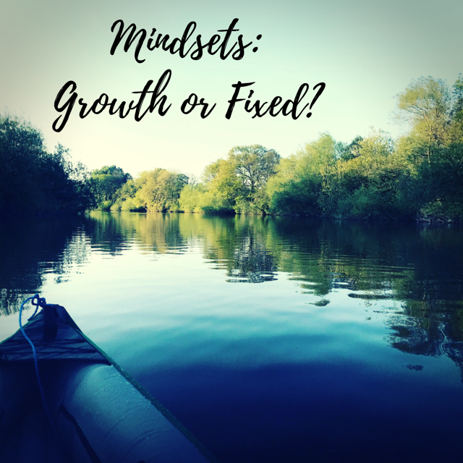

Slide 2
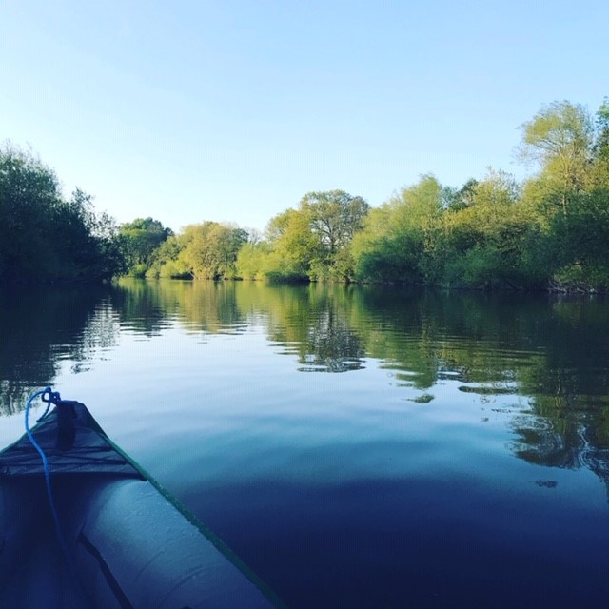
Introduction to this Webinar: Common Questions
The What of Mindsets: Growth verses Fixed
The How of Mindsets: How Mindsets are Formed
The Science Behind Learning and Memory: Can a Mindset Change?
The What of Resilience
The How of Resilience

Slide 3
Q: What is a webinar?
A: A webinar is essentially an online event where a speaker, delivers a presentation to an audience. It is like a virtual Recovery College course.

Slide 4
A: Although you can’t pause the
Webinar, it is being recorded, so you can do what you’ve got to do and then watch the recording later.
Q: What if I need to pause the Webinar

Slide 5
Q: Do I have to turn my webcam on?
A: No. You can see me, but I can’t see you, and no one else can either.

Slide 6
A: There won’t be any scheduled breaks, however, when we stop to do the activities, you can take a break if you need to.
Q: Will there be a break during the webinar?

Slide 7
A: Yes, you do not have to stay for the entire
session if you don’t want to – you can watch this
as a recording later and do the activities in your own time.
Q: Can I leave the webinar whenever I want to?

Slide 8
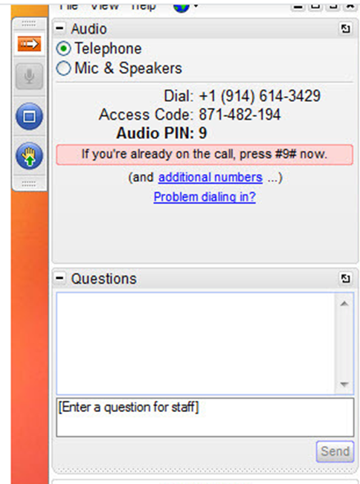
Q: Can I ask a
question,
or make a comment?
A: You can ask a question or comment at any time, but only the speaker will be able to see the question/comment
and respond.

Slide 9
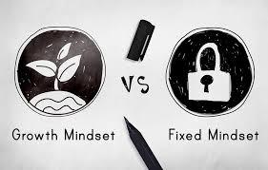
Growth Mindset vs Fixed Mindset

Slide 10
Implicit Theories
Core assumptions about the malleability of personal qualities e.g. intelligence/personality
Internal frameworks we create to make sense of our world
Fundamental underlying beliefs over whether characteristics and abilities can change and develop over time.
Two implicit theories: Entity and Incremental

Slide 11
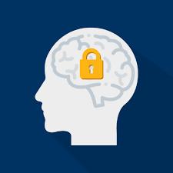
Fixed Mindset
Also called an entity theory: you either have it – or you don’t
The entity world is a world of threats and defences
The entity world is about measuring your ability…and everything measures your ability
A fixed mindset can compromise resilience
People with fixed mindset are more likely to feel shame
People with a fixed mindset find it harder to forgive
People with a fixed mindset are more likely to seek retribution

Slide 12
I'm stupid
He’s bad
This is hopeless
Oh no! A challenge…I’m not strong enough
or smart enough to handle it!
people can’t change
I’m a failure
labels are fixed traits

Slide 13
Growth Mindset
Also called an Incremental theory: attributions can grow and develop over time
The incremental world is about learning and growth and every challenge, effort and setback is seen as an opportunity for learning and growth
The incremental world is one of opportunities to improve
A growth mindset creates resilience
People with a growth mindset are less likely to feel shame
People with a growth mindset are more likely to forgive

Slide 14
I’m learning through this
Yay! A challenge…an opportunity for my brain to grow smarter and stronger!
The brain and its functioning is malleable
There is always hope
People can change

Slide 15
Good News…
positive qualities such as optimism can be learned and practiced and cultivated for health and wellbeing
Martin Seligman, 1991

Slide 16
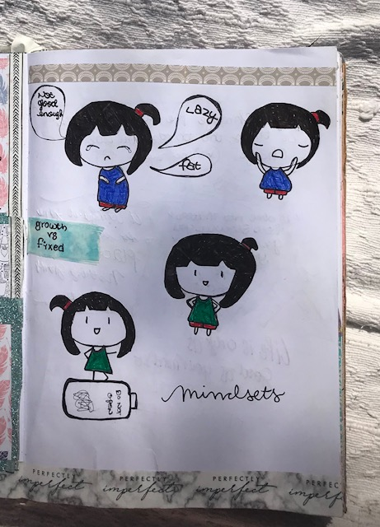
Try This
Example from my Wellbeing Journal
What do Mindsets look like to you?
Draw in your Wellbeing Journal, or write words you associate with each Mindset
How would you explain this concept to someone else?

Slide 17
We Can Move From A Fixed To A Growth Mindset

Slide 18
If we can learn helplessness…

Slide 19
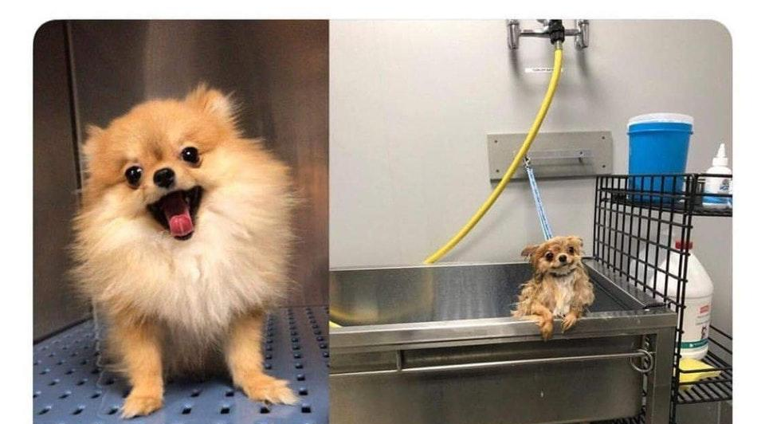
We can learn hopefulness

Slide 20
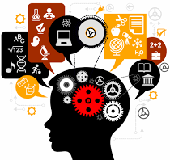
HOW?
The Process of Learning

Slide 21
Memory is essential for the Learning Process…

Slide 22
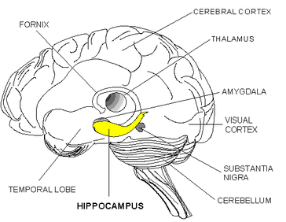
Deep in the brain, the hippocampus helps store memories.
The human brain stores memories in the form of neural activity patterns.

Slide 23
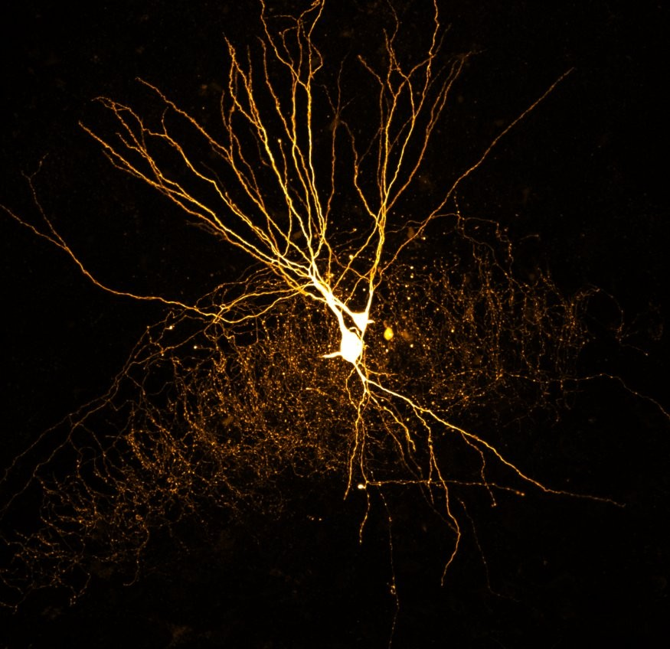
A human brain contains, on average, 86 billion neurons that in total make trillions of synaptic connections.
These nerve cells have branches connecting them to other cells in a complicated network.
Learning and memory require new neural networks to form in the brain.
Synaptic plasticity is a key mechanism underlying this process.

Slide 24
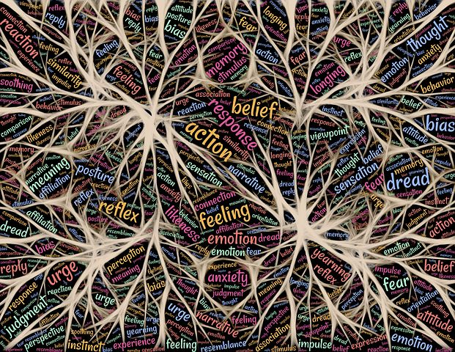
Learning changes the physical structure of the brain
These structural changes alter the functional organization of the brain
In other words, learning organizes and reorganizes the brain

Slide 25
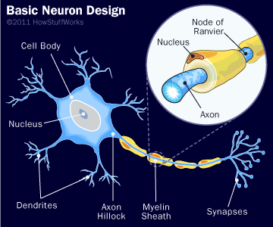
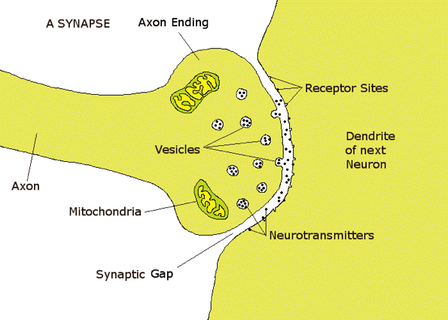
Try copying these diagrams in your Wellbeing Journal, add the labels and try to summarise the process

Slide 26
The Brain Is Like A Muscle
Communication between these brain cells is what allows us to think and solve problems.
When you learn new things, these tiny connections in the brain actually multiply and get stronger. The more that you challenge your mind to learn, the more your brain cells grow.

Slide 27
Try to summarise the learning process in your wellbeing journal, how would you explain this to a friend?
Researchers found that when you can understand this theory and explain it to someone else, you are more likely to take the information on board and put it into practice in your own life.
This has found to be even more effective then positive thinking alone.
(Yeager et al. 2012)

Slide 28
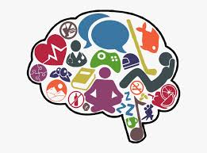
Exercise Your Body…Exercise Your Brain
Exercise is important for brain health, growth and development. (Voss et al. 2010)
Not only does the function of the brain improve, the cells themselves are better able to store information for learning and memory.
The more you exercise your brain, the more you will be able to maintain optimal brain function (Praag et al. 2000).

Slide 29
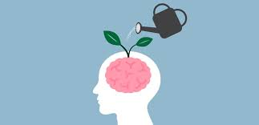
Try this
Picture a Growth Mindset:
When you are learning a new skill or taking in new information, picture your brain growing stronger and smarter as new connections are being formed between neurones.
Picture your brain growing denser neural networks as you grow and learn and face new challenges.
Now, write a letter to an imaginary person who is struggling with feeling stupid or unable to overcome a challenge. Tell them about the brains ability to grow and develop and about the importance of the growth mindset.

Slide 30
Resilience
Resilience comes from 'resiliens', a Latin word meaning 'to recoil or rebound'.
In the 1640s, resilient was used to mean 'springing back'.

Slide 31
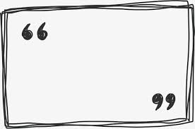
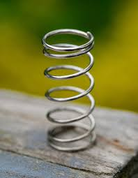
Ability to recoil or spring back into shape after bending, stretching, or being compressed.

Slide 32
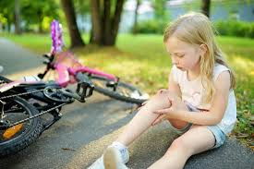
Ability to withstand or recover quickly from difficult conditions

Slide 33
We can learn hopefulness

Slide 34
How Mindsets Influence Resilience

Slide 35
Mindsets create lenses that filter our experience of adversity; in doing so lead to different patterns of
vulnerability or resilience.
Carol Dweck

Slide 36
It is not a quality in the person or the environment
but the interpretation of the adversity which determines resilience.
Carol Dweck

Slide 37
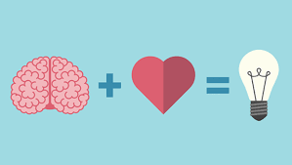
In other words…
Your mindset can determine whether or not the adversity will effect your outcomes

Slide 38
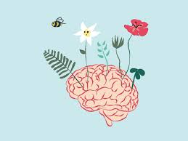
Those with a growth mindset are more resilient when confronting a challenging situation

Slide 39
Our minds are constantly trying to make sense of our world, forming judgements and opinions about every situation, event, and interaction.
In CBT this process is known as Framing

Slide 40
Without the judgments we form, we would have to approach every problem as a brand new one, with no pre-existing experiences, problem-solving techniques, or lessons learned to draw from.
However
The issue with framing situations is that they are not always accurate.

Slide 41
Reframing your Situation
Try This
Reframing, is a process whereby situations and thoughts are challenged and changed.
The Cognitive Behaviour Therapy technique of Reframing is based upon an assumption that we frame our experiences in a certain way – like a Mindset.
For a good resource on this see:
https://positivepsychology.com/cbt-cognitive-restructuring-cognitive-distortions/

Slide 42
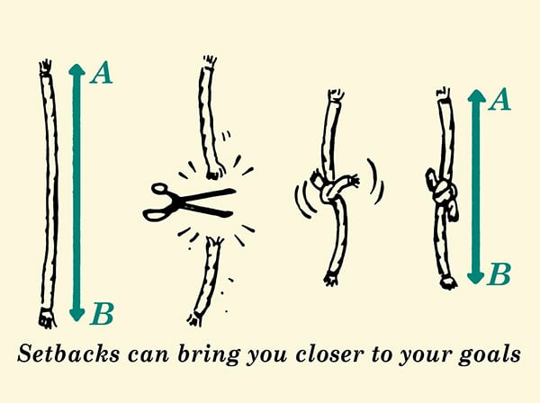
Reframing means accepting the reality of a situation
BUT
acknowledging that the meaning of those things is open to interpretation, and this interpretation changes how you experience them, which changes your reality.
A helpful way to interpret a setbacks is to see it like cutting a piece of string that reaches between where you are now and your goal: if you retie the string, the distance between your position and your goal shrinks.
For example:

Slide 43
Try This
Next time you are faced with a difficult situation, think about what mindset you are using to approach this challenge.
Effort is important, as are resources, skills and support…but if your mindset is Fixed… you will be prevented from fully making use of these assets.
Having a Growth mindset leads to long term effectiveness by maximising your potential.

Slide 44
Check out these great resources to help Reframe your thinking:
(Copy and paste these links into an internet search engine)
https://www.getselfhelp.co.uk/docs/AutomaticThoughts.pdf
https://www.getselfhelp.co.uk/docs/APPLE.pdf
https://www.getselfhelp.co.uk/docs/judge.pdf
https://www.getselfhelp.co.uk/docs/Continuum.pdf
https://www.getselfhelp.co.uk/docs/DifferentPerspectives.pdf
https://www.getselfhelp.co.uk/docs/FACTorOPINION.pdf
https://www.getselfhelp.co.uk/docs/Helicopter.pdf
https://www.getselfhelp.co.uk/docs/SHARP.pdf
https://www.getselfhelp.co.uk/docs/STOPP5.pdf

Slide 45
What we need most is not self-esteem boosting, or trait labelling; but Mindsets which represent challenges as things which can be taken on and overcome.
When we emphasize our potential for change we are more prepared to face life’s challenges resiliently.
Carol Dweck

Slide 46
References and Further Reading
Aronson, F., and Fried, C., and Good, C. (2002) Reducing the effects of stereotype threat in African American college students by shaping theories of intelligence. Journal of Experimental Social Psychology. 38. pp.113-125.
Black, J.E., A.M.Sirevaag, and W.T.Greenough 1987 Complex experience promotes capillary formation in young rat visual cortex. Neuroscience Letters 83:351–355.
Blackwell, L, S., Trzesniewski K, H,. and Dweck, C. (2007) Implicit Theories of Intelligence Predict Achievement Across an Adolescent Transition: A Longitudinal Study and an Intervention. Child Development. 78 (1) pp. 246-263.
Ernst A, Frisén J. (2015) Adult neurogenesis in humans- common and unique traits in mammals. PLoS Biol. 13(1).
Erickson KI, Voss MW, Prakash RS, et al. (2015) Exercise training increases size of hippocampus and improves memory. Proc Natl Acad Sci USA. 108(7) pp.3017-22.

Slide 47
References and Further Reading
Grenville-Cleave, B., (2016) Positive Psychology: A Toolkit for Happiness, Purpose and Well-being. London: Icon Books.
Huttenlocher, P.R., and A.S.Dabholkar 1997 Regional differences in synaptogenesis in human cerebral cortex. Journal of Comparative Neurology 387:167–178.
Juraska, J.M. 1982 The development of pyramidal neurons after eye opening in the visitual cortex of hooded rats: A quantitative study. Journal of Comparative Neurology 212:208–213.
Kennedy, M B., (2016) Synaptic Signalling in Learning and Memory. Cold Spring Harb Perspect. Biol. 8(2).
Masten AS. Ordinary magic. Resilience processes in development. Am Psychol.56(3):227-238.

Slide 48
References and Further Reading
McKay, B. and McKay, K. (2018) How Reframing Builds Resilience. The Art of Manliness. Available from: https://www.artofmanliness.com/articles/reframing-for-resilience/. [Accessed on April 23 2020].
Paunesku, D., Yeager, D. S., Romero, C., and Walton, G. (2012) A brief growth mindset intervention improves academic outcomes of community college students enrolled in developmental mathematics courses. Unpublished Manuscript, Stanford California: Stanford University.
Pearce Stevens, A., (2014) Learning rewires the brain. Science News for Students. Available from: https://www.sciencenewsforstudents.org/article/learning-rewires-brain. [Accessed on 23 April 2020].

Slide 49
References and Further Reading
The National Academies Press (2000) Chapter: 5 Mind and Brain in How People Learn: Brain, Mind, Experience, and School: Expanded Edition. Danvers, MA: The National Academies Press.
van Praag, H., Kempermann, G. & Gage, F. (2000) Neural consequences of environmental enrichment. Nat Rev Neurosci 1, 191–198.
Voss, MW., Prakash, RS., Erickson, KI., Basak,C., Chaddock, L., JS. Kim., Alves, H., Heo, S., Szabo, A,N., White, SM., Wójcicki, TM,. Mailey E L., Gothe, N., Olson, E A., McAuley, E. and Kramer, AF. (2010) Plasticity of brain networks in a randomized intervention trial of exercise training in older adults. Frontiers in Aging Neuroscience 2 pp.1-17
Yeager DS and Dweck, CS. (2012) Mindsets That Promote Resilience: When Students Believe That Personal Characteristics Can Be Developed. Educational Psychologist 47 (4) PP. 302-314.

Slide 50
The End
Thank You

