Slide 1
The importance of a compelling personal vision and mission
With
Bernard Genge
Notes:
On these masterclasses as we all learn in different ways there will be spoken words from me, written words on the ppt, pictures, quotes and for those that are very visual youtube clips to watch afterward. The key to learning however is doing and teaching – 54321 DD

Slide 2
Aims & desired outcomes
Aims – To create a compelling vision for your future supported by a mission statement of creative intent that energises you to make significant positive change in your life.
Outcomes – To have a compelling vision board and mission statement that acts as a rudder on your ship towards a self-chosen destination in your life that gives you unstoppable life fulfilment.
As we go through this masterclass decide what you will START, STOP & CONTINUE doing
Notes:
We all need a compelling vision that is vast and so much bigger than us, so here we will explore thinking beyond our current environment/reality, so it becomes real to us – when you can see a future as if its here you will walk right into your compelling vision. To achieve a compelling vision you need to do things differently and leave some old behaviours/actions behind you – we will look at this in further modules in this series but at a first guess what old behaviours will you leave behind? Latest neuroscience research tells us people would prefer the safety of guilt, insecurity, blame etc. as its familiar, even if destructive. Thoughts/information actioned on repeatedly = transformation/evolution

Slide 3
Set scene
A vision board is a collage of words and pictures that represent your goals and dreams. By placing visual representations of your goals into one space, you can easily visualise it frequently and bring it to life.
You include the stuff you want to look at every day such as photos, quotes, sayings, images of places you want to go to, reminders of events, places, or people, postcards from friends and just about anything that will inspire you. Give yourself some stress-free time to put your board together.
They work because they take the thoughts and dreams in your head and turn them into something real and tangible. But, and it is a big BUT, they only work for you if you are prepared to work with them. If you believe in the law of attraction, a vision board will help you to manifest your deepest dreams and desires.
If its important enough you’ll find the time, if not you will find an excuse.
﻿
Notes:
Do the ribbon exercise.
Salisbury cathedral
Forest story
Ladder story
BCD = Birth, Choices, death – the choices we make in the middle determine the level of satisfaction at D

Slide 4
Important questions to ask
You want to create something that is:
Aspirational in that it’s about what is most important to you.
Inspirational in that it provides life and direction to your day-to-day work (the root of the word “inspiration” relates to breathing life into things).
Motivational in that it provides a reason for the things you do.
What do you want to ‘Have’ and ‘do’ in your life and what sort of person do you really want to ‘be’? These three key words, have, do and be need careful thought, so here are a few questions to get you thinking:
What are my dreams and the legacy I want to leave?
How would my life be better when I fulfil those dreams?
Which of these three words (have, do, be) has the greatest meaning for me?
What’s my life all about?
Am I here for a reason, if so, what is it?
Who really am I? Why?
What would it take to design my life around a purpose?
Will my purpose ever be achieved or is it a course in my life?
What do I need to do to feel fulfilled?
What are my 5 or 6 most important values?
If I never had to work another day in my life how would I spend my time?
When my life is ending what will I regret not doing, seeing or achieving?
Notes:
Next we will discuss a 100th birthday visualisation and we’ve all heard of visualisation, but for visualisation to really work we need to start with the macro i.e. the perfect world, then country, then community, then social circle then self. Most people do it the other way around.
When developing your compelling vision for your future remember that we all walk in shoes that are too small for us, we think in a limited way, act routinely, just get by but think in terms of a magnetic purpose. Think big but lead an egoless life. Don’t live in the basement, ground floor, second floor of your castle go to the penthouse and think about what would really lead you to your purpose physically, psychologically, emotionally, spiritually and socially. In a few minutes I’ll share a story of an old lady with a daily ritual and this is something worth considering – what daily/weekly ritual could you embrace to find your true purpose in life.
A shortcut to your purpose is to surrender to serve.

Slide 5
My 100th birthday visualisation
A great way to answer many of the questions on the previous slide is to do a powerful visualisation.
Project your life forward and imagine for a moment its your 100th birthday and you are still physically and mentally in good condition and are in the privileged position of being at your favourite venue with music playing that truly inspires you and it’s a peaceful, serene and deeply moving experience for you.
Now imagine you are on a balcony looking down on your guests, and your guests include your closest family, friends, colleagues from your work who you really got along with, and people you’ve been associated with through a hobby or interest. In short these are the most important people you’ve connected with throughout your life. They are all talking about you.
What are they saying? Are they talking about the things you have, your possessions and assets? Are they talking about what you have done in your life, the difference you’ve made, the causes you’ve fought for? Or are they talking about you, and sort of person you’ve being in your life, and indeed continue to be?
What would you like them to say?
What will you do to create memories for other people about what you’ve done, have and the person who you are?
Notes:
Some very exciting research recently on energy and energy flow revealed that when you have a completing vision for your future and you can attach empowering emotions to it such as inspiration, gratitude, compassion, care etc. a kind of energy exchange happens and you attract aspects of this vision to your life – spooky but very interesting. If this is true its worth asking what emotions do we emit into the world every day – negative ones such as anger, frustration, envy etc or positive ones such as I just mentioned. Can we choose to attach ourself to these more empowering emotions? Can we live a vision of our future rather than memories of our past? The research suggests when we do this our heart energy goes into coherence and this emits healing chemicals into our body – by 50% in 4 days! It also said when we focus on these positive emotions focusing on living our vision our body follows our mind towards it – its like focusing on a meal and then going to the kitchen to cook it. What would happen if we visualized our compelling vision every day along with the positive emotions associated with it? Would we be drawn to it like our kitchen? Have an inquisitive mind about your future and your compelling vision and the emotions associated with that then give it real intention with focus and see what happens – what do we have to lose? Over time can we make that hardware the new software of the person we want to be. Regular (daily) reflection and visualization of our ideal future is a powerful de-stressing thing to do and it will give you trust and confidence about your future.
Teach your body what it will feel like in the future when you are on course of your vision before it happens. Our energy is where our attention is. Can you create a stronger will/commitment than your current programming.
When we visualize uplifted performance and attach the empowering emotion to get the body involved research suggests you can experience an uplift in performance of 13.5%.

Slide 6
DevelopiWHAT WILL MATTER, By Michael Josephson 2003.
Ready or not, some day it will come to an end.
There will be no more sunrises, no minutes, hours or days.
All the things you collected, whether treasured or forgotten will pass to someone else.
Your wealth, fame and temporal power will shrivel to irrelevance.
It will not matter what you owned or what you were owed.
Your grudges, resentments, frustrations and jealousies will finally disappear.
So too, your hopes, ambitions, plans and to do lists will expire.
The wins and losses that once seemed so important will fade away.
It won’t matter where you came from or what side of the tracks you lived on at the end.
It won’t matter whether you were beautiful or brilliant.
Even your gender or skin colour will be irrelevant.
So what will matter? How will the value of your days be measured?
What will matter is not what you bought but what you built, not what you got but what you gave.
What will matter is not your success but your significance.
What will matter is not what you learned but what you taught.
What will matter is every act of integrity, compassion, courage or sacrifice that enriched, empowered or encouraged others to emulate your example.
What will matter is not your competence but your character.
What will matter is not how many people you knew, but how many will feel a lasting loss when your gone.
What will matter is not your memories but the memories that live in those who loved you.
What will matter is how long you will be remembered, by whom and for what.
Living a life that matters doesn’t happen by accident.
It’s not a matter of circumstance but of choice.
Choose to live a life that matters.
ng Insights into our audience
Notes:
95 year old lady on radio 4 who spoke like a motivated and passionate 20 year old when interviewed about her ‘secret’ to longevity and youthfulness and she said daily purpose. Her daily ritual starts at 5.30 every evening when she puts a piece of lemon in a glass, tow ice cubes, a large gin and then tonic, then lights a candle that glows for 35 minutes and during those 35 minutes reflects on he life’s achievements and then what she is grateful for and can appreciate in her life, offer compassion to the world and all people, forgiveness to herself and anyone she might have offended in her life and renew her commitment to care about what is truly important in life. It maybe by chance but gratitude, appreciation, forgiveness, compassion and caring are 5 of the most powerful healing emotions we can introduce into our life as just mentioned – neuroscience research suggest when we can connect heart and brain by putting our hand on our heart focusing on our heart taking a deep breath and focusing on those emotions releases those healing chemicals into the body.

Slide 7
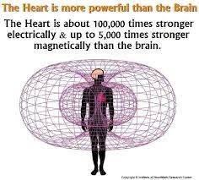
Should we follow our heart?
If your purpose is in your heart, so it makes sense of listen to it and follow it?
Notes:
1 Which is most intelligent? We think it’s the brain but – go to 2
You heart started beating before the brain was formed. Your brain is rational and logical and we all need that from time to time but society has conditioned us all to believe that is the be all, but is it? Your brain wants to keep you safe and that is good but if that is all we have it can lead to despondency and depression, but our heart focuses on where we want to go. There is a saying ‘when you are in your head you are dead to the wonder of untapped potential, magic and living your full authentic self as its only the heart that knows this. Its kind of a choice between rational brain short term acceptance v heart long-term fulfilment.

Slide 8
Your values
Personal values are the things that are important to us, the characteristics, behaviours and guiding principles that motivate us and guide our decisions.
The same value in different people can elicit different behaviours, for example if someone values success, one person may work very hard to gain success in their career, whereas someone else may take advantage of others to climb the career ladder. The difference could be that in the second example the person has never really stopped and thought about it and in the first one they have.
You could have many values but assigning more importance to some values over others. It has been shown that the values that are most important to you often guide your decision making in all aspects of your life such as career, hobbies, beliefs, social circles, self-identity amongst many other things.
Personal values may and may not correlate with a person’s behaviour. Some values may be practiced by an individual and executed in daily life. A personal value may be important to someone, but they are not implementing it in their daily life, and they would like to implement it. And an individual may have a set of personal values that is not in line with their behaviour.
When we live out of synch with our values we experience an internal conflict.
Notes:
Do the demo with hands – or say to delegates hold your hands out in front of you about 12 inches apart then imagine on one hand your fingers and thumb represent your 5 most important values – what are they. Now imagine the other hand is what you do. Then ask delegates to hold their hands together and explain that when what you do is in accordance with your chosen values that is INTEGRITY

Slide 9
Defining your values
Look at and explore times in your life when you were happiest – what were you doing, who were you with etc.
When were you most proud – why was that? Who was with you?
Identify the times when you were most fulfilled and satisfied - what need or desire was fulfilled? How and why did the experience give your life meaning? What other factors contributed to your feelings of fulfillment?
Determine your top values, based on your experiences of happiness, pride, and fulfillment - why is each experience truly important and memorable?
Use the list on the next slide of common personal values to help you get started – and aim for about 10 top values. (As you work through, you may find that some of these naturally combine. For instance, if you value philanthropy, community, and generosity, you might say that service to others is one of your top values.)
Notes:
Happiness and pleasure are different – please is a bar of chocolate or a beer, happiness is living in accordance with your values. By doing that and daily focusing on the value of gratitude happiness becomes a habit.

Slide 10
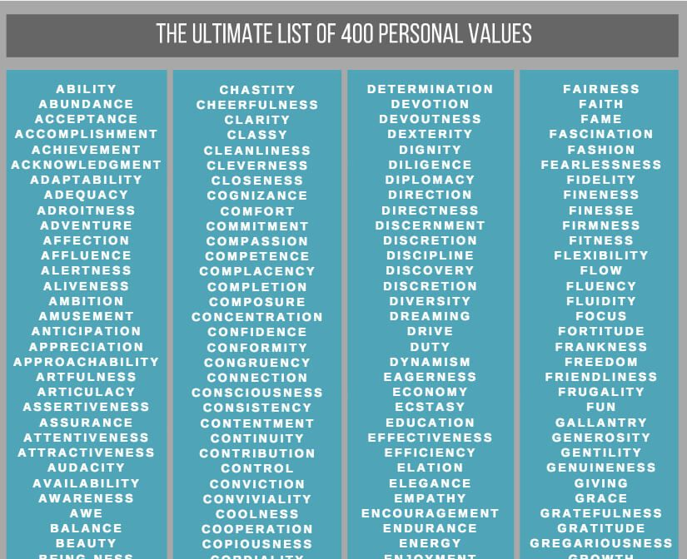
Notes:
Suggest delegates google this tonight

Slide 11
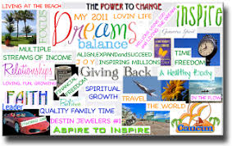
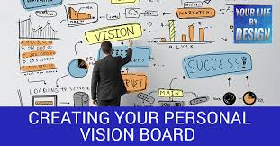
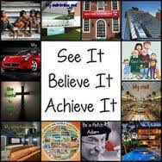
Notes:
Challenge everyone to create their own vision board over the next 30-days, maybe even take themselves off to somewhere peaceful to doit, such as the woods.

Slide 12
Your mission statement
Your mission statement defines who you are as a person and identifies your purpose, whether that’s through your work or simply in life, or indeed both. It explains how you aim to pursue that purpose, and why it matters so much to you.
Keep in short and to the point, it should define what success, greatness and excellence means to you, but be true to yourself and let it reflect your true long-term purpose and greatest passion. Don’t forget other people.
Use powerful words (maybe your values) that inspire you to take action and be the significant person you are really capable of being.
In short it should identify the big picture — the life you want to lead, the character traits you want to embody, the impact you want to have on those around you.

Slide 13
Examples of mission statement’s
“To inspire positive change through teaching and coaching.”
“To create opportunities for today's youth.”
“To encourage, engage, and equip others to believe in the possibilities.”
“To positively impact the life of every person I meet.”
“To help others live the lives they would if they only knew how.”
Tesla. “To accelerate the world's transition to sustainable energy.”
TED. “Spread ideas.”
LinkedIn. “To connect the world's professionals to make them more productive and successful.”

Slide 14
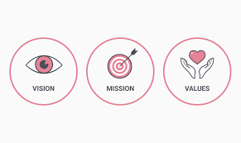
Summary
Review your vision and mission statement regularly and keep it alive, fresh and inspiring.
Once you live and breathe your vision and mission statements why not consider a family version and at work if you lead a team or department do this with your team, if you don’t lead a team maybe put it forward as a suggestion as it can drive a team towards something meaningful and gel the team together.
Whenever you need inspiration in your life your vision and mission should be the source of that.
When you have an important decision to make, are at a crossroads in your life of have a challenge to face be guided by your vision, mission and in particular your self-chosen personal values.
Notes:
You are just a thought/feeling away from changing your life.
You’ll know you’ve cracked it when you are the weathiest person you know regardless of how much money you have, you can communicate joyfully without technology, when walking across the street with someone (to help them) or to see someone is more important than travelling hundreds of miles to go on holiday and when the quality of your life is more important than the quantity of stuff.

Slide 15
Notes:
5 mins 46 how to create a vision for your life

Slide 16
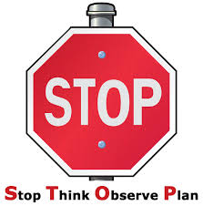
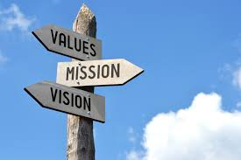
30-day challenge
Within the next 30 days allocate some quality time to create inspiring:
Then live and breathe it, be guided by it daily and then review it regularly.

Slide 17
Action plan
As a result of todays masterclass what will you:
START DOING
STOP DOING
CONTINUE DOING
Notes:
54321 decide/do

Slide 18
Further opportunities
Personal Resilience facebook group.
Ignite: Find Your Passion, Live Your Purpose & Re-Write Your Future
https://www.facebook.com/groups/216645969611627/?ref=share
Personal resilience online programme;
https://ignitepd.thinkific.com/courses/rock-solid-resilience?fbclid=IwAR1dt6Mw_cw8EqDPPJA3bpynSEVhFxwfMWBZpPKO1IZq04ZvxHHc0ty8KRc
bernard.genge@gmail.com

Slide 19
Further information/watching
https://www.youtube.com/watch?v=4vl6wCiUZYc 10 minutes
Best Ted Talks 2015 - Draw your future - Take control of your life

