Slide 1
Dealing with anxieties and worries
With
Bernard Genge

Slide 2
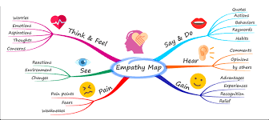
Aims and desired outcomes
Aims – To know what anxiety is and how to control anxiety, worries and concerns.
Outcomes – To have in place useable strategies to control anxiety and process concerns.
As we go through this masterclass decide what you will START, STOP & CONTINUE doing
Notes:
On these masterclasses as we all learn in different ways there will be spoken words from me, written words on the ppt, pictures, quotes and for those that are very visual youtube clips to watch afterward. The key to learning however is doing and teaching – 54321 DD
Zoom – video/mute mic when I’m presenting. Please use the chat box, when you open it you can send a message to the whole group or a specific person. Please use it to ask questions, share thoughts, experiences or even to elaborate on points made in the masterclass – ones that perhaps really resonated with you and why.

Slide 3
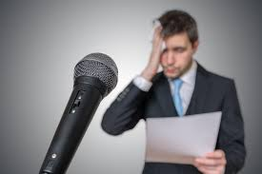
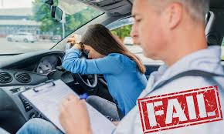
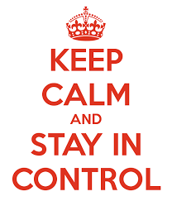
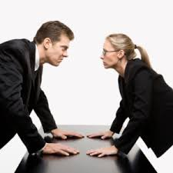
Set scene
Anxiety is a feeling of unease, expressed in ways such as worry, panic, phobias or fear, and it can be mild or severe. Let’s be realistic, we all have feelings of varying degrees of anxiety at some point in our life.
Notes:
During times like these, feeling anxious can be perfectly normal.
But some people find it hard to control their worries. Their feelings of anxiety are more constant and can often affect their daily lives.
They key word here is ‘control’, most of us can cope with mild anxiety, but can we control more severe bouts of anxiety?
On a score of 0 – 10 how would you rate your levels of anxiety over the last year and STOP think about it and observe how it made you feel – today we will plan to understand it more and have strategies in place to manage it.

Slide 4
What is GAD?
GAD (Generalised anxiety disorder) is a common anxiety disorder that involves constant and chronic worrying, nervousness, and tension. Unlike a phobia, where your fear is connected to a specific thing or situation, the anxiety of GAD is diffused—a general feeling of dread or unease that colours your whole life. This anxiety is less intense than a panic attack, but much longer lasting, making normal life difficult and relaxation impossible.
Generalised anxiety disorder is mentally and physically exhausting. It drains your energy, interferes with sleep, and wears your body out. If you have GAD you may worry about the same things that other people do, but you take these worries to a new level. A colleague’s careless comment; a phone call to a friend that isn’t immediately returned becomes anxiety that the relationship is in trouble. Sometimes just the thought of getting through the day produces anxiety. You go about your activities filled with exaggerated worry and tension, even when there is little or nothing to provoke them.
Whether you realise that your anxiety is more intense than the situation calls for, or believe that your worrying protects you in some way, the end result is the same. You can’t turn off your anxious thoughts. They keep running through your head, on endless repeat. But no matter how overwhelming things seem now, you can break free from chronic worrying, learn to calm your anxious mind, and regain your sense of hope.
Notes:
The difference between “normal” worrying and generalized anxiety disorder is that the worrying involved in GAD is:
Excessive.
Intrusive.
Persistent.
Disruptive.

Slide 5
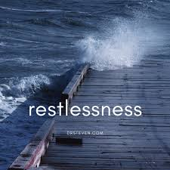
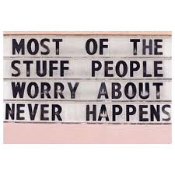
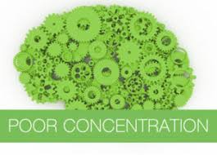
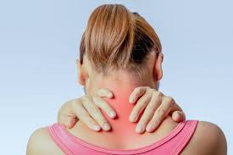
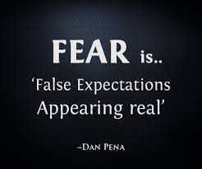
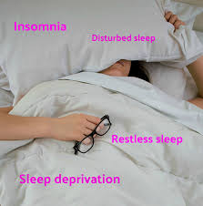
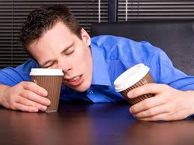
Characteristics of anxiety
Notes:
Mention fight or flight Dr Hans Seyle as anxiety can trigger it, Fight/flight lowers immune system. In the short term Ok (increases immunity) long term bad decreases immunity and this is especially relevant for me as recent research shows us men are more susceptible to viruses, cancer and other diseases because females have different genetics and estrogen which increases immunity.
Stress hormones can alter the behavior of some neutrophils, potentially causing dormant cancer cells to reawaken, a study suggests and when we allow our anxiety to trigger this fight or flight the harmful stress hormones adrenaline and cortisol are released into our system to prepare us – the trouble is the cause of our anxiety is more often a perception of a threat rather than a real threat. In the short term, this increases your pulse and breathing rate, so your brain can get more oxygen. This prepares you to respond appropriately to an intense situation. Your immune system may even get a brief boost. With occasional stress, your body returns to normal functioning when the stress passes.
But if you repeatedly feel anxious and stressed or it lasts a long time, your body never gets the signal to return to normal functioning. This can weaken your immune system, leaving you more vulnerable to viral infections and frequent illnesses. Also, your regular vaccines may not work as well if you have anxiety.
Anxiety causes rapid, shallow breathing. If you have chronic obstructive pulmonary disease (COPD), you may be at an increased risk of hospitalization from anxiety-related complications. Anxiety can also make asthma symptoms worse.
Anxiety disorders can cause rapid heart rate, palpitations, and chest pain. You may also be at an increased risk of high blood pressure and heart disease. If you already have heart disease, anxiety disorders may raise the risk of coronary events. This is just a taste of the physical characteristics, anxiety also affects our digestive system which shuts down when in fight or flight and psychological/emotional disorders.
A zebra doesn’t suffer from ulcers or chronic stress – when it is chased by a lion it goes into flight and if it survives and another zebra has been succomed to the lion it goes back to eating grass and surviving.
Trapped emotion need a lot of energy to suppress them which can cause fatigue and anxiety

Slide 6
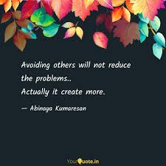
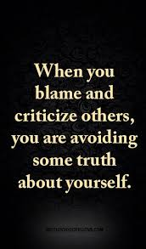
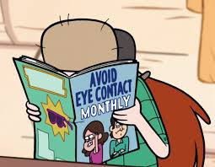
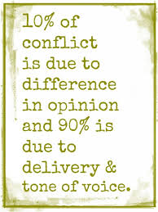
How does it affect us with other people – social anxiety
Notes:
3 – talk about communication pie chart – 7% words, 38% tone of voice, 55% body language – when we have anxiety we have body language and tone of voice that repels people so be aware of how you say things and your body language. Be aware of your preferred conflict style (avoider, accommodate, forcer, collaborator, comprimiser) – this can change when you are stressed or anxious and we can become more of a ‘forcer’ – aggressive, defensive etc.
poor or no communication with others
Arriving late to meetings etc. so frustrating other people

Slide 7
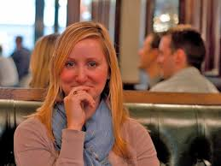
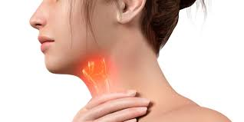
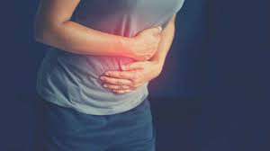
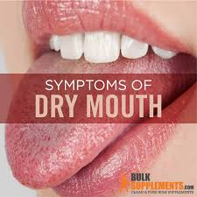
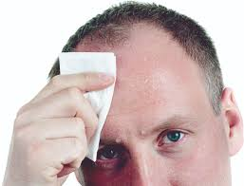
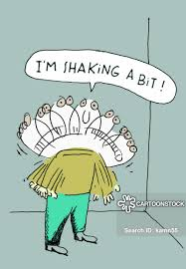
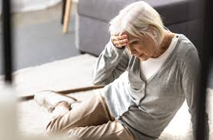
Physical symptoms
Notes:
7
7
4 difficulty breathing
Its worth asking if you experience any of these what is the longer-term chronic physical, emotional and psychological impact of not taking control of anxiety

Slide 8
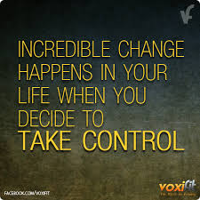
Notes:
Ask everyone to make that all important decision to take control of stress and anxiety in their life – it’s the silent killer and left unchecked it can lead to panic attacks, a sense of doom/depression, headaches, breathing/stomach problems and extreme fatigue to name but a few. It can be a part of PTSD, obsessive compulsive disorder and phobias. It can lead to high blood pressure and heart attacks, IBS, weaken your immune system making you more vulnerable to viruses and vaccines may not work as well. Its big ticket so make that decision today.

Slide 9
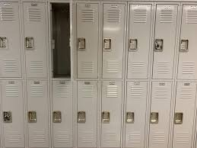
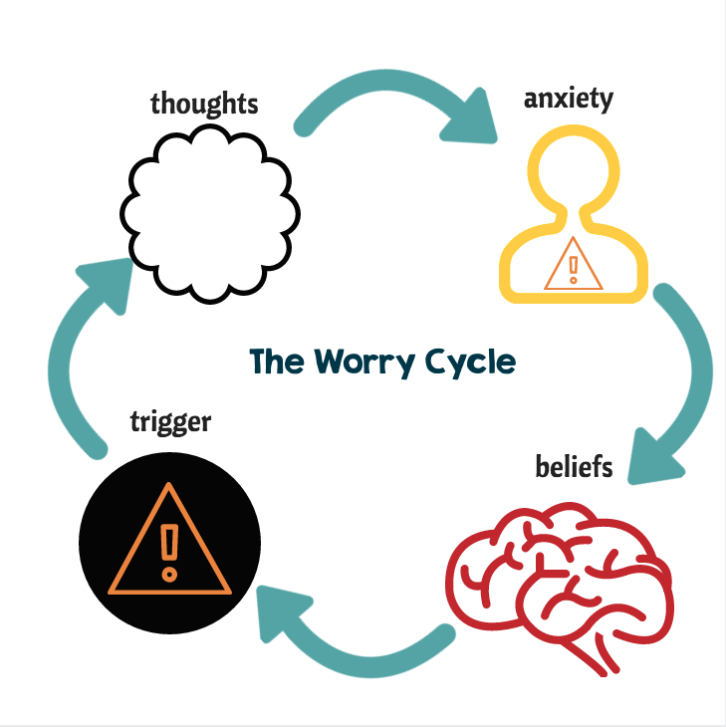
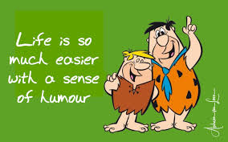
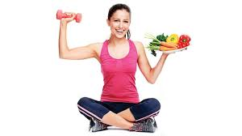
Strategies for dealing with anxiety
Notes:
9
9
4 – lifestyle – diet, water, exercise, sleep/rest & reducing toxins as these all have an impact on immunity and your ability to cognitively deal with anxiety I will mention this again later because its so important and a low hanging fruit quick win. Workouts on an exercise bike is proven to improve mood as blood flows (oxygen and proteins) to the part of the brain that improves mood. It works better when you are exercising the brain at the same time by focusing on something else – it increases by 29% when activating the brain during exercise and opening and closing the eyes – Get a exercise bike and something to focus on – podcast etc. Work the brain and body in tandem!
What about social media – research says passive use = 33% increase risk of anxiety whereas active = 15 decrease. It seems that increasing social media over 3 hours a day increases risk of depression by 80%.

Slide 10
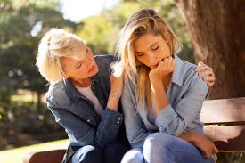
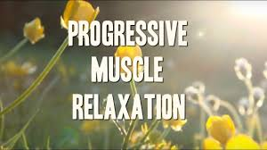
Strategies for dealing with anxiety
Notes:
10
10
2 & 3 – support network. There is something called social prescribing which is like a phone buddy scheme or more specific where specific support is given such as financial advice. There are also peer support groups – WATCH. But it is about quality not quantity of the relationships – make them meaningful. Social prescribing reduces access to the NHS by 30%

Slide 11
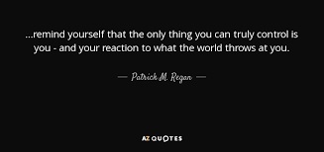
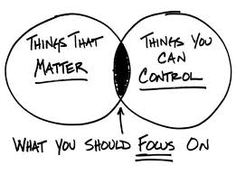
Strategies for dealing with anxiety
So:
Use your self-awareness to identify your fears/ things that don’t matter or you can’t control
Decide to be decisive, especially with problem solving and dealing with issues
Manage your stress – look up, smile and focus on what makes you happy
Practice positive affirmations and visualisation
Try gradual exposure therapy – if it’s the dark start with pictures of the dark
And most importantly deal with the things you are concerned about
Notes:
There's a brutal truth in life that some people either refuse to accept or find it difficult to accept: You have no control over many of the things that happen in your life.
Some people who resist this truth become control freaks. They think if they can gain enough control over other people and the situation’s they find themselves in, they can prevent bad things from happening.
Others know they can't prevent bad things from happening, but they worry about them anyway. They fret about everything from natural disasters to deadly diseases. Their worries keep them occupied, but ultimately, they waste their time and energy, because worrying doesn't do any good.
5th bullet point gradual exposure therapy – use the example of going back to work, familiarize yourself with policies/processes, make contact with colleagues etc.

Slide 12
Strategies for dealing with anxiety
Make friends/alliance with anxiety, don’t fight it or
Regard it as an enemy
Listen to it, learn and deal with it, so you can
Move forward and function with it.
4 L’s
Look – within yourself
Listen – to your voice of anxiety
Love it – use something like EFT
Let go
5 A’s
Acknowledge it
Accept it
Address it
Affirm it
Alienate it
Notes:
1 make the decision
4 – pen – just let go – do this as an anchoring exercise for when you are holding on to worries you need to just let go of – hold the pen as in the photograph but not tightly then focus on the worry you have then when it feels intense with the other hand squeeze a finger, your thumb or pinch a knuckle then open the hand and let go physically of the pen and psychologically of that worry. After this masterclass do this 5 times to really anchor that feeling of letting go inside you.

Slide 13
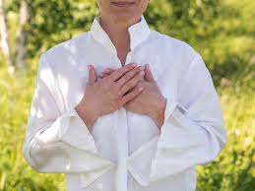
Strategies for dealing with anxiety
Our heart communicates with our brain to influence emotions/awareness.
Our heart controls fight, flight or relaxation.
The brain receives information from the senses and if that is a threat (real or imagined) it tells the heart to produce adrenaline and other chemicals to fight or flight.
Your heart can override this!
By shifting attention from head to heart your body relaxes. This is what you do:
Put hand on heart. Take 5 deep, slow, gentle breaths whilst focusing on your hand on your heart
Recall a time you felt relaxed, in control and good –focus on it
Ask your heart how you can take great care of yourself
Listen to your intuition which is where the answer lies
Notes:
Read this before doing the exercise - Being more in tune with your heart (aware of its sensation – introsection) and connecting heart mind is based on new ground-breaking research and a good start is being able to count your heart beat which communicates to your brain that everything is Ok because its saying ‘I’m in control’ and in times of anxiety you can count it down!
After doing the exercise mention that Yoga can also help with anxiety.

Slide 14
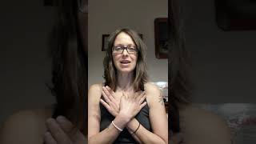
Strategies for dealing with anxiety - the butterfly hug
An immediate anxiety-reducing technique, and is something you can do right now to decrease anxiety and lower your heart rate. It can be done wherever you are comfortable, standing, sitting in a chair or lying down, eyes open or closed.
Cross your hands across your chest, with your middle fingers resting on your collarbones. Hand and fingers should be as vertical as possible, so that the fingers point towards the neck and not towards the arms
Raise your elbows to create your butterfly wings
Slowly tap hands on your chest, alternating left and right
While tapping, breathe in through your nose and exhale through your nose until you start to feel some relief.
Notes:
The “Butterfly Hug”, or “Hug of self love” originated with Lucy Artigas, while working in Acapulco with survivors of hurricane Paulina in 1997. Done as a self soothing approach when under stress.
Aim to breathe slowly and deeply (abdominal breathing) while you observe what is going on through your mind and body such as thoughts, images, sounds, smells, feelings without changing, pushing your thoughts away or judging
You can pretend as though what you are observing is like clouds passing by
Stop when you feel in your body that it has had enough and lower your hands to your thighs
Some approaches encourage you to create/”install” a safe place; a place where you feel safe or calm and think about what images, colours, sounds you see in the safe place
Whilst it isn’t prescriptive about the length of time, this can be done anywhere anytime, and might last just 3-4 minutes, so not a long exercise
You could also wrap your arms around yourself, so that each hand touches the opposite upper arm or shoulder. Then move your hands like the wings of a butterfly, to tap your arms/shoulders in an alternating rhythm. (as an alternative, you can just tap your knees.)
This is what one person said who uses it “f I'm triggered I use the butterfly hug and it's amazing after a bad dream to use as soon as I wake. It stops the flashbacks of the dream coming up all day and dispels the emotional overwhelm after a nightmare”.

Slide 15
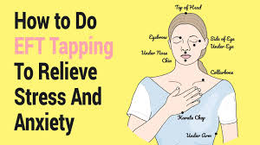
Notes:
On our fb page Ignite

Slide 16
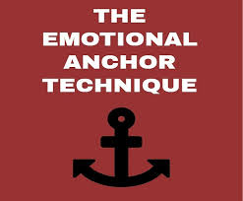
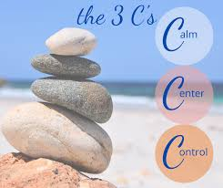
Drop your ‘emotional anchor’
Remember a time when you felt really calm and return to it using all your senses
Make the colours richer, sounds more crisp, feelings stronger, smells and taste sweeter
Squeeze the middle finger and thumb of your right hand when this feeling of calm is most intense – to make an association with this calmness
4. Do this until you feel deep sense of peace and calm
5. Do this several times – when you can just do it and feel calm you’ve anchored this feeling of calmness
6. Now think of something that increases your anxiety (public speaking etc.) then do this sequence to feel calm about that talk (or whatever it is)
7. You can even imagine a challenge such as a difficult question in that talk and handling it confidently
8. Practice makes perfect
Notes:
You can do this exercise with the things that cause the greatest stress in your life – identify the 5 greatest stressors in your life and do this with each one in turn.

Slide 17
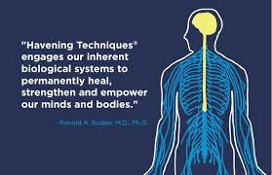
Notes:
The 'havening' technique is a very powerful technique for stress, overwhelming emotions or mental blocks. It is based on research, and with a group of volunteers nearly all of them were able to boost their self-esteem, concentrate better, eliminate worry and let go of disturbing thoughts. Plus, nearly all of them were still benefitting from those changes two months later. Its been used successfully for depression and anxiety.
Dr. Ronald Ruden said that the anecdotal evidence around the technique is "so beyond clinically significant that it is almost not necessary to do these studies.“
I can do another masterclass on this subject

Slide 18
Identifying what you can influence and how
No control concerns Accept and ignore them | Indirect control concerns Who will you influence and how? | Direct control concerns What action will you take?
Score each concern between 0 - 10
Notes:
To mange over-worrying allocate 15 minutes every day as the ‘worry period’, as worries come up during the day write them down then during the ‘worry period’ give them attention and deal with them. For the No Control concerns/worries you can do the pen exercise and the others deal with them.

Slide 19
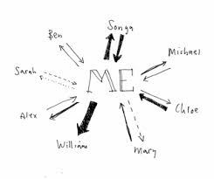
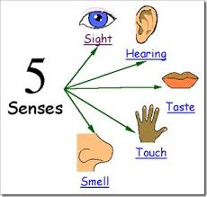
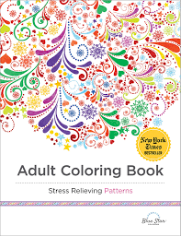
Over-worrying
Human beings have the ability to help or hurt. Know the ones who will hurt and avoid them and the ones who will help and gravitate towards them
Notes:
1 Have the courage to reach out to your support network
4 Learn to calm down quickly – count to 10, take a deep breath, make a fist and then relax it – break the cycle. Meditation slows down those brain waves I mentioned earlier and opens the door between your conscious and unconscious mind = creativity, relaxed mind etc. Meditate on thoughts of being calm, relaxed, in control of the things you can do something about and been happy and fulfilled. Visualise yourself on a sandy shore walking with the sand between your toes. Meditation is a very cheap way of improving your sleep. Meditation is also really good for re programming our fight or flight stress response by meditation ourselves been in control of situations, visualizing it, using positive self talk and when we feel in the greatest control anchoring that feeling.
6 Use your senses relaxing sights, smells, sound, taste, movement, touch.
7 Adopt anxiety-busting habits such as a healthy, balanced lifestyle plays a big role in keeping the symptoms of GAD at bay. In addition to regular exercise and relaxation, water, reduce toxin intake including alcohol & caffeine. During lockdown 50% of people turned to unhealthy food that actually made their anxiety worst! Probiotics in one study was shown to improve mood – use with other things if you do. In the study the placebo group showed a 20% increase in mood but the probiotic group had a 50% increase. They were also known to reduce stress chemicals. Good quality sleep increases good psychological wellbeing Consider a weighted blanket – good for anxiety.
8 –adult coluring book is good for anxiety and over-worrying

Slide 20
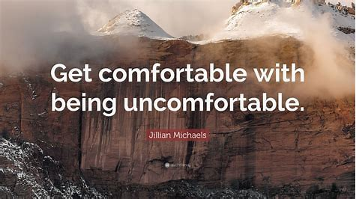
Notes:
You will accomplish a lot more. The goal is to be able to do what you don't want to do or things that make you uncomfortable.
Worriers tend to avoid new things and situations that make them uncomfortable, such as parties or public speaking engagements. The preemptive worry helps them avoid discomfort, but if you force yourself to do the very things that make you uncomfortable, you will rely less on worry as a coping strategy.
Make a commitment to every day stretch your comfort zone and do something you didn’t do yesterday, this will help prevent us worrying about things we can’t control which leads to learned helplessness

Slide 21
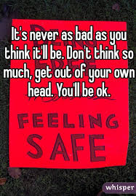
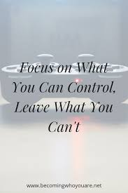
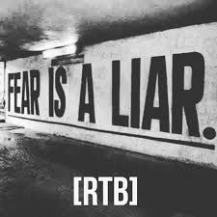
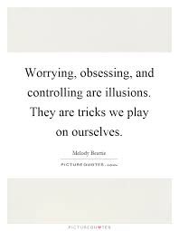
Always remember
Notes:
1 – take control of your thoughts – STOP
2 – three types of control – direct, indirect and no control
3 – False expectation/evidence that appears real. Face everything and rise

Slide 22
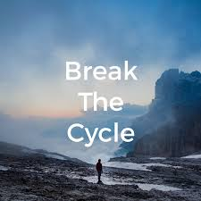
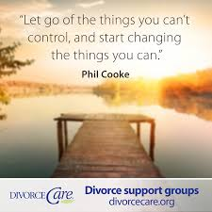
30-day challenge

Slide 23
Action plan
As a result of todays masterclass what will you:
START DOING
STOP DOING
CONTINUE DOING
54321 Decide/do
Notes:
Mind map

Slide 24
Further opportunities
Personal Resilience facebook group.
Ignite: Find Your Passion, Live Your Purpose & Re-Write Your Future
https://www.facebook.com/groups/216645969611627/?ref=share
bernard.genge@gmail.com

Slide 25
Further information/watching
https://www.youtube.com/watch?v=jryCoo0BrRk
Rethinking anxiety: Learning to face fear | Dawn Huebner | TEDxAmoskeagMillyardWomen 18 minutes
We are hard-wired to shrink away from the things that scare us – to fight, flee or freeze in the face of danger. That’s a good thing, but anxiety is about perceived danger, which is different from actual danger. When we act based solely on nervous feelings, our worlds can become very small. Our desperate attempt to avoid discomfort and uncertainty fuels anxiety, and avoidance locks it in place. Yet we can take back control. We can learn to face our fears rather than running from them. Dr. Dawn Huebner believes we can all be taught to overcome fear and anxiety. In this engaging talk she explains how anyone, at any age, can conquer debilitating fear. A clinical psychologist in private practice, she treats children with a variety of emotional, behavioral and developmental concerns. Huebner is the author of “The What To Do Guides for Kids” series, which not only reflect her beliefs about empowerment, but also provide practical advice for parents and children. Her personal journey as a parent, however, led Huebner on a quest to find ways of using cognitive-behavioral therapy as an approach. With simple language and humor, she presents sophisticated concepts in a way easily understood by everyone. These concepts, in book form, have been translated and sold in 12 different languages worldwide.

Slide 26
Further information/watching
https://www.youtube.com/watch?v=zTuX_ShUrw0
Rewiring the Anxious Brain - Neuroplasticity and the Anxiety Cycle 14 mins Emma McAdam
You can rewire your brain to be less anxious through a simple- but not easy process. Understanding the Anxiety Cycle, and how avoidance causes anxiety to spiral out of control, unlocks the key to learning how to tone down anxiety and rewire those neural pathways to feel safe and secure. In this video, I teach three essential things you need to understand about anxiety, three steps to facing and overcoming anxiety, and how the brain can actually change (rewire) it's structure, function, and chemistry when you change how you think and act.
https://foodandmoodcentre.com.au/2020/09/lactobacillus-and-anxiety-whats-the-link/ Lactobacillus and anxiety: what’s the link?

Slide 27
Further information/watching
https://www.youtube.com/watch?v=WWloIAQpMcQ
How to cope with anxiety | Olivia Remes | TEDxUHasselt 15 minutes
Anxiety is one of most prevalent mental health disorders, with 1 out of 14 people around the world being likely affected. Leading up to conditions such as depression, increased risk for suicide, disability and requirement of high health services, very few people who often need treatment actually receive it. In her talk “How to cope with anxiety”, Olivia Remes of the University of Cambridge will share her vision on anxiety and will unravel ways to treat and manage this health disorder. Arguing that treatments such as psychotherapy and medication exist and often result in poor outcome and high rates of relapses, she will emphasise the importance of harnessing strength in ourselves as we modify our problem-coping mechanisms. Olivia will stress that by allowing ourselves to believe that what happens in life is comprehensive, meaningful, and manageable, one can significantly improve their risk of developing anxiety disorders. Anxiety is one of most prevalent mental health disorders, with 1 out of 14 people around the world being likely affected. Leading up to conditions such as depression, increased risk for suicide, disability and requirement of high health services, very few people who often need treatment actually receive it. In her talk “How to cope with anxiety”, Olivia Remes of the University of Cambridge will share her vision on anxiety and will unravel ways to treat and manage this health disorder. Arguing that treatments such as psychotherapy and medication exist and often result in poor outcome and high rates of relapses, she will emphasise the importance of harnessing strength in ourselves as we modify our problem-coping mechanisms. At TEDxUHasselt 2017, Olivia will stress that by allowing ourselves to believe that what happens in life is comprehensive, meaningful, and manageable, one can significantly improve their risk of developing anxiety disorders.

