Slide 1
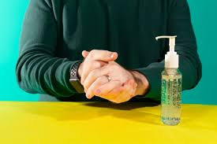
Guidance for people managing health conditions during social distancing (RCOT 2020)*
Everyone’s lives and daily routines have been affected by social distancing and the COVID-19 pandemic. More than ever we need to be looking after ourselves and for many, this includes managing health conditions.
Here are some tips to help you to manage your health conditions during social distancing or self-isolation from the Royal College of Occupational Therapists (RCOT).
*www.rcot.co.uk/staying-well-when-social-distancing

Slide 2
Use digital resources
The NHS App Library* has lots of online tools for managing a range of physical and mental health conditions, most of which are free to use.
Many health charities have self-management information on their websites suitable for specific health conditions.
Make sure that you only take advice from trustworthy sources. If your health needs change, or you become unwell, contact your GP or get NHS advice: 111
*Right click and choose open hyperlink to view NHS Apps Library or copy and paste this address into a search engine.www.nhs.uk/apps-library/

Slide 3
2) Set goals
Goals give us a sense of purpose and mark our progress. They are something to aim for, and can help motivate us.
As you work towards your goal, listen to your body and how you are feeling. Be prepared to be flexible; you may need to adapt your goals and that’s okay.
Consider keeping a diary of what you have been able to do and your achievements – this can be a great reminder of your progress, especially on not so good days.

Slide 4
3) Pace your routine
If you experience fatigue, breathlessness or chronic pain, it can help to spread your activities throughout the day or week, rather than trying to complete everything in one go.
Start by making a list of the tasks and activities you both need and would like to do. Make sure you include activities you enjoy; these shouldn’t be sacrificed for activities that you need to do. Having a balance is very important.
Then break your tasks and activities into small steps, plan when you can do them and give yourself plenty of time. Pace yourself and take regular breaks. Remember, you can be flexible with what you do and when.

Slide 5
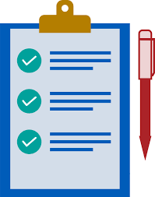
4) Problem Solve
Look at your daily routine and see where you may have problems. Consider each task separately and see if there is anything that you could stop doing, or do differently to make it easier. Identify any triggers that make you feel worse and look for ways to reduce or manage them.

Slide 6
5) Take care of yourself
Eat and drink healthily with plenty of fruit, vegetables and water. Even if you are not hungry, have a little - it will help boost your immune system and energy levels.

Slide 7
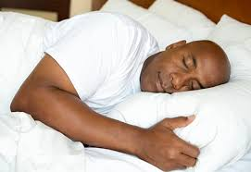
6) Get enough sleep
Sleep is important in managing lots of health symptoms. If you’re struggling to sleep, there are simple steps you can try to improve this. Such as, cutting out alcohol and caffeine, going to bed at a regular time, using blackout curtains and practising relaxation techniques.

Slide 8
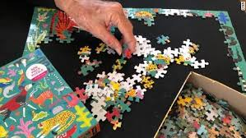
7) Take time to relax
Relaxation can help with managing symptoms like fatigue, breathlessness and chronic pain. The NHS App Library has a number of relaxation tools, including breathing and mindfulness.
Allow yourself time to participate in relaxing activities that you enjoy, such as reading, listening to music, arts and crafts, and puzzles.

Slide 9
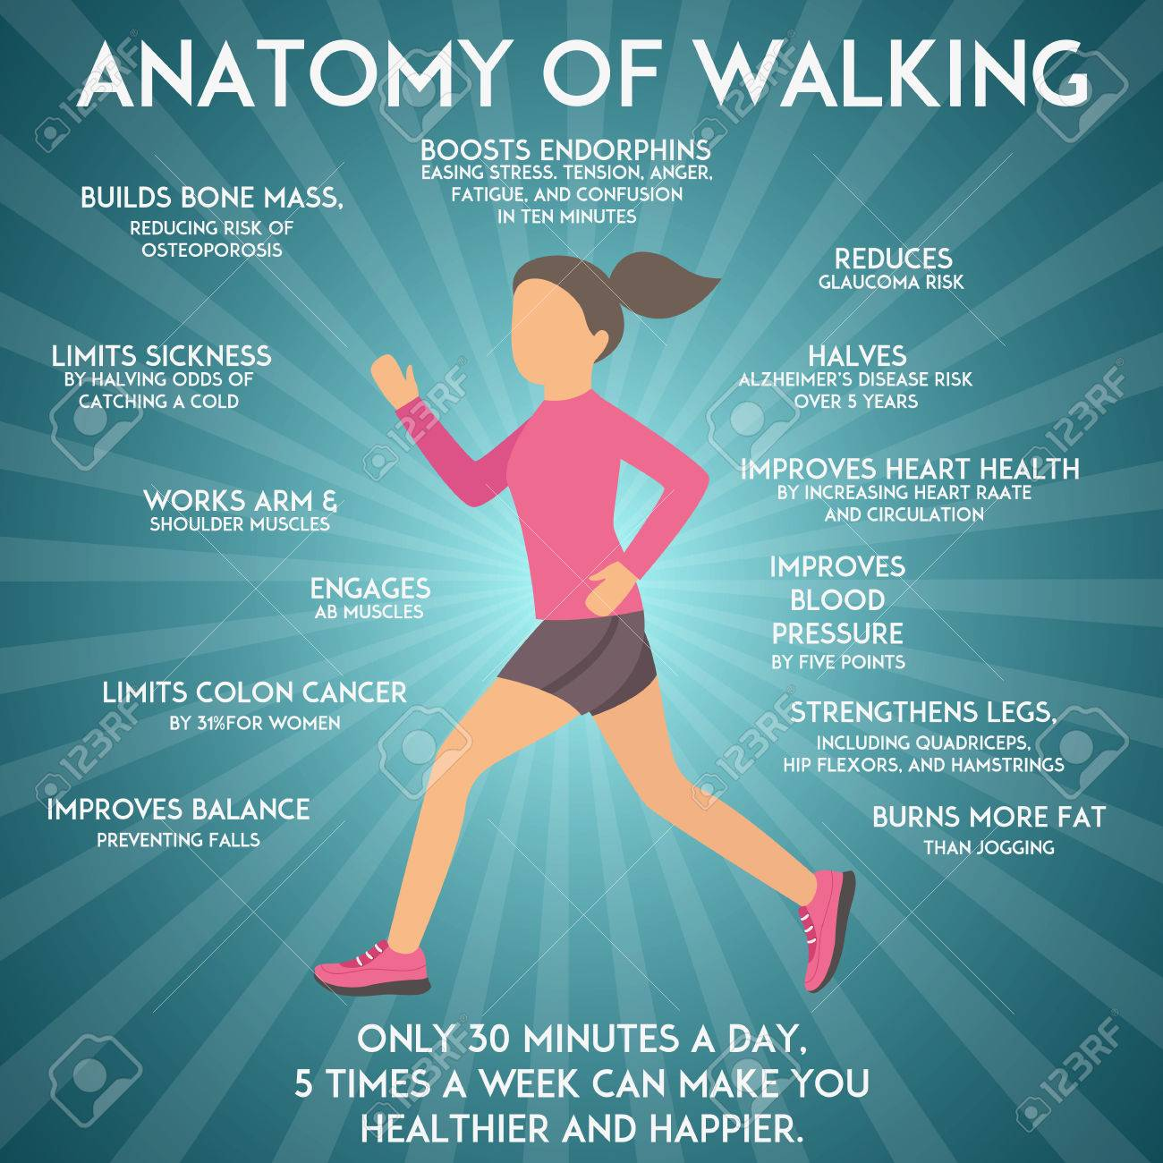
8) Keep moving
Exercise is good for managing a wide range of physical and mental health conditions, but it is important to pace yourself and stick to activities that are suitable for your particular condition. The NHS Fitness Studio has a range of videos that can be followed at home:
https://www.nhs.uk/conditions/nhs-fitness- studio/
Keeping mobile is good for your muscles and joints. Set yourself a timer to remind you to move every 20 minutes.

Slide 10
9) Manage your home
Organise your home so the items you use most are within easy reach and to reduce the demands on your body. Make your home safer by decluttering and removing loose rugs and items which may cause you to trip or fall.
Make adaptations that reduce effort and risk. This could be rearranging furniture, changing the height of your chair or bed, or installing bathing aids. The Disabled Living Foundation provides lots of useful information about equipment and adaptations.

Slide 11
10) Seek support
This is a challenging time for everyone, so ask for help if you need it. Talk to friends and family members and let them know how they can help you. This might include asking them to let you do things for yourself, as keeping active is very important for managing lots of health conditions.
Many health charities offer support for specific health conditions by telephone and through online groups and resources. Look on their websites for more information – remember to only take advice from trustworthy sources.
Organisations like Samaritans and The Silver Line also offer telephone help and advice for people who are having difficulty in any area of their life.

