Slide 1
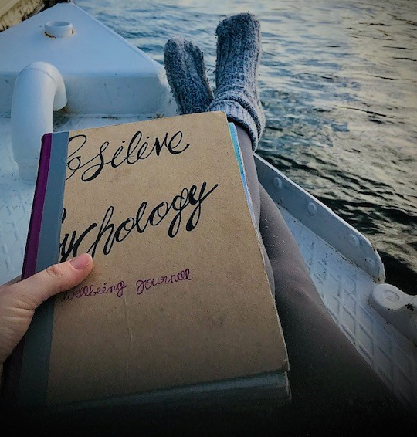
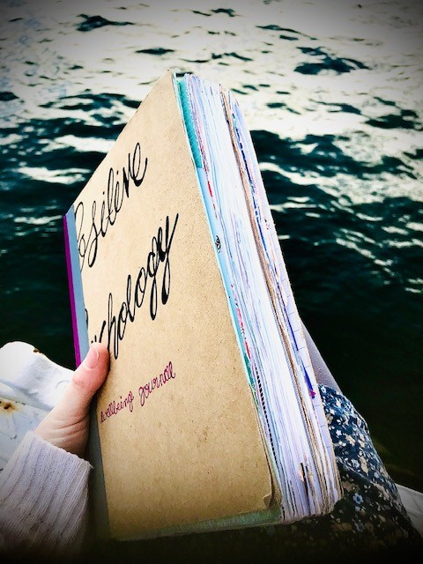
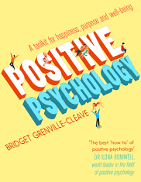
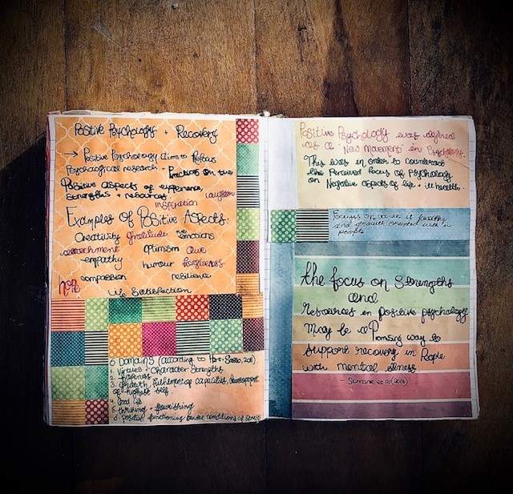
Welcome to
Creating a Wellbeing Journal

Slide 2
Creating a Wellbeing Journal:
Webinar Structure
Introduction to this Webinar: Common Questions
The What of Positive Psychology
The Why of Positive Psychology
The How of Creating a Wellbeing Journal using Positive Psychology
First Topic: Emotions

Slide 3
Q: What is a webinar?
A: A webinar is essentially an online event where a speaker, delivers a presentation to an audience. It is like a virtual Recovery College course.

Slide 4
A: Although you can’t pause the
Webinar, it is being recorded, so you can do what you’ve got to do and then watch the recording later.
Q: What if I need to pause the Webinar

Slide 5
Q: Do I have to turn my webcam on?
A: No. You can see me, but I can’t see you, and no one else can either.

Slide 6
A: There won’t be any scheduled breaks, however, when we stop to do the activities, you can take a break if you need to.
Q: Will there be a break during the webinar?

Slide 7
A: Yes, you do not have to stay for the entire
session if you don’t want to – you can watch this
as a recording later and do the activities in your own time.
Q: Can I leave the webinar whenever I want to?

Slide 8
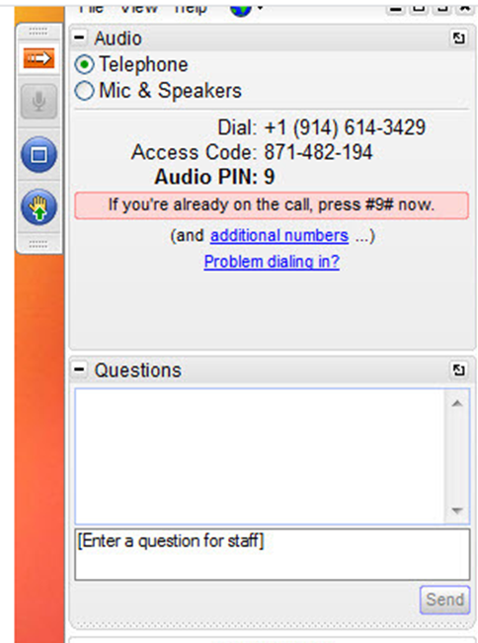
Q: Can I ask a
question,
or make a comment?
A: You can ask a question or comment at any time, but only the speaker will be able to see the question/comment
and respond.

Slide 9
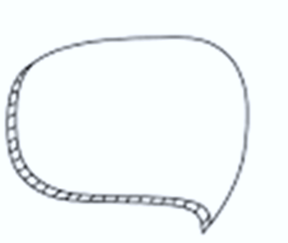
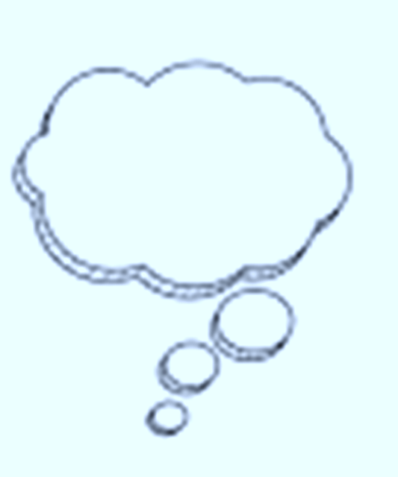
Positive Psychology
What is Positive Psychology?
What is a Wellbeing Journal?
Why Positive Psychology?
Why keep one?

Slide 10
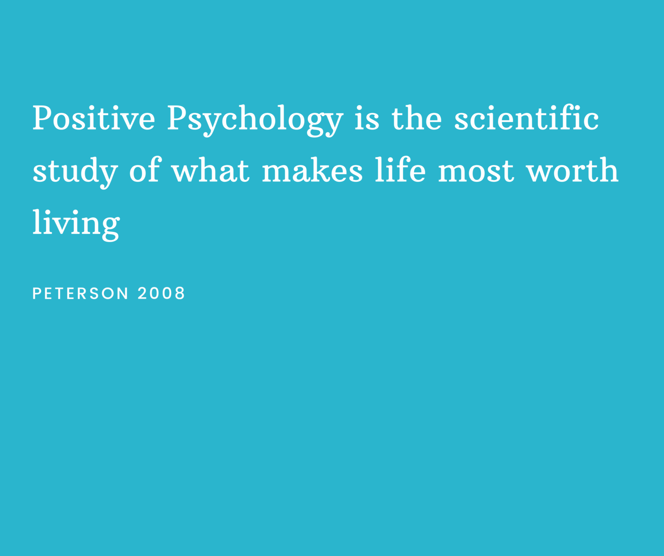

Slide 11
Positive Psychology is a scientific approach to studying human thoughts, feelings and behaviour, with a focus on STRENGTHS rather than WEAKNESSES. – Peterson 2008
Positive Psychology
focuses on the POSITIVE events
and influences in life.
– Peterson 2008

Slide 12
Positive Psychology Definition of Happy
Hedonic
Happiness is subjective; increased pleasure and decreased pain leads to happiness.
Pleasure, comfort, gratitude, hope, and inspiration
are examples of positive emotions that increase our happiness and move us to flourish.
Eudemonic
Happiness comes from the pursuit of virtue and excellence;
flourishing, and the realization of potential leads to happiness.
(Ryan & Deci, 2001)

Slide 13
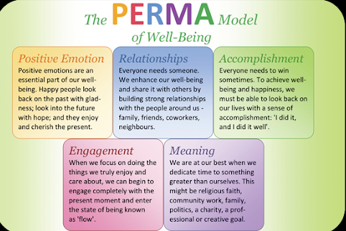
Martin Seligman, Flourish, 2011

Slide 14
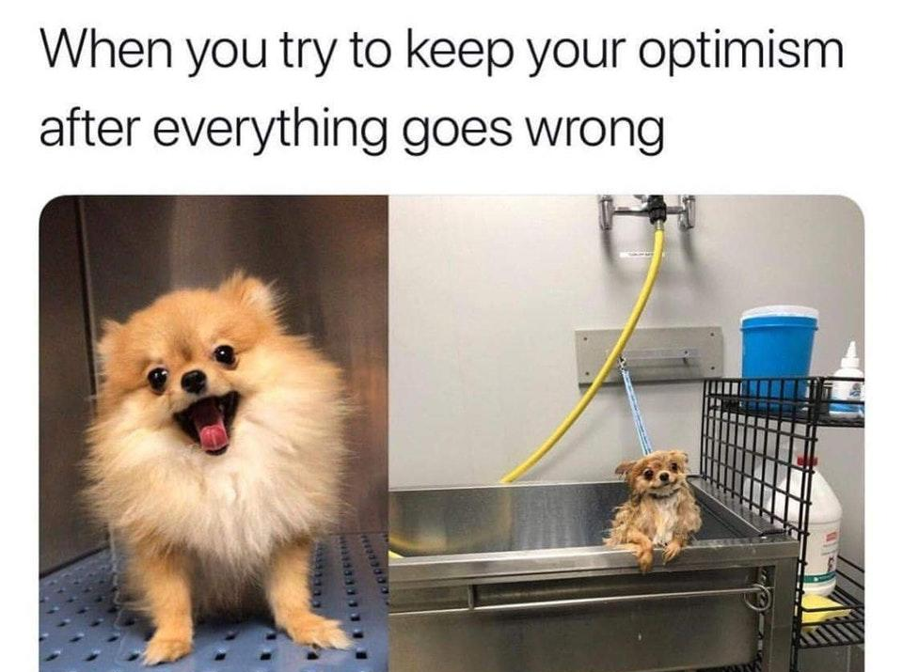

Slide 15
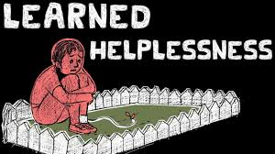
Learned Helplessness vs. Learned Optimism
When people feel like they have no control over what happens, they tend to simply give up and accept their fate.
If we can learn helplessness, it is possible to learn optimism

Slide 16
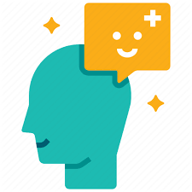
Good News…
positive qualities such as optimism can be learned and practiced and cultivated for health and wellbeing
Martin Seligman, 1991

Slide 17
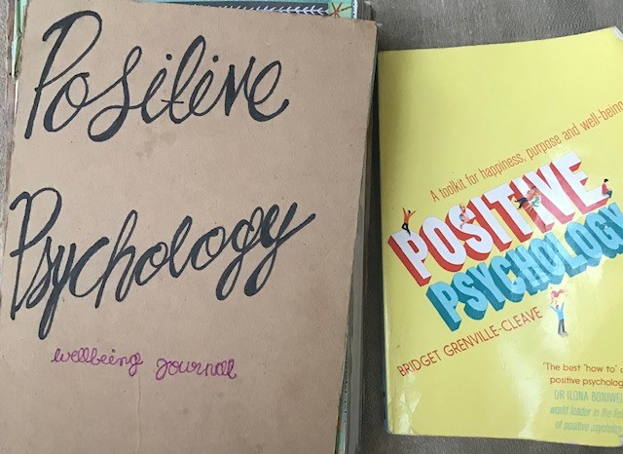
Creating a Wellbeing Journal
Using the book Positive Psychology: A toolkit for happiness, purpose and well-being, by Bridget Grenville-Cleave,
as a guide

Slide 18
Always keep your journal close at hand, that way you can turn to it when you need it most…
Notice how engaging with your journal helps you to breathe easier, how it opens your heart and broadens your mind. Soon you’ll be thinking more expansively and compassionately.
Why a
Wellbeing
Journal?
- Barbara Fredrickson
A Wellbeing Journal helps to capture and store these positive emotions, sort of like a scrap book of a favourite holiday, or a beloved photo album.

Slide 19
You Will Need…
1.
Notebook/journal/scrapbook/paper/computer/smartphone
2..
Pens/pencil
3.
Items to decorate journal with: washi tape, craft paper, scissors, glue etc.

Slide 20
Inside cover
of my Wellbeing Journal

Slide 21
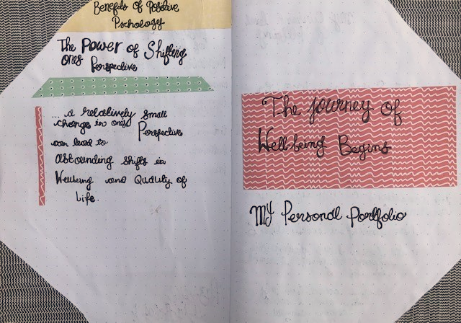
The title page of my Wellbeing Journal; also called my “Personal Portfolio”

Slide 22
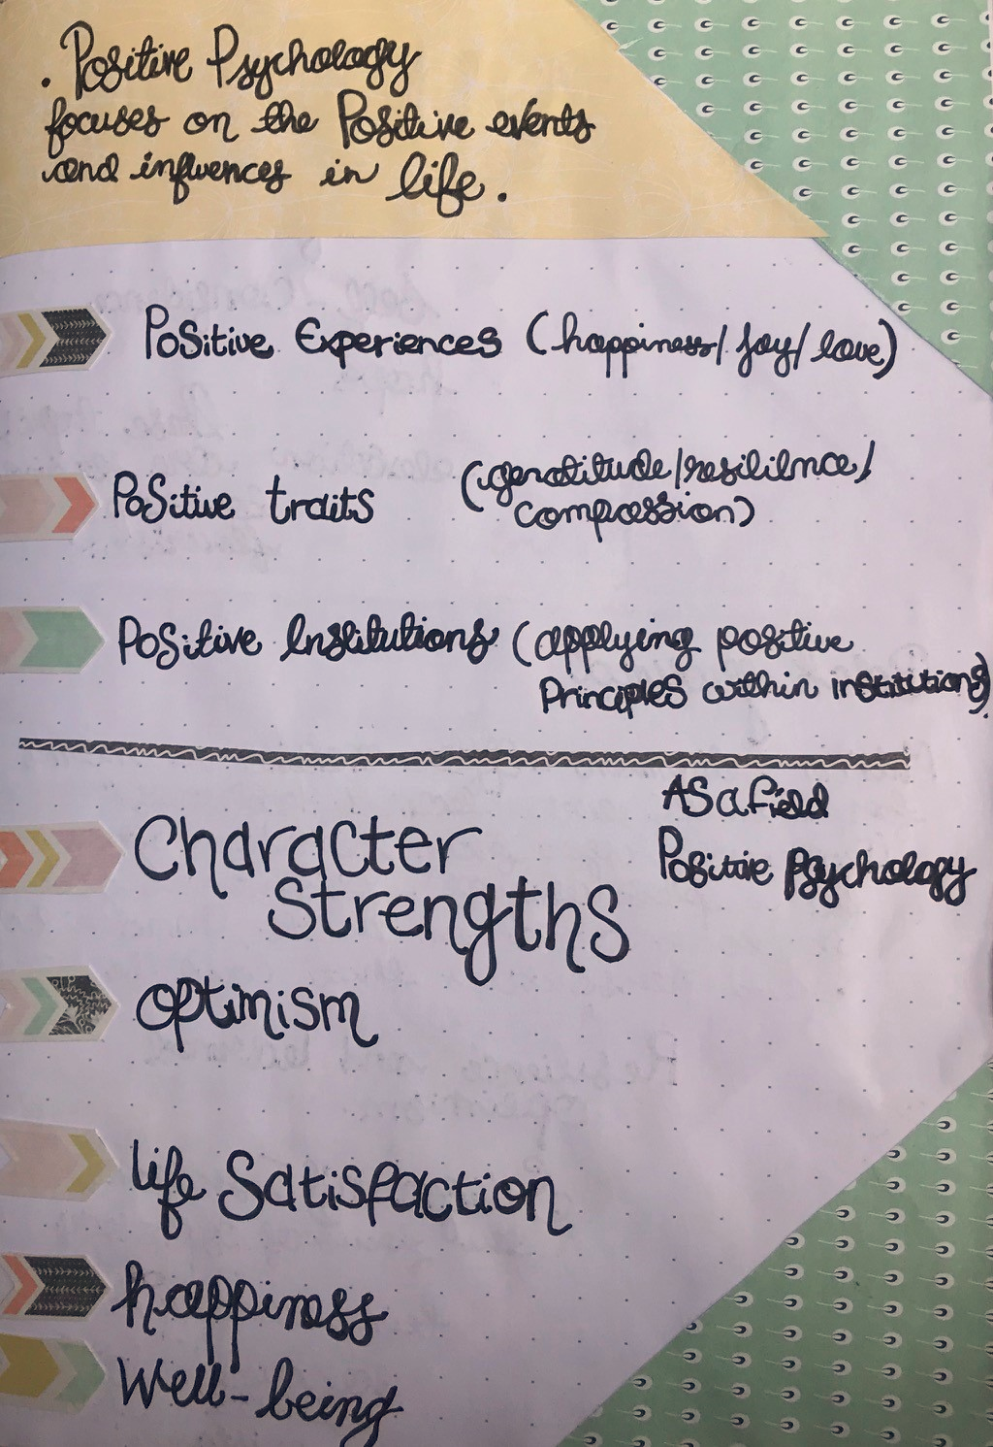
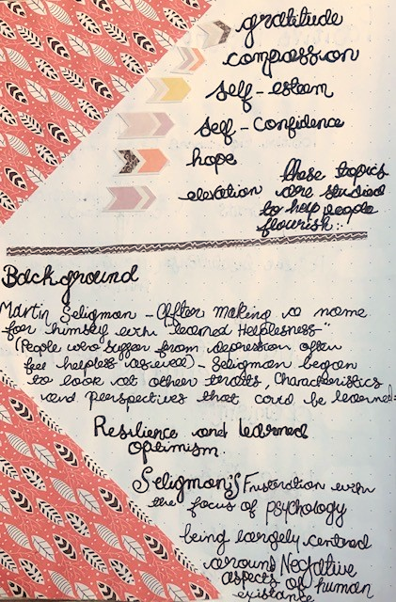
Examples from my Wellbeing Journal – giving back ground information on what Positive Psychology is and how it can be beneficial for health and wellbeing.

Slide 23
Emotions

Slide 25
Positive emotions not only signal flourishing, but also produce flourishing
Not only in the present moment but over the long term as well
Positive emotions are worth cultivating, not just as end states in themselves but also as a means to achieving psychological growth and improved well-being over time
The broaden-and-build theory experiences of positive emotions broaden people's thought action ranges, which build their long-term personal resources (Frederickson, 2001)
Contentment
broadens by creating the urge to savour current life circumstances and integrate these circumstances into new views of self and of the world
Interest
broadens by creating the urge to explore, take in new information and experiences, and expand the self in the process
Love
broadens by creating recurring cycles of urges to play with, explore, and savour loved ones
Joy
broadens by creating the urge to play, push the limits, and be creative

Slide 26
The Upward Spiral
Of Emotions
Fredrickson and Joiner (2018)
Positive emotions lead us to more expansive and creative thoughts and behaviour which create additional personal resources over time in these areas
Intellectual: e.g. problem-solving skills
Positive emotions create “upward spirals”
of thought and action, preparing you for
future challenges.
Physical: e.g. strength and cardiovascular health
Social e.g. friendships, relationships and connections
Psychological: e.g. developing resilience and optimism

Slide 27
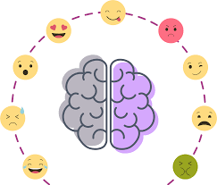
The Difference Between Negative and Positive Emotions
Evidence shows that positive and negative emotions are not equal
Grenville-Cleave (2016)
However, some negative emotions reduce our level of well-being more than positive emotions increase it.
Some negative emotions serve an important purpose;
Anger at a social injustice for example, and fear of a dangerous animal – bot emotions spur us on to act.
We need to increase our amount of positive experiences more then the intensity.

Slide 28
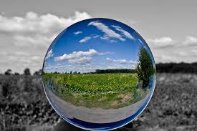
Positive emotions tend to be more fleeting then negative ones; and negative emotions tend to be more “sticky” then positive ones.
Some Final thoughts on Positive Emotions
If we experience a negative and a neutral one, we are more likely to be affected by the negative one, rather than the neutral one.
If we have a negative and a positive experience close together, we are more likely to dwell on the negative one.

Slide 29
Welcome to
Creating a Wellbeing Journal

Slide 31
What are the Barriers to Wellbeing?
The Negativity Bias
Duration Neglect
We pay more attention to, and give more weight to NEGATIVE experiences rather than Positive ones.
We are more likely to remember and take seriously a criticism, insult or piece of negative information.
In the past we needed to be aware of potential danger, but now this in-built negativity bias can interfere with wellbeing.
The duration of a negative or positive experience does not make a difference.
What does make a difference is the:
INTENSITY of the PEAK of the experience, and how the experience ENDS.

Slide 32
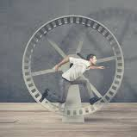
What are the Barriers to Wellbeing?
Social Comparison
The Hedonic Treadmill
If we see people around us seemingly doing better than us, this makes us feel worse about our lives.
Material things cannot bring permanent wellbeing, nor experiences.
Like a treadmill, adaptation goes on and on and we just want more.

Slide 33
Try this:
Duration Neglect
As long as we end a negative experience on a positive note, we won’t remember the experience being as bad as it was
If you do a have a series of unpleasant tasks to do, do the most unpleasant ones first, and end on a high note
Reframe every bad experience in a positive way
Reward yourself at the end of a positive experience

Slide 34
Martin Seligman, Flourish, 2011

Slide 35
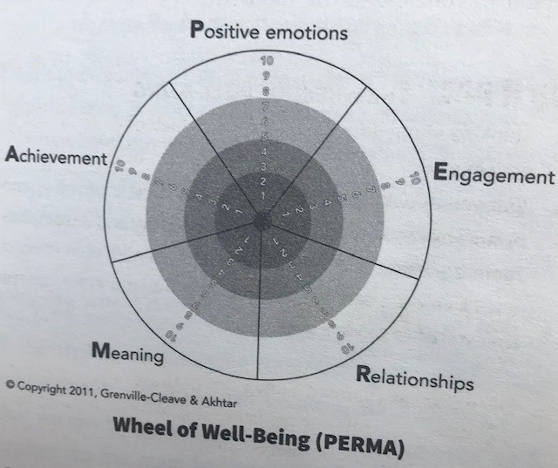
What is your current level of wellbeing?
Grenville-Cleave & Akhtar, 2011

Slide 36
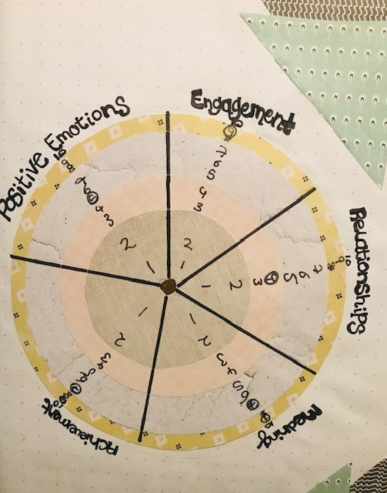
My homemade
Wheel of Wellbeing

Slide 37
Satisfaction
with
Life Scale
Diener, E., Emmons, R. A., Larsen, R. J., & Griffin, S. (1985). The Satisfaction with Life Scale.
Follow this link to the Satisfaction with Life Scale
Satisfaction with Life Scale

Slide 38
The Warwick-Edinburgh Mental Well-being Scale
Follow this Link
https://www2.uwe.ac.uk/services/Marketing/students/pdf/Wellbeing-resources/well-being-scale-wemwbs.pdf

Slide 39
After completing one (or all) of these questionnaires, write or draw a reflection about the results in your wellbeing journal.
Were there any surprises?
Was the score(s) what you expected?
How do you feel now having competed the questionnaire(s)?
What else are you thinking about?

Slide 41
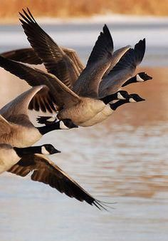
Promote Feelings
of Wellbeing
Positive emotions have an un-doing effect on negative ones
almost like an ‘inner- re-set button’.
Add items to your wellbeing journal which promote feelings of positivity (hope, joy, faith, love, strength, fun etc.) keep adding items and keep looking at them to boost feeling of positivity.

Slide 42
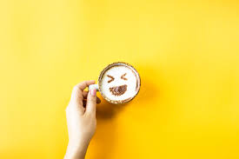
Create a Humour Diary
Humour has been shown to increase wellbeing
Crawford and Caltabiano (2011)
Before you go to sleep, write down 3 funny things that happened in your day…
Read it regularly for an instant boost

Slide 43
Create a Play List of Activities that bring Pleasure
Negative emotions tend to be more ‘sticky’ and positive ones more ‘fleeting’.
The frequency therefore, is more important of the intensity.
Create a PLAYLIST of activities that bring you pleasure. Try to engage in one of these each day, journal about your experiences doing this.

Slide 44
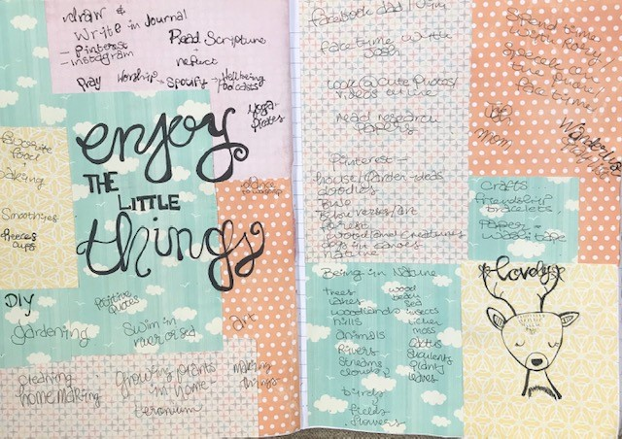
My Playlist of Positive Activities

Slide 45
Flow is one of life’s highly enjoyable states of being, wrapping us entirely in the present, and helping us be more creative, productive, and happy.
-Moore 2019
Flow Is:
Being immersed in a task
Oblivious to the outside world
Focused only on your own progress and what’s going on right here and now?
When you are doing something you love, like playing music or a certain sport, then realizing that time has totally passed you by

Slide 46
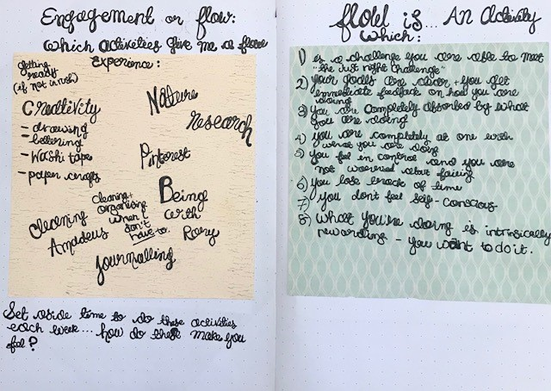
Activities which give me a sense of FLOW

Slide 47
Make a list of your best qualities, skills, and strengths
in your Wellbeing Journal using a table like this one
Life Domain | My best qualities, skills and strengths
Relationships/friendships
Work
Home
Study
Hobbies
Other
We all have transferable skills from one area of life which we can use in another area.
Consider how you could apply these qualities when faced with a new challenge.

Slide 48
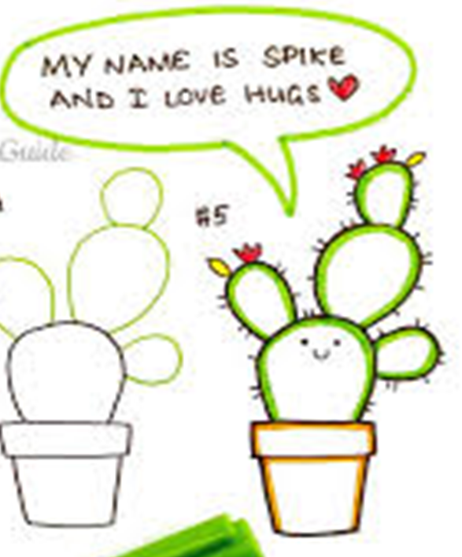
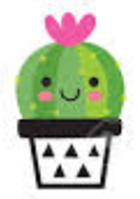
Positive Relationships
Your relationships with friends, family, loved ones, colleagues, and others are a central source of wellbeing
You can increase positive emotion and reduce negative emotion in your relationships
Happiness is contagious, you can boost your positive emotions and others by performing acts of kindness.
Moods and behaviours are contagious;
people’s happiness depends on the happiness of others with whom they are connected.

Slide 49
Positive Relationships - Activity
1. Take any close relationship you have at the moment
and think past over the past 24 to 48 hours….
2. How many positive moments (times when you laughed, enjoyed each others company or helped each other out) can you list? Write them down.
3. How many negative moments (times when you shouted or got angry with each other)
Can you remember for the same time period? Write it down.
4. What is the ratio of shared happy moments to unhappy ones?
5. What can you do to increase the positive
and reduce the negative?

Slide 51
Martin Seligman, Flourish, 2011

Slide 52
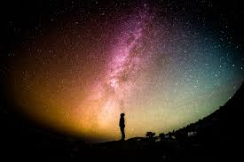
Meaning
One of the core components of Wellbeing
Incorporates self-awareness, and makes sense of who you are, what you do and how you fit into the grand scheme of things.

Slide 53
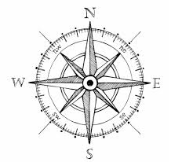
Meaning performs two important factors:
Provides a foundation which helps us to be more resilient and able to bounce back
from adversity.
2. Gives us a sense of purpose and direction for our lives.
Anchors us
Enables us to set goals for our lives
and points the way

Slide 54
Purpose
Purpose is a MOTIVATOR, it encompasses your goals, values and aspirations
A life with out purpose
is like a ship with out a rudder; we need it for stability and steering

Slide 55
Try this
Imagine fast forwarding to the end of your life,
how would you answer the following questions?
How and for what, do I want to be remembered?
By whom do I want to be remembered?
Which of my accomplishments and personal strengths would I want others to talk about?
When I look back, am I satisfied with the life I have lived?
Am I living my life in such a way now that this will be achieved?

Slide 56
By answering these questions, you may begin to see whether you are living to your values, achieving your goals and living the life you want to be living.
Think about what small changes you could make to ensure you are headed in the right direction.
What can you realistically do? What is in your control? What are you currently doing to move you toward your goals?

Slide 57
There are several pathways of
finding meaning.
It doesn’t always happen in a grand reveal. It helps to be curious about yourself, about other people, and about life.
-Bridget Grenville-Cleave

Slide 58
Sometimes people think that their life purpose should suddenly become clear in a kind of epiphany,
But it’s often a slower process, a gradual realization which takes place over time
- Bridget Grenville-Cleave

Slide 59
Finding Meaningful Work to Benefit your Wellbeing
Change the way you perceive your job
(or a job you would want to have), by answering these questions – then reflect on these in your
Wellbeing Journal
If you were given the opportunity to create your own job description either within the organisation in which you work, or some place else, what would your responsibilities be?
2. How would this new job differ then your current one – or one you’ve done in the past?
3. Why do you want to make this change?
4. What has stopped you from making this change?
5. What would enable you to make this change?

Slide 60
Accomplishment

Slide 61
Accomplishment is the final element of the PERMA model for Wellbeing.
Accomplishment includes:
Achievement
Success
Competence
Mastery
Progress towards dreams
Skill and effort are two main contributors to goal achievement, both of which can be increased.

Slide 62
Look back at your Wheel of Wellbeing, ask yourself: Which activities have you done recently which contributed to you sense of:
Competence
Mastery
Achievement
Try
this
Do you get a sense of accomplishment from the tings you do day–to-day? If so, from which activities in particular?
Which activities can you do which increase the feeling of accomplishment in your life?
Reflect on these in your Wellbeing Journal

Slide 63
In your Wellbeing Journal make a table with three columns like this:
Time Period | Achievements which made me feel proud | Natural Abilities, Interests and Strengths Used
0-10
10-20
20-30
30-40
In the first column, write each decade of your life. In the second column, write any achievement you can think of which made you feel proud now as you look back on your past. Include all achievements, big and small.
Were there any achievements you had forgotten about?
Were there more then you initially thought?
In the final column reflect on which natural abilities, interests and strengths, enabled you to achieve these.

Slide 64
Did any patterns emerge?
Pick one prominent accomplishment from your table, reflect on this accomplishment, spend time savouring the memories from this achievement, recall:
What happened? What did you do to make this success a reality? What skills and abilities did you use? What setbacks and challenges did you have to overcome? Who else was involved? What exactly makes you proud about this achievement? What positive feelings arise now when looking back?
Ask yourself
and reflect in your Wellbeing Journal:

Slide 65
Accomplishment Anchor
You can use your past success to give you confidence and spur you on to greater accomplishments, and to give you a boost of positivity.
Look back regularly at your accomplishment table; try to find a memento from each accomplishment – such as a photo/medal/certificate etc. revisit this table whenever you need a boost.

Slide 66
Appreciative
Inquiry

Slide 67
Appreciative Inquiry (AI) was developed by David Cooperridge in the mid-eighties. His wife, an artist, educated him about the “appreciative eye” – an idea that assumes that in every piece of art there is beauty. AI applies this principle to business.
In every piece of art
there is beauty
AI is a way of looking at change which focuses on identifying and doing more of what is already working, rather than looking for problems and trying to fix them.
AI is a STRENGHS based approach to managing change
"The Kiss" by Gustav Klimt

Slide 68
AI starts from a POSITIVE perspective.
Instead of thinking about what is not currently working, AI asks: WHAT IS WORKING WELL? and building upon this.
Focusing on what is working well generates enthusiasm, energy and engagement necessary to recreate the positive and deal with the negative more effectively then the traditional approach by focusing only on the negative.

Slide 69
AI is based on FIVE Principles:
1.Words create worlds reality is not an objective fact, it is a subjective experience. This means that we can change how we view the world, and how we feel, by changing the way we describe our experience, and the stories we tell.
2. Asking questions starts the process of change.
3. Our individual experience is a story which can be reinterpreted and told in different ways.
4. We can create positive change effectively by creating positive images of the future.
5. An in-depth review of what went well and what is working now is significantly more helpful then just analysing what went wrong.

Slide 70
You begin your Appreciative Inquiry by focusing on the POSITIVE future that you want to create,
Rather then the problem that you want to solve

Slide 71
Stage 1: Discovery – What’s Best?
Asking positively framed questions about the future you want to create and reflecting on the answers.
Through being curious and asking questions you create the environment for discovery.

Slide 72
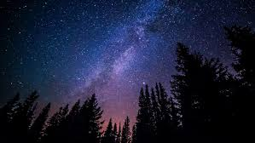
The Miracle Question
Imagine that in the middle of the night, when you were fast asleep, a miracle happens: all the problems you are having are solved. But since the miracle happened in the middle of the night, nobody tells you that it happened. When you wake up the next morning, how will you know that the miracle happened. WHAT WILL BE DIFFERENT?
This is a good exercise to do to help you visualise clearly what this positive future looks like and feels like; as well as helping you to imagine the part you play in this.

Slide 73
Stage 2: Dream – What's Next
Creating a positive and compelling vision for the future, based on the reflections from the
discovery stage.

Slide 74
Create a positive and compelling vision of the future, based on the descriptions and stories described in stage one.
WHAT MIGHT BE?
Projecting the image of the best of what you want and what you value in to the future.
Try This:
Reflect on these questions in your Wellbeing Journal.
What vision do you have of your future?
Describe:
Words/pictures/images/thoughts/feelings
/smells and colours
Can you draw the vision?
Make a collage of pictures from magazines or photos which describe your vision for the future that you want to create.

Slide 75
Stage 3: Design – How Might We?
Answering the question: How can it be?
Positive images of the past rather then its problems and difficulties.
You get MORE of what you focus on.

Slide 76
AI is rooted in POSITIVE IMAGES rather than problems and difficulties.
YOU GET MORE OF WHAT YOU FOCUS ON.

Slide 77
Stage 4: Destiny – What Will We
The practical work of making your vision into a reality. Focusing on the positive creates its own momentum. By spontaneously developing and improving; always building positively on what went on before you are developing the ability to improvise.

Slide 78
Reflect further on the image of the future that you want,
and ask yourself the following questions:
What exactly is happening?
What are you doing differently?
What parts of your life would you keep? What would you let go?
What would you be doing differently?
What new things would you do?
Who else is involved?
What part are they playing in supporting you? What are they saying or doing?
What does this positive future look and feel like in detail?
Write or draw your thoughts in your Wellbeing Journal

Slide 79
Personal Attributes which energise us; they make you feel like the “real you” and enable us to perform at our best
Strengths: energise us and can lead to an increase in wellbeing
Character
Strengths
We feel intrinsically motivated to use our strengths, and wont feel like a chore.
Looking back at your childhood can give us clues as to what our strengths might be:
What were you good at?
What did you love doing?
What did you find easy to do?

Slide 80
Benefits for Using your Strengths
Increased resilience
Increased vitality and positive energy
Decreased stress
Increased confidence and self-esteem
Increased happiness and wellbeing
Improved work performance
Increased engagement
More likely to achieve your goals

Slide 81
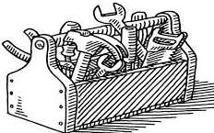
Strengths Toolkit
Another way to think about you strengths is as a
PERSONAL TOOLKIT.
An invisible collection of resources which you can draw on at any time to help you tackle challenges and resolve issues.
Try This:
1.Think of an issue you are currently facing. Summarize it in your Wellbeing Journal.
2. Now list your strengths underneath.
3. How might you use that strength to deal with this problem?

Slide 83
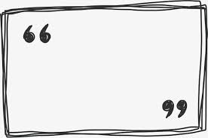
The more alternatives, the more difficult the choice.
-Abbe d’Allainval

Slide 84
We all have a choice, we also have to take responsibility for the decisions that we make
Choice means that we have freedom, however, increased choice makes us unable to make decisions and reduces our wellbeing
Some choice is good for us, but too much choice is not
Too much choice can overwhelm us, causing anxiety and stress and ultimately indecision
Learn to accept a choice as “good enough” rather then “the best”
in order to relieve some stress

Slide 85
Think about the choice you have to make on a scale of 1-10, ten is as important as life or death,
And one is relatively unimportant.
When you’re faced with a seemingly difficult choice to make, or are feeling overwhelmed by a multiple number of choices, try this:
Lower your expectations, and be satisfied with “good enough”
Once you have made your choice, settle on it
Practice GRATITUDE: Write down 3 good things about the choice you’ve made, and be thankful for what you have

Slide 86
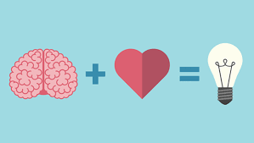
Emotionally Intelligent people are :Self-aware, self-managed, socially-aware and socially skilled
Emotional
Intelligence
Emotional Intelligence is linked with: wellbeing, positive moods and self-esteem
Emotional Intelligence can be learned
and improved upon

Slide 87
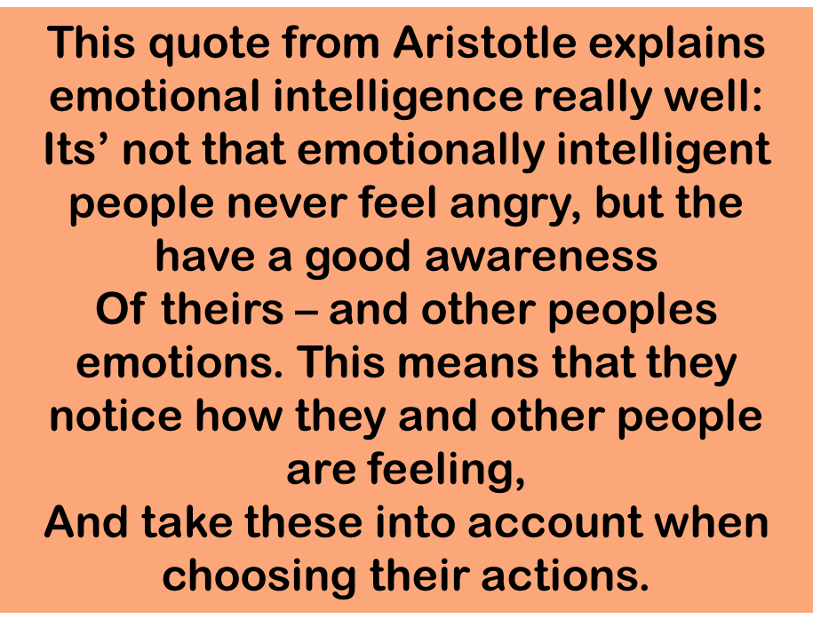
“Anybody can become angry — that is easy, but to be angry with the right person and to the right degree and at the right time and for the right purpose, and in the right way — that is not within everybody's power and is not easy.”
Aristotle

Slide 88
The Four Skills of Emotional Intelligence
IDENTIFYING emotions
USING emotions
UNDERSTANDING the causes of emotions
MANAGING your emotions effectively

Slide 89
Can you name your emotions accurately?
Notice that you can be feeling negative and positive emotions at the same time.
Notice too, that if you are not feeling negative, that does not necessarily mean that you are feeling “on top of the world”.
Being able to pinpoint your own feelings is the first step in becoming emotionally intelligent; follow these links for online test you can take to assess your emotions
You can register on the University of Pennsylvania’s Authentic Happiness page, where you can get loads of different resources as well as complete questionnaires such as Scale of Positive and Negative Experience (SPANE)
and the Positive and Negative Affect Scale (PANAS)
Both of these can be found at:
https://www.authentichappiness.sas.upenn.edu/testcenter

Slide 90
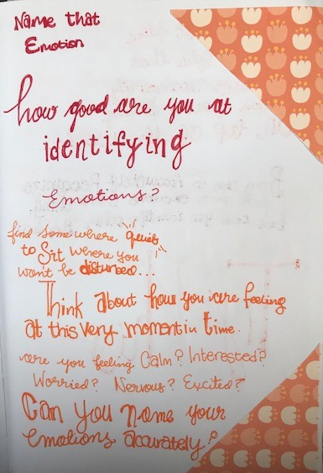
Find somewhere quiet to sit for a few minutes where you wont be disturbed. Think about how you are feeling; are you feeling CALM?
INTERESTED? ANXIOUS? Nervous? Excited?
Try This
Example of this page from my Wellbeing Journal

Slide 91
Being able to identify your emotions is one thing,
But can you identify other peoples?
NOW watch the same clip with the sound ON.
How accurate were you with the characters emotions?
Reflect on this in your Wellbeing Journal.
Try This:
Watch a clip of people interacting online, perhaps on a Youtube clip or Iplayer.
Watch ten minutes of the clip with the sound OFF.
What emotions could you identify from the characters Faces and BODY LANGUAGE?
Make a note of this in your Wellbeing Journal
Practice spotting people’s emotions whenever you watch people interacting.
Try to make a practice of focussing on faces to improve your ability to identify emotions.

Slide 92
Emotionally intelligent people know how to USE their emotions - and other people’s too.
Negative emotions:
Make us more focused
Enables us to be more critical
Enables us to be able to spot mistakes
Enables us to pay attention to detail
Emotionally intelligent people understand how feelings influence thinking and behaviour, and therefore know how to USE emotions effectively.
Positive emotions:
Expand our thinking
Enable us to think up new ideas
Enables us to consider new possibilities
Enable us to use a strength based approach to problem solving.
POSITIVE and NEGATIVE emotions are both useful, and effect us in different ways:

Slide 93
Understanding Emotions
Certain thoughts and beliefs lead to specific emotions, which leads to specific behaviour. (Ellis and Beck)
Understanding emotions is a sign of emotional intelligence.
People with high emotional intelligence are aware (often intuitively) of the connections between thoughts, beliefs, feelings and behaviours, and they use this information to make sense of why they, and other people, feel the way they do.
People with high emotional intelligence understand what causes certain emotions and how emotions are linked together, and how one can lead to an other.

Slide 94
When you put these skills together, you can predict emotional reactions.
To be able to manage our own emotions, this is a very useful skill to have.
Try This:
Think of a time recently when you became very aware of your own emotions.
What led you to feel this way?
Can you identify your underlying thoughts and beliefs?
Was there a progression of different emotions or a sudden switch from one emotion to another?
What patterns of emotional reaction do you recognize in yourself generally?
What are your emotional triggers?

Slide 95
An emotionally intelligent person is able to manage their emotions effectively .
For example, they know how to improve a bad mood, relax when they feel nervous, and remain calm when they are angry.
Try it now
Think forward, to a time when your emotions would normally be heightened (public speaking, or dealing with a difficult person.)
How would you LIKE to feel in that situation?
How would you like to feel BEFORE the situation?
How would you like to feel AFTER the situation?
How might you achieve the most appropriate blend of emotions to ensure you are able to optimally function?

Slide 96
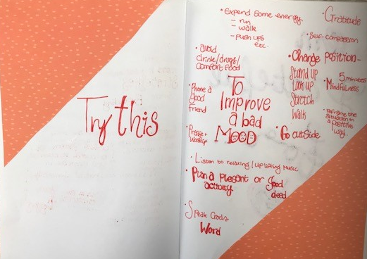
Here are some examples from my Wellbeing Journal for ways I can manage a bad mood.
Think of a few which you can add to your Wellbeing Journal.
Examples from my Wellbeing Journal

Slide 97
References
Crawford, SA. and Caltabiano,NJ., (2011) Promoting emotional well-being through the use of humour. The Journal of Positive Psychology. 6:3.
Fredrickson, B. (2001) The role of positive emotions in positive psychology. The broaden-and-build theory of positive emotions. Am Psychol. 56(3) pp. 218–226.
Fredrickson, B. (2009) Positivity: Ground-breaking Research Reveals How to Embrace the Hidden Strength of Positive Emotions, Overcome Negativity, and Thrive. New York: Crown Publishers.
Fredrickson, BL. And Joiner, T. (2018). Reflections on Positive Emotions and Upward Spirals. Perspectives in Psychological Science. 13 (2) pp. 194-199.
Grenville-Cleave, B., (2016) Positive Psychology: A Toolkit for Happiness, Purpose and Well-being. London: Icon Books.

Slide 98
Peterson, C. and Park, N. (2014) Meaning and Positive Psychology, International Journal of Existential Psychology and Psychotherapy, 5(1) pp.1-8.
Ryan, R. M., & Deci, E. L. (2001) On Happiness and Human Potentials: A review of research on hedonic and eudaimonic well-being. Annual Reviews Psychology. 52:141-66.
Seligman, M., (1991) Learned Optimism. New York: AA Knopf.
Seligman, M., (2011) Flourish., Boston MA: Nicolas Brealey Publishing
University of Pennsylvania: Authentic Happiness (2020)Questionnaire Centre. Available from: https://www.authentichappiness.sas.upenn.edu/testcenter [Accessed on 05/04/2020].

